Slide 1
Network measurement in sdn networks
Issues, Experiments & Analysis

Slide 2
Traditional measurement methodology
Ping packets
Uses ICMP’s ECHO_REQUEST and ECHO_REPLY datagrams
The GNU C Library provides two data types specifically for representing an elapsed time.
Struct timeval (microsecond resolution) E.g., 123456 microseconds
Struct timespec (nanosecond resolution E.g., 123456789 nanoseconds
ECHO_REQUEST datagrams uses struct timeval.

Slide 3
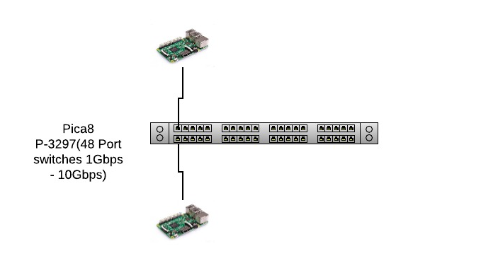
Traditional measurement methodology
Ping packets
Ping gives Round Trip Measurement.
Ping gives a resolution of microsecond.
RoundTrip Times seen:
rtt min/avg/max/mdev = 0.297/0.349/0.420/0.041 ms
Inter-arrival time = 1 sec (constant)

Slide 4
Traditional measurement methodology
Other stuff about ping packets
Lowest inter-arrival times : 0.2 seconds from the application.
In my observations so far, I am seeing average observations of RTT vary between 275 to 350 ms.

Slide 5
Alternative approaches
Use time synchronization + timestamping
Network Time Protocol
Precision Time Protocol

Slide 6
Alternative approaches
Network TIME PROTOCOL
Precision time protocol
NTP can usually maintain time to within
10’s ms over the public internet,
1 ms accuracy in LAN under ideal conditions.
On a LAN, it achieves clock accuracy in the <1 µs
suitable for measurement and control systems.
We will start with NTP and then move onto PTP.

Slide 7
Timestamping packets
Timestamp packets from source (src) so that we can measure the time using a difference calculation.
End to End One way Delay = (t₂ – t₁)
Where,
t₂= (System time at the destination, dst)
t₁= (Time in the packet, stamped at the source, src)
Used GNU Libc’s clock_gettime( ) function to get the time and send it from one host to another, where the destination calculated the difference.

Slide 8
Timestamping packets-EXPERIMENTS
Issues with time wrapping at client and server. Need to fix this. WIP
Update: Fixed by changing from CLOCK_MONOTONIC to CLOCK_REALTIME.
CLOCK_MONOTONIC is for use in a single system. CLOCK_REALTIME is better suited for measurements across systems. Both are subject to NTP corrections.
Reference POSIX standards. http://pubs.opengroup.org/onlinepubs/9699919799/functions/contents.html

Slide 9
Timestamping packets-EXPERIMENTS
Experiment: Calculate OWT(One Way Trip Time) by synchronizing the clocks using NTP
Results: OWT is turning out to be 5.8ms.
Is synchronization the issue? Potentially. We can verify this by performing another experiment.

Slide 10
Timestamping packets-EXPERIMENTS
Experiment: With NTP, calculate RTT on the same host(say server) by having the client send back the timestamped packet back to the server(ack) and then calculate the time at the server for (packet send + ack packet receive).
Results: RTT is turning out to be approx. 0.9ms. This is not adding up with the 5.8ms we got as the OWT.
Conclusion: Synchronization is the issue indeed! Based on our observations, NTP is NOT GOOD ENOUGH for sub-millisecond accuracy of time synchronization.
So, we move onto PTP

Slide 11
Timestamping packets-EXPERIMENTS
Experiment: Calculate OWT(One Way Trip Time) by synchronizing the clocks using PTP
Results: OWT is coming to be 0.242ms or 242µs (average). This makes sense since it is roughly half the RTT.
Minimum Timing = 228 µs
Topology Figure on next slide

Slide 12
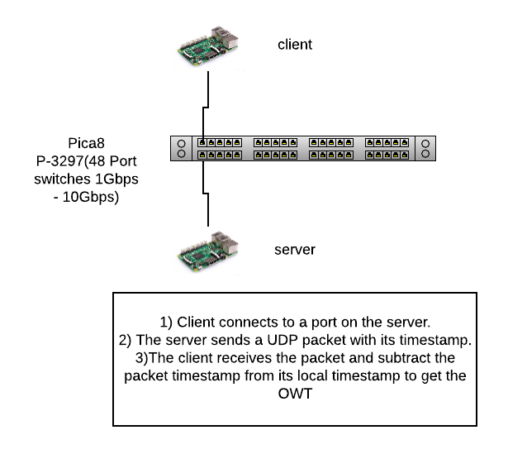
Timestamping packets-EXPERIMENTS

Slide 13
Timestamping packets-EXPERIMENTS
Experiment: Add one more switch to estimate the packet processing time
Results: OWT with 2 switches in between is coming to be 0.249ms or 249µs.(average)
Worst case timing : 262µs
Topology Figure on next slide

Slide 14
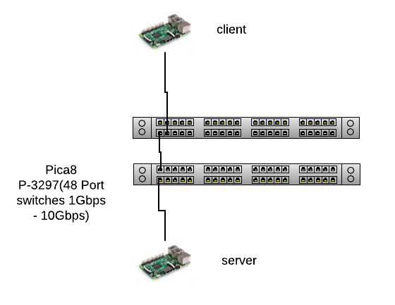
Timestamping packets-EXPERIMENTS

Slide 15
RESULTS
Switch Processing delay = Worst case End to End delay with 2 switches – Min. End to End delay with 1 switch = (262 – 228) µs = 34 µs

Slide 16
Questions From Discussions/weekly meeting/slack
Reverse the switch order in Host-Switch-Switch-Host to ensure that there is no switch level artifacts in the measurements.
Update: Verified this. Numbers are in the same ballpark.
Worst case is coming identical almost (262µs)
What are the packet sizes?
Packet sizes are 60 bytes sent with a time gap of 1 second.

Slide 17
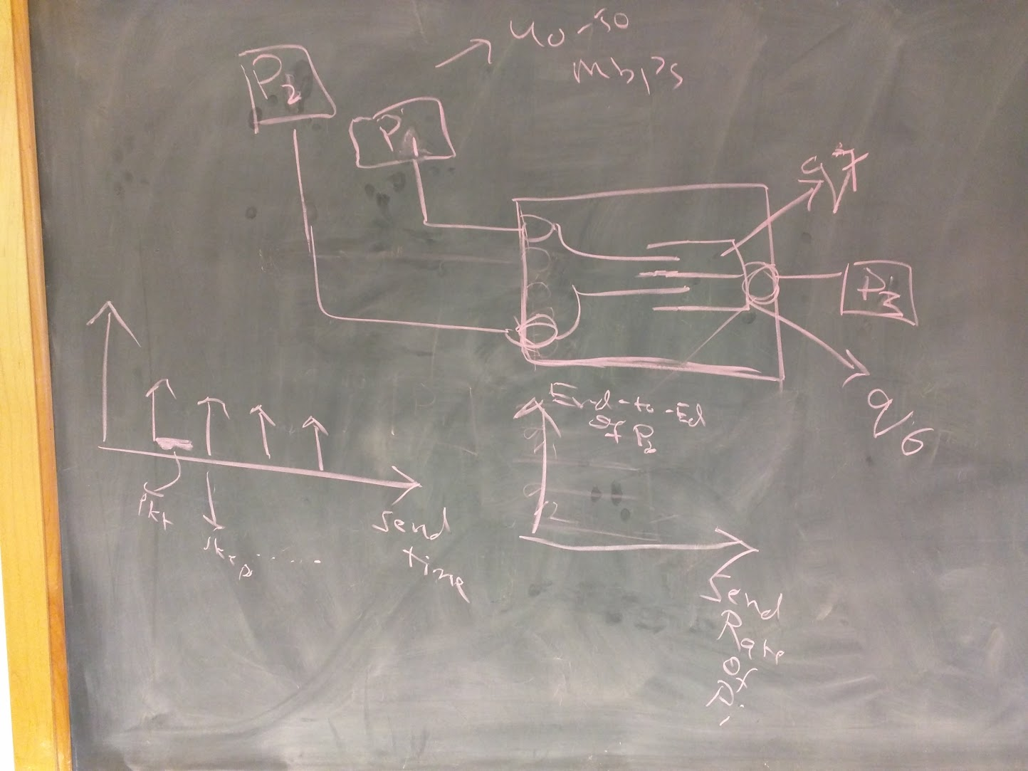
Next steps(from slack, meeting, disc with rakesh)
Perform an experiment with different packet sizes and log the delay
Same priorities here
Queueing experiment suggested by Rakesh
“does the priorities kick show up in end-to-end delay?”

Slide 18
Next steps(from slack, meeting, disc with rakesh)
Add another switch to perform Host-Switch-Switch-Switch-Host to confirm the observations.
To Do.
We got the fresh switches with us, needs to be setup.

Slide 19
Backup Slides

Slide 20
Traffic generation tools
Many other traffic measurement tools are available
Netperf
Iperf
Moongen – Best paper award in Internet Measurement Conference 2015

Slide 21
ping with variable delays between packets
Model the delay between packets as a random variable.
Calculate the density function value before sending the packet
Poisson Distribution
Gaussian Distribution
Uniform Distribution

