Slide 1
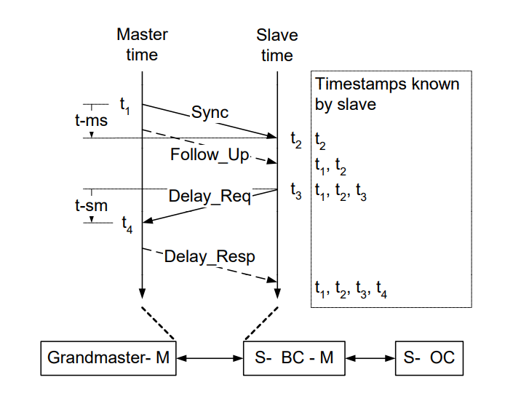
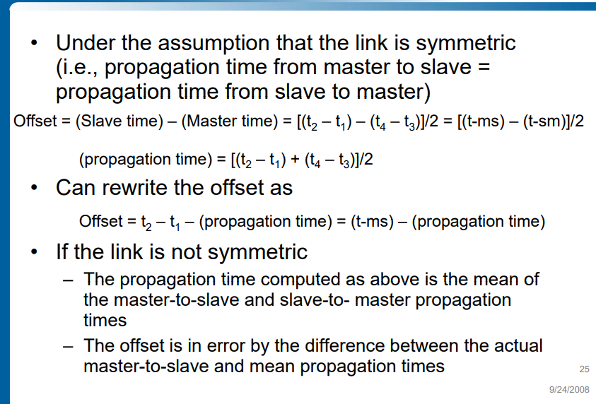
Update
PTP Protocol
Notes:
Now that we have seen the attack side, let us move onto the defense side to improve safety/security/resiliency of CPS.

Slide 2
Update
Changes in the SDN topology:
Prioritize PTP traffic and give it the highest priority by assigning it to queue 7.
The remaining Real-time traffic uses the queues 0-6.
The background traffic was earlier generated by iperf3 – now we have moved it to pktgen, a kernel-based traffic generator.
Observations:
With sufficient background traffic (800M) to saturate the link, we are seeing the priorities of the flows come into action.
The 99.9th percentile is now closer to 99th percentile though the value for 99.9th percentile is in millisecond occasionally.
Notes:
Now that we have seen the attack side, let us move onto the defense side to improve safety/security/resiliency of CPS.

Slide 3
Update
3. Question: Is the number of PTP packets directly proportional to the number of anomalies in the data?
8 RT flows generated by Pi’s
No Background flows
From this data, we can conclude that the variation is not so much dependent on the number of PTP sync packets as this could be potentially within a standard deviation.
Packet Count | Default PTP Setting #Anomaly | 2x PTP #Anomaly
500k | 200 | 250
300k | 125 | 150
200k | 85 | 100
100k | 45 | 50
Packet Count | DEFAULT PTP SETTING #Anomaly | 2x PTP #Anomaly | 4x PTP #Anomaly | 8x PTP #Anomaly
1000k | 475 | 470 | 500 | 560

Slide 5
Next Steps
Measure e2e delay with Zodiac GX switch.
Issues with IP assignment in CSL network – hopefully should be fixed soon
Patching pktgen with measurement
RT Kernel
Challenges?

