Slide 1

Data Science & Machine Learning
www.brainybeam.com Email Id: sagar@brainybeam.in

Slide 2

1.Data Structure and Mathematical Operations using NumPy
NumPy: Explain what NumPy is and how it is used in Python. Discuss its features, such as its array data structure and ability to perform mathematical operations.
pip install numpy
www.brainybeam.com Email Id: sagar@brainybeam.in

Slide 3
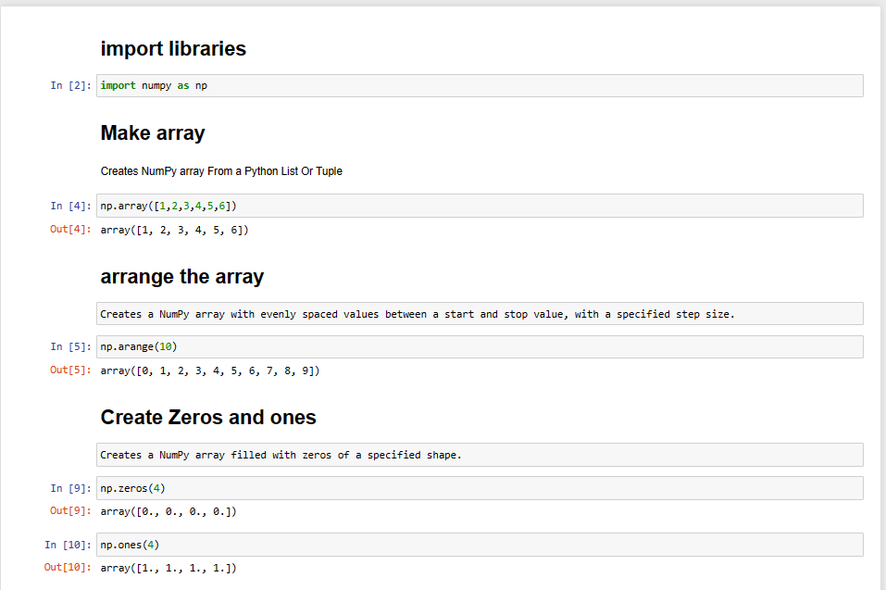

www.brainybeam.com Email Id: sagar@brainybeam.in

Slide 4
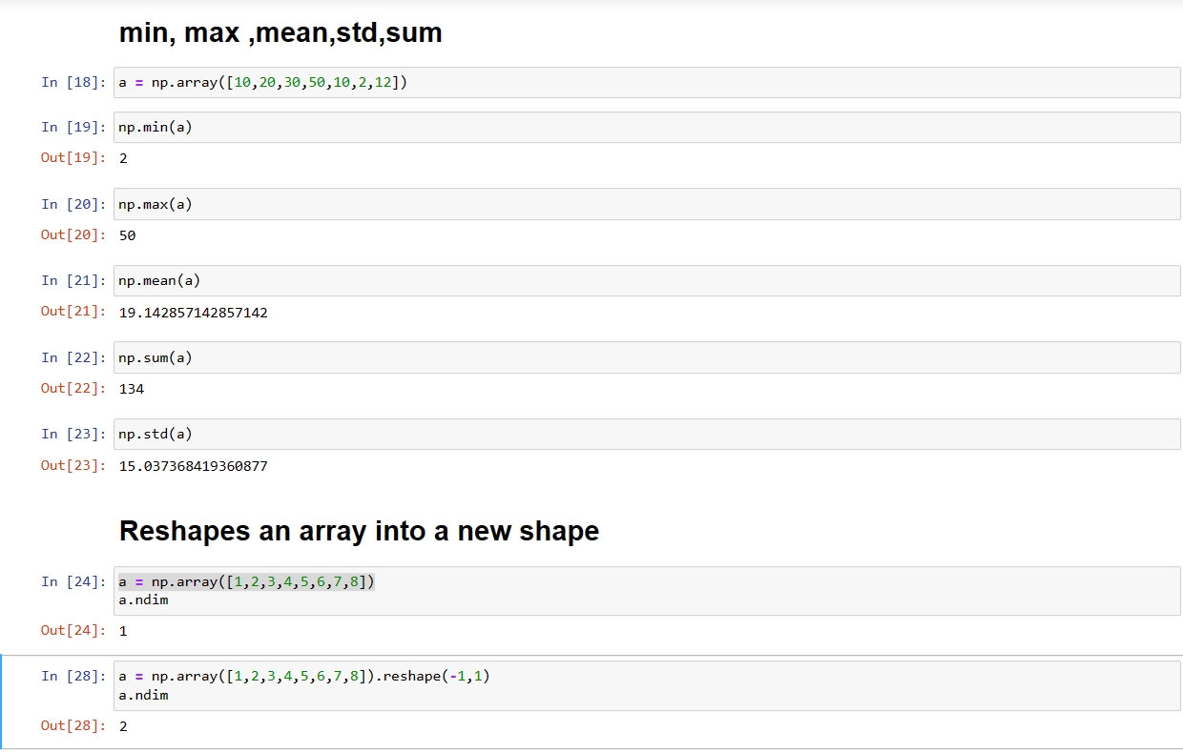
www.brainybeam.com Email Id: sagar@brainybeam.in

Slide 5

Analyzing ,Cleaning ,Exploration & Manipulation of data using Pandas
Pandas is a popular open-source data analysis library for the Python programming language. It is designed to handle structured data and provides powerful data manipulation and analysis capabilities.
With Pandas, you can easily read in and write out data from various formats such as CSV, Excel, SQL databases, and more. It also provides a range of functions for cleaning and transforming data, handling missing values, and handling DateTime data.
www.brainybeam.com Email Id: sagar@brainybeam.in

Slide 6
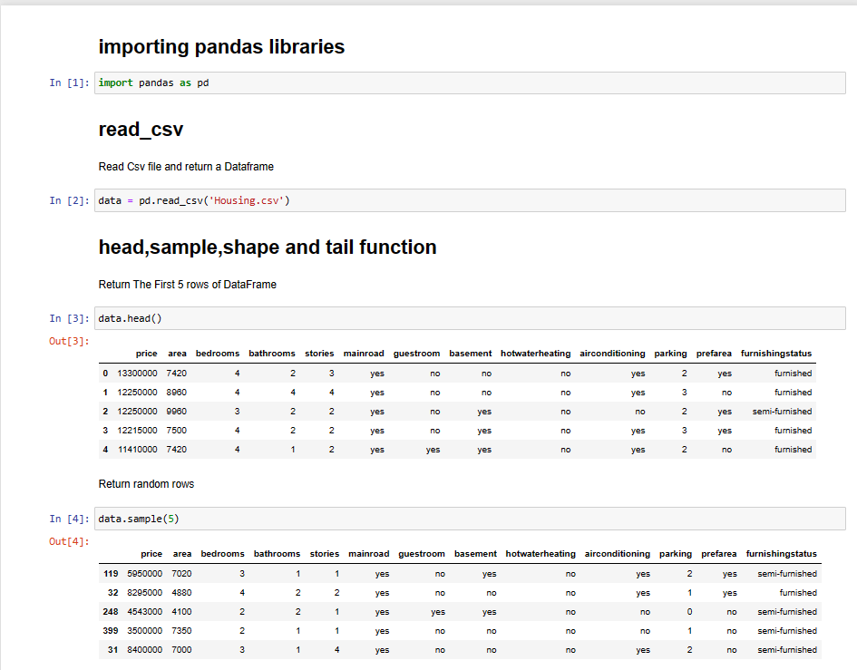
www.brainybeam.com Email Id: sagar@brainybeam.in

Slide 7
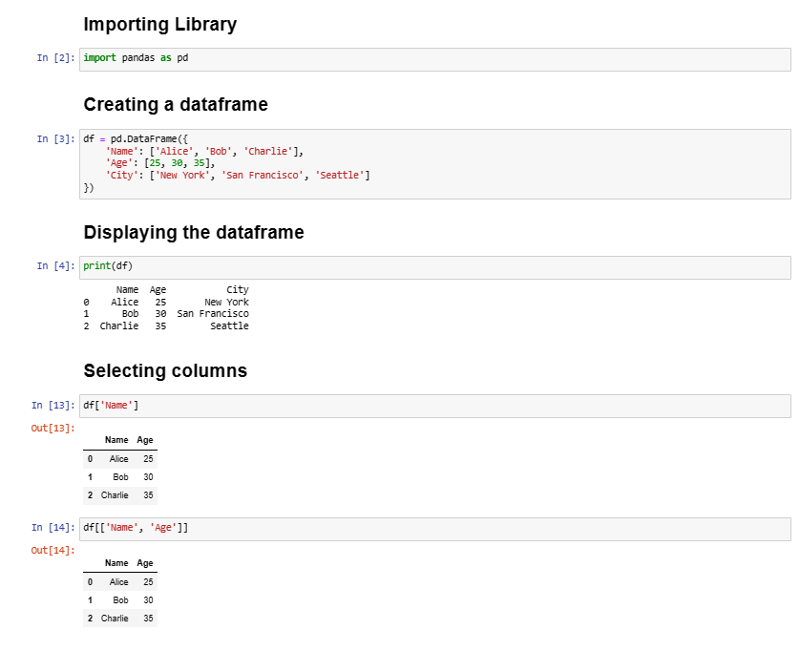
www.brainybeam.com Email Id: sagar@brainybeam.in

Slide 8
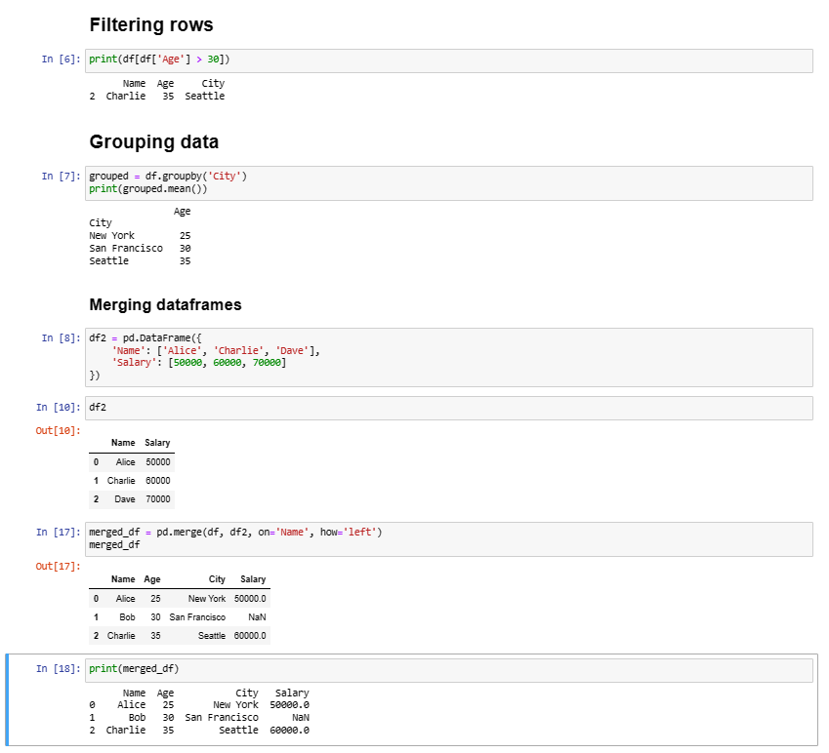
www.brainybeam.com Email Id: sagar@brainybeam.in

Slide 9
Encoding Techniques- Label Encoding & One-hot Encoder
Label Encoding:
Label Encoding is a technique used to convert categorical data into numerical data.
It assigns a unique numerical value to each category present in the categorical variable.
It is useful for ordinal categorical data, where the categories have a natural ordering, such as small, medium, large.
Label Encoding can lead to the false assumption of a natural ordering between categories, which can affect the performance of certain machine learning algorithms.
It is straightforward to implement and can be easily used in a variety of machine learning models.
www.brainybeam.com Email Id: sagar@brainybeam.in

Slide 10
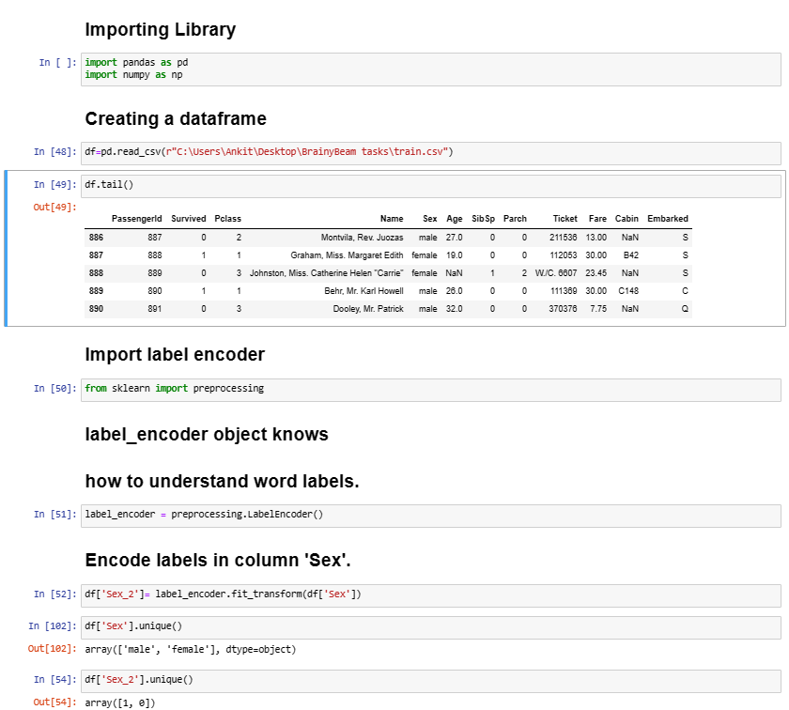
www.brainybeam.com Email Id: sagar@brainybeam.in

Slide 11
One-Hot Encoding:
One-Hot Encoding is a technique used to convert categorical data into a binary representation.
It creates a new binary column for each category present in the categorical variable and assigns a value of 1 to the corresponding column for each observation.
One-Hot Encoding avoids the false assumption of a natural ordering between categories, and it can be easily used in a variety of machine learning models.
However, One-Hot Encoding can lead to the curse of dimensionality, where the number of features increases significantly when there are many categories, which can affect the performance of some machine learning algorithms.
www.brainybeam.com Email Id: sagar@brainybeam.in

Slide 12
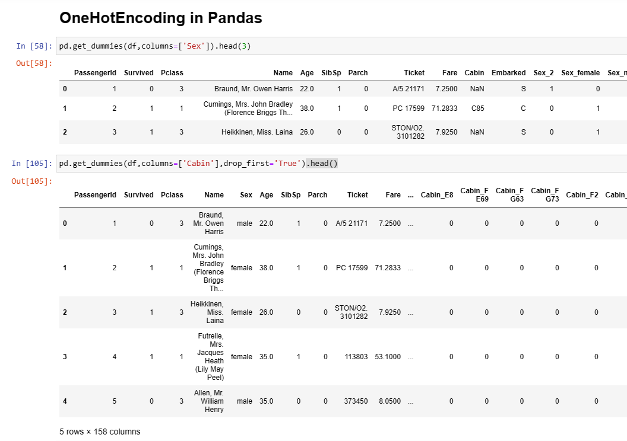
www.brainybeam.com Email Id: sagar@brainybeam.in

Slide 13
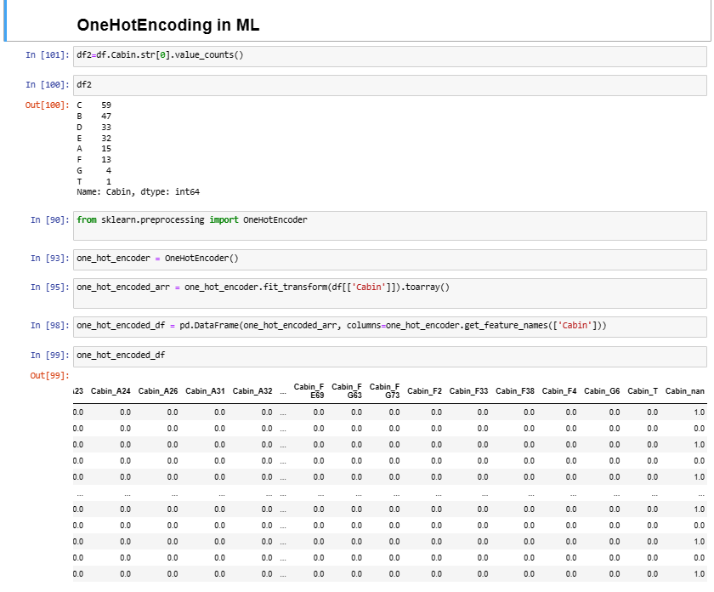
www.brainybeam.com Email Id: sagar@brainybeam.in

Slide 14

Interactive visualization using Matplotlib
Matplotlib is a Python library for creating data visualizations.
It provides a variety of customizable plots, including line plots, scatter plots, bar plots, histograms, and more.
It can be used in Jupyter notebooks, scripts, and standalone applications.
Matplotlib supports a variety of output formats, including PNG, PDF, and SVG.
Matplotlib can be integrated with other libraries such as NumPy, Pandas, and SciPy.
www.brainybeam.com Email Id: sagar@brainybeam.in

Slide 15
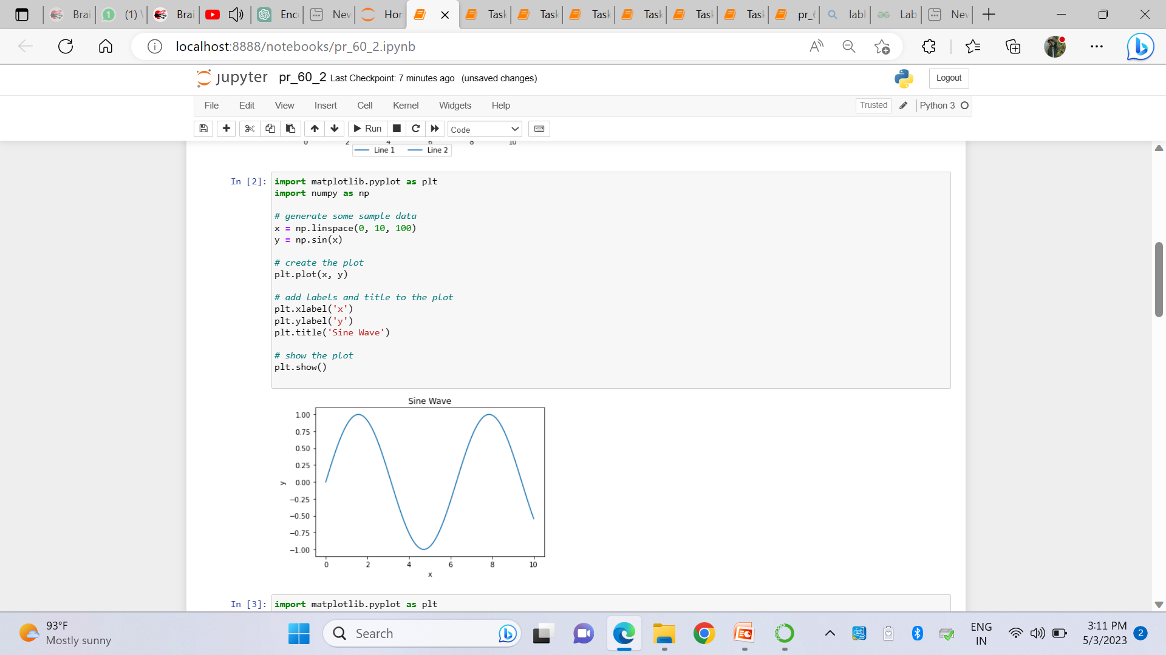
www.brainybeam.com Email Id: sagar@brainybeam.in

Slide 16
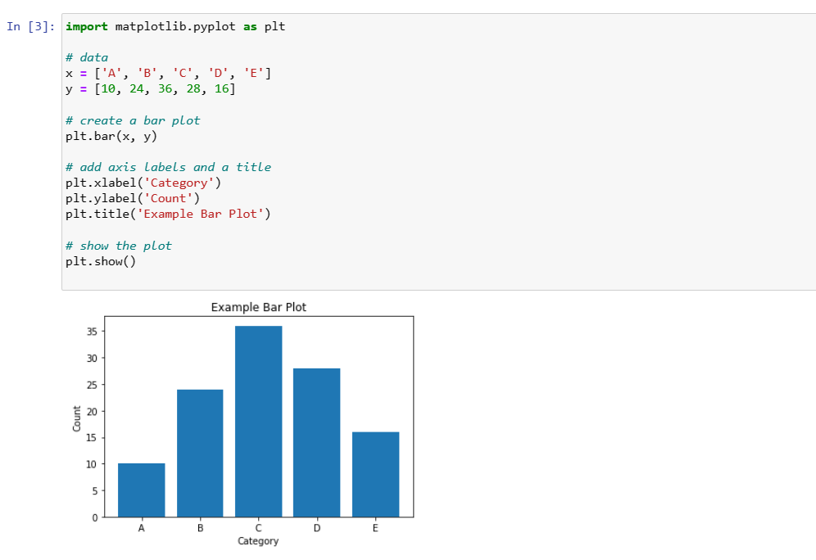
www.brainybeam.com Email Id: sagar@brainybeam.in

Slide 17
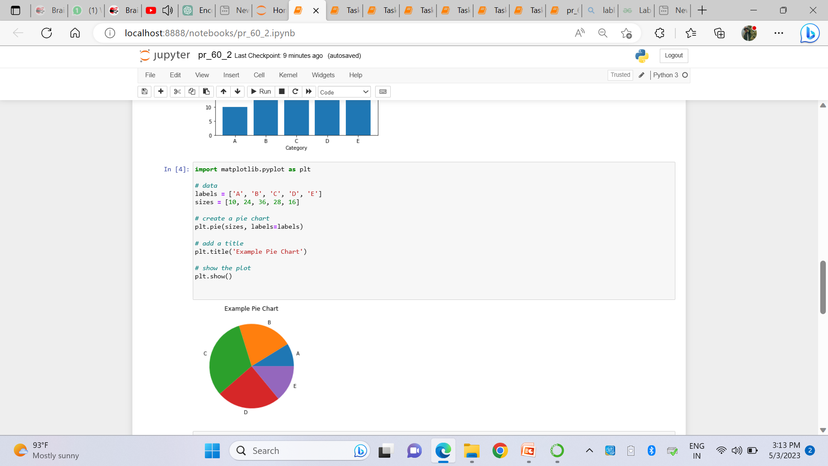
www.brainybeam.com Email Id: sagar@brainybeam.in

Slide 18
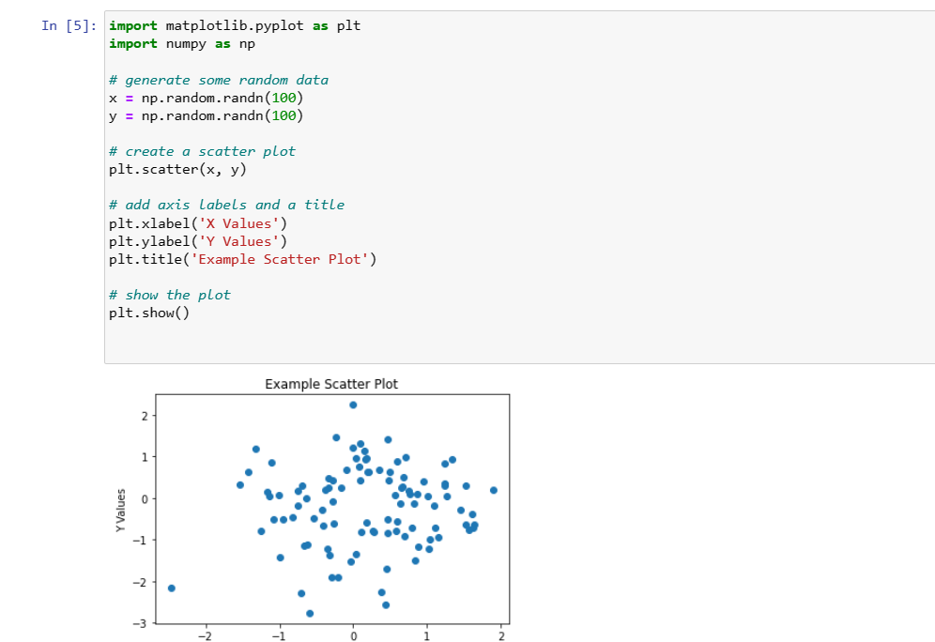
www.brainybeam.com Email Id: sagar@brainybeam.in

Slide 19
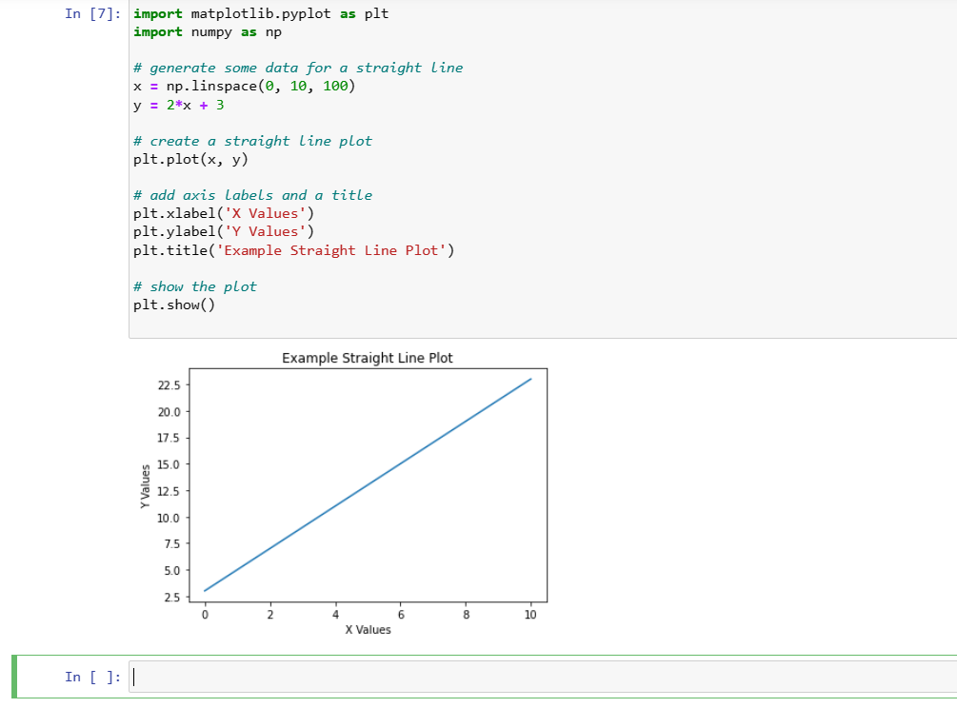
www.brainybeam.com Email Id: sagar@brainybeam.in

Slide 20
Normalization Techniques: Min-Max Scaler, MaxAbsScaler ,RobustScaler & Standard Scaler
Normalization is a common technique used in machine learning to scale numeric features to a common range. This is important because it can help improve the performance of certain algorithms by ensuring that no single feature dominates the others.
StandardScaler is a method of standardizing data such the the transformed feature has 0 mean and a standard deviation of 1. The transformed features tells us how many standard deviation the original feature is away from the feature’s mean value also called a z-score in statistics.
www.brainybeam.com Email Id: sagar@brainybeam.in

Slide 21
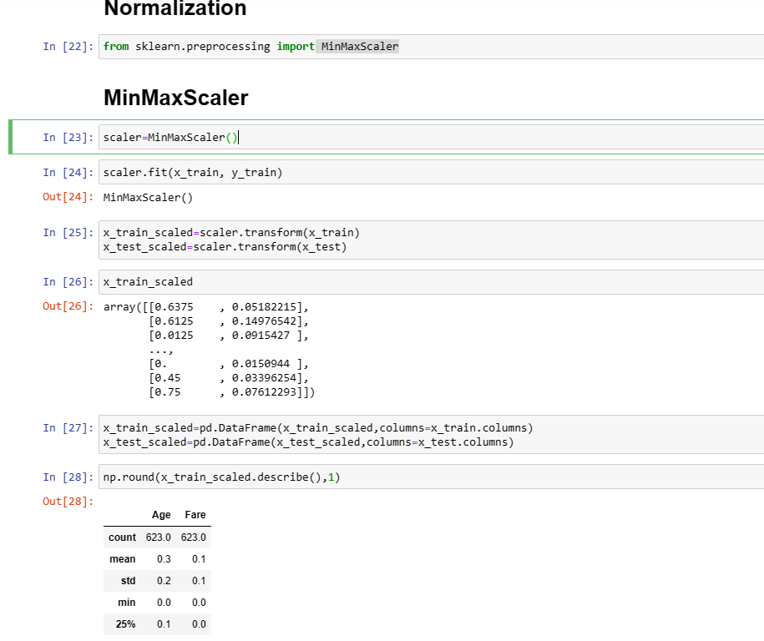
www.brainybeam.com Email Id: sagar@brainybeam.in

Slide 22
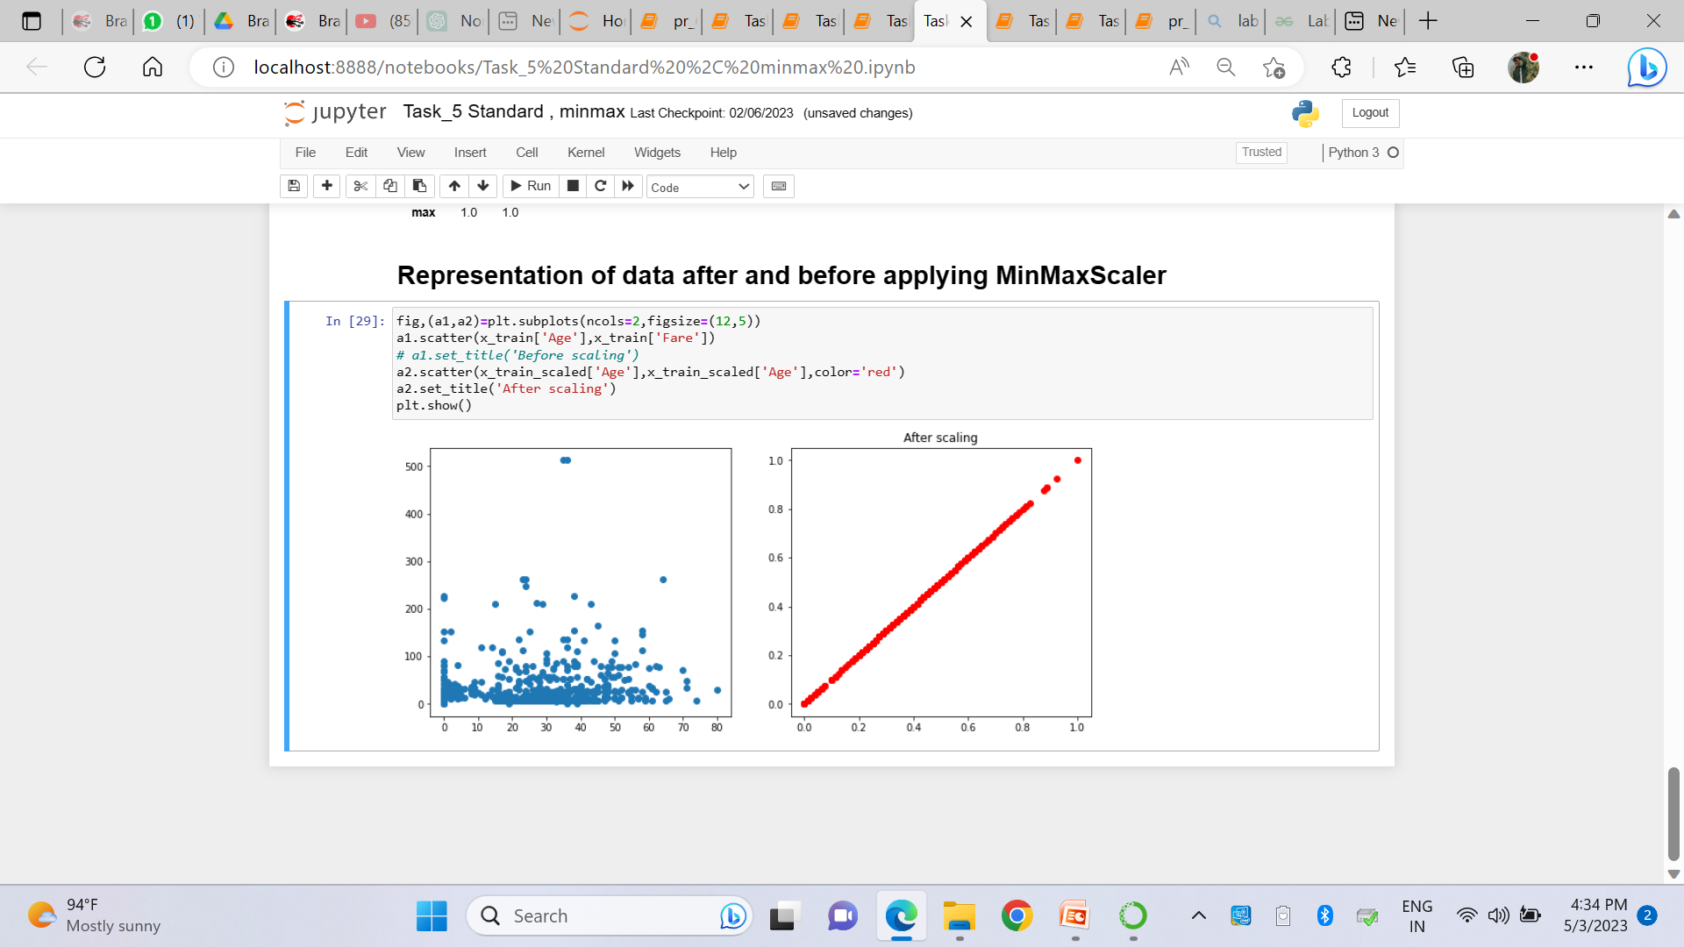
www.brainybeam.com Email Id: sagar@brainybeam.in

Slide 23
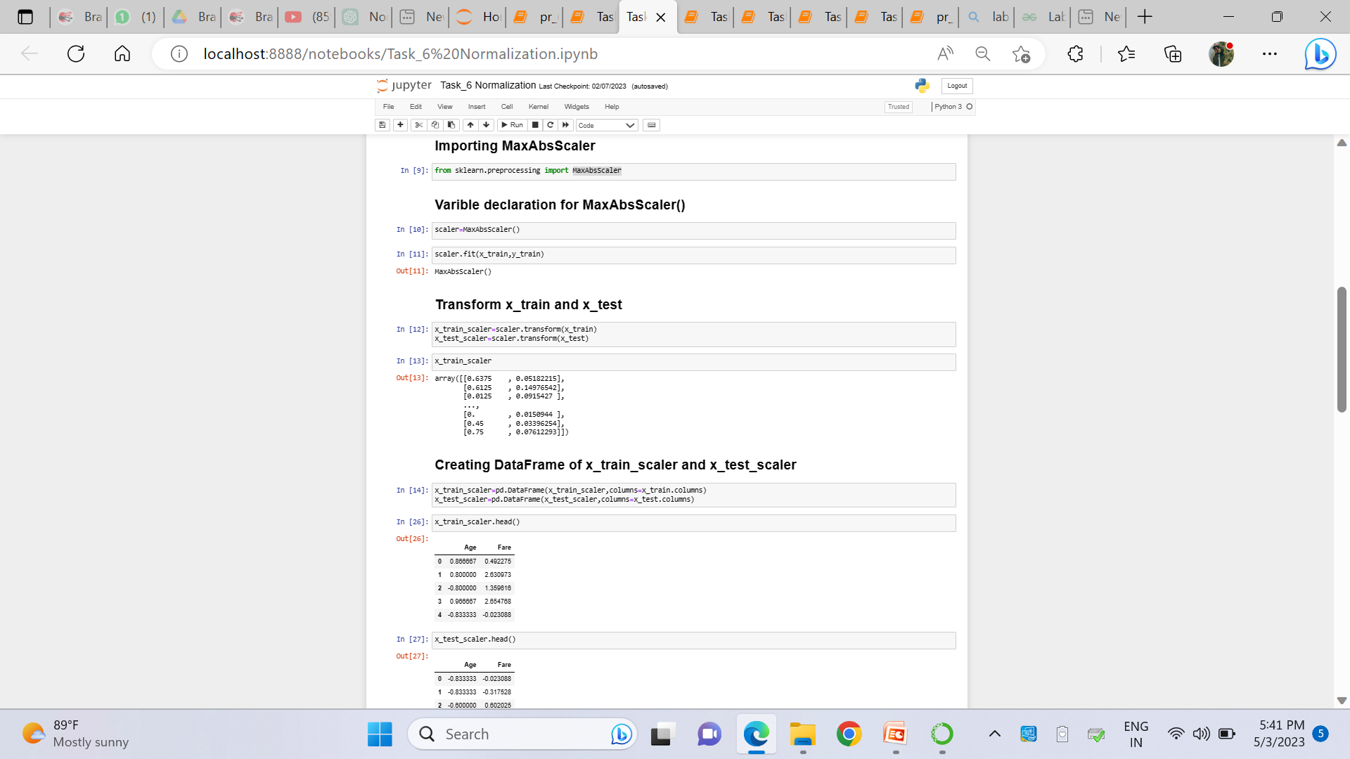
www.brainybeam.com Email Id: sagar@brainybeam.in

Slide 24
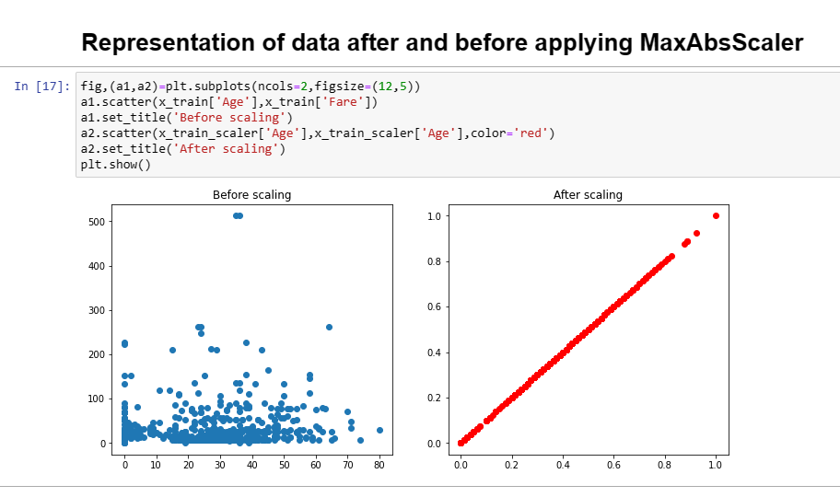
www.brainybeam.com Email Id: sagar@brainybeam.in

Slide 25
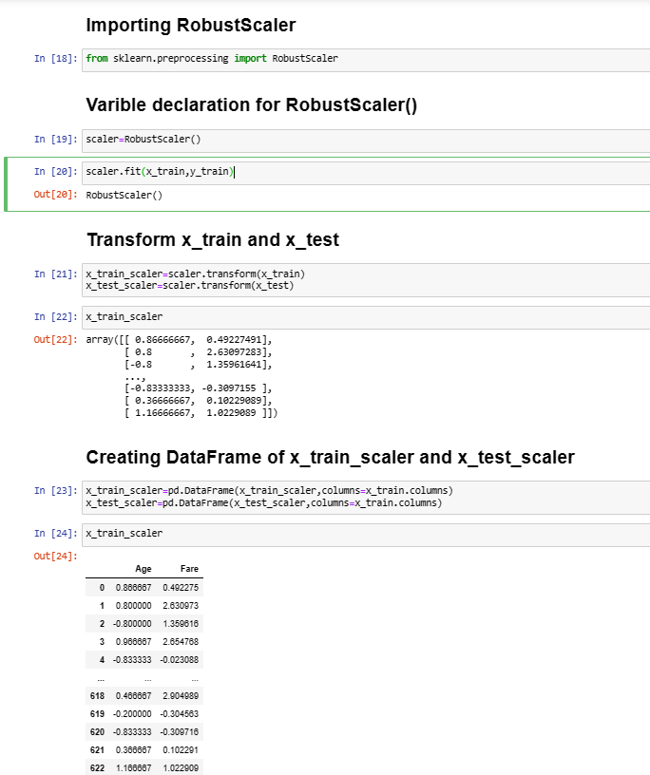
www.brainybeam.com Email Id: sagar@brainybeam.in

Slide 26
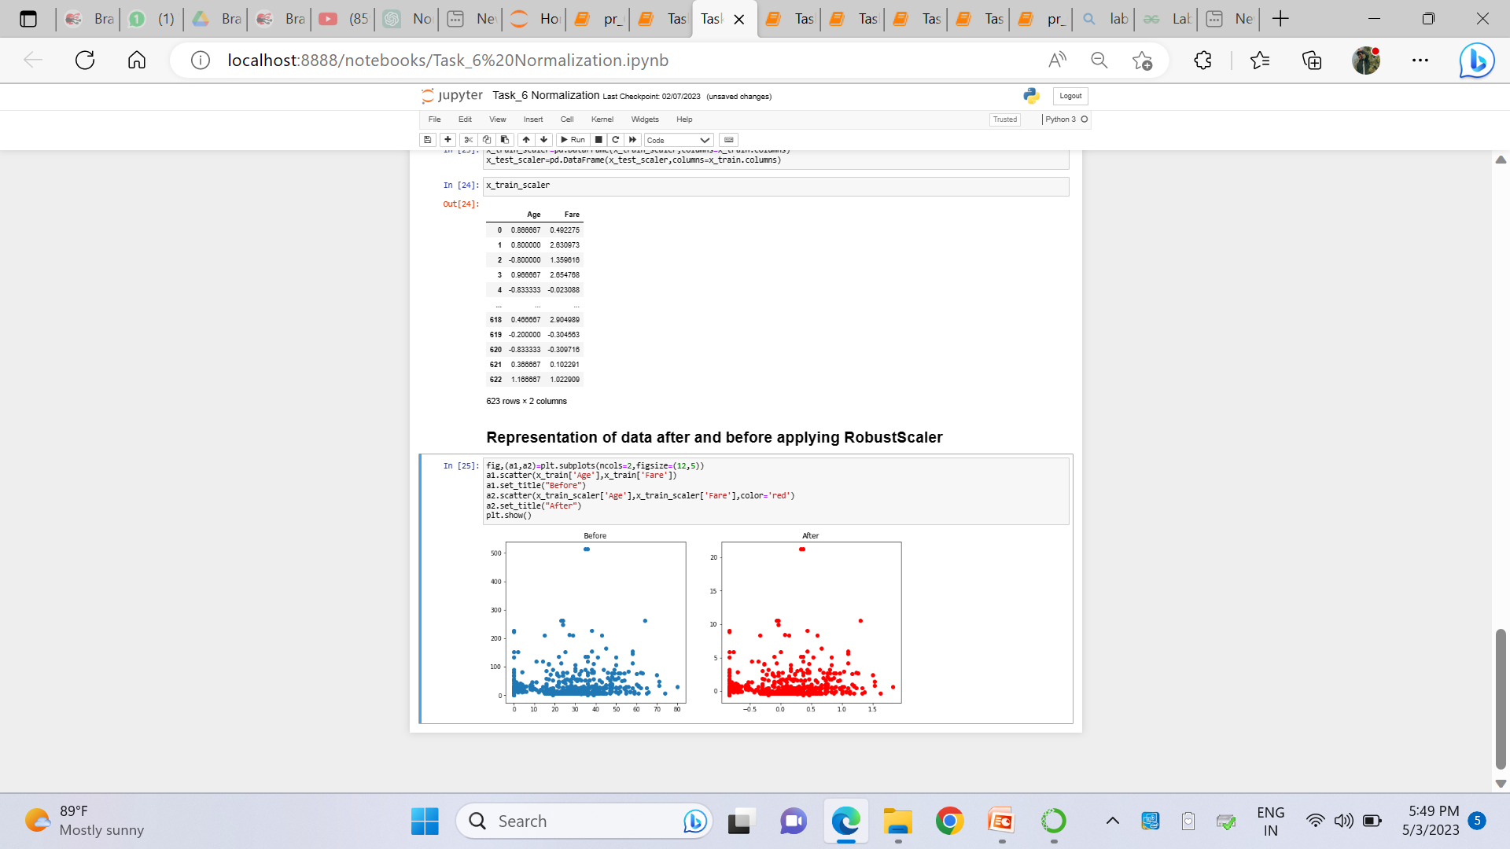
www.brainybeam.com Email Id: sagar@brainybeam.in

Slide 27
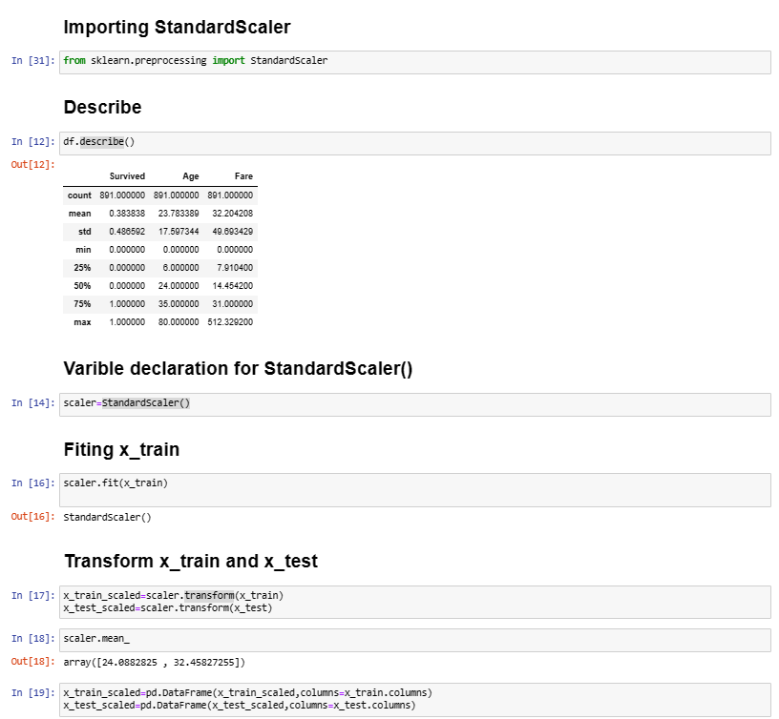
www.brainybeam.com Email Id: sagar@brainybeam.in

Slide 28
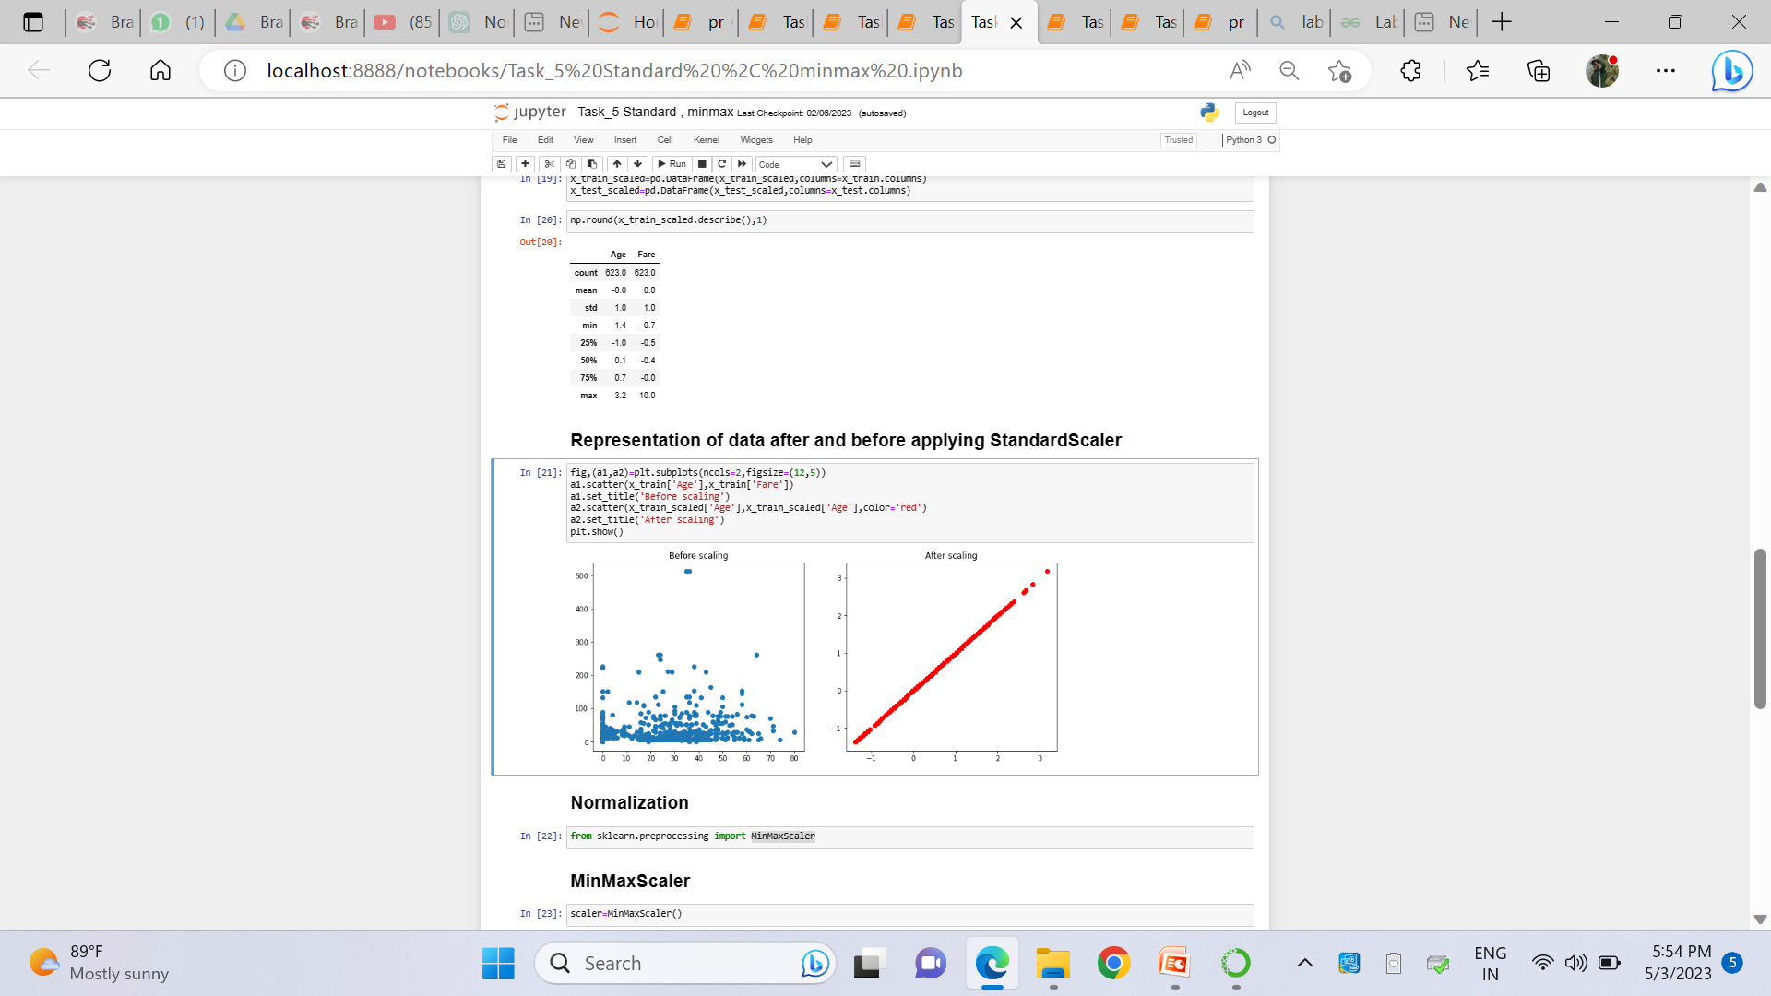
www.brainybeam.com Email Id: sagar@brainybeam.in

Slide 29
Statistical Graphical using Seaborn
Seaborn is a Python data visualization library based on Matplotlib. It provides a high-level interface for creating informative and attractive statistical graphics. Seaborn includes a number of built-in themes and color palettes to help you create visually appealing plots with minimal effort.
Histograms
Violin plots
Box plots
Heatmaps
www.brainybeam.com Email Id: sagar@brainybeam.in

Slide 30
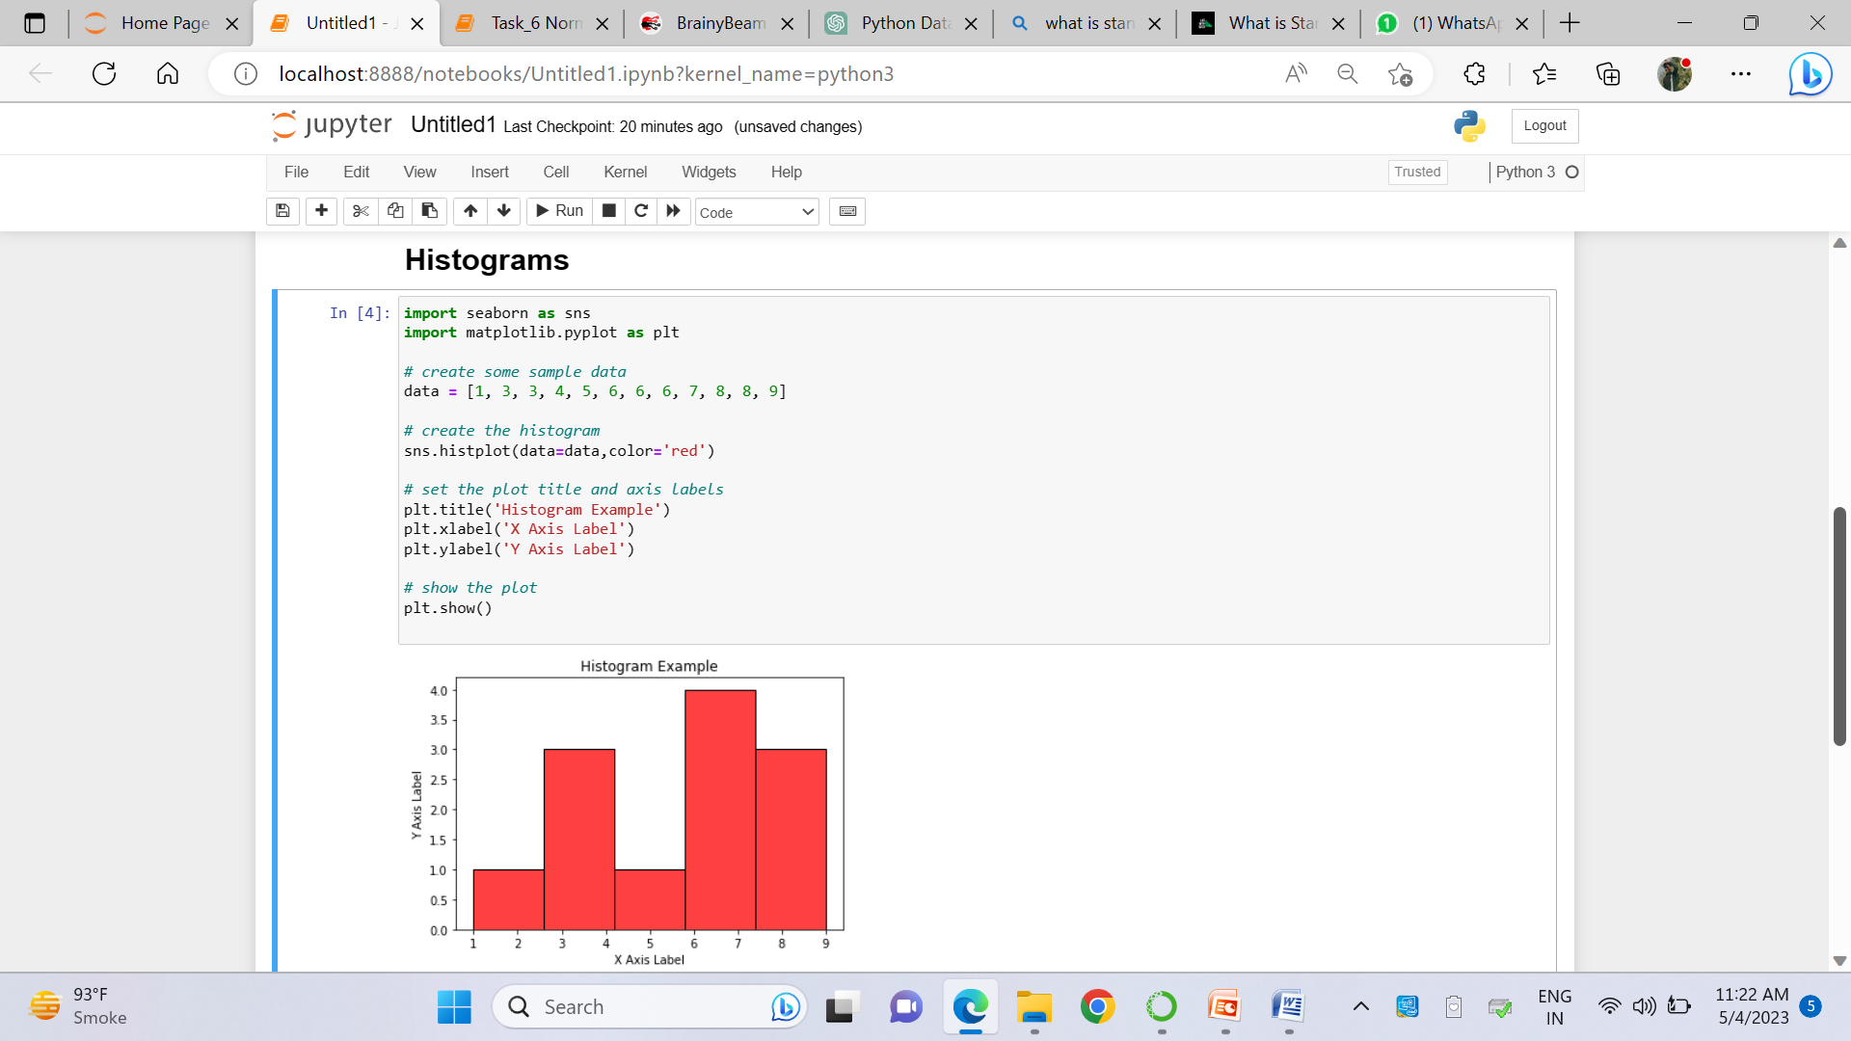
www.brainybeam.com Email Id: sagar@brainybeam.in

Slide 31
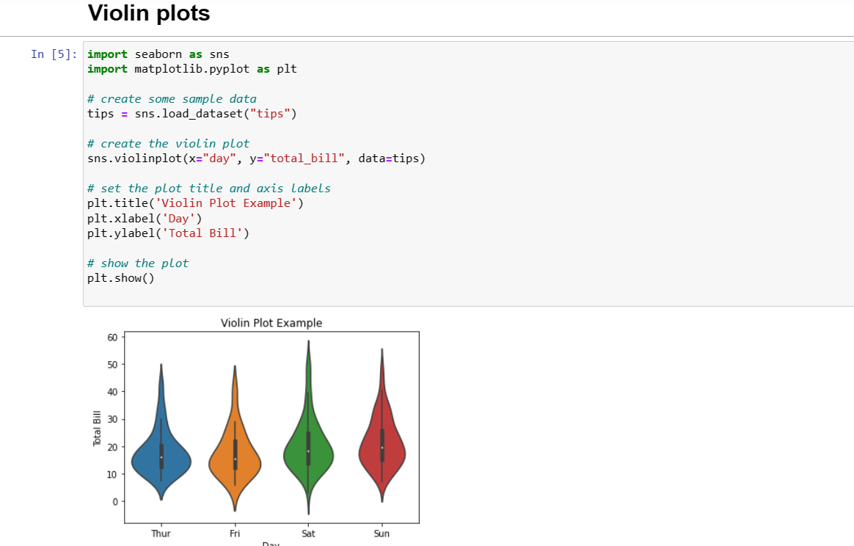
www.brainybeam.com Email Id: sagar@brainybeam.in

Slide 32
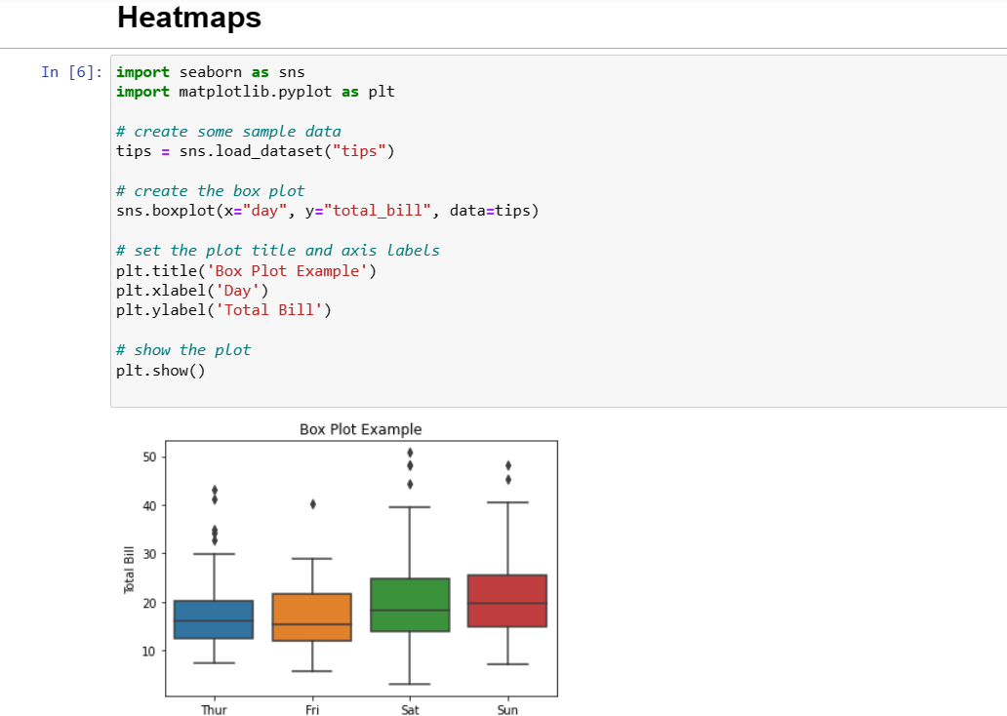
www.brainybeam.com Email Id: sagar@brainybeam.in

Slide 33
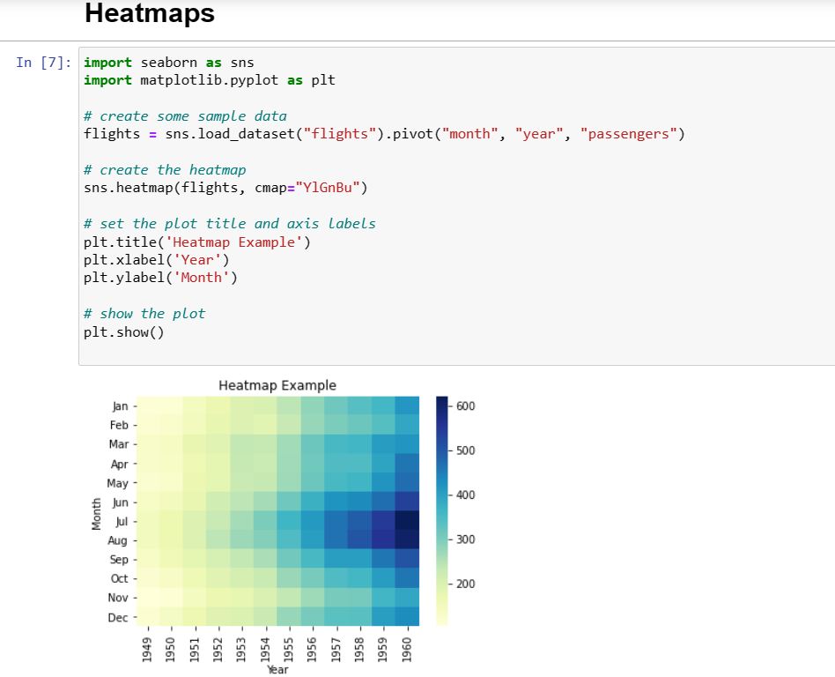
www.brainybeam.com Email Id: sagar@brainybeam.in

Slide 34
Sentiment analysis & Topic Classification and Relationship Extraction using NLP
What is NPL
Natural language processing (NLP) refers to the branch of computer science—and more specifically, the branch of artificial intelligence or AI—concerned with giving computers the ability to understand text and spoken words in much the same way human beings can.
What is Sentiment analysis
Sentiment analysis is the process of using natural language processing and machine learning techniques to identify and extract subjective information from text data, such as opinions, attitudes, and emotions.
www.brainybeam.com Email Id: sagar@brainybeam.in

Slide 35
What is Relationship Extraction
Relation Extraction is the task of predicting attributes and relations for entities in a sentence. For example, given a sentence “Barack Obama was born in Honolulu, Hawaii.”, a relation classifier aims at predicting the relation of “bornInCity”. Relation Extraction is the key component for building relation knowledge graphs, and it is of crucial significance to natural language processing applications such as structured search, sentiment analysis, question answering, and summarization.
www.brainybeam.com Email Id: sagar@brainybeam.in

Slide 36
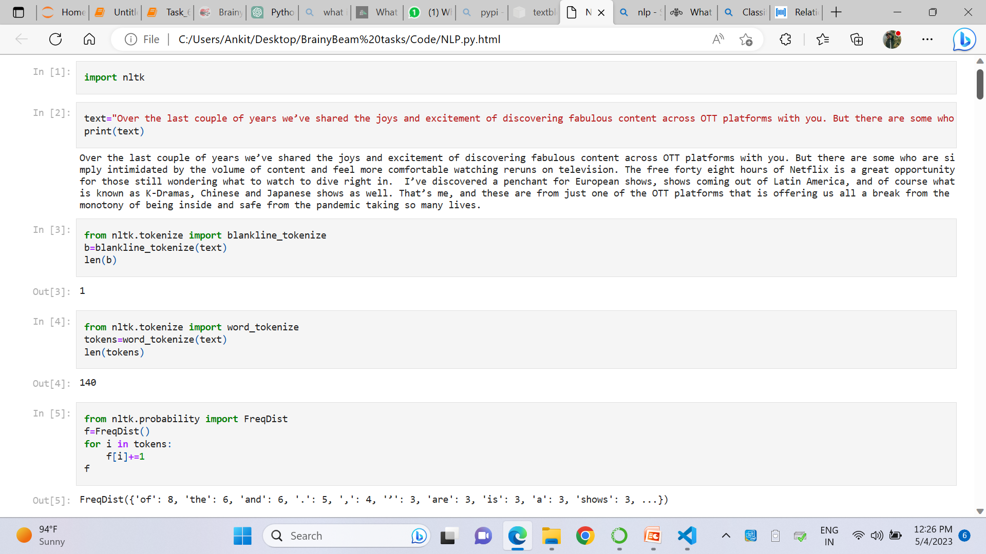
www.brainybeam.com Email Id: sagar@brainybeam.in

Slide 37
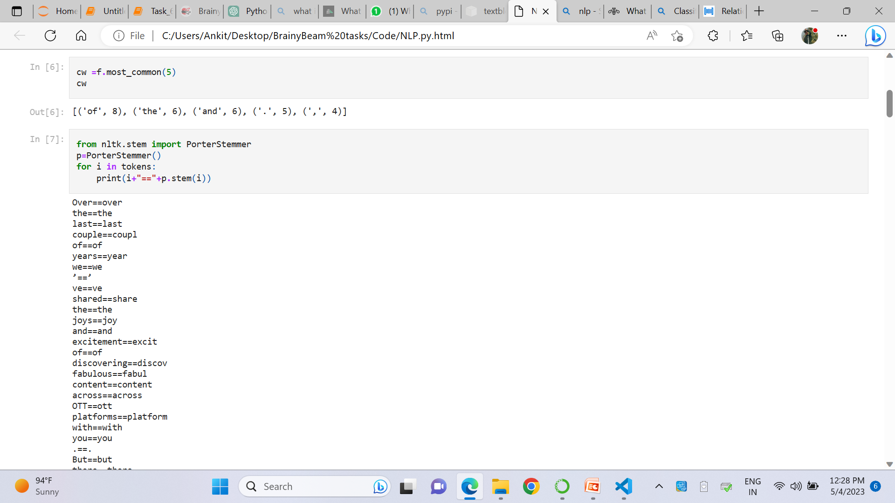
www.brainybeam.com Email Id: sagar@brainybeam.in

Slide 38
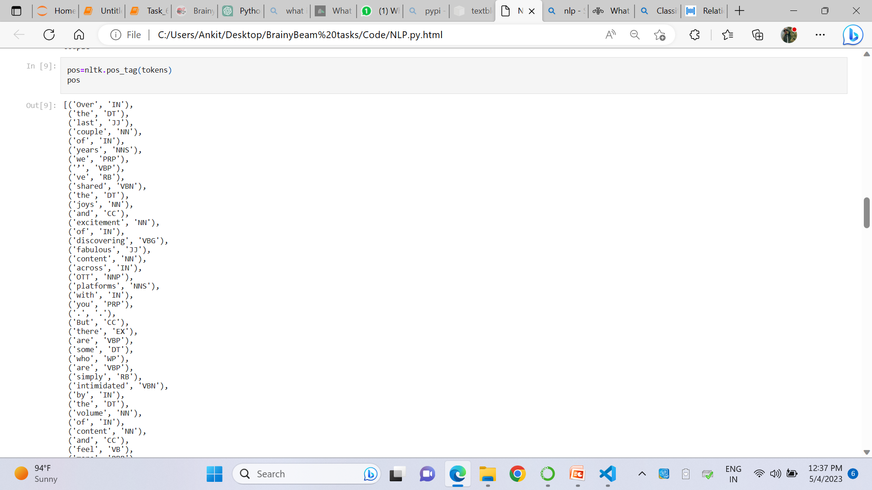
www.brainybeam.com Email Id: sagar@brainybeam.in

Slide 39
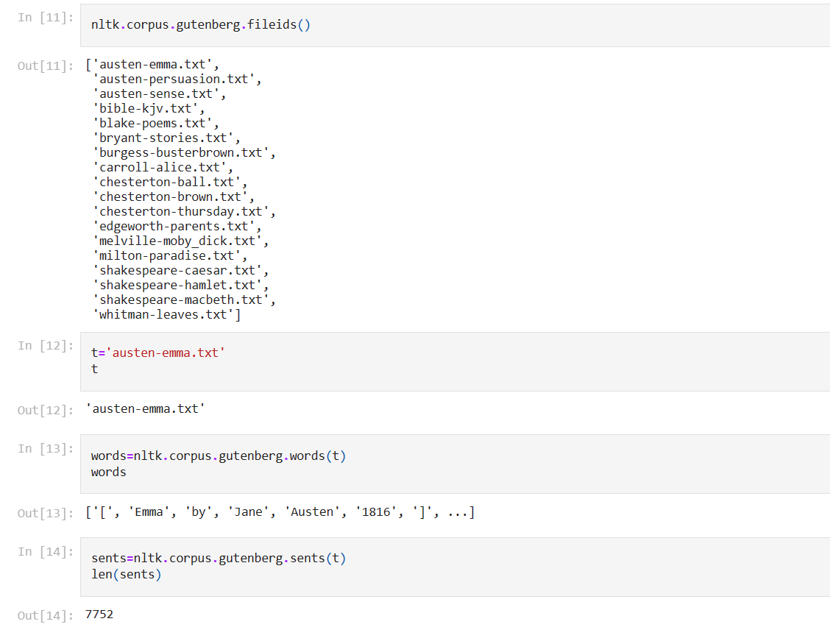
www.brainybeam.com Email Id: sagar@brainybeam.in

Slide 40
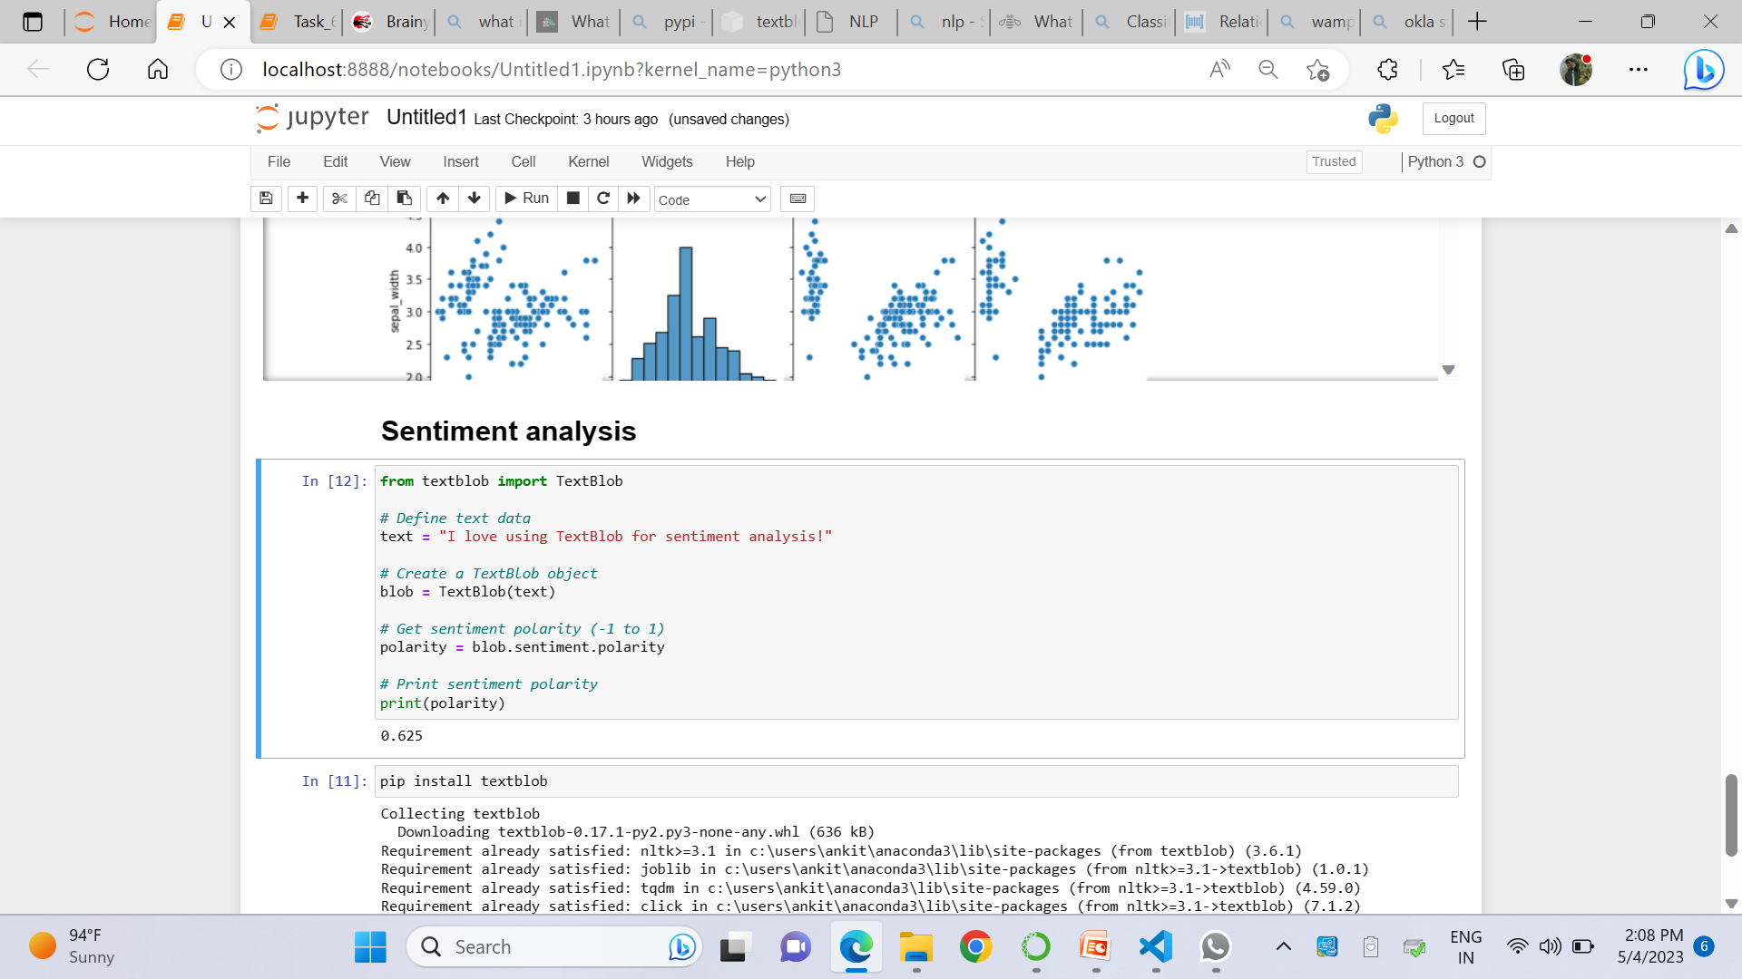
www.brainybeam.com Email Id: sagar@brainybeam.in

Slide 41
Feature Extraction using LDA & TF-IDF
Feature extraction is the process of transforming unstructured data, such as text, into a set of meaningful features that can be used for further analysis or modeling. Two popular methods for feature extraction in natural language processing are Latent Dirichlet Allocation (LDA) and Term Frequency-Inverse Document Frequency (TF-IDF).
What is LDA
The main idea behind LDA is that documents are represented as a mixture of topics, and each topic is represented as a distribution over words. The goal is to discover these underlying topics and their word distributions by looking at the words that appear in the documents. This can help in identifying the main themes or topics that are present in the documents.
www.brainybeam.com Email Id: sagar@brainybeam.in

Slide 42
What is TF-IDF
TF(t, d) is the term frequency of term t in document d, which is the number of times t occurs in d divided by the total number of words in d.
IDF(t) is the inverse document frequency of term t, which is calculated as the logarithm of the total number of documents in the collection divided by the number of documents that contain t. The IDF score is used to downweight the importance of terms that occur in many documents and upweight the importance of terms that occur in few documents.
www.brainybeam.com Email Id: sagar@brainybeam.in

Slide 43
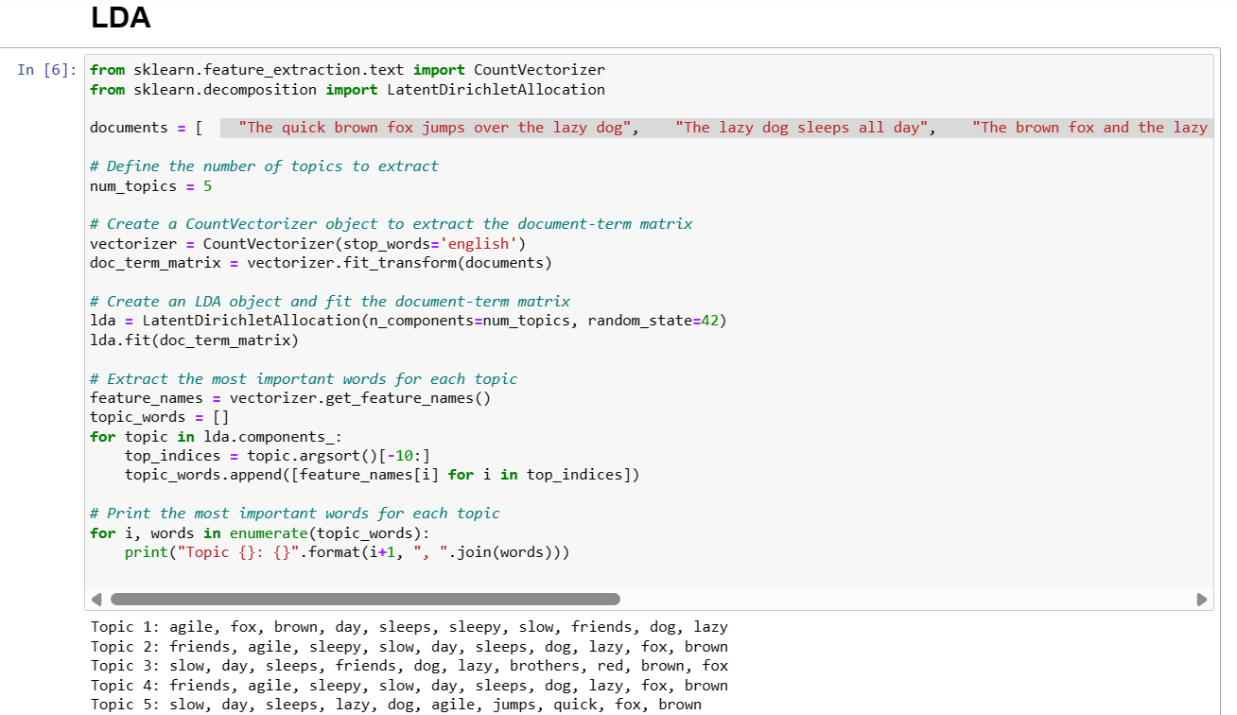
www.brainybeam.com Email Id: sagar@brainybeam.in

Slide 44
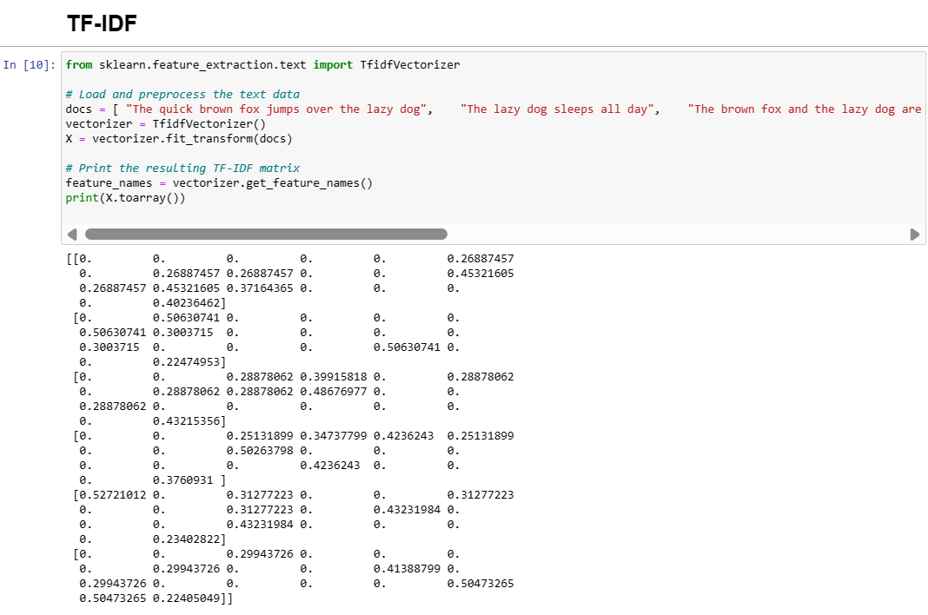
www.brainybeam.com Email Id: sagar@brainybeam.in

Slide 45
Statistical Modelling using SkLearn
Scikit-learn (formerly scikits.learn and also known as sklearn) is a free software machine learning library for the Python programming language. It features various classification, regression and clustering algorithms including support vector machines, random forests, gradient boosting, k-means and DBSCAN, and is designed to interoperate with the Python numerical and scientific libraries NumPy and SciPy
www.brainybeam.com Email Id: sagar@brainybeam.in

Slide 46
RFM Analysis
What is RFM analysis?
RFM stands for recency, frequency, monetary value. In business analytics, we often use this concept to divide customers into different segments, like high-value customers, medium value customers or low-value customers, and similarly many others.
Recency: How recently has the customer made a transaction with us
Frequency: How frequent is the customer in ordering/buying some product from us
Monetary: How much does the customer spend on purchasing products from us.
www.brainybeam.com Email Id: sagar@brainybeam.in

Slide 47
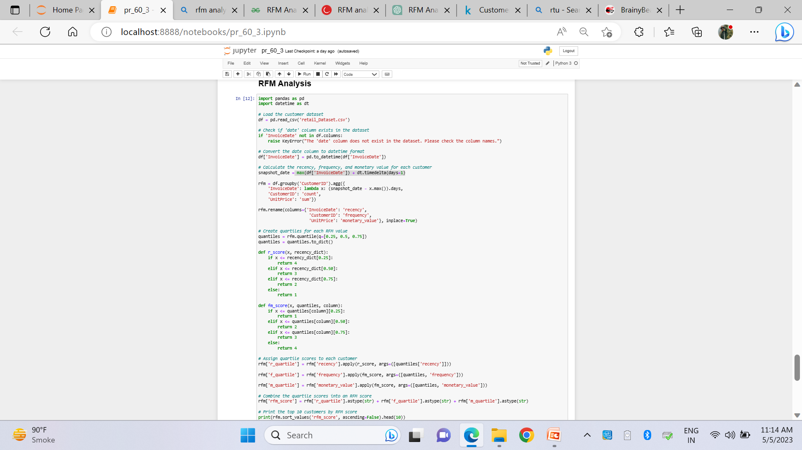
www.brainybeam.com Email Id: sagar@brainybeam.in

Slide 48
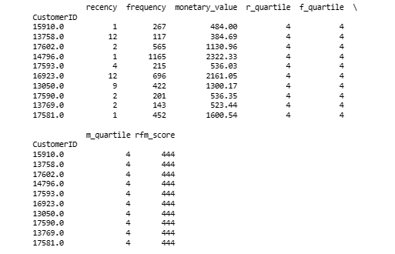
www.brainybeam.com Email Id: sagar@brainybeam.in

Slide 49
Regression using Linear Regression
Linear regression is a statistical method used to model the relationship between a dependent variable (also known as the response or target variable) and one or more independent variables (also known as predictors or features). The goal of linear regression is to find a linear equation that best describes the relationship between the variables, in terms of how the independent variables influence the dependent variable.
Y= m*x + c
β1 = Σ((Xi - X_mean)*(Yi - Y_mean)) / Σ((Xi - X_mean)^2)
β0 = Y_mean - β1*X_mean
www.brainybeam.com Email Id: sagar@brainybeam.in

Slide 50
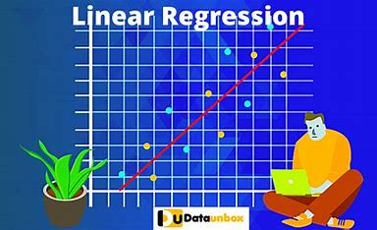
www.brainybeam.com Email Id: sagar@brainybeam.in

Slide 51
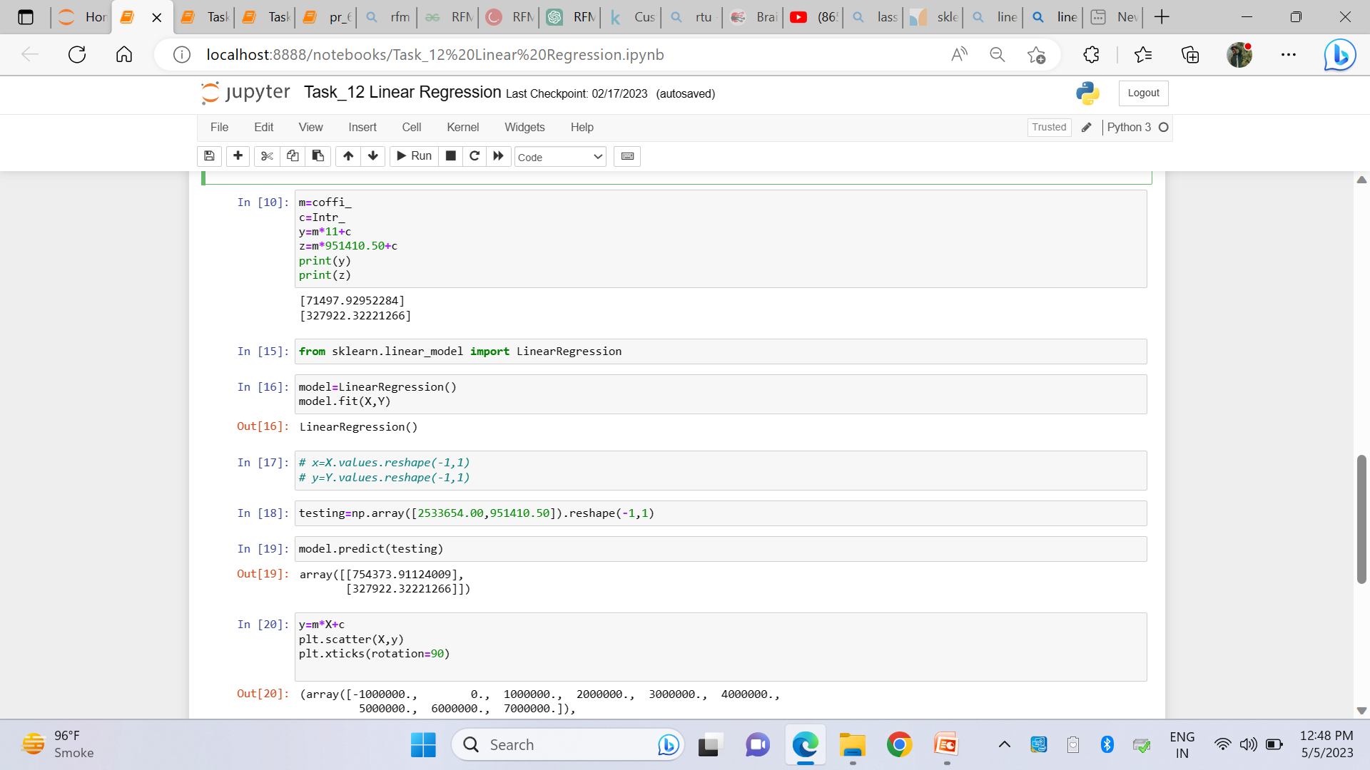
www.brainybeam.com Email Id: sagar@brainybeam.in

Slide 52
What is LASSO
LASSO, which stands for Least Absolute Shrinkage and Selection Operator, is a statistical method used for feature selection and regularization in regression analysis.
In LASSO regression, a penalty term is added to the ordinary least squares (OLS) regression function, which penalizes large values of the coefficients, forcing them towards zero. The penalty term is proportional to the absolute value of the coefficients, resulting in a "shrinkage" of the coefficients towards zero. As a result, LASSO can help to prevent Overfitting and improve the model's generalizability by reducing the variance of the model.
www.brainybeam.com Email Id: sagar@brainybeam.in

Slide 53
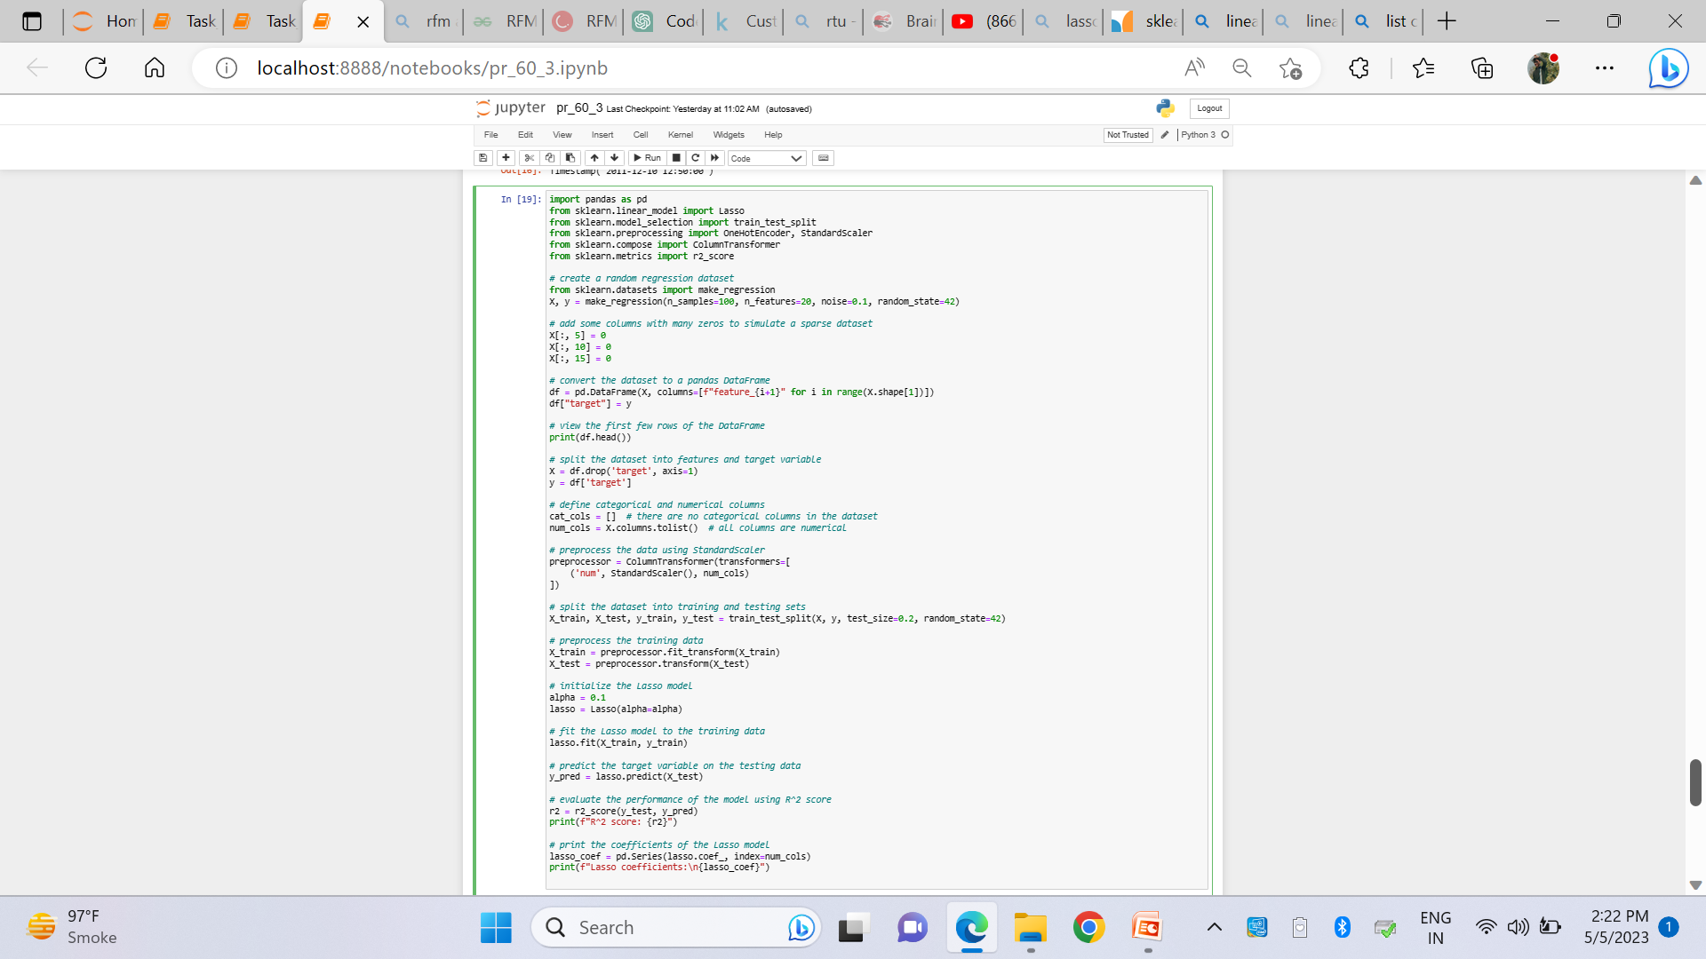
LASSO
www.brainybeam.com Email Id: sagar@brainybeam.in

Slide 54
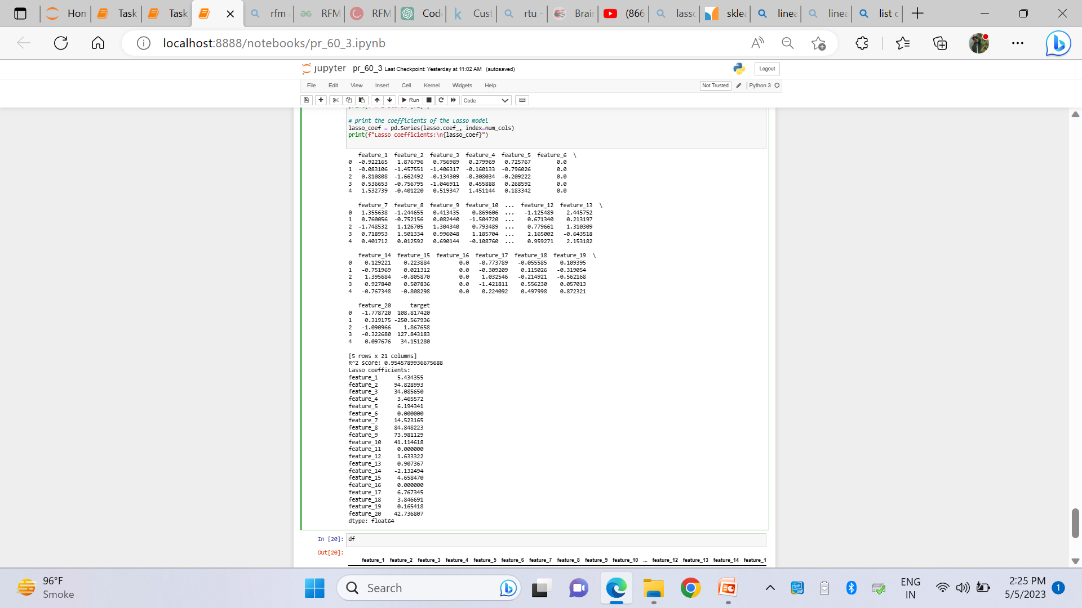
www.brainybeam.com Email Id: sagar@brainybeam.in

Slide 55
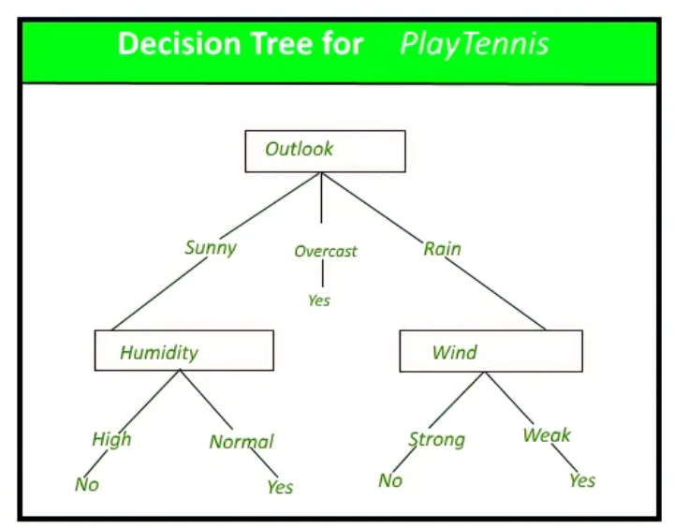
Decision Tree
Decision Tree is the most powerful and popular tool for classification and prediction. A Decision tree is a flowchart-like tree structure, where each internal node denotes a test on an attribute, each branch represents an outcome of the test, and each leaf node (terminal node) holds a class label.
www.brainybeam.com Email Id: sagar@brainybeam.in

Slide 56
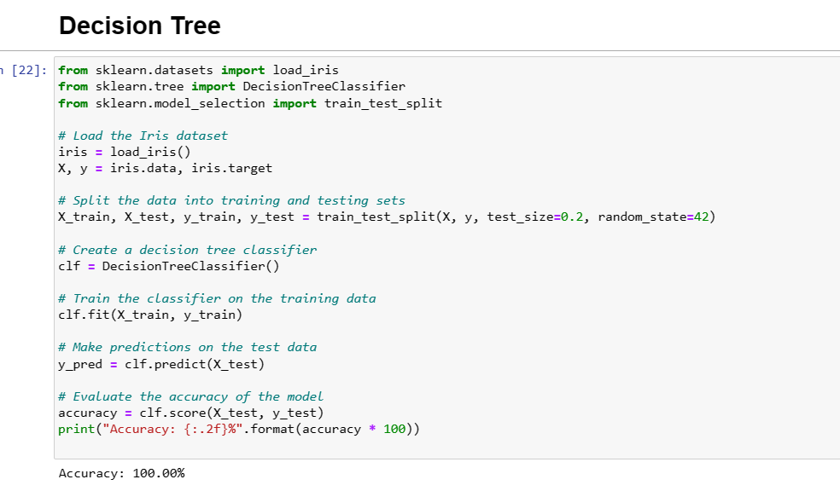
www.brainybeam.com Email Id: sagar@brainybeam.in

Slide 57
Random Forest
Random Forest is a popular machine learning algorithm used for both classification and regression tasks. It is an ensemble method that combines multiple decision trees to improve the predictive accuracy and reduce Overfitting.
The basic idea of Random Forest is to build multiple decision trees using bootstrap samples of the training data and randomly selected subsets of the features. Each decision tree is trained on a different subset of the data and features, resulting in a diverse set of trees that collectively produce better predictions than any individual tree.
www.brainybeam.com Email Id: sagar@brainybeam.in

Slide 58
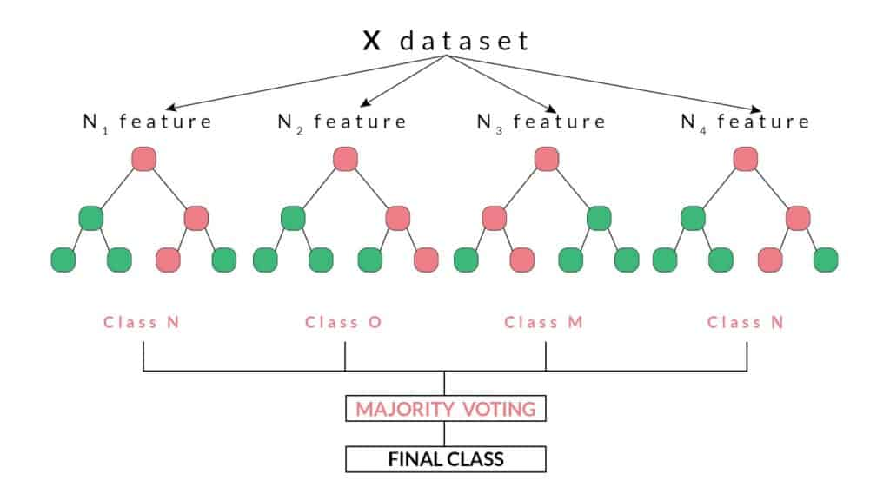
www.brainybeam.com Email Id: sagar@brainybeam.in

Slide 59
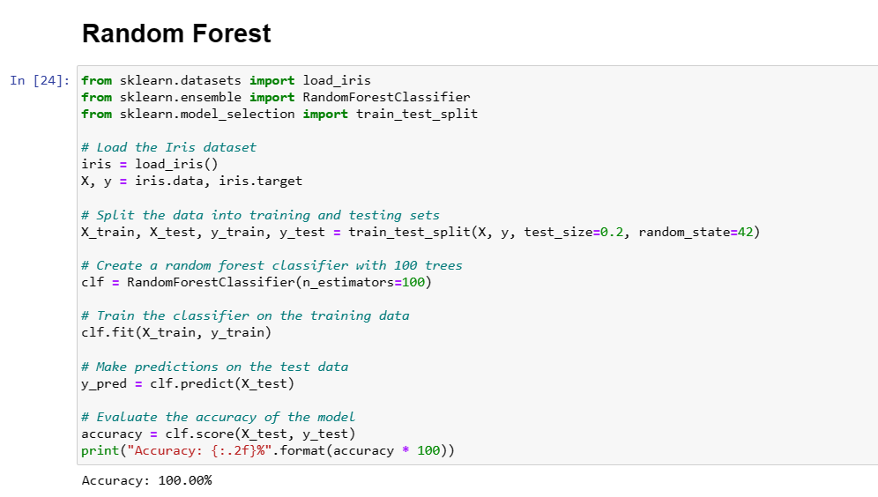
www.brainybeam.com Email Id: sagar@brainybeam.in

Slide 60
SVM(Support Vector Machines)
SVM stands for Support Vector Machines, which is a popular supervised machine learning algorithm used for classification and regression tasks. It works by finding the hyperplane that best separates the classes in the input space.
In the case of binary classification, SVM tries to find the hyperplane that maximizes the margin, i.e., the distance between the hyperplane and the closest data points of each class. The data points that lie closest to the hyperplane are called support vectors, hence the name Support Vector Machines.
www.brainybeam.com Email Id: sagar@brainybeam.in

Slide 61
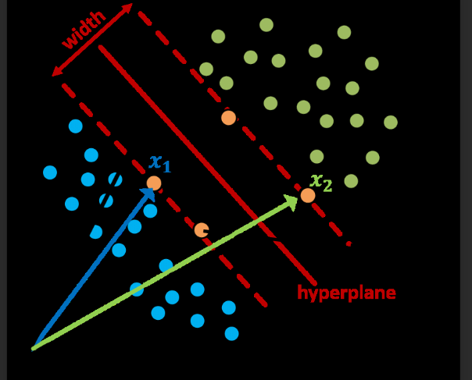
www.brainybeam.com Email Id: sagar@brainybeam.in

Slide 62
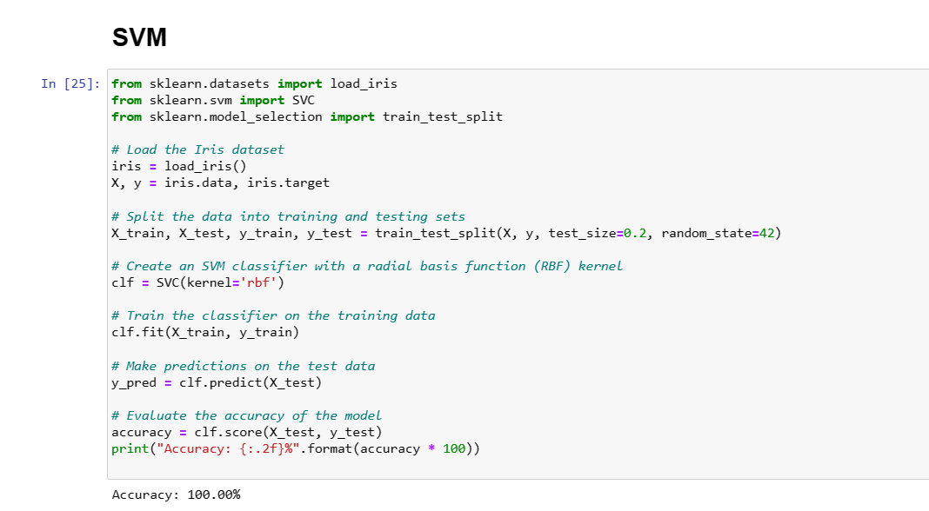
www.brainybeam.com Email Id: sagar@brainybeam.in

Slide 63
Classification using Naive Bayes
Naive Bayes is a probabilistic machine learning algorithm used for classification tasks. It is based on Bayes' theorem, which is a statistical rule that describes the probability of an event, based on prior knowledge of conditions that might be related to the event.
The "naive" assumption in Naive Bayes is that the features are conditionally independent of each other given the class label. This means that the presence or absence of one feature does not affect the probability of the presence or absence of another feature, given the class label. Although this assumption is often violated in practice, Naive Bayes can still perform well in many cases and is computationally efficient.
www.brainybeam.com Email Id: sagar@brainybeam.in

Slide 64
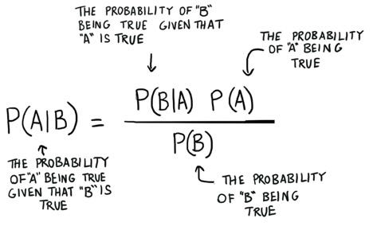
www.brainybeam.com Email Id: sagar@brainybeam.in

Slide 65
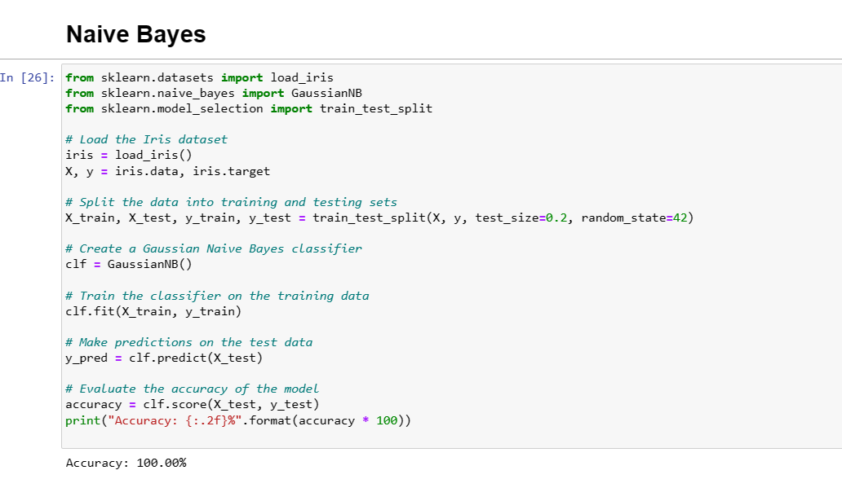
www.brainybeam.com Email Id: sagar@brainybeam.in

Slide 66
K-Nearest Neighbors (KNN)
K-Nearest Neighbors (KNN) is a simple and popular classification algorithm in machine learning. In KNN, a new data point is classified based on its proximity to the K nearest neighbors in the training data. The K nearest neighbors are determined based on a distance metric, such as Euclidean distance or Manhattan distance.
www.brainybeam.com Email Id: sagar@brainybeam.in

Slide 67
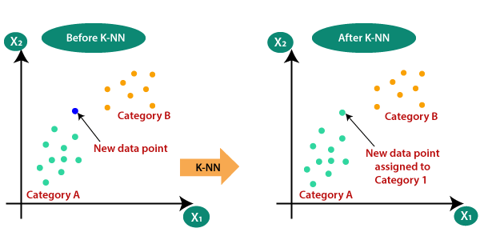
www.brainybeam.com Email Id: sagar@brainybeam.in

Slide 68
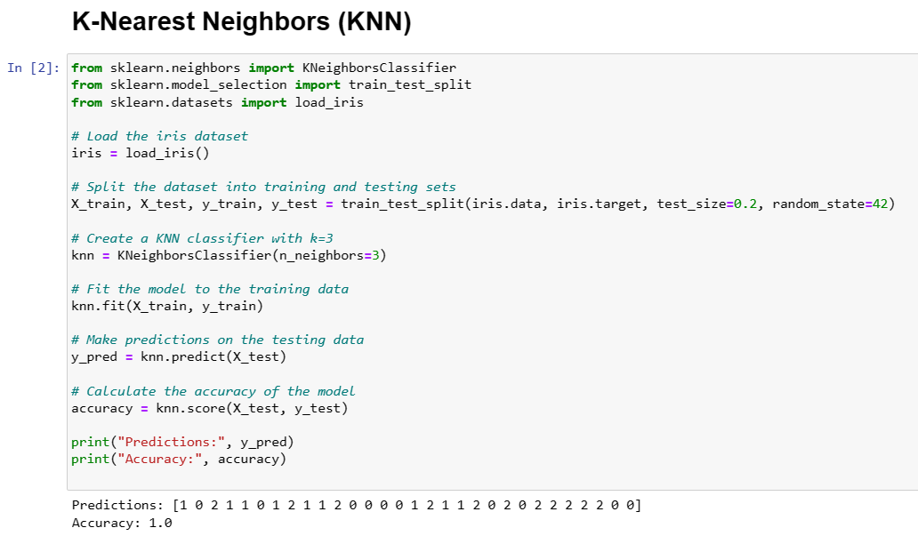
www.brainybeam.com Email Id: sagar@brainybeam.in

Slide 69
Evaluation metrics-RMSE(Root Mean Squared Error)
RMSE stands for Root Mean Squared Error, which is a commonly used evaluation metric for regression problems. It measures the average difference between the predicted values and the actual values in a dataset.
The formula for RMSE is:
RMSE = sqrt((1/n) * sum((actual_value - predicted_value)^2))
www.brainybeam.com Email Id: sagar@brainybeam.in

Slide 70
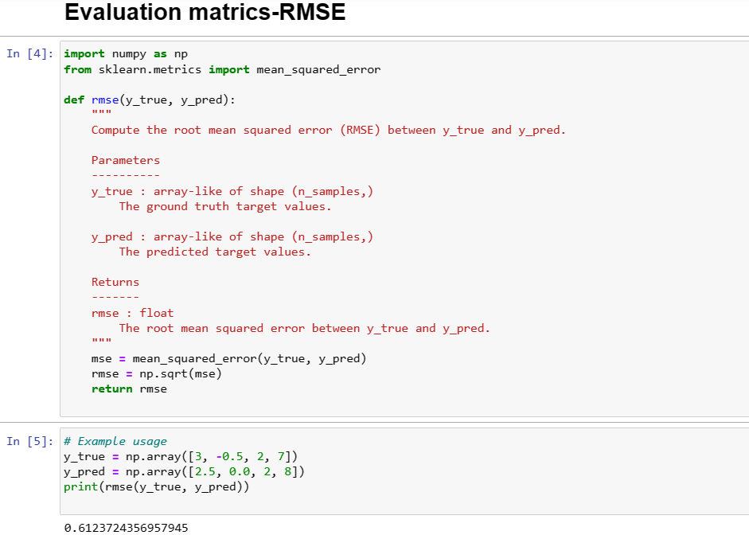
www.brainybeam.com Email Id: sagar@brainybeam.in

Slide 71
MSE(Mean Squared Error)
MSE stands for Mean Squared Error, which is another commonly used evaluation metric for regression problems. It measures the average squared difference between the predicted values and the actual values in a dataset.
The formula for MSE is:
MSE = (1/n) * sum((actual_value - predicted_value)^2)
www.brainybeam.com Email Id: sagar@brainybeam.in

Slide 72
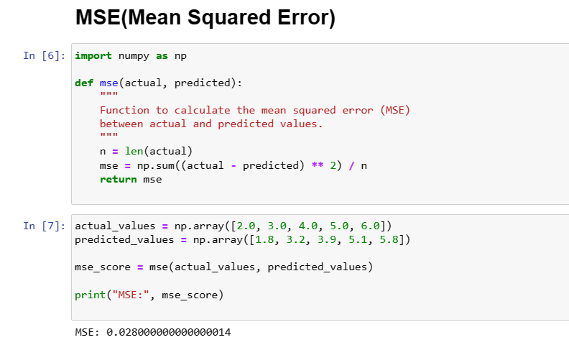
www.brainybeam.com Email Id: sagar@brainybeam.in

Slide 73
Precision
Precision is a metric that is commonly used to evaluate the performance of a binary classification model. It measures the proportion of true positive predictions out of all the positive predictions made by the model. In other words, it measures how accurate the model is when it predicts the positive class.
Precision = True Positives / (True Positives + False Positives)
www.brainybeam.com Email Id: sagar@brainybeam.in

Slide 74

www.brainybeam.com Email Id: sagar@brainybeam.in

Slide 75
Recall
Recall is another commonly used metric to evaluate the performance of a binary classification model. It measures the proportion of true positive predictions out of all the actual positive instances in the data. In other words, it measures how well the model is able to identify positive instances.
Recall = True Positives / (True Positives + False Negatives)
www.brainybeam.com Email Id: sagar@brainybeam.in

Slide 76

www.brainybeam.com Email Id: sagar@brainybeam.in

Slide 77
F-measure
F-measure, also known as F1-score, is another metric commonly used to evaluate the performance of a binary classification model. It is a harmonic mean of precision and recall, which balances both metrics.
Here's the formula for F-measure:
F1-score = 2 * (precision * recall) / (precision + recall)
www.brainybeam.com Email Id: sagar@brainybeam.in

Slide 78

www.brainybeam.com Email Id: sagar@brainybeam.in

Slide 79
Thank you
www.brainybeam.com Email Id: sagar@brainybeam.in

