Slide 1


Gujarat Technological University
NEW L. J. INSTITUTE OF ENGINEERING AND TECHNOLOGY
DEPARTMENT OF INFORMATION TECHNOLOGY/COMPUTER SCIENCE AND ENG.
ACADEMIC YEAR – 2024-2025
Summer Internship (3170001)
Predicting Customer Response to Telemarketing Campaigns
HOD NAME:
Dr. Gayatri Pandi
CSE&IT,
NEW LJIET.
PREPARED BY,
Gopeshkumar Rabadiya
211430116017
GUIDED BY,
Roshni Mandli
Semester: 7TH DEPARTMENT OF IT

Slide 2
Outline
Objective
Introduction
Role and Responsibilities During Internship
Internship Work
Conclusion
Future Enhancement
Completion Certificate

Slide 3
Objective
Main Objective: increase the effectiveness of the bank's telemarketing campaign This project will enable the bank to develop a more granular understanding of its customer base, predict customers' response to its telemarketing campaign and establish a target customer profile for future marketing plans.
By analysing customer features, such as demographics and transaction history, the bank will be able to predict customer saving behaviours and identify which type of customers is more likely to make term deposits. The bank can then focus its marketing efforts on those customers. This will not only allow the bank to secure deposits more effectively but also increase customer satisfaction by reducing undesirable advertisements for certain customers.

Slide 4
2. Introduction to Python Programming
Python is widely recognized as a versatile programming language highly valued for its simplicity, clarity, and adaptability, making it a foundational tool in the field of data science.
Its broad applicability spans areas such as statistical analysis, machine learning, and natural language processing, catering to both beginners and experts due to its user-friendly syntax.
Python's extensive standard library offers a wide array of modules and packages tailored to various data-related tasks, including data manipulation, visualization, and machine learning algorithms. Additionally, its support for different programming paradigms, such as procedural, object-oriented, and functional programming, provides data scientists with unmatched flexibility in designing their solutions.
In the realm of data science, Python is complemented by a diverse range of specialized libraries and frameworks, each designed for specific stages of the data analysis process.
For instance, Pandas, NumPy, and Matplotlib excel in data manipulation, numerical computation, and visualization, while scikit-learn and TensorFlow provide comprehensive toolsets for machine learning and deep learning tasks.

Slide 5
3. Role and Responsibilities During Internship
"Predicting Customer Response to Telemarketing Campaigns," here are some roles and responsibilities i have taken on during my internship:
1. Data Collection and Preprocessing
2. Feature Engineering
3. Model Building
4. Model Evaluation
5. Implementation and Deployment
6. Reporting and Documentation
7. Collaboration
8. Continuous Learning

Slide 6
4. Internship Work
AIM: This project will enable the bank to develop a more granular understanding of its customer base, predict customers' response to its telemarketing campaign and establish a target customer profile for future marketing plans.
By analysing customer features, such as demographics and transaction history, the bank will be able to predict customer saving behaviours and identify which type of customers is more likely to make term deposits. The bank can then focus its marketing efforts on those customers. This will not only allow the bank to secure deposits more effectively but also increase customer satisfaction by reducing undesirable advertisements for certain customers.
Output:

Slide 7
Table of Contents
1. Project Background
2. Data Cleaning
3. Exploratory Data Analysis
4. Data Visualization
5. Machine Learning: Classification
6. Machine Learning: Regression
7. Conclusion & Recommendations

Slide 8
Project Background
Nowadays, marketing spending in the banking industry is massive, meaning that it is essential for banks to optimize marketing strategies and improve effectiveness. Understanding customers’ need leads to more effective marketing plans, smarter product designs and greater customer satisfaction.

Slide 9
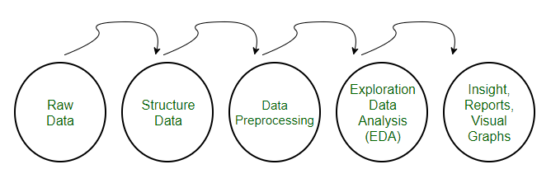
Data Cleaning

Slide 10
Load the raw data
This dataset is about the direct phone call marketing campaigns, which aim to promote term deposits among existing customers, by a Portuguese banking institution from May 2008 to November 2010. It is publicly available in the UCI Machine learning Repository, which can be retrieved from http://archive.ics.uci.edu/ml/datasets/Bank+Marketing#.

Slide 11
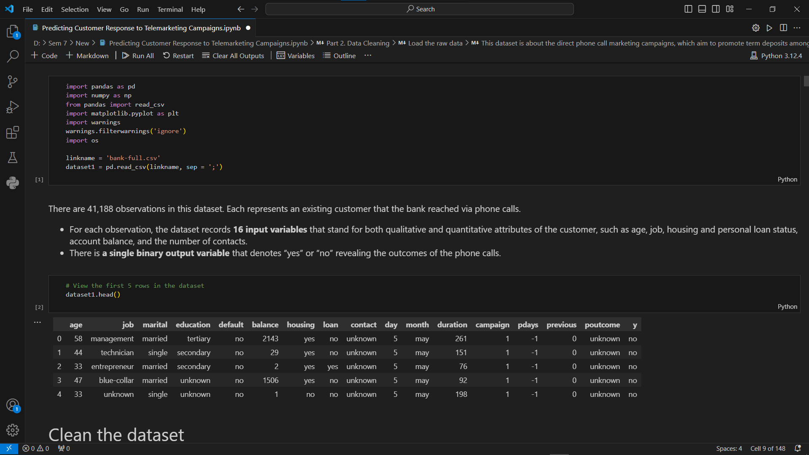

Slide 12
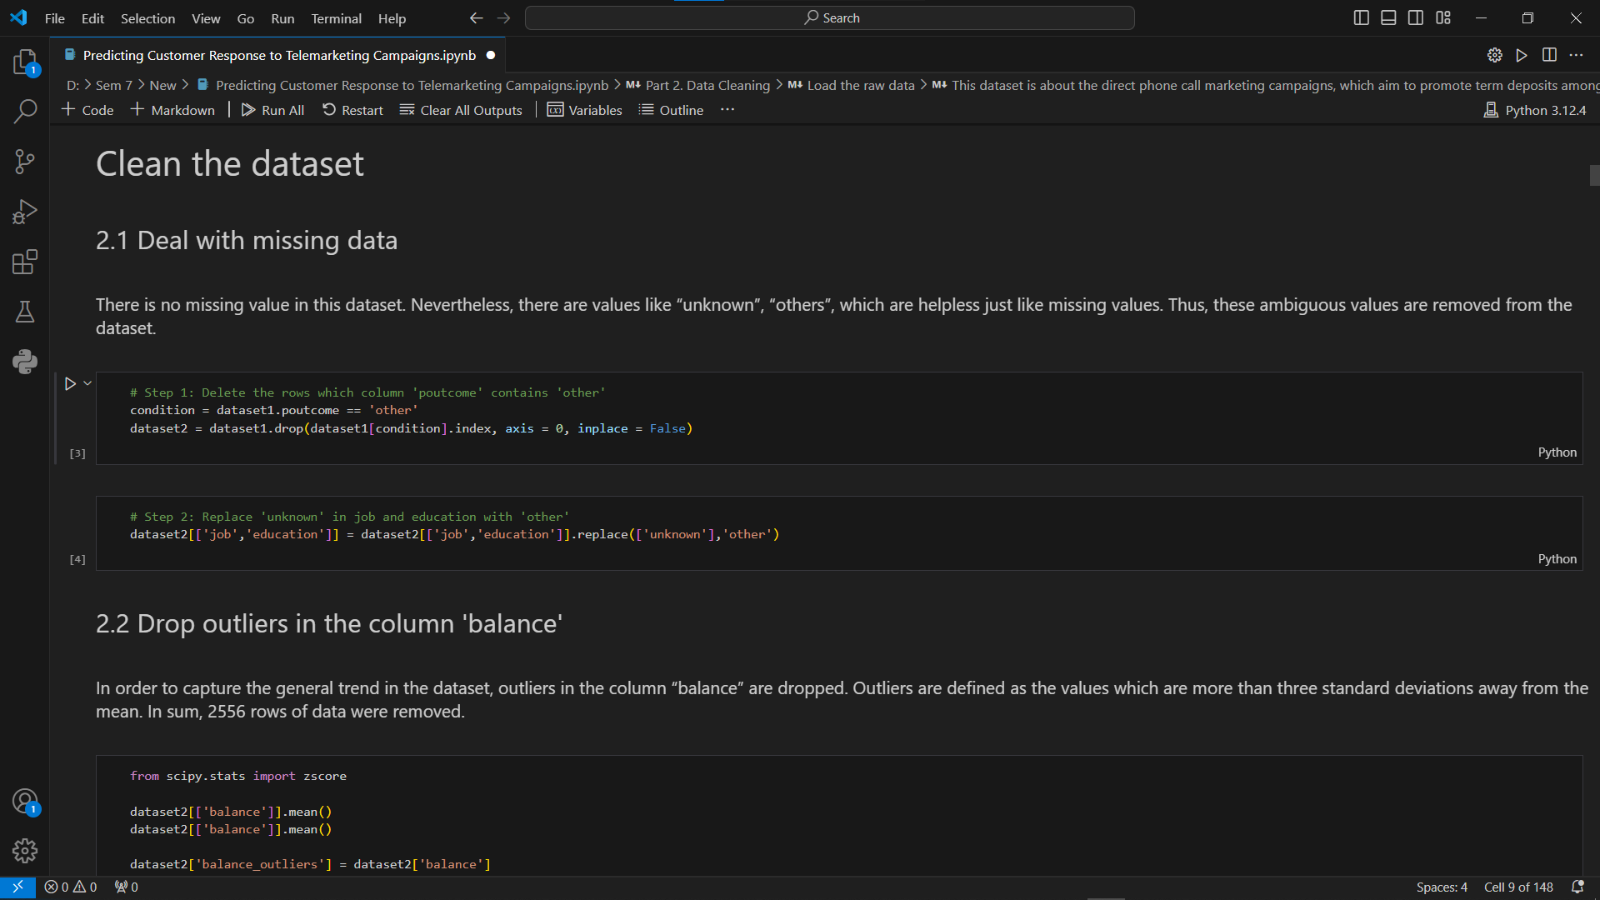

Slide 13
Exploratory data analysis
To obtain a better understanding of the dataset, the distribution of key variables and the relationships among them were plotted.

Slide 14
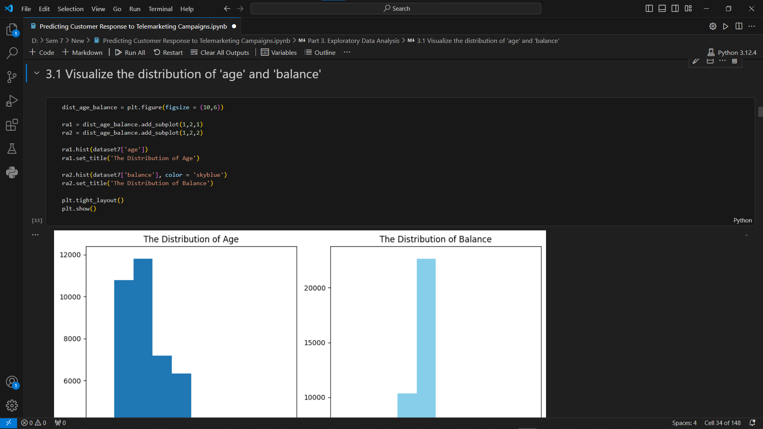

Slide 15
Data Visualization
With a sound knowledge of the distribution of key variables, further analysis of each customer characteristic can be carried out to investigate its influence on the subscription rate.

Slide 16
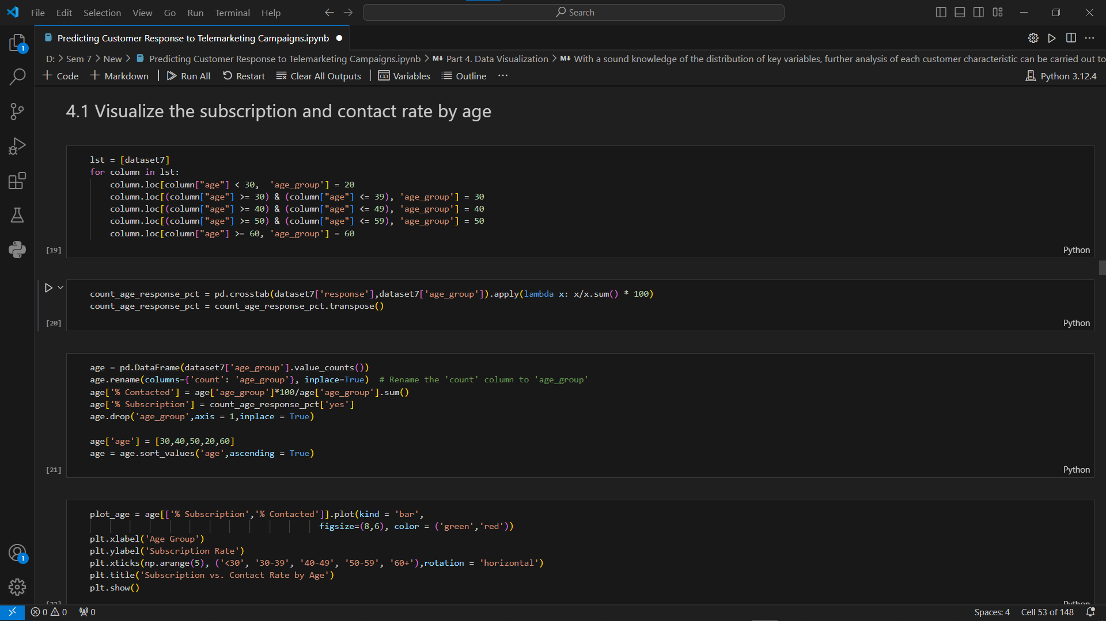

Slide 17
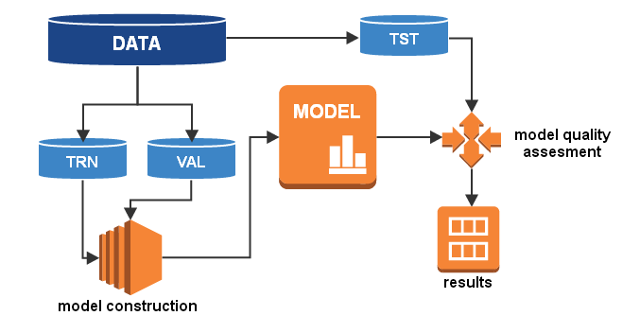
Machine Learning: Classification
The main objective of this project is to identify the most responsive customers before the marketing campaign so that the bank will be able to efficiently reach out to them, saving time and marketing resources. To achieve this objective, classification algorithms will be employed. By analysing customer statistics, a classification model will be built to classify all clients into two groups: "yes" to term deposits and "no" to term deposits.

Slide 18
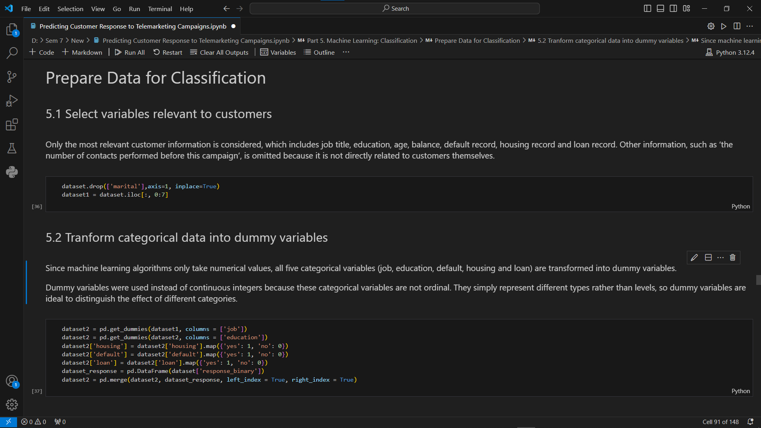

Slide 19
Machine Learning: Regression
Regression analysis is carried out to complement the classification result and help the bank better predict campaign outcome based on customer statistics.
Since the duration of a phone call is positively correlated with the campaign outcome, it can serve as another indicator of the possibility of subscription. In this part, regression algorithms will be used to estimate the duration of a phone call, helping the bank better predict subscription rate.

Slide 20
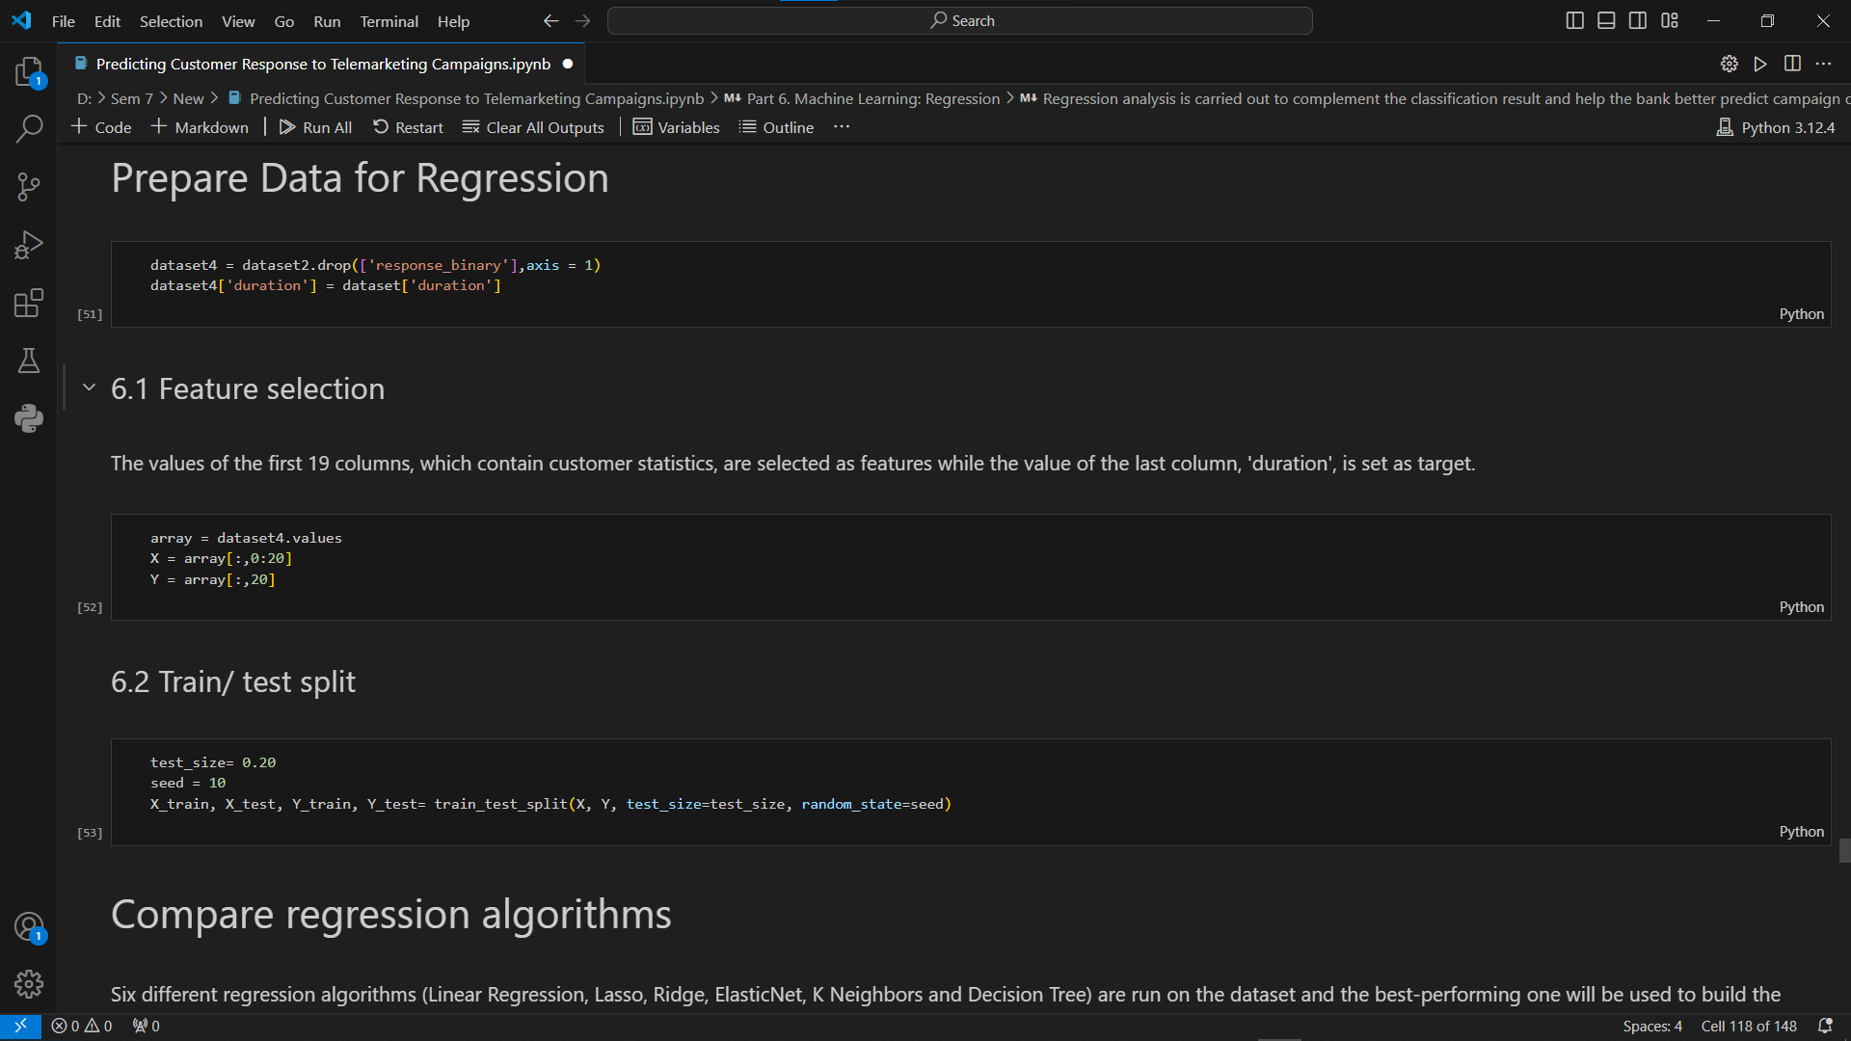

Slide 21
5. Conclusion
According to previous analysis, a target customer profile can be established. The most responsive customers possess these features:
* Feature 1: age < 30 or age > 60
* Feature 2: students or retired people
* Feature 3: a balance of more than 5000 euros

Slide 22
By applying logistic and ridge regression algorithms, classification and estimation model were successfully built. With these two models, the bank will be able to predict a customer's response to its telemarketing campaign before calling this customer. In this way, the bank can allocate more marketing efforts to the clients who are classified as highly likely to accept term deposits, and call less to those who are unlikely to make term deposits.
In addition, predicting duration before calling and adjusting marketing plan benefit both the bank and its clients. On the one hand, it will increase the efficiency of the bank’s telemarketing campaign, saving time and efforts. On the other hand, it prevents some clients from receiving undesirable advertisements, raising customer satisfaction. With the aid of logistic and ridge regression models, the bank can enter a virtuous cycle of effective marketing, more investments and happier customers.

Slide 23
6. Future Enhancement
Recommendations
1. More appropriate timing
When implementing a marketing strategy, external factors, such as the time of calling, should also be carefully considered. The previous analysis points out that March, September, October and December had the highest success rates. Nevertheless, more data should be collected and analyzed to make sure that this seasonal effect is constant over time. If the trend has the potential to continue in the future, the bank should consider initiating its telemarketing campaign in fall and spring.

Slide 24
2. Smarter marketing design
By targeting the right customers, the bank will have more and more positive responses, and the classification algorithms would ultimately eliminate the imbalance in the original dataset. Hence, more accurate information will be presented to the bank for improving the subscriptions. Meanwhile, to increase the likelihood of subscription, the bank should re-evaluate the content and design of its current campaign, making it more appealing to its target customers.
3. Better services provision
With a more granular understanding of its customer base, the bank has the ability to provide better banking services.

Slide 25
Digital Images Retrieved From
https://www.geeksforgeeks.org/data-preprocessing-machine-learning-python/
https://www.jejurtv.com/blank-6
https://giphy.com/gifs/animation-animated-l378c04F2fjeZ7vH2
http://algolytics.com/tutorial-how-to-determine-the-quality-and-correctness-of-classification-models-part-1-introduction/
https://sendiancreations.com/our-marketing-services/best-motion-graphics/opening/
https://www.agencialorean.com.br/conteudos/ineficaz-organico

Slide 26
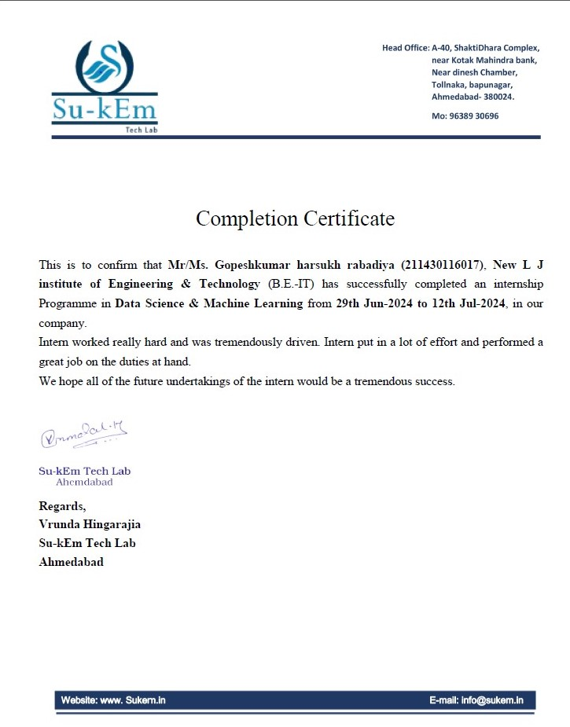
7. Completion Certificate(Company/Course)

Slide 27


