Slide 1
GRUBHUB
An Online food Delivery app
Group 9:
Chengyuan Huang
Aritra Biswas
Gopesh Vijayvergiya
Cynthia Sharon
Ashi Sharma

Slide 2

GrubHub is an online and mobile food ordering platform that connects hungry diners with local restaurants. It enables users to order food from nearby restaurants.

Slide 3
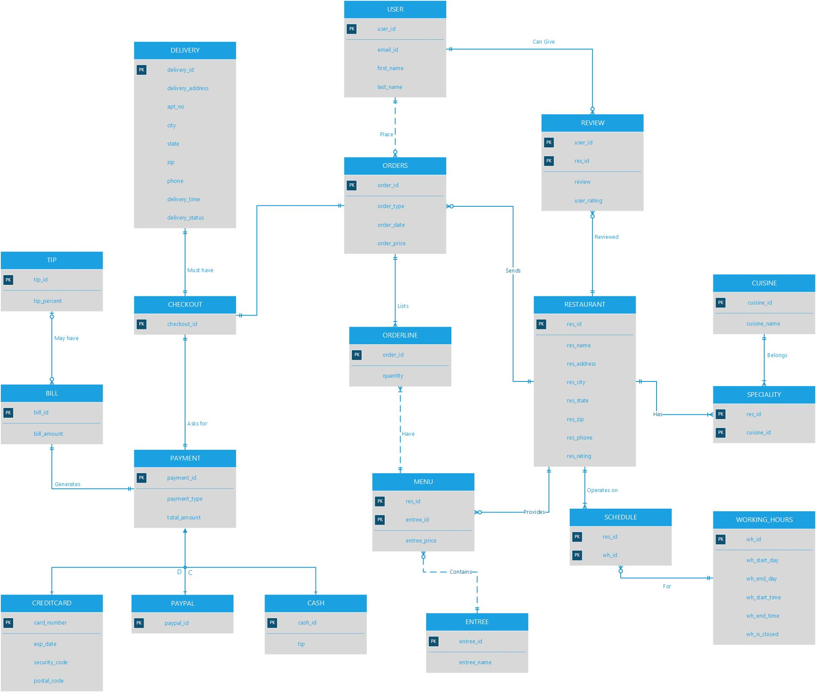
ERD Diagram

Slide 4
ERD Short Explanation
Users can register for GrubHub using their email id or can login into the app using their Facebook account. Each user will have an email_id, password, first name, last-named.
Users can save their Payment details and each user can have none or many payment details saved. Payment details can save only credit cards and will have a unique payment, detail_id, card number, expires on, security code and postal code. At the checkout, the user will have these three payment options: Credit card, Amex and PayPal.
Each user can browse many Restaurants by cuisine, cities, zip codes
Restaurant will have a unique restaurant id, restaurant name, restaurant address, restaurant city, restaurant state, restaurant zip, operating hours
Each restaurant has a menu of Items from which a user can order and a restaurant will have atleast one item and an item can belong to many restaurants. Items will have a unique item id, item name, item description, item price.
Each user can place only one Order at a time but can have many past orders associated with him/her. An order can contain many items.
An order will have an order id, item id, item quantity, total amount and delivery type (home delivery or pick up).

Slide 5
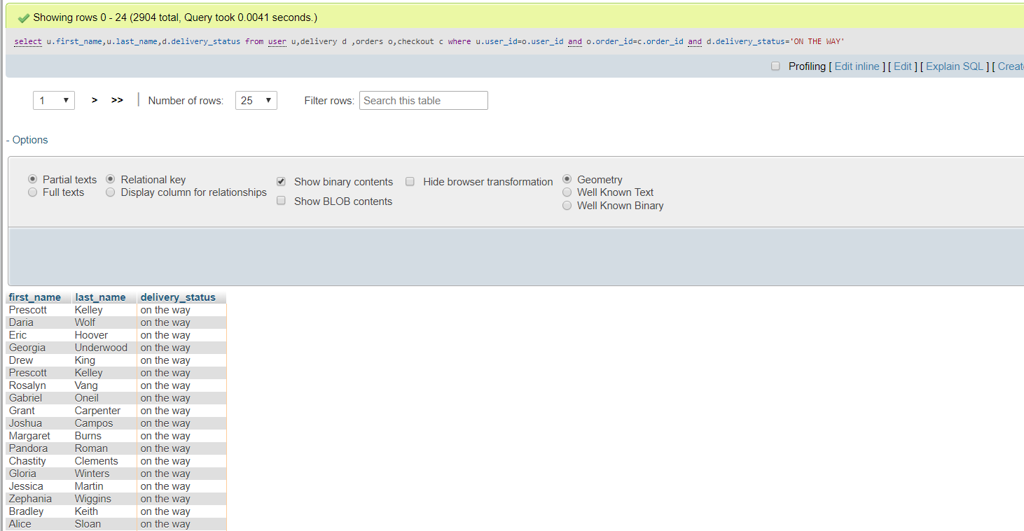
Queries –Scenario 1 List of users who are having order on the way
Select
u.first_name,u.last_name,d.delivery_status
from user u,delivery d ,orders o,checkout c
where u.user_id=o.user_id
and o.order_id=c.order_id
and d.delivery_status='ON THE WAY';

Slide 6
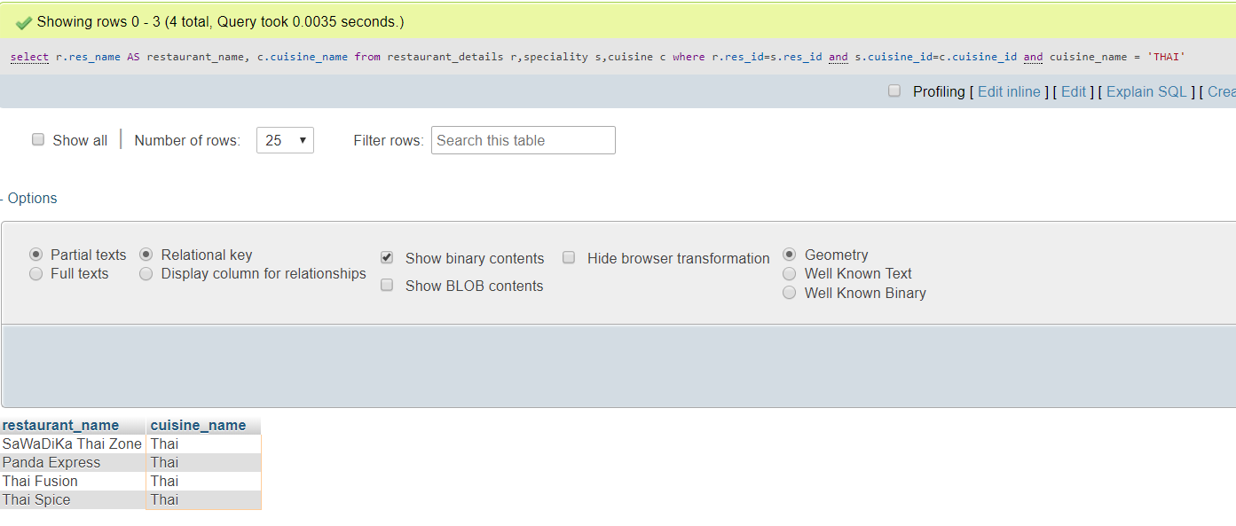
Scenario – 2 List all the restaurants with THAI cuisine
select r.res_name AS restaurant_name, c.cuisine_name
from restaurant_details r,speciality s,cuisine c
where r.res_id=s.res_id
and s.cuisine_id=c.cuisine_id
and cuisine_name = 'THAI‘

Slide 7
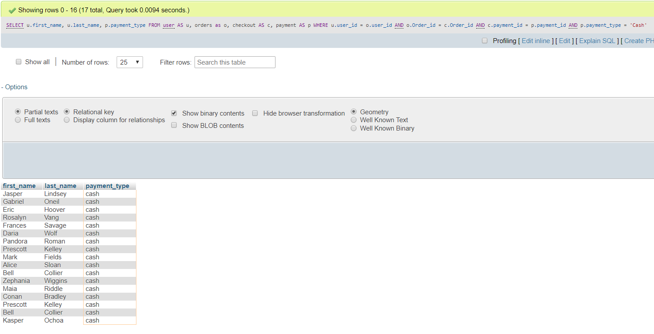
Scenario 3 Users who paid by cash
SELECT u.first_name, u.last_name, p.payment_type
FROM user AS u, orders as o, checkout AS c, payment AS p
WHERE u.user_id = o.user_id
AND o.Order_id = c.Order_id
AND c.payment_id = p.payment_id
AND p.payment_type = 'Cash'

Slide 8
Scenario – 4 People who ordered for more than 25$
select DISTINCT u.first_name, u.last_name,u.email_id, r.res_name,o.Order_id,o.Order_type,o.order_price,c.payment_id,p.payment_type, e.entree_name,i.quantity
from user as u, restaurant_details as r, orders as o, menu as m, orderline as i, checkout as c,payment as p, entree_details as e
where u.user_id=o.user_id
and r.res_id=o.res_id
and i.order_id=o.Order_id
and c.Order_id=o.Order_id
and i.entree_id=m.entree_id
and c.payment_id=p.payment_id
and e.entree_id=m.entree_id
group by r.res_name
HAVING o.order_price > 25

Slide 9
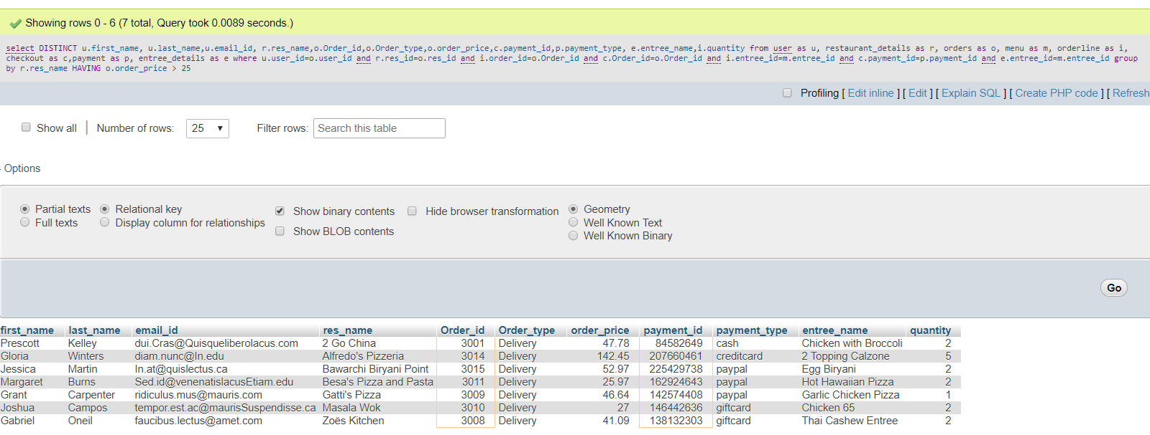

Slide 10
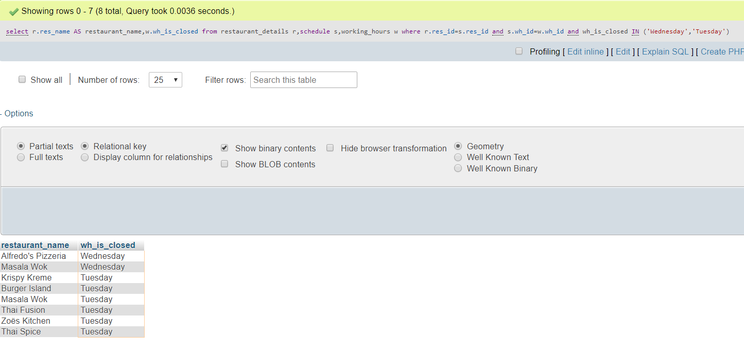
Scenario- 5 List all the restaurants that are closed in Wednesdays or Tuesdays
select r.res_name AS restaurant_name,w.wh_is_closed
from restaurant_details r,schedule s,working_hours w
where r.res_id=s.res_id
and s.wh_id=w.wh_id
and wh_is_closed IN ('Wednesday','Tuesday')

Slide 11
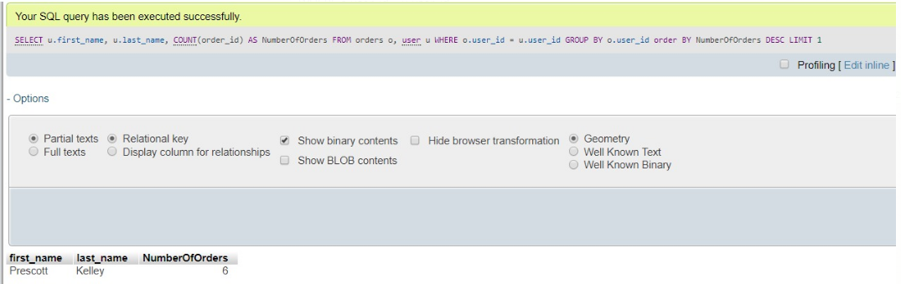
Scenario – 6 User having the highest number of orders
SELECT u.first_name, u.last_name, COUNT(order_id) AS NumberOfOrders
FROM orders o, user u
WHERE o.user_id = u.user_id
GROUP BY o.user_id
order BY NumberOfOrders
DESC LIMIT 1;

Slide 12
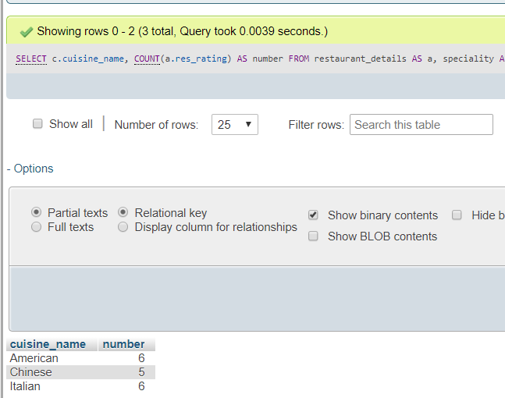
Scenario 7 The number, name of each kind of cuisine which get ‘4’ and above rate
SELECT c.cuisine_name, COUNT(a.res_rating) AS number
FROM restaurant_details AS a, speciality AS b, cuisine AS c
WHERE a.res_id=b.res_id AND b.cuisine_id=c.cuisine_id
GROUP BY c.cuisine_name
HAVING number > 4

Slide 13
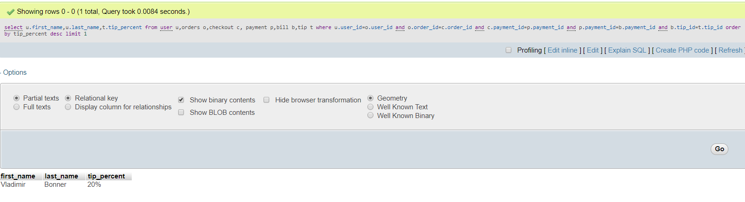
Scenario 8 Person who paid with highest tip
select u.first_name,u.last_name,t.tip_percent
from user u,orders o,checkout c, payment p,bill b,tip t
where u.user_id=o.user_id
and o.order_id=c.order_id
and c.payment_id=p.payment_id
and p.payment_id=b.payment_id
and b.tip_id=t.tip_id
order by tip_percent desc limit 1;

Slide 14
New Feature
There are lot of options to pay using smart device like the apple payment and Samsung payment.
We have decided to include the same in the grub hub feature, where the customer has the option to pay using apple or Samsung money. We have included this in the cash on delivery option.
The Grub hub delivery man can have the scanning device by which the customer can pay through apple or Samsung money.
We have added sub type entities for the cash entity. Hence cash is the parent entity and apple and Samsung are the child entity. Apple pay has the apple id and the Samsung pay has the Samsung id.

Slide 15
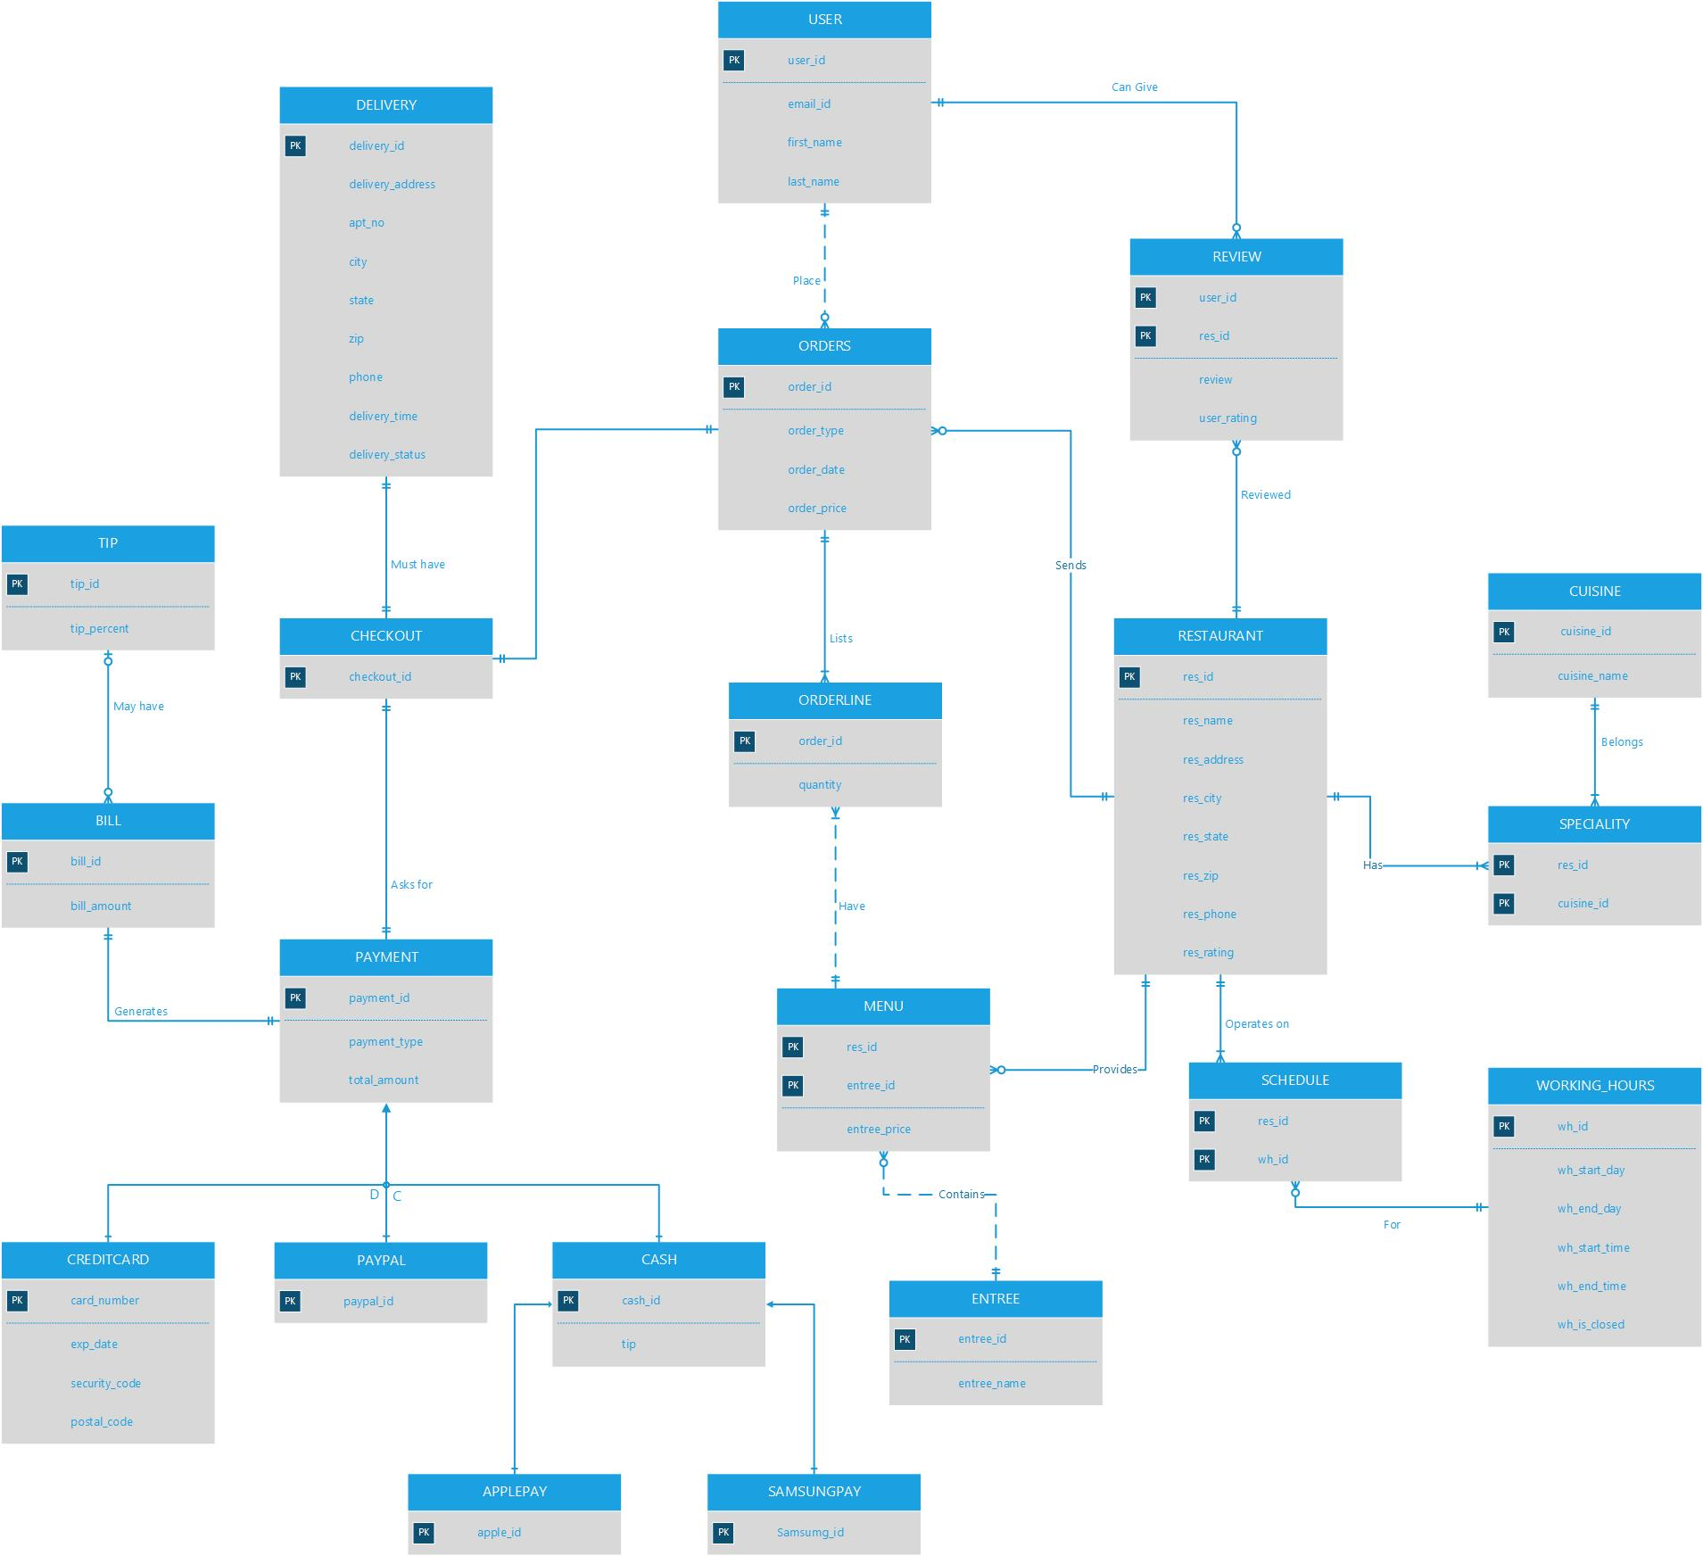

Slide 16


