Slide 1
Sandboxing DuckDB with io/fs
Achille Roussel, GopherCon 2026

Slide 2

Who am I?
Co-Founder, CTO https://firetiger.com
Gopher since 2014
Open-source author and contributor
Notes:
Hello everyone, thank you all for being here.
My name is Achille, I'm currently the Co-Founder and CTO of Firetiger, where we develop AI agents that verify your code changes in production.
I've been using Go since 2014 and authored and contributed to a bunch of projects, including the Go runtime and compiler.

Slide 3
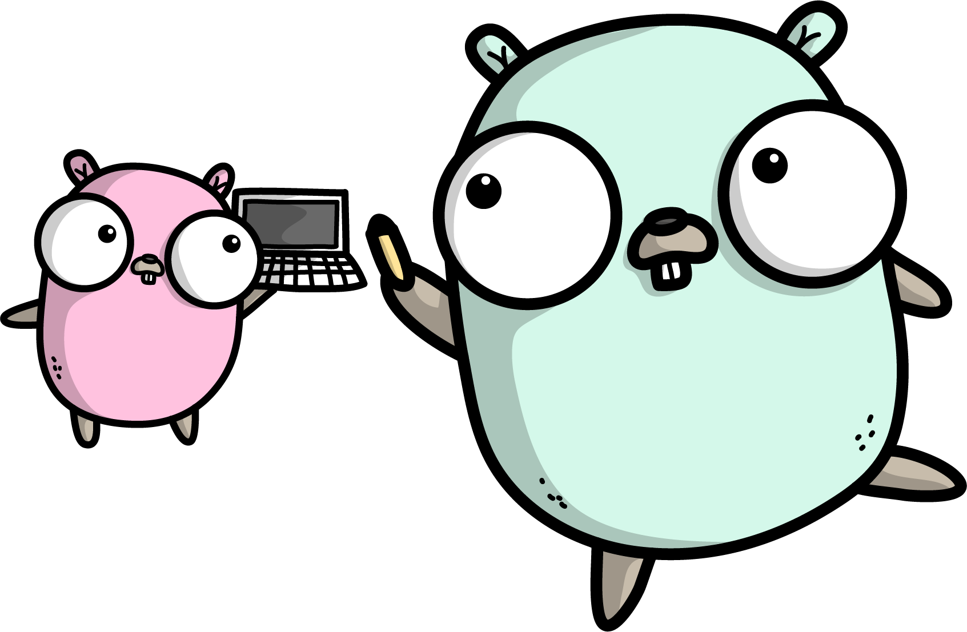
What are we talking about today?
DuckDB
CGO
io/fs
github.com/firetiger-oss/go-duckfs
Notes:
Today I’ll be talking about a project I started about two years ago called go-duckfs.
It’s a Go package that does only one thing: it lets you mount a Go file system on a DuckDB instance.
This is effectively a sandboxing mechanism, because it allows the Go application to capture all I/O operations that are performed by an embedded DuckDB instance.
This is code that we have heavily used in production, all data access that our agents do use a query engine based on DuckDB and this package.
I’m going to cover why we chose to develop this package, what challenges we encountered using CGO for the implementation, how we solved them, and what it enabled for us.

Slide 4
What is DuckDB?
Embedded database for analytics
Full SQL support
Query anything! (csv, json, parquet)
Notes:
A few words about what DuckDB is.
It’s an embedded SQL database optimized for analytics workloads: it's not a database server, it's a library you include in your application. It’s designed to leverage columnar file formats to support really high-performance queries.
But it can query almost anything. Whether it's a CSV, JSON, Parquet, or any of the dozens of formats that it supports, you can use it as your swiss-army knife wherever you need your application to query data.

Slide 5
What is DuckDB?
SELECT * FROM 'records.csv';
SELECT * FROM 'events.json';
SELECT * FROM 's3://bucket/table/*.parquet';
Notes:
I’m showing here a couple of examples of how you’d query various files with DuckDB.
Under the hood, the engine builds one logical query plan, and then derives a physical plan for each data source, doing predicate pushdown whenever the source allows for it.
There's also a large number of community extensions, and this is where it gets a little bit crazy.
There are extensions to query pretty much anything anywhere.
Because it's all SQL, you can join across all of these data sources in a single query.
It’s really powerful, it’s open-source, but there’s one problem…

Slide 6

It’s written in C++
Notes:
It’s written in C++
In the Go ecosystem, we have a strong tendency to rewrite everything in Go. And nowadays with coding agents, rewriting has never been cheaper. The bar for deciding whether rewrite or reuse has shifted really far towards rewrite.
Rewrite is very tempting, but in this case it would be the wrong call, there has been so much research and engineering injected into developing DuckDB, it wouldn’t be effective to restart from scratch just to have a Go version, so using CGO here is still the right call.
But obviously, it comes with a set of challenges.

Slide 7


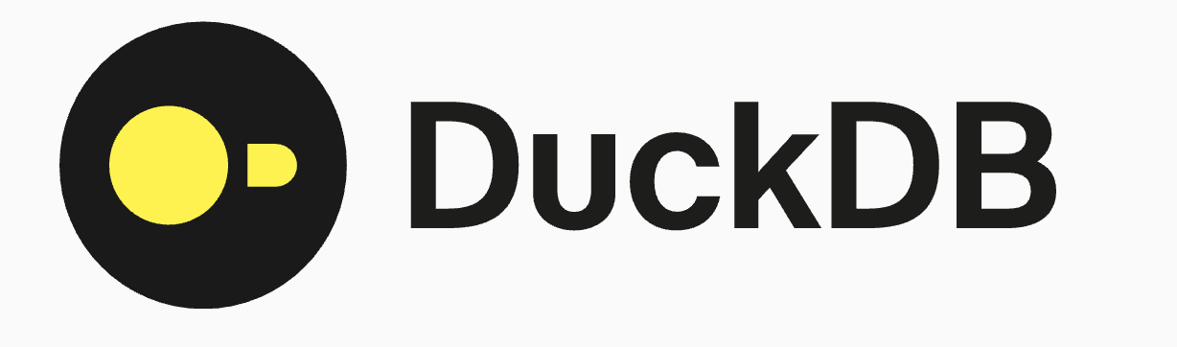
How are we using DuckDB?
S3
SQL
Agent
Notes:
Quickly to illustrate before I dive into those challenges, this architecture diagram shows where it sits in our stack.
Agents generate SQL statements and tools calls to execute the queries, which are sent over RPC to a server written in Go.
The server handles functions like authentication and instrumentation, then builds the query context including the DuckDB instance, and runs the query on behalf of the agent against an object store like S3 that contains the customer’s data.

Slide 8
What could go wrong?
Difficult to build
Competing I/O stacks
Credential management
Instrumentation / Debugging / Performance
Notes:
So we embedded a C++ query engine in a Go service. And I want to ask you all, what could possibly go wrong?
Even if CGO is the right call, we still inherit a bunch of problems.
It’s more difficult to build, even if the go build command tries to abstract away a lot of that complexity, we still involve a second compiler and linker in the build system, which are more difficult to use and much slower than go.
We also end up with two I/O stacks: one for the Go code which uses the io and net packages, and another for the C code which issues syscalls directly.
Things like credential management becomes even more of a pain: the C code makes its own network requests, it has to be given the authentication tokens somehow.
And then things that we take for granted in Go programs like instrumenting the application with OpenTelemetry or debugging performance problems with pprof… none of this works in the C code.
We intended to run a SQL query, and we’re several layers down the rabbit hole dealing with problems that have nothing to do with our original goal.
That’s where the fun engineering work starts, let’s see how we solved each of those problems.

Slide 9
Keeping builds deterministic
Static linking → slow
Dynamic linking → weird
Notes:
Starting with the build issues. Go is opinionated, it says programs are statically linked binaries.
But when we build with CGO we now have to decide if we’re going to use static or dynamic linking.
Intuitively, I thought i would be better to stick with static linking because that’s how we do things in Go and it would likely remove a bunch of problems.
But statically linking C++ code is so slow, it was completely impractical, it literally added minutes to each go build command.
Dynamic linking avoid this, but it’s weird.
Now our program is in two separate files, and if the version of the dynamic library doesn’t match the one we built against, then we get weird missing symbol errors and we can’t even start.
We chose to use dynamic linking because we needed the build times to be fast, but we had to figure out how to keep the build deterministic to avoid those weird problems.

Slide 10
Keeping builds deterministic
FROM ghcr.io/prefix-dev/pixi:latest AS pixi
WORKDIR /src
COPY pixi.toml pixi.lock .
RUN pixi install --locked
Notes:
We solved this at the docker image layer using the multi-stage build.
The first layer installs the pixi package manager, copies the pixi files that describe which version of DuckDB we target, and then installs the pre-built binary.

Slide 11
Keeping builds deterministic
FROM golang:1.25 AS build
WORKDIR /src
COPY --from=pixi /src/.pixi .pixi
COPY . .
ENV CGO_LDFLAGS="-L/src/.pixi/envs/default/lib -lduckdb"
RUN go build -tags=duckdb_use_lib
Notes:
The second stage copies the DuckDB binary over along with the application sources, and builds the Go program with those flags to enable dynamic linking.
This gives us a best-of-both-worlds solution: the docker build caches each layer so we don’t reinstall DuckDB each time, and the package manager ensures that we target a specific version of the library thank to the lock file, to ensure that the builds remain deterministic.
This model saved us from a lot of initial headaches when trying to compile programs that embedded DuckDB.
If you’re using CGO, I recommend that you consider using a package manager like pixi to manage your C dependencies.

Slide 12
Two I/O stacks = too many problems
Usability
Performance
Observability
Security
Notes:
Alright, on to the run time problems now.
First, usability problems: for example, dealing with credentials. When the C code has their own HTTP client, they manage authentication independently from the rest of the application, we need to figure out how to pass credentials from the main program into the C layer. Often times the C client behaves slightly differently. Personally, that’s the kind of problems I already don’t like to solve once, so having to do it twice is a no-go.
We also hit a lot of performance problems that just don’t exist in Go, because the C code manages its own thread and connection pools. When your queries are slow because you exhausted a connection pool within the C layer, good luck debugging this problem.
Because we also lose all observability when going through C: the trace context doesn’t propagate, we can’t even add counters or logs because the C code goes directly to the kernel for I/O.
Last but not least, it also comes with a bunch of security concerns. Half of the application is using the random TLS library that happened to be installed on the OS instead of the net/tls package already built into the application. This is 2x the threat surface, really not the kind of problems we want to be dealing with.

Slide 13
SELECT * FROM 'gophers.parquet';
VFS: open("gophers.parquet")
Notes:
Thankfully, DuckDB is very well designed, and all I/O goes through one virtual file system abstraction.
By default, DuckDB ships with an implementation that uses the local file system, but several extensions provide their own VFS, to support reading from remote object stores for example.

Slide 14

Virtual File Systems in Go: io/fs
Can we mount a Go fs.FS as virtual file system under DuckDB?
Notes:
So it seemed plausible that we could write an extension letting us mount a Go file system using the io/fs package.
If we can mount an FS instance as the virtual file system on DuckDB, then we would capture all I/O performed by the query engine, and we’d have a primitive we can use to solve for all the problems that were introduced by embedding this library.
Easier said than done.
Alright, let's get into the juicy stuff: how do you actually build this? Now I’m going to get into the more dense part of the talk: I want to show you the main challenges we faced within the implementation, and how we solved them.

Slide 15
io/fs: abstracting virtual file systems
package fs type File interface { Read(b []byte) (int, error) Stat() (FileInfo, error) Close() error }
Notes:
The io/fs package is built around two core interfaces.
The File interface represents a file handle that you can read from, get metadata, and close when we’re done with it.
You have examples of types implementing this interface in the standard library, like os.File

Slide 16
io/fs: abstracting virtual file systems
package fs type FS interface { Open(name string) (File, error) }
Notes:
The second interface represents the file system, and it’s one of those powerful single-method interfaces.
The only operation common to all file systems is opening a file based on its name or path.
And that’s it, that’s all we have to work with, it’s a simple API.
The goal is to make DuckDB call this Open method on an FS instance, and have it use the returned File handle to read data.
Unfortunately it’s not that simple, due to the rules of CGO. Let me illustrate.

Slide 17
Mounting fs.FS as Virtual File System
conn, err := duckfs.Open("", nil, os.DirFS("./gophercon"))
...
db := sql.OpenDB(conn)
defer db.Close()
rows, err := db.Query(`SELECT name FROM 'gophers.parquet'`) ...
Notes:
This is how an application uses the duckfs package, there’s only one function called duckfs.Open, which constructs a DuckDB connector pre-configured with the Go file system passed as argument.
Then the returned connector can be used to construct a sql.DB and issue SQL queries, from there, it’s your typical database/sql code.
What we don’t see here, si that underneath, the code will have used the FS instance to open a File handle and read data.
But a major constraint we have to deal with is that we’re not allowed to return a Go pointer from a function invoked by C.
This constraint exists because the garbage collector cannot track Go pointers that are copied into C memory.
So our job is to explicitly retain all Go objects that will be accessed from C.
Basically, we have to do manual memory management in the duckfs package.

Slide 18
CGO: mapping handles to Go objects
var (
globalFsys filemap[fs.FS]
globalFiles filemap[fs.File]
)
type filemap[T comparable] struct { ... } func (m *filemap[T]) lookup(id int32) (T, bool) func (m *filemap[T]) register(value T) int32 func (m *filemap[T]) unregister(id int32) (T, bool)
Notes:
We solve it in duckfs with this filemap type, which maps Go objects to numeric identifiers, similar to a file descriptor.
All Go objects that must be accessed from C are tracked in those global maps.
The id can be passed to C, there is no problem with this, and we rely entirely on DuckDB for the lifecycle management.

Slide 19
CGO: mapping handles to Go objects
//export duckfs_file_open
func duckfs_file_open(id C.int, path *C.char) C.int {
p := C.GoString(path)
fsys, ok := globalFsys.lookup(int32(id))
...
f, err := fsys.Open(p)
...
return C.int(globalFiles.register(f))
}
Notes:
When an object is created by a C call, it is registered in one of those global maps.
When DuckDB closes a file, the object is unregistered, and the garbage collector to eventually reclaim them.
Here is to illustrate the duckfs_file_open function, which is the Go function invoked when DuckDB opens a file.
The id it gets as argument is the id of the file system instance, we look it up in the global map of file systems currently registered, then we call its Open method which returns a File object.
That File object is then registered in the global map of files, and its corresponding identifier returned to DuckDB.

Slide 20
CGO: mapping C calls to fs.FS
class GoFileSystem : public FileSystem {
public:
GoFileSystem(int id) :
FileSystem(),
id(id) {
} ...
}
Notes:
Let’s look at the other side, what does the implementation look like within the DuckDB extension.
Something that was surprising to me was to realize how similar the abstractions were: DuckDB and the io/fs package use the exact same model.
There’s a C++ class representing the file system, and another class for the file handles.
That’s nice because it makes our job straightforward.
In our DuckDB extension, we extend those C++ classes as types that hold the identifiers representing the corresponding Go objects.
That’s how we maintain the mapping between C++ and Go objects.

Slide 21
CGO: mapping C calls to fs.FS
class GoFileHandle : public FileHandle {
public:
...
~GoFileHandle() override {
duckfs_file_close(this->id);
}
...
}
Notes:
Similarly the FileHandle class embeds the id representing the corresponding fs.File object on the Go side.
What I’m showing here is a special method in C++, it’s the destructor.
The destructor is called by DuckDB when the object is not needed anymore, and our implementation simply calls the duckfs_file_close function, which is declared in the Go code as a CGO function.
When called, it receives the id of the file that’s being destroyed, and we can unregister the corresponding fs.File object and close it.
That’s how we synchronize the lifecycle of the Go objects on the lifecycle of the C++ objects managed by DuckDB.

Slide 22
CGO: context.Context propagation
// BROKEN: ctx not passed to VFS
rows, err := db.QueryContext(ctx,
`SELECT name FROM 'https://gophercon.com/gophers.parquet'`) ...
Notes:
Alright, the last challenge we faced that I wanted to talk about is context propagation.
The DuckDB driver supports context interrupts, but it has no way of propagating the context through the C call stack.
This context is coming from the incoming RPC request, it contains the identity of the caller, the tracing span, all the state that’s supposed to be passed through to all outbound requests.

Slide 23
CGO: context.Context propagation
func HTTPFS(ctx context.Context, client *http.Client) fs.FS { return &httpFS{ctx: ctx, client: client} } type httpFS struct { ctx context.Context client *http.Client
} func (fsys *httpFS) Open(name string) (fs.File, error) { ... return &httpFile{fsys: fsys, name: name}, nil }
Notes:
To solve for this, we use ephemeral FS objects.
For example, say we want to support querying remote files via http, we can provide an implementation of the FS interface that captures the context, then it can inject that context in the http requests that it creates.
This is where this model starts to really shine, you can see how we can inject pretty much anything within DuckDB by owning the file system layer.
We use this model extensively for testing as well, because we can inject pretty much anything we want in there.

Slide 24
CGO: context.Context propagation
conn, err := duckfs.Open("", nil, &httpFS{ ctx: ctx, client: http.DefaultClient,
})
...
Notes:
I’m calling it ephemeral because the idea is that this object will be created on demand for each incoming request we serve.
It captures the context of a single request, then gets throw away after the query returns.
Obviously we cannot trace what’s going on within the query engine itself, but we can propagate the context to all outbound I/O operations, and that’s enough for our use case.

Slide 25
Takeaways
Why reuse software with CGO
Deterministic builds with dynamic linking
Using io/fs to capture I/O from C land
Context propagation through C call stack
Notes:
Using CGO came with a bag of problems, but solving for those problems was much more effective than trying to rewrite the code in Go.
The problems we ran into were not unique to us, any application who embeds a significant piece of C code will run into the same issues.
First the build problems: in our case we solved it using dynamic linking and the docker build system to keep it but and still deterministic.
Then we had to deal with the the problem of having two I/O stacks in the application: we implemented a virtual file system for DuckDB using the io/fs package, allowing us to completely sandbox the query engine and capture all I/O operations.
And finally, we used this sandboxing layer to restore context propagation throughout the call stack, this allowed us to pass state like the caller identity or tracing context, so we could apply access control and retain deep visibility into our system’s behavior.

Slide 26
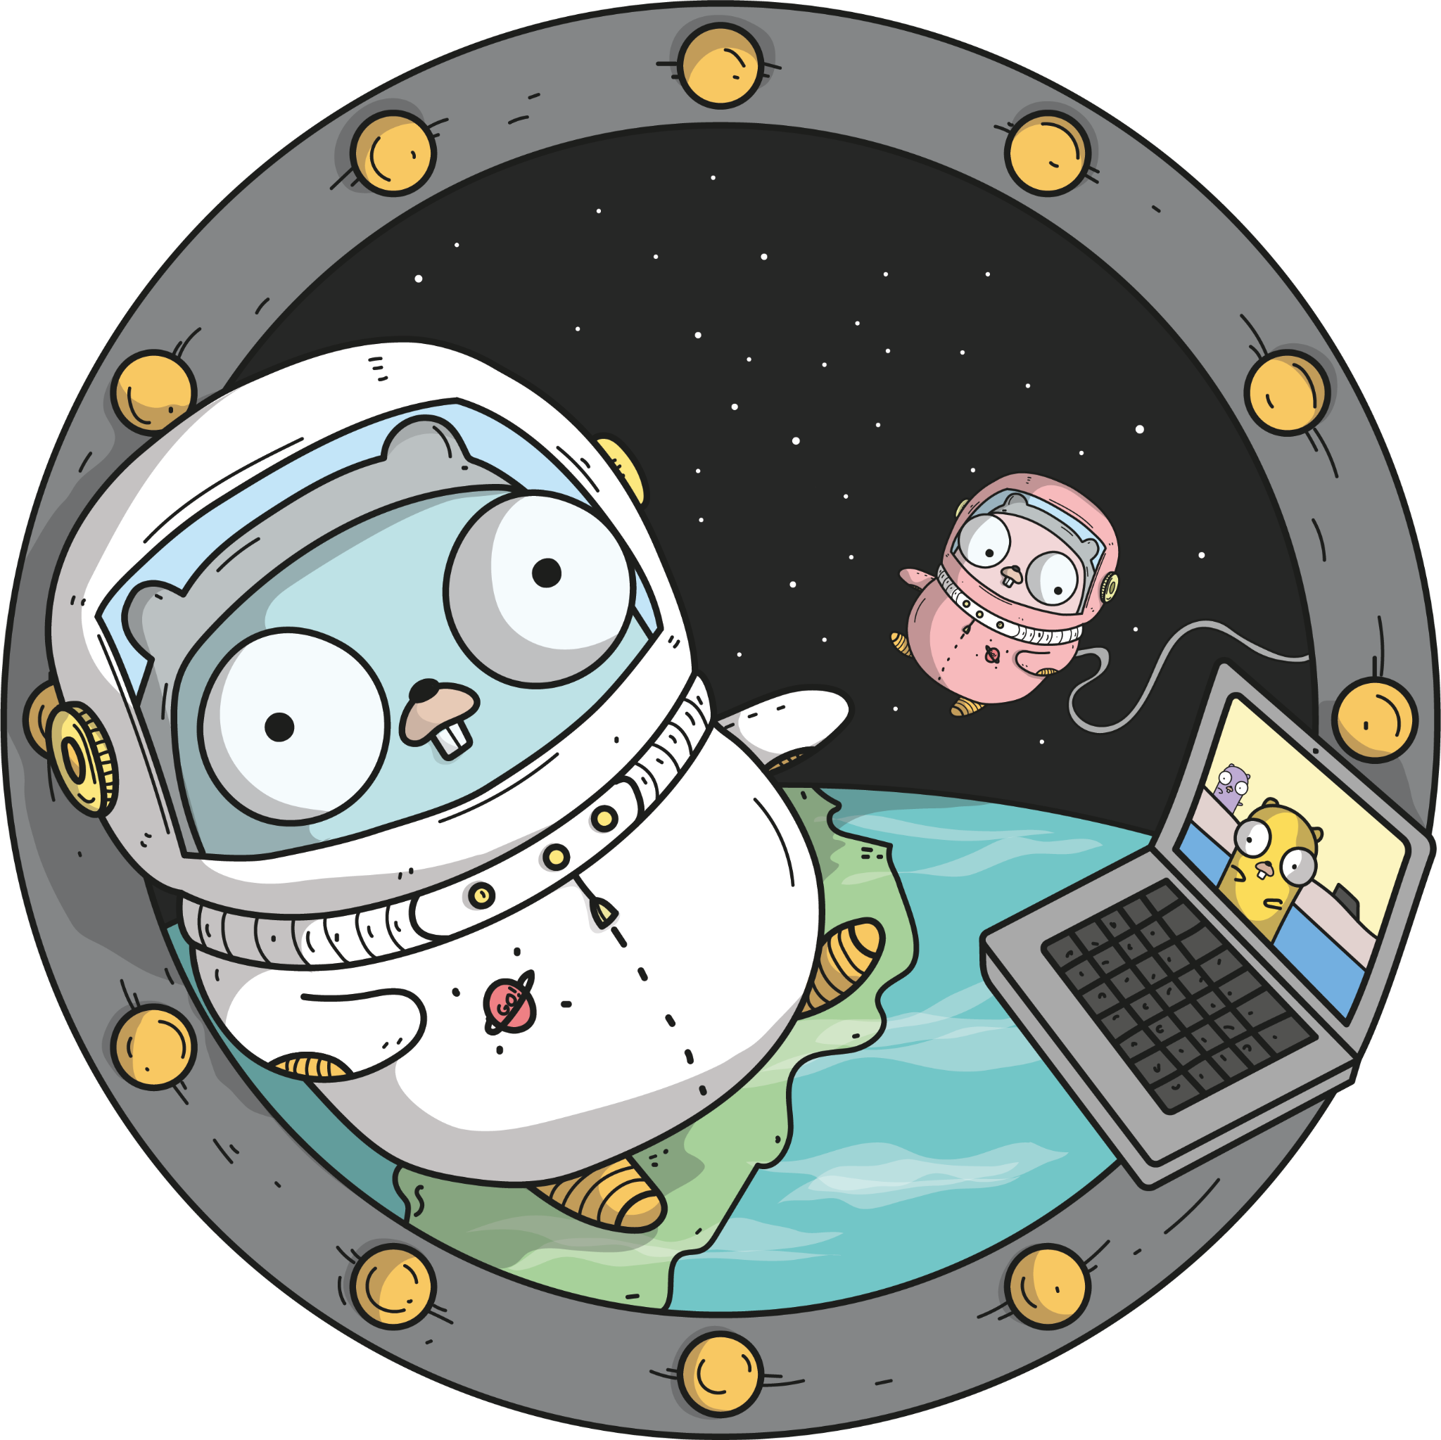
Sandboxing DuckDB with io/fs
Notes:
I hope this was useful, and next time you have to integrate a piece of C code in your Go application, you’ll be a bit more prepared for the challenges to expect, and have a few pointers as to how you can solve them.
Thank you.

