Slide 1



Unix Pipes Are Better Than Agents
DERICK SCHAEFER
Technology Leader, Developer, Author
Gopher Con 2026
Notes:
Hi, I’m Derick Schaefer. I designed and built Reserve, an unofficial, open-source, cross-platform CLI for exploring macroeconomic data. RESERVE is designed around the APIs provided by The Federal Reserve Bank of St. Louis’s FRED platform and is built in Go.
While building and testing RESERVE, I accidentally learned something about AI agents.
This learning changed how I think about command-line interfaces.
I’ll admit the title of this talk is intentionally provocative.
I’m not here to argue against agents.
I’m here to argue that one of their biggest challenges has already been solved……about fifty years ago.

Slide 2
The Shifting Boundary
> Unix Pipe
> Agentic
Economics Question
Agent
(Reason & Search)
Economics Question
Agent
(CLI Invocation)
CLI
get data
CLI
transform
CLI
analyze
Headlines
Reports
Data
API
Agent
(Reasoning)
Agent
(Reasoning)
Answer
Answer
Notes:
Right now, everyone seems to be moving intelligence as far left as possible.
Whether or not there is an MCP server in the mix, the expectation is that the agent understands everything, remembers everything, plans everything, and executes everything.
But Unix took a very different approach.
<CLICK>
For decades we've been moving determinism to the right.
Small programs.
Simple interfaces.
And Composable pipelines producing deterministic output
That difference is the heart of this talk.

Slide 3
Unix Philosophy
> Do one thing well.
>
> Work well with others.
Notes:
I assume most here are familiar with The Unix Philosophy.
Do one thing well.
Work well with others.
The only thing that's changed is who "others" are.
Today...
Others include agents.

Slide 4
Reserve
Command Surface
Get Data
<noun> <verb>
reserve obs get
reserve series list
reserve release get
Transformation
<verb> <verb>
reserve transform pct-change
reserve transform normalize
reserve release get
Analysis
<verb> <noun>
reserve analyze summary
reserve analyze correlation
reserve chart bar
> reserve obs get | reserve transform pct-change | reserve analyze summary
Notes:
Reserve follows exactly this philosophy. Built with Cobra, it organizes commands and sub-commands under three logical surfaces:
One command set retrieves data.
Another transforms it.
Another analyzes it.
Each sub-command is deterministic and has a single responsibility.
<CLICK>
The pipeline is where the complexity lives—not inside the individual commands.

Slide 5
An Economics Assignment
Compare today's credit regime with 2010. . .
Notes:
Now imagine putting on your macroeconomics hat and asking an agent a high-level question:
“Compare today’s credit regime with 2010” “That’s economics speak for How Easy Is It To Get a Loan from a Bank?”
There is no question that the model behind the agent can reason about economics.
Still, it has choices.
It could explore and create a plan or use Reserve to get right at the data
The problem is it has absolutely no idea how to drive Reserve.
Unless...
Reserve can progressively teach it.
That became the experiment.

Slide 6
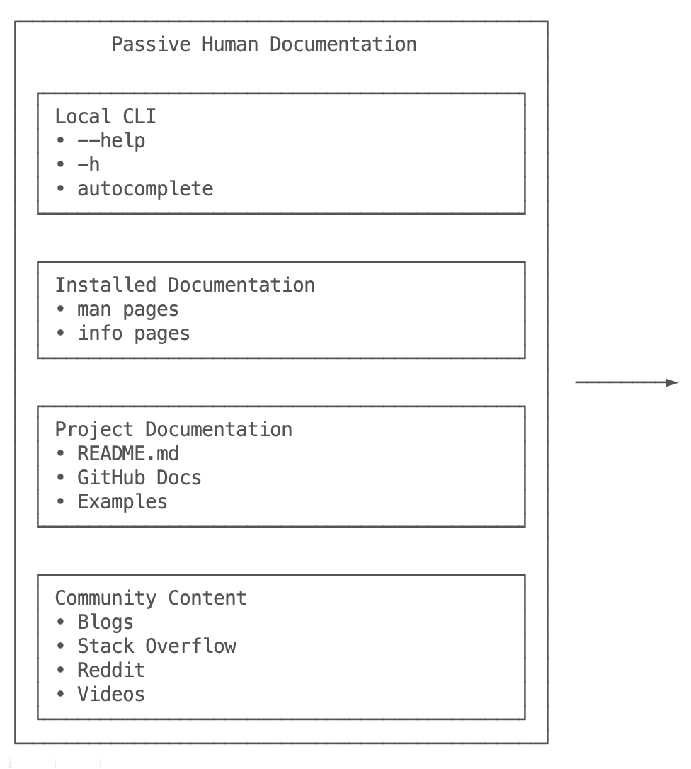
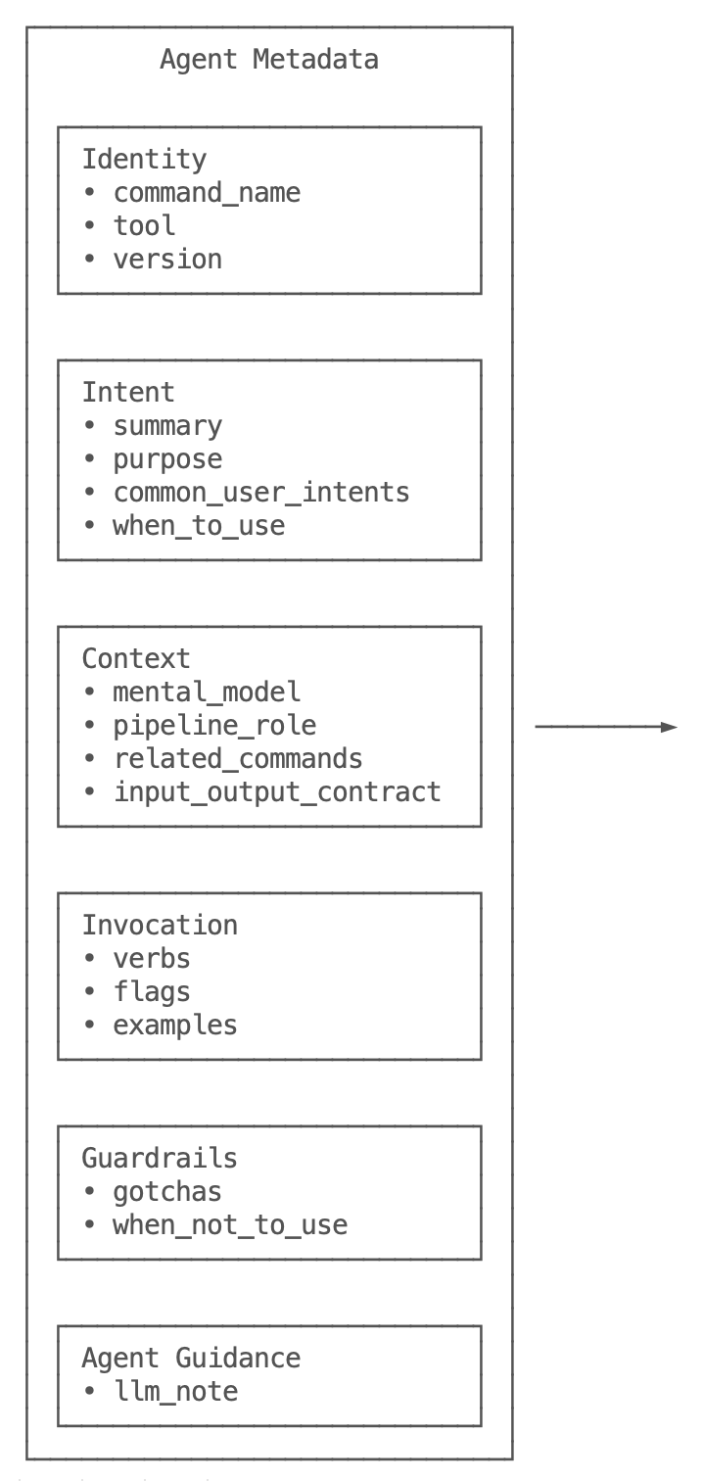
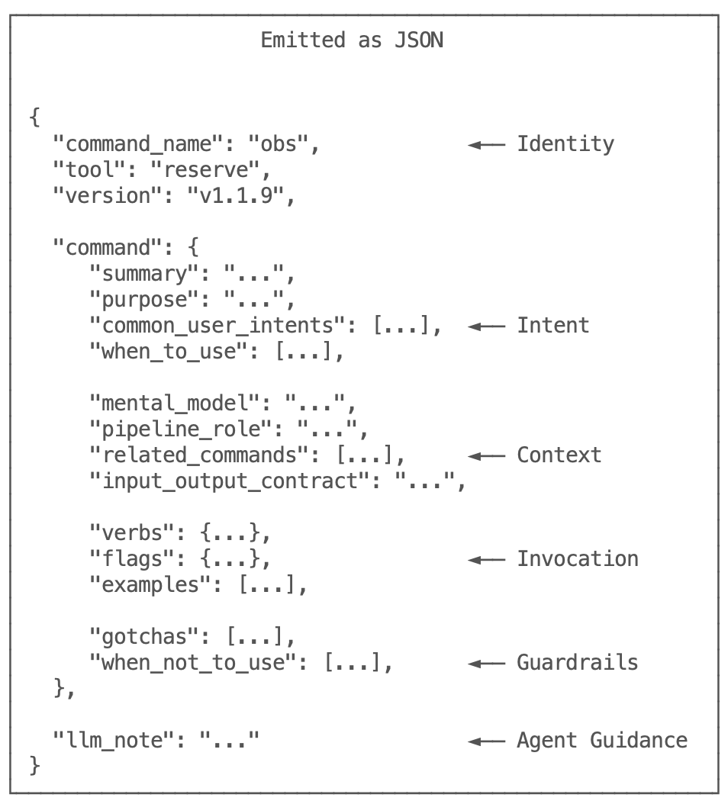
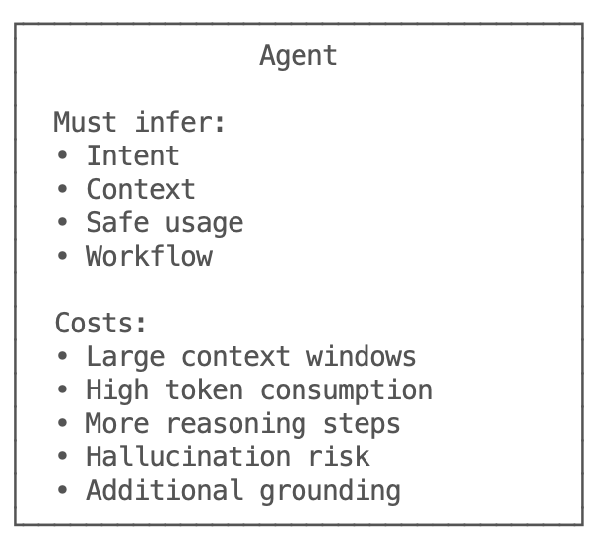
Documentation Problem
Notes:
Humans read documentation. . . .Agents consume structure.
When agents can’t find it, they spend tokens creating it.
Instead of assuming an agent would scrape a README or infer behavior from a HELP flag. Reserve publishes structured onboarding.
<CLICK>
The onboarding starts with a simple TOC and then every command describes:
its identity, . . .its intent,. . .its context,. . . how to invoke it,. . .common mistakes,. . .and real pipeline examples.
Instead of making the agent infer how Reserve works, Reserve teaches the agent how to use it.
Additionally, its content is structured under a unified JSON schema to provide agents consistency throughout the command surface.

Slide 7
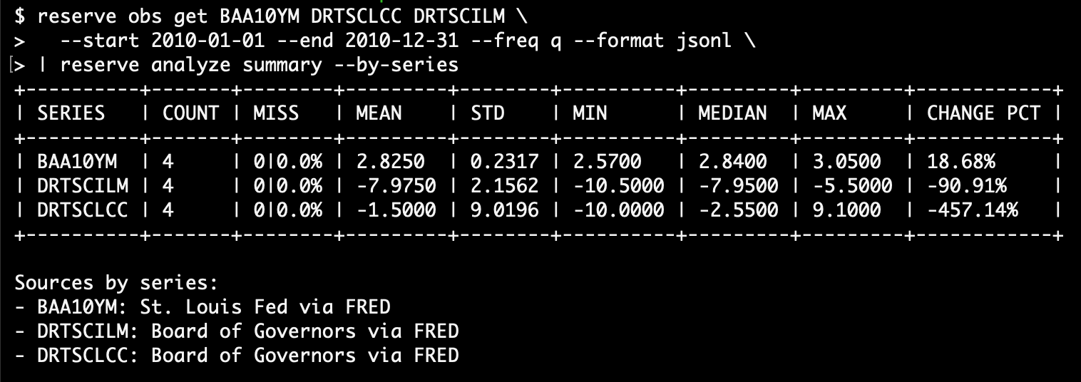
Precise Pipeline
reserve obs get BAA10YM DRTSCLCC DRTSCILM \
--start 2010-01-01 --end 2010-12-31 --freq q --format jsonl \
| reserve analyze summary --by-series
Notes:
Now the agent has enough information to generate deterministic pipelines prior to reasoning about our credit regime ask.
It doesn’t invent APIs.
It doesn’t hallucinate syntax.
It doesn’t rely on trial and error.
It composes commands, exactly like a Unix experienced economist would.
The interesting part isn’t that it wrote a pipeline.
It’s that it wrote the right pipeline—including concurrency, the required flags, and the correct data format.
<CLICK>
The result is meaningful data for credit regime analysis. I know this is a busy slide, but these 3 data points confirm that in 2010 the lending environments were fairly accessible.
.

Slide 8
Token Conservation
reserve onboard --topic all
reserve obs get --ai-onboard
2,700 lines of JSON
30K words
200K characters
Estimated 60K tokens required to process
3.6B potential token relationships
500 word average
1200 token average
21 commands sharing consistent JSON schema
98% reduction in token relationships
Notes:
Another part of this experiment was to analyze token usage based on the patterns.
Token conservation is a real consideration. Even with a focused approach, the onboarding document requires about sixty thousand tokens to process.
But an agent almost never needs all of it.
It follows the table of contents and reads only the commands it's interested in.
For most interactions...
that's closer to twelve hundred tokens. Because of the consistent JSON schema, the potential landscape of token relationships are greatly reduced.
The result is
Smaller context. Better focus. Better reasoning.

Slide 9
Conclusion
> "Unix Pipes Are Better Than Agents."
> “Unix Pipes Make Better Agents."
Notes:
So...
Are Unix pipes better than agents?
Maybe that's the wrong question..
What this experiment convinced me of is something slightly different.
Agents are good at reasoning.
CLIs are good at deterministic execution.
Rely less on hope and magic. Give agents structure and allow them to connect what they need through composition.
Maybe the finding is
<CLICK>

Slide 10

RESERVE & Repository Architecture Proposal Links
Derick Schaefer
schaeferauthor@gmail.com
https://github.com/derickschaefer/
Not affiliated with nor endorsed by Federal Reserve Bank of St. Louis
Notes:
If you’re interested in the implementation, Reserve is open source.
If you’re interested in the architectural ideas behind it, I’ve also published an accompanying paper.
The QR code will take you to these links and a copy of this presentation.
Thank you.

Slide 11
RESERVE Onboarding Approaches
Visual Studio Code or Claude Code
Prompt the agent, “I am going to use RESERVE to get some data. Onboard yourself with ./reserve onboard –topic toc
Claude or Chat GPT UI
reserve onboard export ./onboard <directory>
Upload the JSON files from <directory> into the project repo
Prompt the agent to get up to speed on RESERVE
Command Level
reserve onboard obs
Reserve onboard transform
Reserve onboard chart

Slide 12
Credit Regime Analysis
Credit spreads were narrower in 2025: BAA10YM averaged about 1.71% in 2025 versus 2.83% in 2010, suggesting lower perceived credit risk or less compensation demanded by investors.
Bank lending standards were much tighter in 2025: DRTSCILM moved from a mean of about -7.98 in 2010 to +10.18 in 2025, meaning C&I lending standards shifted from easing to tightening.
Consumer credit standards also tightened: DRTSCLCC moved from about -1.50 in 2010 to +7.40 in 2025, indicating a clear move from looser to tighter credit-card underwriting.
The overall regime shifted from a post-crisis, easing/repair backdrop in 2010 to a more selective, tighter-credit environment in 2025.
BAA10YM - Baa Corporate Bond Spread (10Y Treasury)
DRTSCILM - Banks Tightening C&I Loan Standards
DRTSCLCC - Banks Tightening Credit Card Standards

