Slide 1
GitHub Copilot instruction file for Java Developers
Using Copilot + Instructions File in IntelliJ IDEA

Slide 2
Agenda
How Copilot works with Java in IntelliJ IDEA
Using a Copilot instructions file for your team/project
Hands‑on Java examples to solve using instruction file

Slide 3
What is GitHub Copilot?
AI coding assistant from GitHub, powered by large language models (LLMs)
Understands your current file, project context, and comments
Suggests whole lines, blocks, or functions as you type
Supports Java, Spring Boot, tests, config files, and more
Integrates directly into IDEs like IntelliJ IDEA

Slide 4
What is a Copilot Instructions File?
A markdown file (e.g. copilot-instructions.md) checked into your repo
Gives Copilot extra context about your project and coding standards
Defines how you want code to be generated: style, patterns, frameworks
Acts like a shared "Project README" for the AI assistant
Helps teams get consistent, predictable suggestions across the codebase

Slide 5
Typical Contents of Instructions File
Project context: domain, key modules, and business terminology
Technology stack: Java version, Spring Boot version, testing frameworks
Coding style: naming conventions, package structure, logging standards
Architecture rules: hexagonal/clean architecture, layers, boundaries
Security, validation, and error‑handling guidelines
Examples of good code vs. code smells to avoid

Slide 6
Sample Instructions Snippet (Conceptual)
• Use Java 17, Spring Boot 3.x, and Spring Web for REST APIs.
• Prefer constructor injection, not field injection.
• Use SLF4J logging with parameterized messages and no System.out.
• For REST controllers, return ResponseEntity<T> with proper status codes.
• Unit tests must use JUnit 5 and Mockito; aim for readable, AAA style tests.

Slide 7
Java Example #1 – Spring Boot REST API
Goal: Generate a basic REST controller for Customer operations.
1. Add a comment like:
// Create a REST controller for /customers with CRUD methods using Spring Boot
2. Start typing class and method signatures – accept Copilot suggestions.
3. Ensure it follows your instructions file (constructor injection, logging, etc.).
4. Review and adjust response codes, validation, and error handling.

Slide 8
Java Example #2 – JUnit Test Generation
Goal: Create unit tests for a service class (CustomerService).
1. Open CustomerServiceTest.java (or create it).
2. Add a comment:
// Write JUnit 5 tests for CustomerService using Mockito, happy and error paths
3. Let Copilot propose test methods and assertions.
4. Verify proper mocks, interactions, and edge cases per project guidelines.

Slide 9
Java Example #3 – Refactoring Legacy Code
Goal: Improve readability and structure of a large legacy method.
1. Add a comment:
// Refactor this method into smaller, readable private methods, no behavior change
2. Start extracting methods; Copilot can suggest new method bodies and names.
3. Use Copilot to introduce value objects, enums, or records if appropriate.
4. Run tests to ensure behavior is unchanged.

Slide 10
Best Practices for Java Developers
Always review suggestions like code from a junior teammate.
Seed Copilot with good comments and meaningful method names.
Let the instructions file encode your team’s standards and architecture rules.
Use Copilot for repetitive patterns: DTOs, mappers, test scaffolding, configs.
Combine with static analysis and code review for safety and quality.

Slide 11
Pitfalls and Limitations
Copilot may hallucinate APIs or methods that don’t exist.
Generated code might not follow your performance or security constraints.
Large methods or unclear names lead to weaker suggestions.
Do not paste or describe highly sensitive data in prompts/comments.
Still need human design decisions, domain understanding, and reviews.

Slide 12
Rolling Out Copilot in Your Team
Start with a pilot group of experienced Java developers.
Define and maintain a shared copilot-instructions.md in each major repo.
Track productivity and quality metrics before/after the pilot.
Share examples of effective prompts and patterns in code reviews.
Expand usage gradually and refine instructions based on feedback.

Slide 13
Key Takeaways
GitHub Copilot can significantly speed up Java development in IntelliJ IDEA.
An instructions file guides Copilot towards your team’s standards.
Use Copilot heavily for boilerplate, tests, and refactors – review carefully.
Treat it as an assistant, not a replacement, for engineering judgment.
Next step: create an instructions file and try the example flows in your project.

Slide 14
Why Focus on the Instructions File?
The instructions file is the "brain" that guides Copilot in your repo.
Without it, suggestions are generic and may not match your architecture.
With it, suggestions follow your layers, naming, logging, and security rules.
Teams can encode tribal knowledge once and reuse it across microservices.
Great instructions file → higher‑quality suggestions → less rework.

Slide 15
Designing Your copilot-instructions.md
Keep it short, opinionated, and example‑driven (2–4 pages).
Split into sections: Domain, Tech Stack, Architecture, Coding Standards, Testing.
Prefer concrete rules over vague guidance.
Show small before/after Java snippets so Copilot learns good patterns.
Review & evolve the file just like production code (PRs, reviews, owners).

Slide 16
Java Class Scenario – Legacy CustomerService
public class CustomerService {
private CustomerRepository customerRepository;
private Logger logger = Logger.getLogger(CustomerService.class.getName());
public Customer findCustomer(String id) {
logger.info("Finding customer " + id);
Customer customer = customerRepository.findById(id);
if (customer == null) {
throw new RuntimeException("Customer not found");
}
return customer;
}
public void updateEmail(String id, String email) {
Customer customer = customerRepository.findById(id);
customer.setEmail(email);
customerRepository.save(customer);
System.out.println("Updated email for " + id);
}
}

Slide 17
Problems in This Class
Field injection for repository (harder to test, unclear dependencies).
Uses java.util.logging and System.out instead of standard SLF4J pattern.
Throws raw RuntimeException without error code or domain meaning.
No validation for id/email, no null checks on update path.
Business rules and technical concerns mixed together.

Slide 18
Instructions File – Rules to Fix This
• Use constructor injection for all Spring components (no field injection).
• Use SLF4J with parameterized logging; no System.out.println allowed.
• Service methods must throw domain‑specific exceptions (e.g. CustomerNotFoundException).
• All public service methods validate inputs and log at DEBUG/INFO, errors at ERROR.
• Repository access is wrapped in Optional to avoid null checks.

Slide 19
Refactored CustomerService – Guided by Instructions
@Service
public class CustomerService {
private static final Logger log = LoggerFactory.getLogger(CustomerService.class);
private final CustomerRepository customerRepository;
public CustomerService(CustomerRepository customerRepository) {
this.customerRepository = customerRepository;
}
public Customer findCustomer(String id) {
validateId(id);
return customerRepository.findById(id)
.orElseThrow(() -> new CustomerNotFoundException(id));
}
public void updateEmail(String id, String email) {
validateId(id);
validateEmail(email);
Customer customer = findCustomer(id);
customer.setEmail(email);
customerRepository.save(customer);
log.info("Updated email for customerId={}", id);
}
private void validateId(String id) {
if (id == null || id.isBlank()) {
throw new IllegalArgumentException("id must not be blank");
}
}
private void validateEmail(String email) {
// reuse shared validation util or pattern from instructions file
}
}

Slide 20
How Copilot Uses the Instructions File Here
You write a comment: // Refactor to use constructor injection and SLF4J logging per guidelines.
Copilot proposes a constructor + final fields instead of field injection.
Logging suggestions follow SLF4J pattern with placeholders and no string concat.
When you type Optional<Customer>, Copilot completes orElseThrow with custom exception.
Validation helpers and exception names follow examples from your instructions file.

Slide 21
Java Scenario – Incomplete OrderService
@Service
public class OrderService {
@Autowired
private OrderRepository orderRepository;
public void placeOrder(OrderRequest request) {
// TODO: implement later
}
}

Slide 22
Using Instructions File to Drive Implementation
Instructions define:
• Use transactional boundaries at service layer.
• Validate request DTOs using Bean Validation annotations and custom validators.
• Publish domain events for important state transitions.
Developer comment:
"// Implement placeOrder with validation, transaction, and domain event publishing"
Copilot suggests the full method skeleton aligned with these rules.

Slide 23
Prompt Patterns for Java + Instructions File
“// Using project guidelines, create a service method to …”
“// Following our logging and exception rules, handle error cases for …”
“// Generate JUnit 5 tests for this class, using Mockito as in the examples.”
“// Apply our hexagonal architecture style to split this logic into ports/adapters.”
“// Refactor to match the sample in copilot-instructions.md: …”

Slide 24
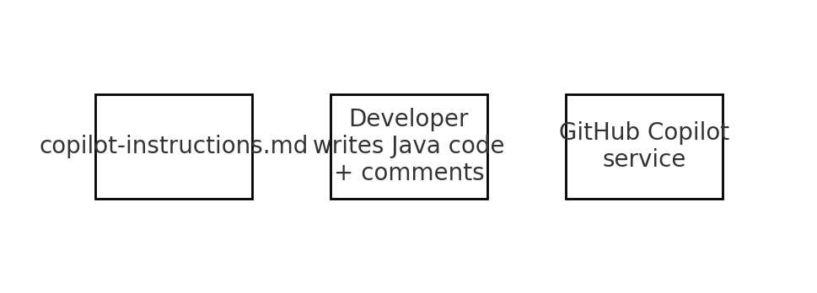
How the Instructions File Influences Suggestions
Animations idea: reveal each block and arrow step‑by‑step while explaining the flow.

Slide 25
Checklist for a Strong Instructions File
1. Opinionated rules
(no "it depends")
2. Short examples
(before vs after Java snippets)
3. Kept in sync
with architecture decisions

Slide 26
Real Instructions File Example (Excerpt)
# GitHub Copilot Instructions
## General Coding Principles
- Write clean, production-quality Java 17+ code.
- Follow SOLID and DRY principles.
- Use meaningful variable and method names.
- Prefer functional styles where appropriate.
- Avoid commented‑out code and unused imports.
## Formatting & Style
- Follow Google Java Format standards.
- Use 4‑space indentation; no tabs; max line length ~120 chars.
- Add a newline at the end of each file.
- Use consistent spacing around operators, commas, and keywords.
Tip: Animate each section (General, Formatting, Logging, Testing) to appear one-by-one while you explain.

Slide 27
How This Instructions File Steers Copilot
Copilot reads this file as part of the project context.
Suggestions for Java classes use Java 17+, SOLID, and your logging rules by default.
Null-handling, logging style, and method naming follow the examples in this document.
When you request tests, Copilot proposes JUnit 5 + Mockito patterns from the guidelines.
Code reviews can now ask: “Does this follow copilot-instructions.md?” instead of subjective preferences.

Slide 28
Example Java Class – RiskyBusiness (Before)
package com.syf.provider.apply.component.service.util;
import java.util.List;
public class RiskyBusiness {
private String name; // may be null
private List<String> items; // may be null
private Collaborator collaborator; // may be null
public RiskyBusiness() {
// default constructor, does no initialization
}
public RiskyBusiness(String name, Collaborator collaborator) {
this.name = name; // may be null
this.collaborator = collaborator; // may be null
}
public void printNameLength() {
// Potential NPE if name is null
System.out.println(name.length());
}
public void addItem(String item) {
// Potential NPE if items is never initialized
items.add(item);
}
public void processItems() {
for (String item : items) { // items or item can be null
System.out.println(item.toLowerCase()); // Potential NPE
}
}
public void doWorkWithCollaborator() {
// Deep potential NPE if collaborator is null
collaborator.printUpperCaseItems(items);
}
public static void main(String[] args) {
RiskyBusiness rb1 = new RiskyBusiness();
rb1.printNameLength(); // NPE
rb1.addItem("test"); // NPE
RiskyBusiness rb2 = new RiskyBusiness("Alice", null);
rb2.doWorkWithCollaborator(); // NPE
}
}
class Collaborator {
private String name;
public Collaborator(String name) {
this.name = name;
}
public String getName() {
// can return null
return name;
}
public void printUpperCaseItems(List<String> items) {
items.stream() // items might be null
.map(String::toUpperCase) // item might be null
.forEach(System.out::println);
}
}

Slide 29
What’s Wrong With RiskyBusiness.java?
Multiple potential NullPointerExceptions: name, items, collaborator, and individual list elements.
No constructor guarantees for invariants (fields may stay null forever).
System.out.println used for logging instead of SLF4J standard defined in instructions.
Collaborator API allows nulls and returns null from getter, pushing risk to callers.
No validation, no defensive programming, and no unit tests safeguard this behavior.
This class clearly violates several rules from copilot-instructions.md.

Slide 30
Using Instructions File to Fix RiskyBusiness
Add a guiding comment above the class:
// Refactor this class to follow copilot-instructions: null-safety, SLF4J logging, no System.out, Java 17 style.
Start rewriting the constructors; let Copilot propose final fields and safe defaults.
Apply logging standards: private static final Logger log = ..., parameterized messages.
Use Optional and defensive checks instead of allowing naked null values.
Generate JUnit 5 tests for edge cases (empty items, null inputs) using the testing guidelines.

Slide 31
RiskyBusiness (After) – Guided by Instructions File
package com.syf.provider.apply.component.service.util;
import org.slf4j.Logger;
import org.slf4j.LoggerFactory;
import java.util.ArrayList;
import java.util.Collections;
import java.util.List;
import java.util.Objects;
public class RiskyBusiness {
private static final Logger log = LoggerFactory.getLogger(RiskyBusiness.class);
private final String name;
private final List<String> items;
private final Collaborator collaborator;
public RiskyBusiness(String name, List<String> items, Collaborator collaborator) {
this.name = Objects.requireNonNull(name, "name must not be null");
this.items = new ArrayList<>(items != null ? items : List.of());
this.collaborator = collaborator;
}
public int getNameLength() {
return name.length();
}
public void addItem(String item) {
if (item == null || item.isBlank()) {
log.warn("Ignoring blank item for RiskyBusiness name={}", name);
return;
}
items.add(item);
}
public List<String> getItems() {
return Collections.unmodifiableList(items);
}
public void processItems() {
items.stream()
.map(String::toLowerCase)
.forEach(it -> log.info("Processing item name={}, item={}", name, it));
}
public void doWorkWithCollaborator() {
if (collaborator == null) {
log.error("No collaborator configured for name={}", name);
return;
}
collaborator.printUpperCaseItems(items);
}
}
class Collaborator {
private final String name;
public Collaborator(String name) {
this.name = Objects.requireNonNull(name, "name must not be null");
}
public String getName() {
return name;
}
public void printUpperCaseItems(List<String> items) {
if (items == null || items.isEmpty()) {
return;
}
items.stream()
.filter(Objects::nonNull)
.map(String::toUpperCase)
.forEach(System.out::println); // could be replaced by log if needed
}
}

Slide 32
Story: From RiskyBusiness to SafeBusiness
1. Show the original RiskyBusiness.java and ask the audience to spot risks (NPEs, logging, no tests).
2. Connect each issue to a specific rule in copilot-instructions.md (null-handling, logging, formatting).
3. Add a single comment telling Copilot to refactor using those rules.
4. Accept and tweak the suggested changes until they fully match your standards.
5. Finally, generate tests from the instructions file and run them live in IntelliJ.

Slide 33
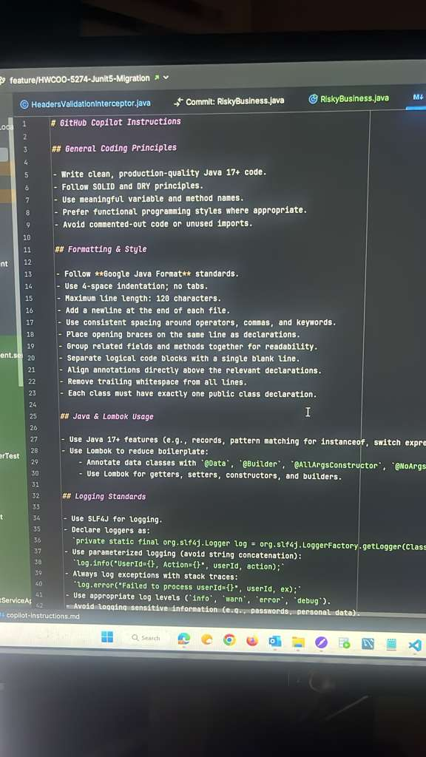
IntelliJ – copilot-instructions.md in Action
Tip: Use simple appear/fade animations to reveal key regions while you explain.

Slide 34
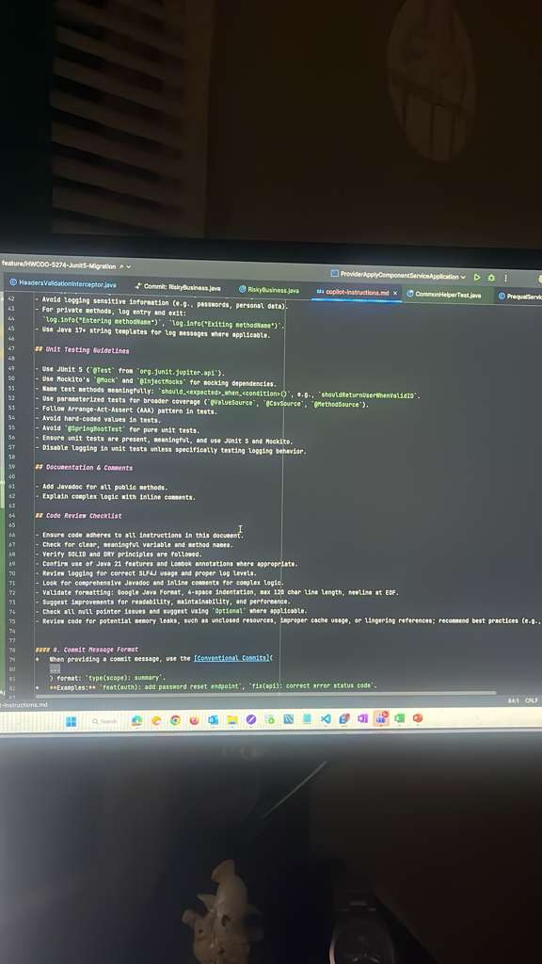
Instructions File – Testing & Code Review Sections
Tip: Use simple appear/fade animations to reveal key regions while you explain.

Slide 35
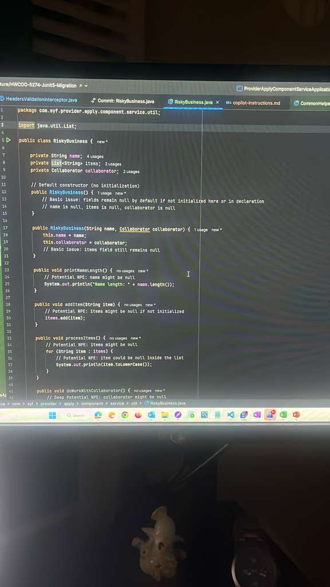
RiskyBusiness.java – Before Refactor (IDE View)
Tip: Use simple appear/fade animations to reveal key regions while you explain.

Slide 36
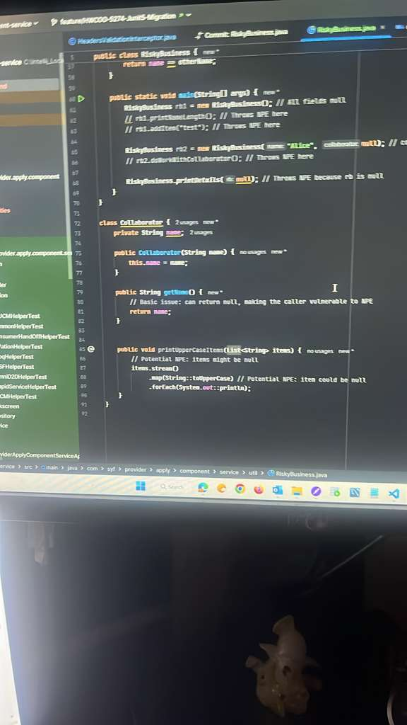
RiskyBusiness.java – Main Method and Collaborator
Tip: Use simple appear/fade animations to reveal key regions while you explain.

