Slide 1
Demystifying Data Science & Machine Learning
By Praneet Mokkapati
@growingsmart

Slide 2
Audience Pulse

Slide 3
Audience Pulse
What are your expectations from this session?
What interests you and Why?
What would you like to commit personally?
Have you tried or read about AI/DS/ML ?

Slide 4
Quick Intro to Python

Slide 5
What is Learning?

Slide 6
What is Learning?
Knowledge Acquisition: Set of Similar Experience(s) Information Extraction (Learning): Broad Guidelines:
Avoid Pain Seek Pleasure

Slide 7
What do you want to learn?

Slide 8
What do you want to learn?
Who are you (Pick any 1) ? Retail Store Bank
Academics
Event Management

Slide 9
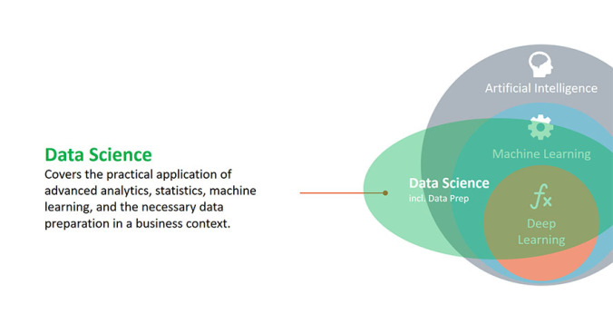

Slide 10
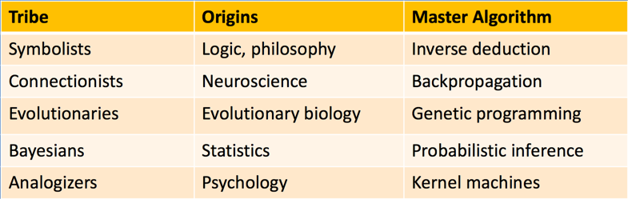
Five Tribes of Machine Learning
Video : https://www.youtube.com/watch?v=E8rOVwKQ5-8

Slide 11
ML Problems ??

Slide 12
ML Problems
Given Housing Data in an area, can we predict the rate at which a house with certain attributes will be able to sell? – Regression
Given the past values of a stock, can we predict the graph of the stock in intraday trade? – Forecasting
Is the email received Spam or Not Spam? – Text Mining/Classification
Given the past credit history of an individual, can we predict if the individual is going to repay a loan for a certain amt. under a set of conditions – Classification

Slide 13
ML Problems
Market Basket Analysis
People who have bought this also bought? – Recommendations Given what I know, what movie can I recommend? – Recommendations
Is the movie Hit or Flop from Twitter feed? – NLP/Sentiment Analysis
Given a vehicle fleet, can we come up with the route plan ? – Optimization (more becoz of the time constraint)

Slide 14
Intelligence ?

Slide 15
Intelligence - Regression
X | Y
4 | 16
12 | 48
17 | 68
22 | ??
29 | ??

Slide 16
Intelligence – Regression (With Noise)
X | Y
3 | 19
5 | 35
7 | 37
11 | 53
14 | ??

Slide 17
Intelligence – Regression
X | Y
3 | 18
5 | 100
7 | 294
11 | 1210
14 | ??
8 | ??

Slide 18
Intelligence
Demo

Slide 19
Intelligence - Classification
X | Target
3 | True
5 | True
7 | True
9 | True
13 | False
15 | False
17 | False
6 | ???
11 | ???
https://archive.ics.uci.edu/ml/datasets/Tic-Tac-Toe+Endgame

Slide 20
Intelligence - Classification
X | Y | Target
3 | 5 | True
2 | 7 | False
2 | 6 | True
4 | 4 | True
4 | 5 | False
5 | 2 | False
5 | 3 | True
6 | 2 | ???

Slide 21
Intelligence
Demo

Slide 22
Intelligence - Others
Unsupervised Learning
Clustering
PCA
KMeans
Reinforcement Learning
https://www.youtube.com/watch?v=fiQsmdwEGT8

Slide 23
Visual Intro to ML
http://www.r2d3.us/visual-intro-to-machine-learning-part-1/

Slide 24
Guide to Data Science
http://collaboratescience.com/creatives_ds/

Slide 25
Interested?
Curated ML List
Awesome Lists – ML
Scikit Learn Videos
Applied Data Science with Python | Coursera
Recommender Systems | Coursera
Python Data Science Handbook
iPython Notebooks
Siraj Raval
Offbeat:
Stanford Visual Recognition
Berkeley Reinforcement Learning
MIT Self Driving Cars

Slide 26
Demos
Siraj Raval Smarter Video
https://www.youtube.com/watch?v=XTNl5WxklgE

Slide 27
Foundations

Slide 28
Basic Statistics
Central Tendencies:
Mean
Median
Mode

Slide 29
Basic Statistics
Central Tendencies: Mean, Median, Mode
Player to Pick ? : (Mean = Median = Mode = 10 for all 3)
A | Points Scored | 7 | 8 | 9 | 10 | 11 | 12 | 13
 | Frequency | 1 | 1 | 2 | 2 | 2 | 1 | 1
B | Points Scored | 7 | 9 | 10 | 11 | 13
 | Frequency | 1 | 2 | 4 | 2 | 1
C | Points Scored | 3 | 6 | 7 | 10 | 11 | 13 | 30
 | Frequency | 2 | 1 | 2 | 3 | 1 | 1 | 1

Slide 30
Goodness Measures – Airlines
The frequency distribution of “No-Shows” from 200 randomly selected flights on an airline sector is:
# of No-Shows | 1 | 2 | 3 | 4 | 5 | 6 | Total
Frequency | 70 | 40 | 10 | 20 | 20 | 40 | 200
What is your advice for the airlines on the number of seats they should overbook on this sector?

Slide 31
Goodness Measures – Airlines
# of No-Shows | 1 | 2 | 3 | 4 | 5 | 6 | Total
Frequency | 70 | 40 | 10 | 20 | 20 | 40 | 200
X | 1 | 2 | 3 | 4 | 5 | 6
P(X=x) | 0.35 | 0.20 | 0.05 | 0.10 | 0.10 | 0.2

Slide 32
Goodness Measures – Airlines – Scenario 1
The Airlines tells you that it will pay you Rs.500 for your consulting and Rs.1500 as bonus for each correct prediction (prediction must be exactly correct, no more no less)

Slide 33
Goodness Measures – Airlines – Scenario 1 (What If)
The Airlines tells you that it will pay you Rs 500 for your consulting and Rs 1500 as bonus for each correct prediction (prediction must be exactly correct, no more no less)
X | 1 | 2 | 3 | 4 | 5 | 6
P(X=x) | 0.35 | 0.20 | 0.05 | 0.10 | 0.10 | 0.2
Mean = 1 * 0.35 + 2 * 0.20 + 3 * 0.05 + 4 * 0.10 + 5 * 0.10 + 6 * 0.20 = 3 Median = 2 Mode = 1

Slide 34
Goodness Measures – Airlines – Scenario 1 (What If)
The Airlines tells you that it will pay you Rs 500 for your consulting and Rs 1500 as bonus for each correct prediction (prediction must be exactly correct, no more no less)
X (Your Earnings) | 500 | 500 | 2000 | 500 | 500 | 500
P(X=x) | 0.35 | 0.20 | 0.05 | 0.10 | 0.10 | 0.2
E(X) = 500 * ( 0.35 + 0.20 + 0.10+ 0.10 + 0.20) + 2000 * 0.05 = Rs. 575

Slide 35
Goodness Measures – Airlines – Scenario 2
Instead of a binary state for your earnings, if the airlines offers to pay you Rs 2000 for the consulting minus Rs 125 for each under or overbooked seat, what will be your advice now?

Slide 36
Goodness Measures – Airlines – Scenario 3
Instead of penalizing based on absolute magnitude of the prediction error, if the airlines offers to pay you Rs 2500 for the consulting minus Rs 75 times the square of the prediction error (penalizing larger errors more), what will be your advice now?

Slide 37
Goodness Measures – Airlines – Closing Note
Regression – RMSE, MAE Classification – Confusion Matrix Ranking/Recommendation - RMSE, MAE Other Constraints: Computational Complexity Law of Diminishing Results

Slide 38
Goodness Measures – Airlines – Closing Note
If your business depends on it, does one sample of past 200 flights cut it ?

Slide 39
Confidence Intervals/Hypothesis Testing
Demo

Slide 40
Market Basket Analysis

Slide 41
Market Basket Analysis can give:
• Actionable rules
• Trivial rules People who buy shoes also buy socks
• Inexplicable People who buy shirts also buy milk

Slide 42
It is not just retail and baskets:
Unusual combinations of insurance claims can be a sign of fraud and can spark further investigation.
Medical patient histories can give indications of likely complications based on certain combinations of treatments.
Text categorization

Slide 43
ID | PRODUCT
1 | Orange Juice
2 | Window Cleaner
3 | Soda
4 | Milk
5 | Detergent
Let us do a problem
ORDER ID | ITEMS | PRODUCTS
1 | 1,3,4 | ORANGE JUICE, SODA, MILK
2 | 2,3,5 | WINDOW CLEANER, SODA, DETERGENT
3 | 1,2,3,5 | ORANGE JUICE, WINDOW CLEANER, SODA, DETERGENT
4 | 2,5 | WINDOW CLEANER, DETERGENT

Slide 44
Insights
Window Cleaner and Detergent are more likely to be purchased together than any other two items.
Milk is never purchased with soda, window cleaner or detergent
Soda, window cleaner and detergent are mostly purchased together

Slide 45
Market Basket Analysis
How do we generate these rules automatically on large data?

Slide 46
ID | PRODUCT
1 | Orange Juice
2 | Window Cleaner
3 | Soda
4 | Milk
5 | Detergent
APRIORI ALGORITHM
ORDER ID | ITEMS | PRODUCTS
1 | 1,3,4 | ORANGE JUICE, SODA, MILK
2 | 2,3,5 | WINDOW CLEANER, SODA, DETERGENT
3 | 1,2,3,5 | ORANGE JUICE, WINDOW CLEANER, SODA, DETERGENT
4 | 2,5 | WINDOW CLEANER, DETERGENT

Slide 47
APRIORI ALGORITHM
ORDER ITEMS
1,3,4
2,3,5
1,2,3,5
2,5
ITEMS | Prob
1 | 2/4
2 | 3/4
3 | 3/4
4 | 1/4
5 | 3/4
ITEM Set | Prob
1,2 | 1/4
1,3 | 2/4
1,5 | 1/4
2,3 | 2/4
2,5 | 3/4
3,5 | 2/4
ITEM Set | Prob
2,3,5 | 2/4

Slide 48
SUPPORT, CONFIDENCE AND LIFT
Antecedent | Consequent | Support | Confidence | Lift
{2} | {3,5} | 3/4 | 2/3 | 0.67/0.5 = 4/3
{3} | {2,5} | 3/4 | 2/3 | 0.67/0.75 = 8/9
{5} | {2,3} | 3/4 | 2/3 | 0.67/0.5 = 4/3
{2,3} | {5} | 2/4 | 2/2 | 1/0.75 = 4/3
{3,5} | {2} | 2/4 | 2/2 | 1/0.75 = 4/3
{2,5} | {3} | 2/4 | 2/3 | 0.67/0.75 = 8/9
Support: probability of Antecedent occurring
Confidence: Number of times antecedent and consequent were occurring together/number of times Antecedent was present
Lift: Confidence / Prob of the Consequent

Slide 49
Market Basket Analysis
Demo & Hands On

