Slide 1



Module-2
Unit-II
MONITORING, PERFORMANCE & OPTIMIZATION
Dr Simhadri Chinna Gopi
Assist Prof.
Dept of CSE

Slide 2
Unit-II
Monitoring ML systems in production
Logging and error tracking
Model performance metrics tracking
Tools overview: Prometheus, Grafana, Evidently
Performance optimization: Scaling strategies, Resource optimization.
Security in AI systems (MLSecOps overview)
Governance: Explainability, Bias detection
Ethical considerations

Slide 3
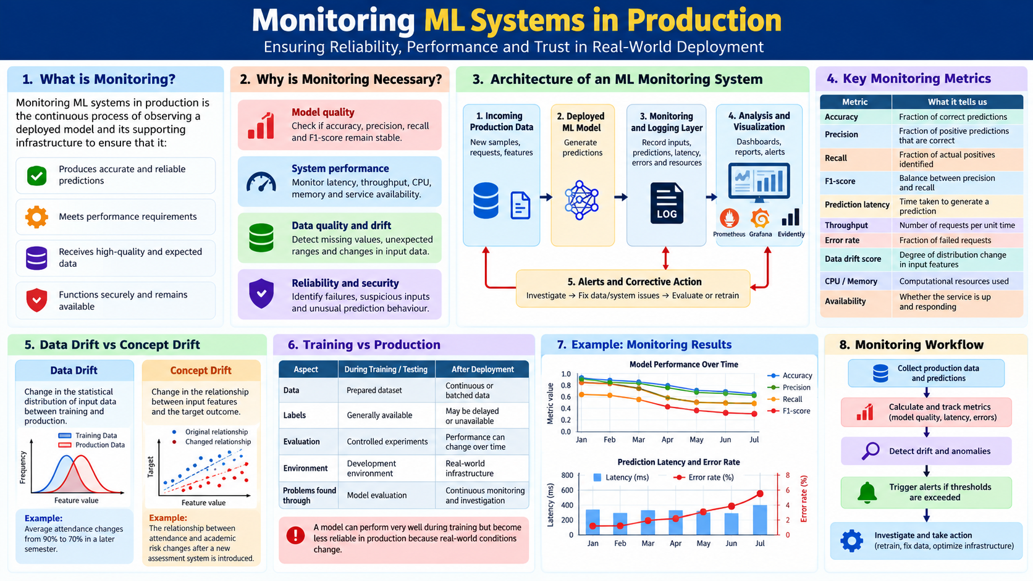

Slide 4
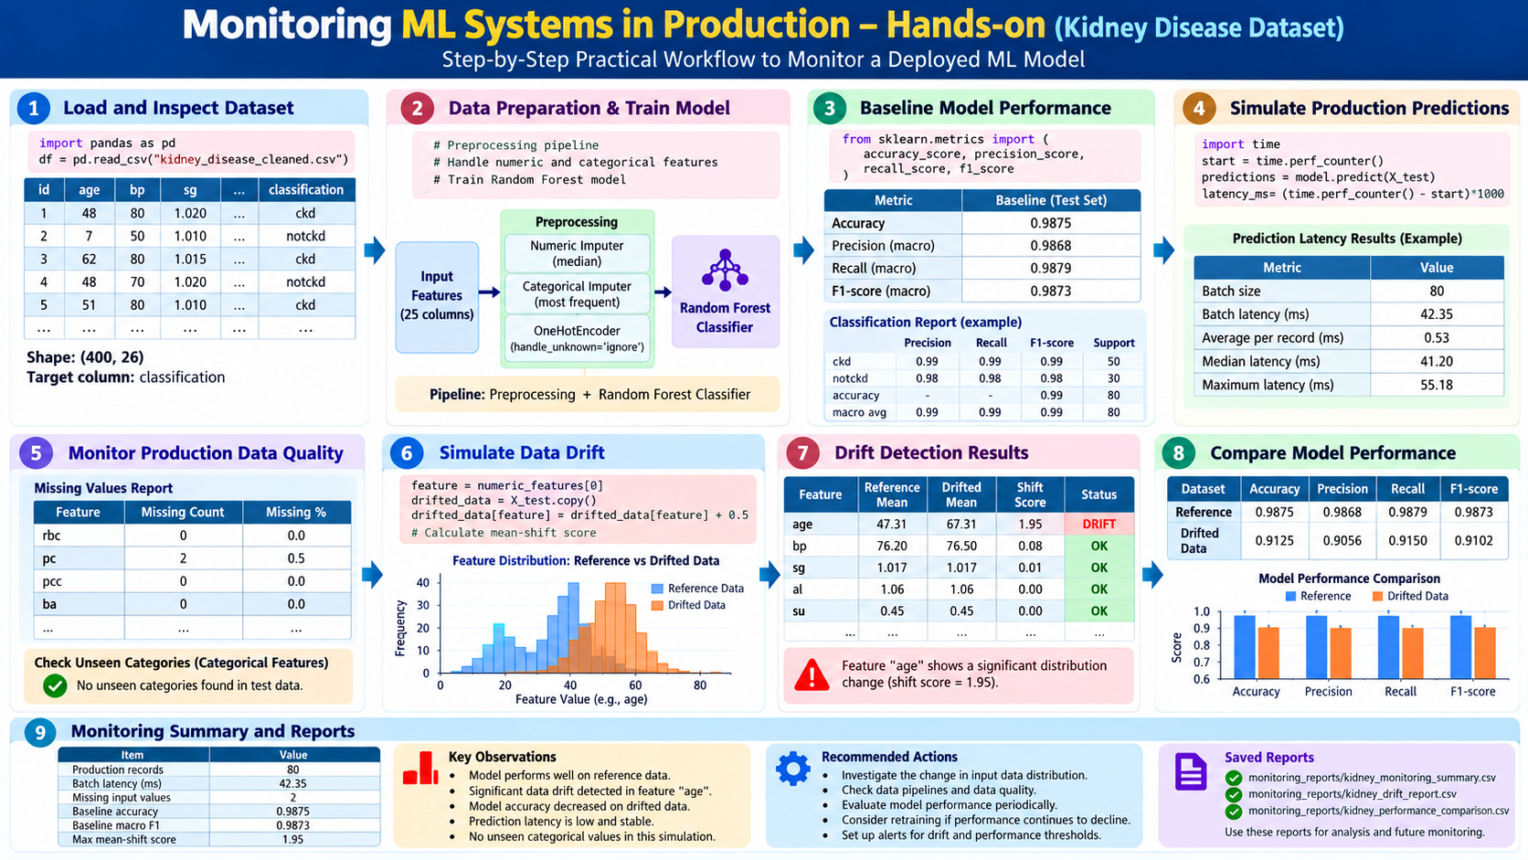

Slide 5
Unit-II
Monitoring ML systems in production
Logging and error tracking
Model performance metrics tracking
Tools overview: Prometheus, Grafana, Evidently
Performance optimization: Scaling strategies, Resource optimization.
Security in AI systems (MLSecOps overview)
Governance: Explainability, Bias detection
Ethical considerations

Slide 6
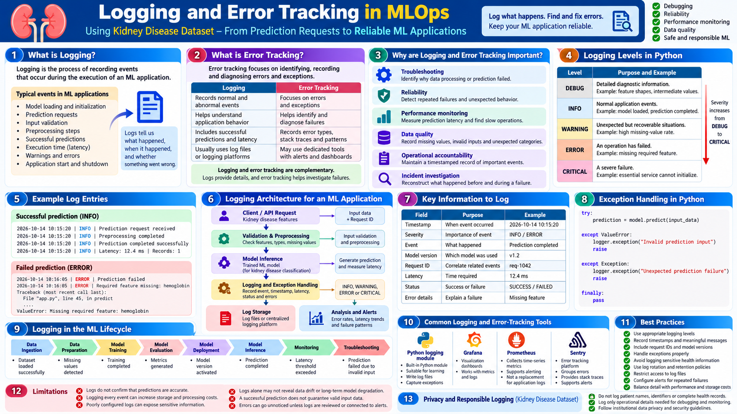

Slide 7
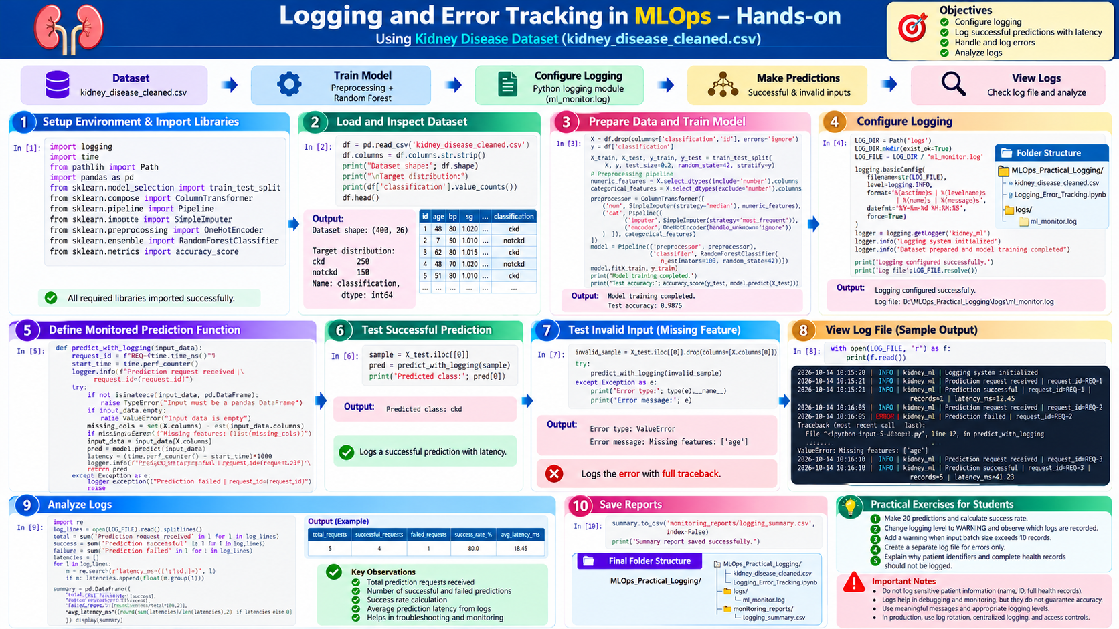

Slide 8
Unit-II
Monitoring ML systems in production
Logging and error tracking
Model performance metrics tracking
Tools overview: Prometheus, Grafana, Evidently
Performance optimization: Scaling strategies, Resource optimization.
Security in AI systems (MLSecOps overview)
Governance: Explainability, Bias detection
Ethical considerations

Slide 9
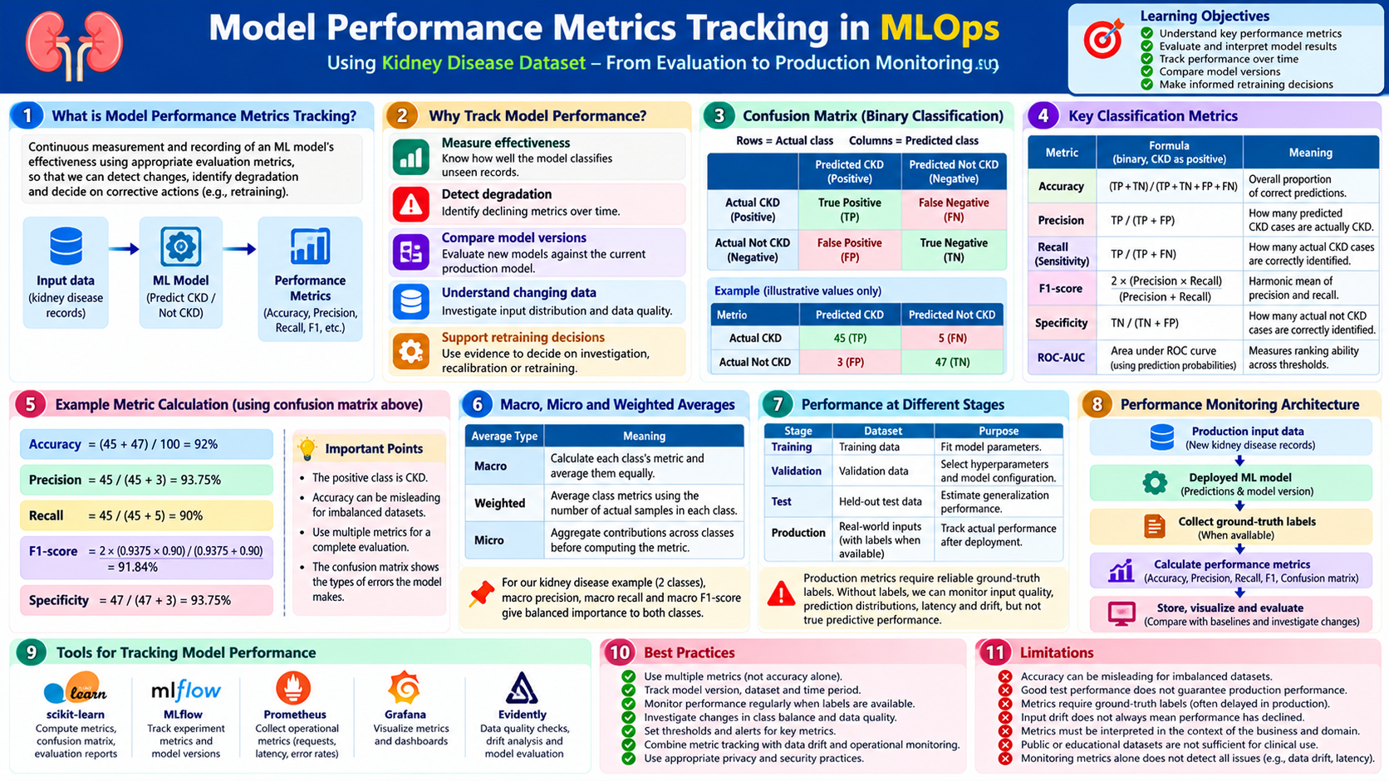

Slide 10
Unit-II
Monitoring ML systems in production
Logging and error tracking
Model performance metrics tracking
Tools overview: Prometheus, Grafana, Evidently
Performance optimization: Scaling strategies, Resource optimization.
Security in AI systems (MLSecOps overview)
Governance: Explainability, Bias detection
Ethical considerations

Slide 11
