Slide 1
Akka IDP: Reusable Multi‑Agent Pattern
Durable Akka Workflow: state persisted at every step; automatic recovery & retries
Reusable AI agents orchestrated in a modular pipeline (7 agents)
Multi‑modal AI: text + vision (GPT‑4o Vision) across classification & extraction
Enterprise‑grade: fault‑tolerant, horizontally scalable, and observable
Zero‑code reuse via SPI configuration (prompts, schemas, rules)
Agent | Role / Capability | Modalities
ClassificationAgent | Document type identification | Text + Vision
ExtractionAgent | Structured data extraction | Text + Vision
TransformationAgent | Payload transformation | Text
PublisherAgent | CMS/target publishing | Text
VisionDetectionAgent | Detect handwritten/corrections | Vision
EvaluationAgent | Extraction confidence scoring | Vision
ClarityAgent | Document quality assessment | Vision
SPI‑Driven Reusability: Configure prompts, extraction schemas, and validation rules per document type — no code changes required. The same agents are reused across scenarios while the workflow ensures reliability and recovery.
Built on Akka SDK • Java 21 • Azure OpenAI GPT‑4o Vision

Slide 2
Durable Workflow & Orchestration
IdpWorkflow (Akka) persists state at every step — enabling automatic recovery & targeted retries.
Self‑healing: resumes from last successful step after failure/restart
Deterministic orchestration: each agent invocation recorded in durable state
Distributed by design: workflows scale horizontally across the cluster
Observability: instrumented steps for tracing & audit
1) Ingestion: REST API or Event Hub triggers new workflow
2) ClassificationAgent: determine document type (text + vision)
3) ExtractionAgent: pull structured data using prompts/schemas
4) TransformationAgent: map data to target payload/schema
5) Vision/Evaluation/Clarity: visual checks & confidence scoring
6) PublisherAgent: submit/upload to CMS or downstream systems
7) Completion: workflow verifies success and commits results
Compared to ad‑hoc scripts: durable state prevents data loss; supervision + retries isolate failures and keep processing on track.
Built on Akka SDK • Java 21 • Azure OpenAI GPT‑4o Vision

Slide 3
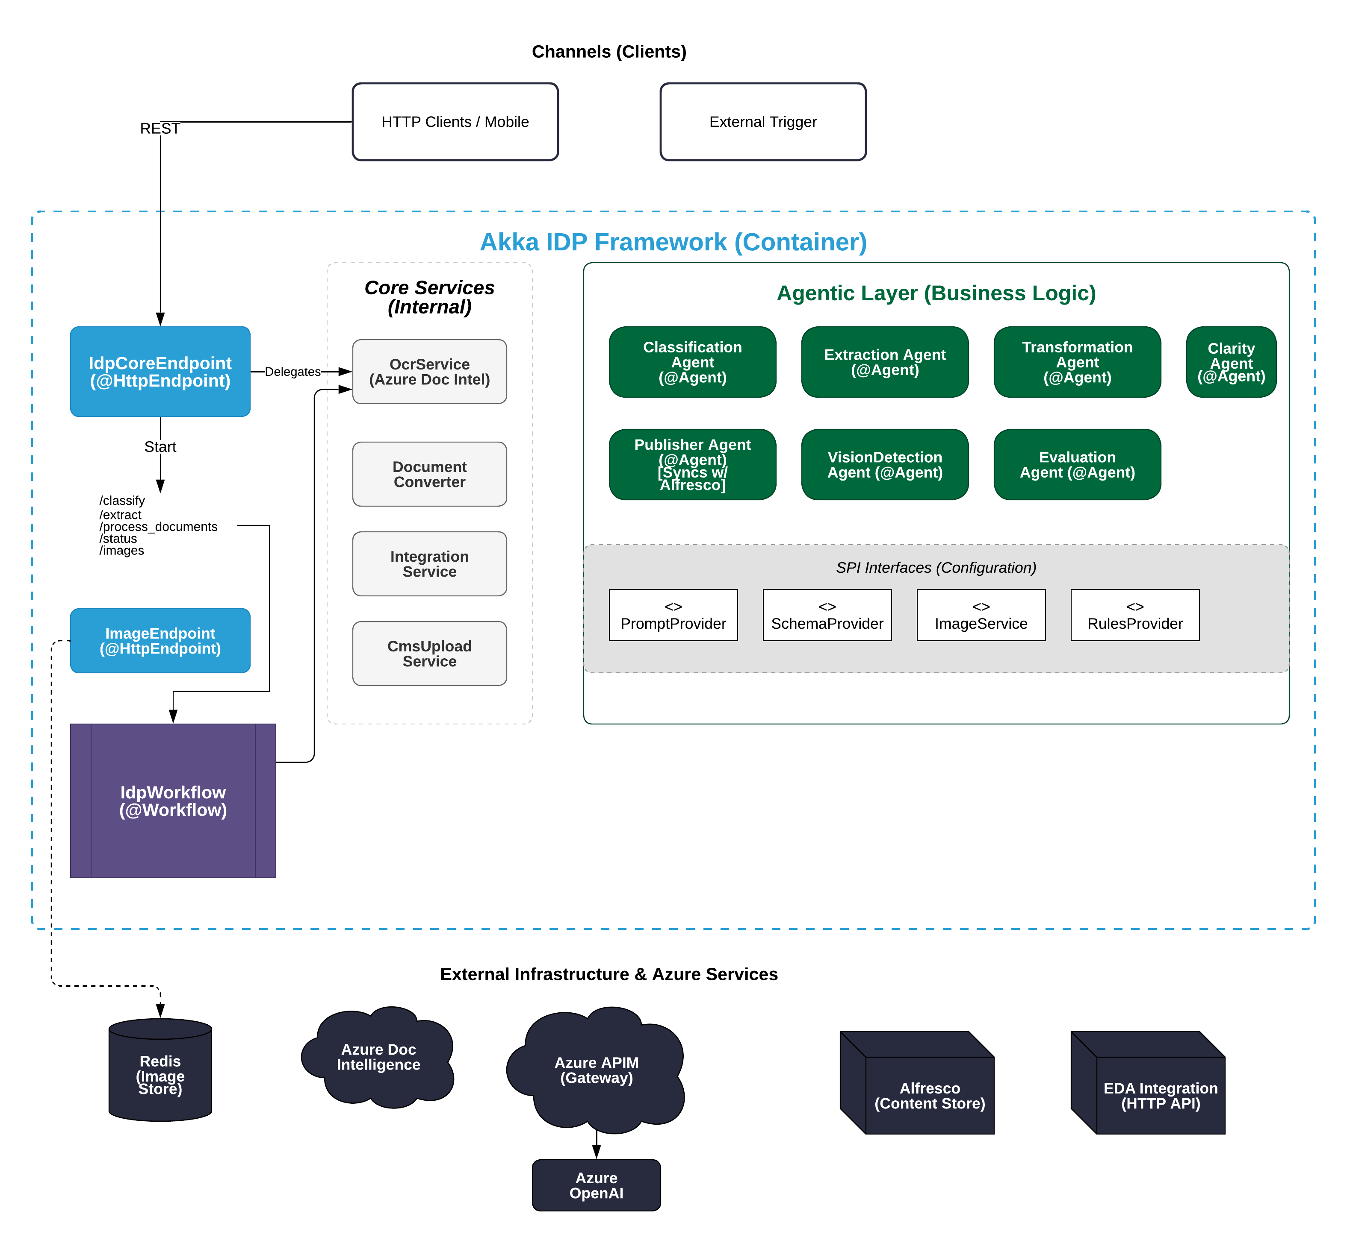
System Overview

Slide 4
Seven Reusable Agents
Agent | Role / Capability | Modalities
ClassificationAgent | Determine document type/category using text + image understanding | Text + Vision
ExtractionAgent | Extract structured fields (schemas/prompts) from document | Text + Vision
TransformationAgent | Map extracted data to target payloads for downstream systems | Text
PublisherAgent | Publish metadata/content to CMS, databases, or APIs | Text
VisionDetectionAgent | Detect handwritten marks/corrections/stamps in images | Vision
EvaluationAgent | Score extraction confidence; flag low‑quality outputs | Vision
ClarityAgent | Assess scan quality/legibility; gate processing if unclear | Vision
Agents are generic and reusable; document‑specific behavior comes from configuration (prompts, schemas, rules).
Built on Akka SDK • Java 21 • Azure OpenAI GPT‑4o Vision

Slide 5
Service Provider Interfaces (SPI) Configuration for Zero‑Code Reuse
Business logic is externalized. Configure per document type:
config.json — document types, routing & settings
prompts/*.txt — LLM prompts for classification & extraction
schemas/*.json — structured outputs to extract
rules/*.json — validation & quality gates
Onboard a new document type (no code changes):
Add a schema JSON describing the fields to extract
Write prompts for classification/extraction aligned to the schema
Add validation rules for business checks
Deploy the updated configuration; the same agents & workflow handle it
Effect: true reuse. Engineers update config, not code; agents and workflows remain unchanged.
Built on Akka SDK • Java 21 • Azure OpenAI GPT‑4o Vision

Slide 6
Enterprise Readiness & Multi‑Modal AI
Reliability & Scale
Actor supervision + retries → fault tolerance
State persistence → no lost transactions
Horizontal scaling of workflows across nodes
Enterprise Integrations & Modalities
Azure APIM, OAuth2, observability & audit
Event‑driven integration for downstream systems
Text + Vision: GPT‑4o Vision for document images & content
Built on Akka SDK • Java 21 • Azure OpenAI GPT‑4o Vision

