Slide 1


AdaLoom
Transforming Software Delivery at Scale
AI-Powered End-to-End Automation

Slide 2


Executive Summary
The Vision
Early Results
AdaLoom is an AI-powered platform automating the entire software development lifecycle. Unlike simple code assistants, AdaLoom transforms business requirements directly into production-ready applications using specialized AI agents.
Our Proof of Concepts demonstrate a 70-80% reduction in development time. This shift enables us to accelerate digital transformation, enforce consistent quality, and reduce operational costs dramatically.

Slide 3








The Business Challenge
Time to Market
Talent Scarcity
Inconsistent Quality
Traditional cycles take weeks or months, limiting response to market opportunities and threats.
Shortage of senior developers drives up costs and creates severe delivery bottlenecks.
Manual coding introduces variability, security vulnerabilities, and long-term technical debt.

Slide 4

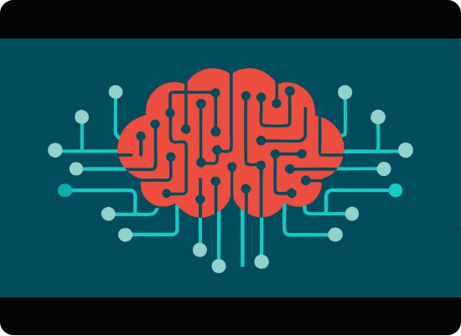
The AdaLoom Solution
Intelligent Automation
AdaLoom uses a team of specialized AI agents—architects, developers, and security specialists—working in concert.
•
Input: Structured "OpenSpec" business requirements.
•
Process: Agents generate code, write tests, and scan for security.
•
Output: Production-ready application in under 5 minutes.
Like having an expert engineering team available 24/7.

Slide 5




From Requirement to Production
Define
Generate
Validate
Deploy
Business Analyst creates "OpenSpec" requirements.
AI Agents architect and write code & tests.
Automated security scans & 80%+ test coverage.
Push to production environment in minutes.

Slide 6
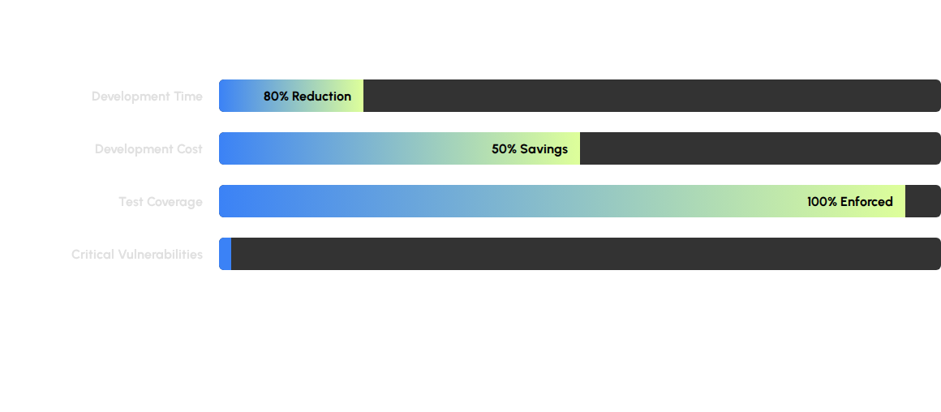
Projected Efficiency Gains
Comparison against traditional manual software development baselines.

Slide 7

Talent Strategy Transformation
AdaLoom doesn't replace developers; it elevates them.
Our engineers transition from routine coding to high-value roles:
•
Specification Architects: Defining precise needs.
•
Quality Reviewers: Ensuring business alignment.
•
Innovation Leaders: Solving complex problems.
Result: Higher retention and attraction of top-tier engineering talent.

Slide 8







Enterprise-Grade Foundation
Azure Infrastructure
OpenAI GPT-5
Security First
Built on secure, scalable Microsoft Azure cloud services with Active Directory integration and Key Vault management.
Leveraging state-of-the-art language models to interpret requirements and generate high-quality, secure code.
Production-grade security scanning, full audit trails, and compliance checks built into the core loop.

Slide 9
Phased Rollout Strategy
Phase | Timeline | Scope & Focus
Phase 1: Pilot | Current | Internal pilot with select teams. Focus on net-new microservices and API development.
Phase 2: Expansion | Next Quarter | Expand to additional teams using proven patterns. Refine "OpenSpec" training.
Phase 3: Scale | 6-12 Months | Broad adoption across the organization. Establish Centers of Excellence and full governance.

Slide 10


Risks & Mitigation
Technical Risks
Organizational Risks
•
AI Accuracy: Mitigated by 100% automated testing, strict compilation checks, and human review steps.
•
Resistance to Change: Managed through clear communication of "elevation not replacement" and training.
•
Integration: Addressed via standard API patterns and phased rollout.
•
Skills Gaps: Comprehensive training on writing effective specifications.
•
Availability: 99.9% SLA with fallback to standard dev tools.
•
Governance: Policy requiring human oversight for critical systems.

Slide 11


The Path Forward
Strategic Recommendations
•
Continue Investment: Fund AdaLoom expansion to capitalize on 200-300% ROI potential.
•
Accelerate Adoption: Prioritize high-volume routine work to free up senior capacity immediately.
•
Build Expertise: Establish a Center of Excellence to drive best practices.
•
Commercial Potential: Explore IP protection for our unique agent architecture.

Slide 12

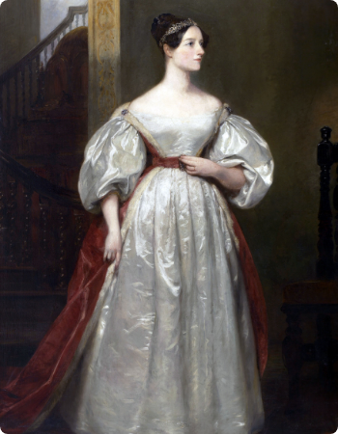
The Name "AdaLoom"
"Named after Ada Lovelace, who envisioned machines creating anything expressible symbolically, and the Jacquard loom that inspired computing itself."
We bring their vision to life: machines that create software, guided by human intent, at unprecedented speed.

Slide 13
Q & A
Thank you.

Slide 14





Image Sources
https://static.vecteezy.com/system/resources/previews/060/289/390/non_2x/brain-and-circuit-an-abstract-representation-of-a-brain-composed-of-circuitry-lines-signifying-the-intelligence-of-ai-in-processing-and-writing-code-vector.jpg
Source: www.vecteezy.com
https://img.freepik.com/premium-photo/portrait-diverse-software-development-team-collaborating-project-modern-office-focus-lead-engineer-instructing-colleagues-copy-space_236854-29531.jpg
Source: www.freepik.com
https://assets.conversion.ai/i/97f44c3b-f8ea-4830-a342-5139f1ec7649
Source: skyrushmarketing.com
https://upload.wikimedia.org/wikipedia/commons/8/87/Ada_Lovelace.jpg
Source: wikipedia.org

