Slide 1
Digital Portfolio
STUDENT NAME:GOPINATH.P
REGISTER NO AND NMID: 212405373 AND F10D19954B0591D9DF8463E128A88614
DEPARTMENT: BCA
COLLEGE: Apollo Arts And Science College Chennai /
MADRAS UNIVERSITY

Slide 2
PROJECT TITLE
PERSONAL PORTFOLIO WEBSITE USING FRONT-END DEVELOPMENT

Slide 3


AGENDA
Problem Statement
Project Overview
End Users
Tools and Technologies
Portfolio design and Layout
Features and Functionality
Results and Screenshots
Conclusion
Github Link
3/21/2024 Annual Review

Slide 4

PROBLEM STATEMENT
Many students lack a professional platform to showcase their coding skills and projects.
Traditional resumes don't demonstrate practicalapplications or creativity.
Solution: A portfolio website with interactive projects and a responsive design.

Slide 5

PROJECT OVERVIEW
This project is a personal portfolio website designed to:
Present myself as a creative web learner.
Showcase skills & real-time projects.
Provide a professional contact channel.
Build a digital identity beyond resumes.

Slide 6

WHO ARE THE END USERS?
Recruiters - to know both technical & soft skills.
Faculty & Peers - for academic presentation.
General Audience - to connect & know my interests.

Slide 7

TOOLS AND TECHNIQUES
HTML, CSS, JavaScript - for Layout & interactivity.
Responsive Web Design - for accessibility.
Creative Typography & Icons - to make it engaging.
CodePen/GitHub - for hosting.

Slide 8
PORTFOLIO DESIGN AND LAYOUT
Hero Section - name, tagline & CTA button.
About Me - short intro with creative description.
Projects Showcase - interactive apps with brief descriptions.
Contact Me - form for communication.
8

Slide 9
FEATURES AND FUNCTIONALITY
Fully responsive design.
Project highlights with live demo links.
Clean modern gradient background.
Contact form with message submission.
Showcases 3 projects:
ColorPickr - Color palette generator.
2. Calcify - Stylish calculator app.
3. NoteHive - Notes app with categories & search.

Slide 10
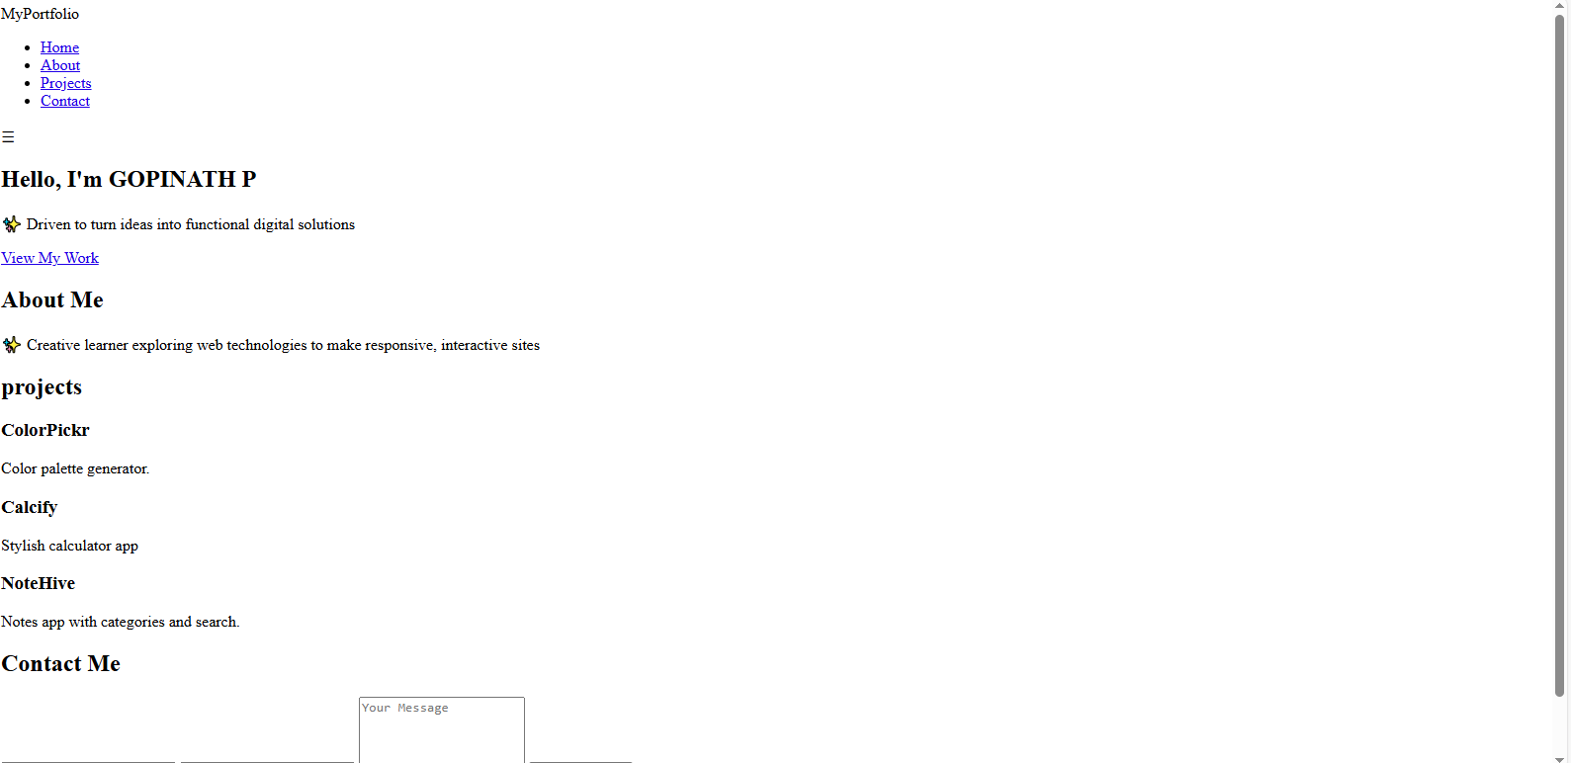
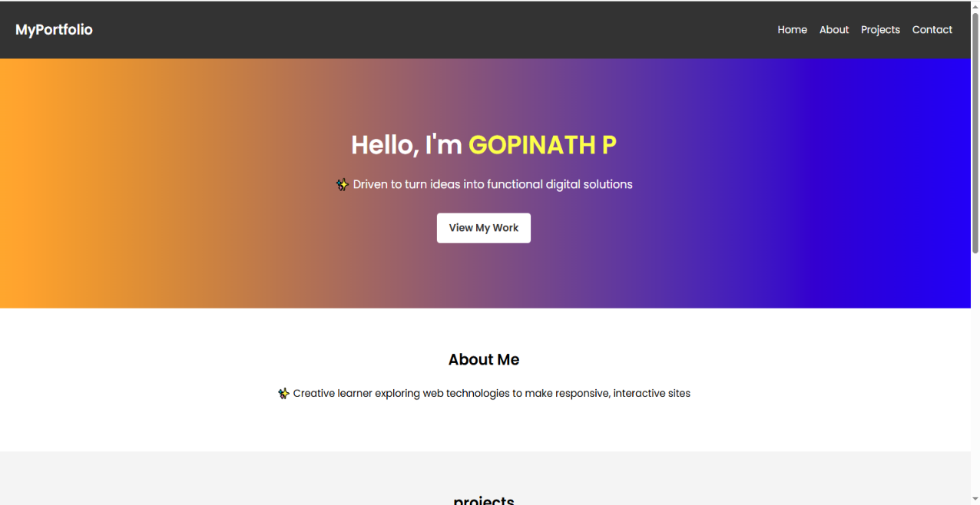
RESULTS AND SCREENSHOTS
BEFORE ADDING CSS : AFTER ADDING CSS:
3/21/2024 Annual Review
10

Slide 11
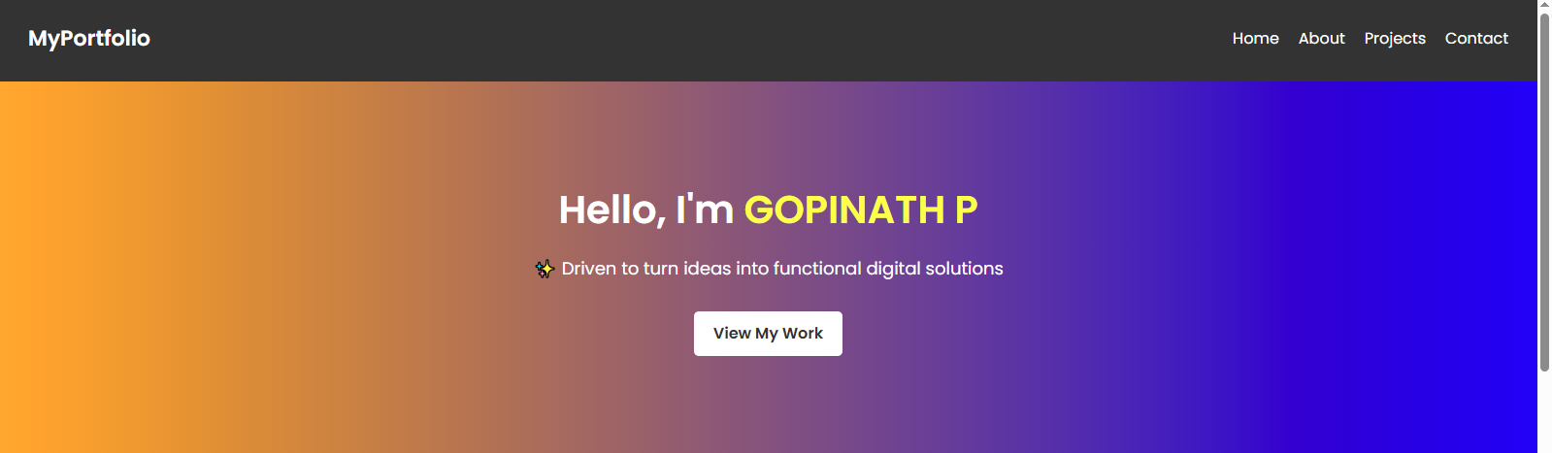
HOME SECTION:

Slide 12

ABOUT SECTION

Slide 13
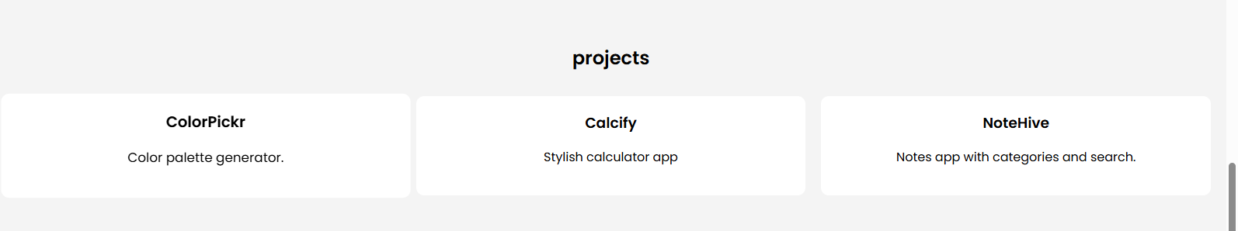
PROJECT SECTION:

Slide 14

CONTACT SECTION:

Slide 15
CONCLUSION
Built a modern portfolio website combining creativity & functionality.
Demonstrates practical coding projects and technicalskills.
Future scope: Add certifications, blog posts & advancedfeatures.
15

Slide 16
GITHUB LINK:
https://gopibca24aascc-sketch.github.io/TNSDC-FWD-Digitalportfolio/

