Slide 1

ONLINE CV BUILDER
J.Gopichand
41611070
CSE WITH SPECIALIZATION IN ARTIFICIAL INTELLIGENCE AND MACHINE LEARNING
Guided by : Dr. Minu Susan Jacob

Slide 2
Presentation Outline
Course Certificate
Introduction
Objectives
System Architecture / Ideation Map
Module Implementation
Results and Discussions
Conclusion
References

Slide 3
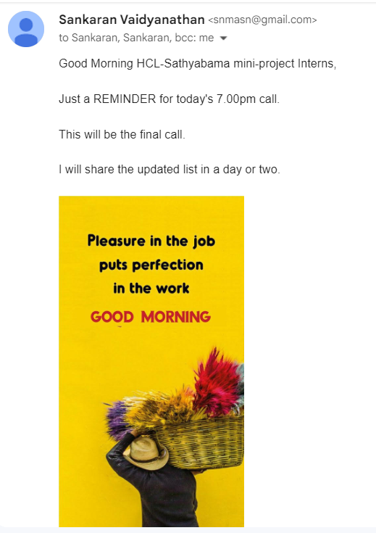
Internship Proof

Slide 4
Introduction
It is an application that simplifies the task of creating a resume for individuals. The system is flexible to be used and reduces the need of thinking and designing an appropriate resume according to qualifications. The system is developed to provide an easy means for creating a professional looking resume. Individuals just have to fill up a form that specifies questions from all required fields such as personal questions, educational, qualities, interest, skills and so on. The answers provided by the users are stored and the system automatically generates a well structured resume. Users have option to create resume in any format and file.

Slide 5
Objectives
Simplify Resume Creation
User-Friendly Interface
Customization
Real-Time Preview
Printing and Downloading
Accessibility
The webpage will auto-generate a nice and properly formatted Resume from the information filled up in a form.

Slide 6
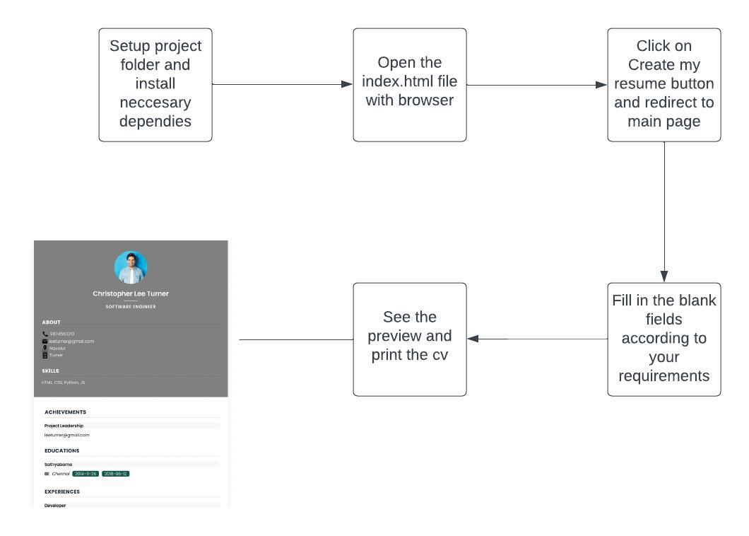
System Architecture
Architecture of Online CV Builder

Slide 7
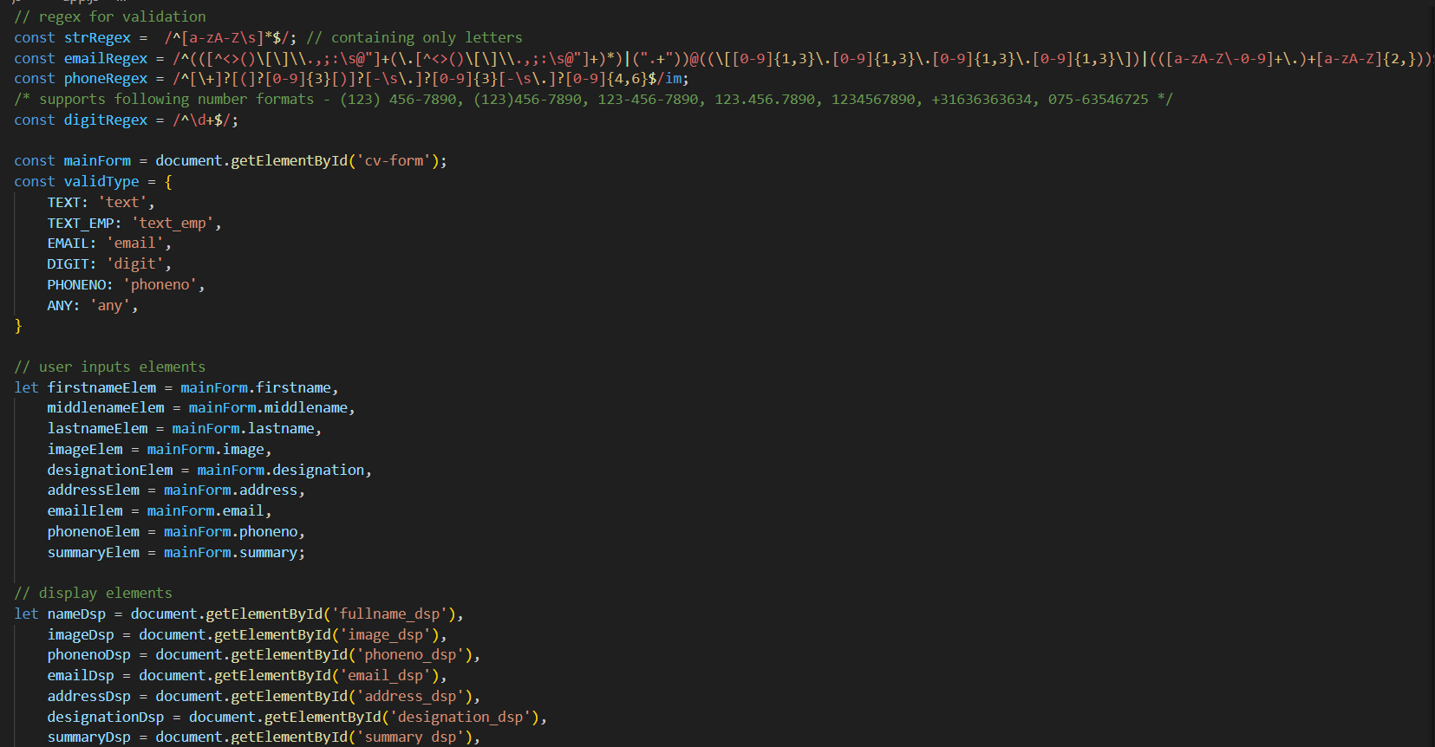
Module Implementation
Main dart

Slide 8
Project Implementation
Project Planning and Analysis:
Define the project scope, objectives, and requirements.
Conduct market research and competitor analysis to understand user needs and industry standards.
Design User Interface (UI) and User Experience (UX):
Design the user interface (UI) for the CV builder, including the layout, fields, and templates.
Focus on creating a user-friendly and intuitive user experience (UX) to ensure ease of navigation and data entry.

Slide 9
Project Implementation
Frontend Development:
Build the frontend of the website, including the user registration/login system and the CV creation interface.
Implement responsive design to ensure compatibility with various devices and screen sizes.
CV Template Customization:
Create a selection of CV templates for users to choose from.
Implement features for customizing template colors and styles to allow users to personalize their CVs.

Slide 10
Project Implementation
Real-Time Preview and Editing:
Develop a real-time preview feature that displays the CV as users enter their details and make template customizations.
Enable users to edit and update their CV content within the platform.
Export and Download Functionality:
Implement options for users to export their completed CVs in different formats (e.g., PDF, Word).
Include a "Download" and "Print" feature for users to save or print their CVs directly from the platform.

Slide 11
Software & Hardware Requirements
Software Requirements & Hardware Requirements
PROCESSOR : Intel Core i3 or a better processor
OPERATING SYSTEM : Windows 8, Windows 10, MAC OS, Linux.
MEMORY : 4 GB RAM or higher
HARD DISK SPACE : Minimum 32 GB or higher
GRAPHICS CARD : Integrated Graphics card or a better one
INTERNET : Must have a good internet connection.
TEXT EDITOR : Notepad, Visual Studio etc
WEB BROWSER : Google Chrome, Mozilla Firefox, and Microsoft Edge.

Slide 12
Results and discussion
Results and discussion
User Adoption and Engagement
The launch of the Online CV Builder has been met with enthusiastic adoption among our target users, including job seekers, students, and professionals. The platform has witnessed consistent growth in user registrations and CV creations since its inception. Key user engagement metrics, such as the number of CVs created and the time spent on the platform, have shown promising results.

Slide 13
Results and discussion
Results and discussion
User Feedback and Satisfaction
User feedback has played a pivotal role in shaping the Online CV Builder's evolution. Through surveys, user interviews, and direct feedback channels, we have gathered valuable insights into the platform's strengths and areas for improvement. The feedback has been overwhelmingly positive regarding the user-friendly interface, template variety, and real-time preview feature.

Slide 14
Conclusion
In conclusion, the online CV builder project is a valuable tool that can help job seekers of all levels of experience create professional-looking CVs quickly and easily. The project provides a variety of features, including templates, formatting options, resume writing tips, and export options, to help job seekers create CVs that are tailored to their specific needs and goals.

Slide 15
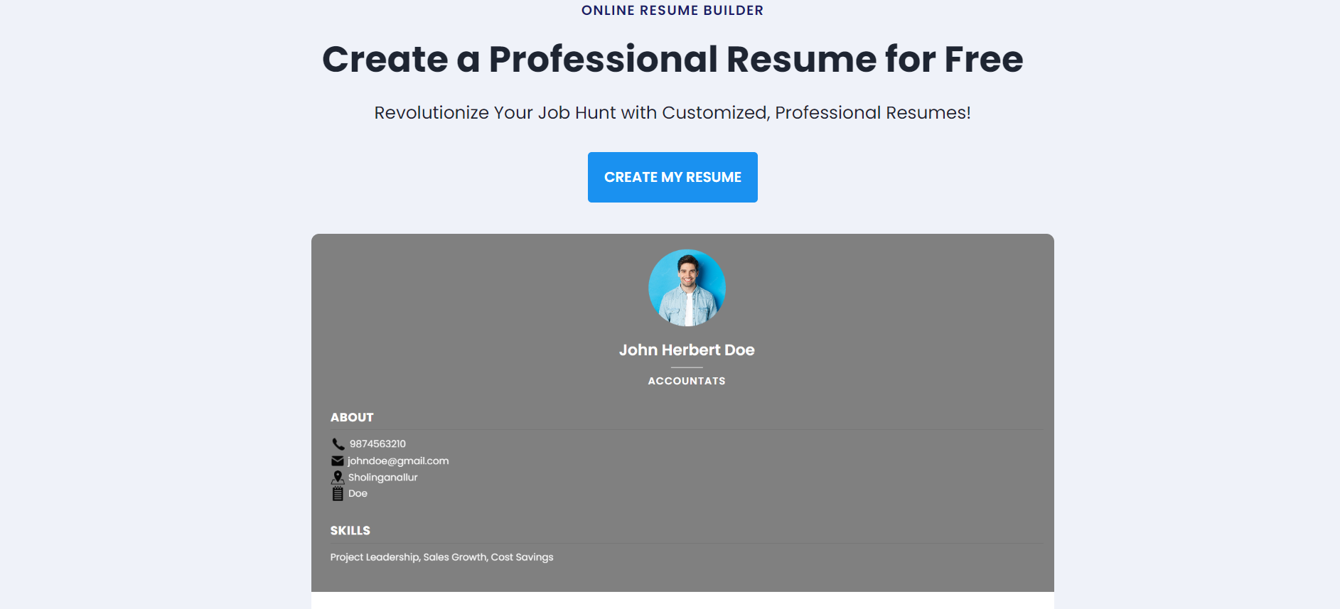
Application - Snapshots

Slide 16
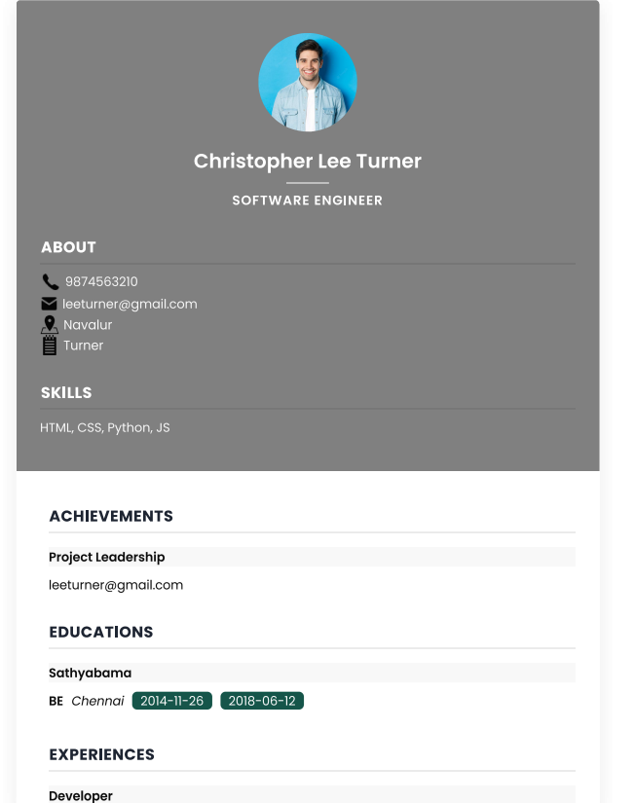
Application - Snapshots

Slide 17
References
Canva: Canva is a versatile design platform that includes a selection of free and paid resume templates. It offers a drag-and-drop interface and allows for extensive customization, making it suitable for both beginners and professionals.
Website: https://www.canva.com/
Zety (formerly known as Novoresume): Zety offers a user-friendly interface with a wide range of customizable templates and an intuitive CV-building process. It provides options for creating both resumes and cover letters.
Website: https://zety.com/
LinkedIn: If you have a LinkedIn profile, you can use the LinkedIn Resume Builder to convert your profile information into a professional resume. It's a convenient way to ensure your resume is up-to-date and reflects your LinkedIn experience.
Website: https://www.linkedin.com/

