Slide 1
EXERCISE RECOMMENDATION METHOD BASED ON MACHINE LEARNING

Slide 2
GUIDANCE:
COLLABORATORS:
MR .V.B.CHARI
HOD
CHINNAPOGU GOPI
THOTA LAKSHMI CHARAN
KOTCHIRI KARTHIK
KASHIM SAIDA
SRINIVAS KUMAR
CHIRANJIVI
22333-CM-011
22333-CM-062
22333-CM-032
22333-CM-054
22333-CM-012
22333-CM-042

Slide 3

CONTENTS
ABSTRACT
INTRODUCTION
LITERATURE SURVEY
SYSTEM ANALYSIS
SYSTEM ARCHITECTURE
MODULES
SYSTEM DESIGN
SYSTEM REQUIREMENTS
SCREENSHOTS
ALGORITHMS USED
CONCLUSION
FUTURE SCOPE
REFERENCES

Slide 4
ABSTRACT
It proposes a recommender system (RS) to support the fitness assistance system (FAS) with artificial intelligence.
The aim of this is to develop an RS that has an ability to learn, analyze, and predict.
This makes the suggestions as well as communicate to human through AI.
Artificial Neural Network and Logistic Regression have been employed to predict the workouts.

Slide 5
INTRODUCTION
The RS is known as a part of information filtering system which helps the users seek the prediction..
we use machine learning algorithms on activity data to build a predictive module in the basic training layer (BTL).
we also build the trainer agent (TA) with Soar architecture and machine learning algorithm.
TA can reflect the prediction of BTL for suggesting the several workouts.

Slide 6
LITERATURE SURVEY
Toward the next generation of recommender systems: a survey of the state-of-the-art and possible extensions
AUTHORS: G. Adomavicius, A.
It presents an overview of the field of recommender systems and describes the current generation of recommendation methods that are usually classified into the following three main categories: content-based, collaborative, and hybrid recommendation approaches. It also describes various limitations of current recommendation methods and discusses possible extensions that can improve recommendation capabilities and make recommender systems applicable to an even broader range of applications. These extensions include, among others, an improvement of understanding of users and items, incorporation of the contextual information into the recommendation process, support for multicriteria ratings, and a provision of more flexible, less intrusive types of recommendations.

Slide 7
SYSTEM ANALYSIS
EXISTING SYSTEM
PROPOSED SYSTEM

Slide 8
EXISTING SYSTEM
In the existing recommender systems and describes recommendation methods that are usually classified into the following three main categories:
content-Based
Collaborative
Hybrid recommendation approaches
Recommender systems applicable to an even broader range of applications.
These extensions include,an improvement of understanding of users and items,and it is more flexible.
hybrid recommendation approaches.

Slide 9

DISADVANTAGES OF EXISTING SYSTEM:
Each element of the user space C can be defined with a profile.
Profile includes various user characteristics, such as age, gender, income, marital status, etc.
In the simplest case, the profile can contain only a single (unique) element, such as User ID.

Slide 10
PROPOSED SYSTEM
The RS is known as a part of information filtering system.
It helps the users seek the prediction of rating or preference.
We use machine learning algorithms on activity data to build a predictive module in the BTL that classify the user’s activity in their workout.
we also build the TA with Soar architecture and machine learning algorithm to reflect the prediction of BTL.

Slide 11
ADVANTAGES OF PROPOSED SYSTEM:
The FAS is the system designed to support users doing exercise with fitness assistance equipment (FAE).
It is used to support lifting the weight of exercise instead of the traditional method.
The proposed RS used in FAS is a system combined with artificial intelligence (AI),which plays a role as a professional trainer.
Professional trainer will give the training instructions of workout for users based on predictability.

Slide 12
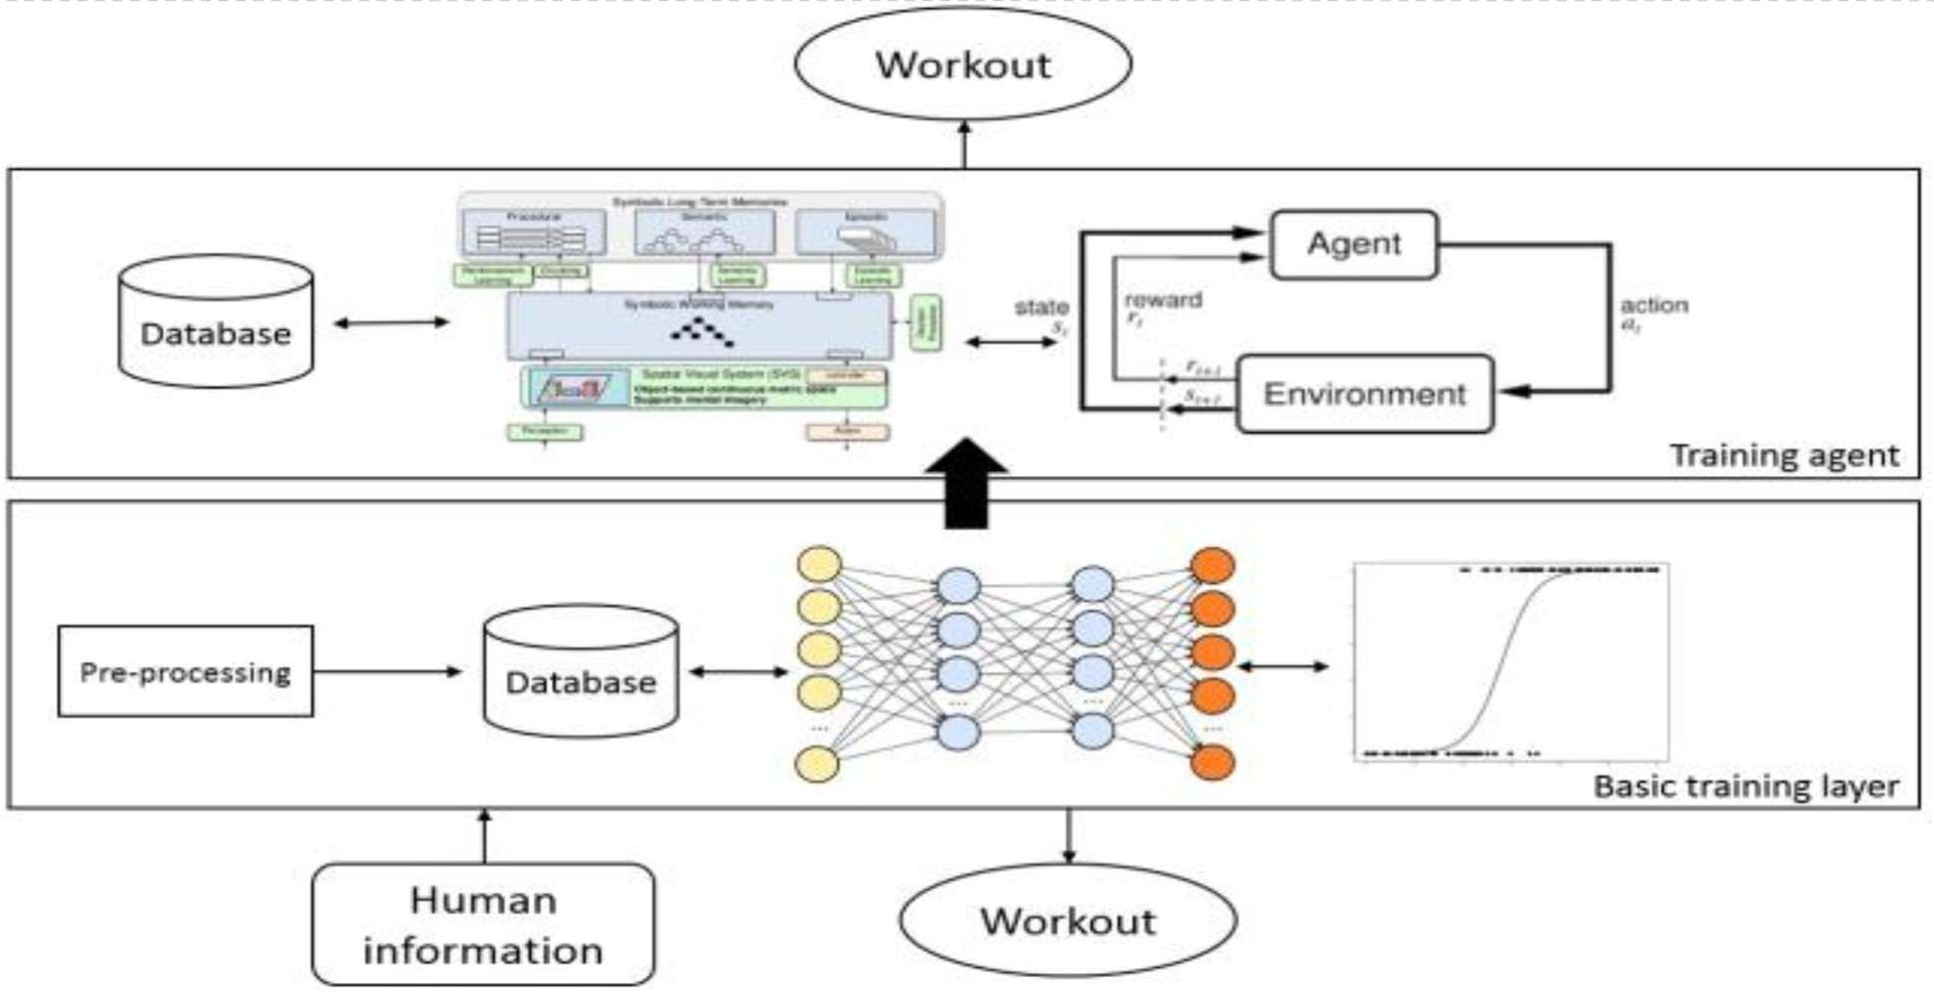
SYSTEM ARCHITECTURE

Slide 13
MODULES
FAS
USER
ADMIN

Slide 14
FAS:
The FAS is the system designed to support users doing exercise.
In FAS, the proposed RS is added to predict appropriate suggestions for users.
Machine learning algorithms help RS improve the ability of learning, identifying and acquiring knowledge from the real work out data.

Slide 15
USER:
The RS is known as a part of information filtering system which helps the users seek the prediction of rating.
A fitness assistant framework is developed to smartly track and identify user’s activity based on contextual interpretation.
In the proposed RS, we use machine learning algorithms on activity data to build a predictive module in the basic training layer (BTL).

Slide 16
ADMIN:
The aim of admin is to approve the users and the entire data must be gathered to admin.
Admin maintain the all registered user information and admin should maintain the users daily status reports.
The purpose of this is to design the RS that will suggest personalized workout to the users and predict the plan for doing exercise in future.

Slide 17



SYSTEM DESIGN

Slide 18
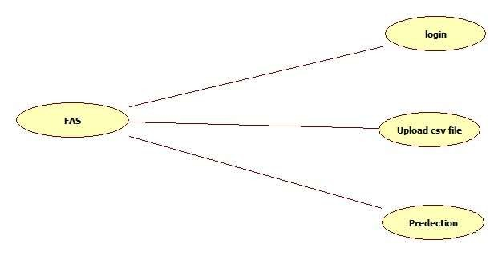
USE CASE DIAGRAM

Slide 19
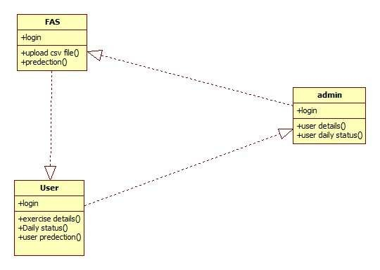
CLASS DIAGRAM

Slide 20
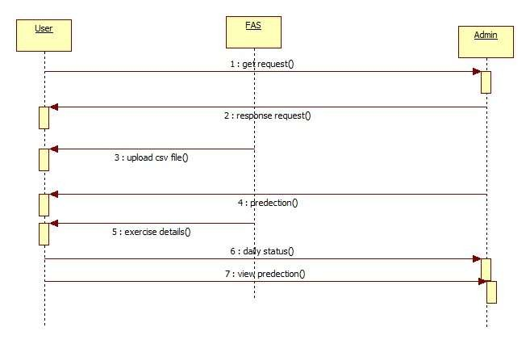
SEQUENCE DIAGRAM

Slide 21
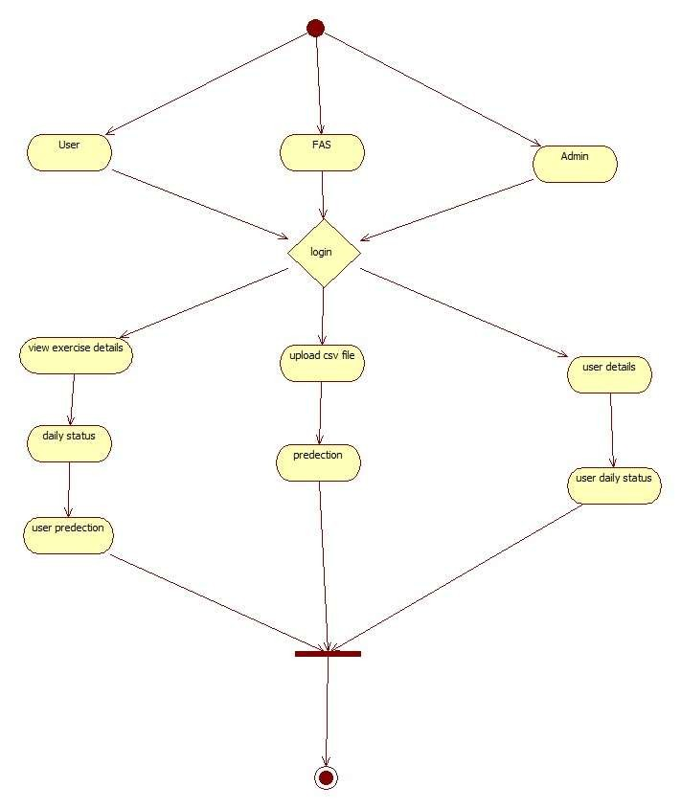
ACTIVITY DIAGRAM

Slide 22

SYSTEM REQUIREMENTS

Slide 23
HARDWARE REQUIREMENTS
System
Hard Disk
Ram
: Pentium IV 2.4 GHz.
: 40 GB.
: 512 Mb

Slide 24
SOFTWARE REQUIREMENTS
Operating system
Coding Language
Web Framework
Designing
Data Base
: Windows 7 Ultimate.
: Python.
: Django
: Html, CSS, JavaScript.
: MySQL.

Slide 25
ALGORITHMS USED
ARTIFICIAL NEURAL NETWORKS
LOGISTIC REGRESSION
REINFORCEMENT LEARNING

Slide 26
ANN:
ANN is generally used in cases where what has happened in past is repeated almost exactly in same way. I t is a kind of machine learning technique which has enormous memory. i t can handle much more variability as compared to traditional models.
LOGISTIC REGRESSION:
Logistic regression is basically a supervised classification algorithm. I t is a regression model. The model builds a regression model to predict the probability that a given data entry belongs to the category numbered as “ 1 ”.
REINFORCEMENT LEARNING ALGORITHM:
Reinforcement learning ( RL) is an area of machine learning concerned with how intelligent agents to take actions in an environment in order to maximize the notion of cumulative reward. Reinforcement learning is one of three basic machine learning paradigms, alongside supervised learning and unsupervised learning.

Slide 27
CONCLUSION
In this , we proposed RS for fitness assistance system and a novel method for fitness workout recommendation with artificial intelligence algorithms.
We developed a system with several machine learning algorithms to predict and train data to give the suggestion for the fitness workout.
The ANN with LR implements the prediction of workout parameters with the best accuracy. The proposed RS is expected to give better recommendation for user to do exercise

Slide 28
FUTURE SCOPE
As future work of this study, we plan to focus on improving the TA module in the proposed RS.
TA will be developed in future work for improving its features to calculate the epsilon value.

Slide 29
REFERENCES
Toward the next generation of recommender systems: a survey of the state-of-the-art and possible extensions.
ANALYTICS VIDYA
WIKIPEDIA

