Slide 1
Wetube
DEVELOPED BY
CHOTAI SALONI , DHANDHUKIYA MANSI

Slide 2
DEFINATION
WeTube is a video-sharing platform where users can upload videos, watch others' videos, and search for specific content.
A WeTube website would offer basic features like video uploading, viewing, and searching.
WeTube offer more advanced features like , comments, likes, and save video functionality.
WeTube is a one type of social site , user can enjoy historical videos , study videos and etc…
WeTube is useful for every people and child.
Wetube work like youtube.

Slide 3
OBJECTIVE
To Become familiar with the concepts of Python Language.
To Implement the concepts of basic and flask python operations for making this project used in real life.
To become familiar with different modules and libraries.
Our site is meant to entertain and de-stress people.
You can also view the website with logging in to the Wetube website.

Slide 4
TECHNICAL REQUIREMENTS
Python 3.13.0
Flask 3.1.0
Database (e.g., SQLite3)
Frontend framework (e.g., Bootstrap, Html , CSS)

Slide 5
Moules/Libraries Used:
Flask:
Flask is a micro web framework written in Python.
It's used to build web applications, including WeTube.
Flask provides a lightweight and flexible way to handle HTTP requests and responses.
SQLite3
SQLite3 is a self-contained, file-based relational database.
It's used in WeTube to store video metadata, user information, and other data.
SQLite3 provides a convenient and efficient way to manage data in a small to medium-sized application.

Slide 6
Flask-SQLAlchemy
Flask-SQLAlchemy is an ORM (Object-Relational Mapping) tool for Flask.
It provides a high-level interface for interacting with the database, making it easier to work with data models and queries.
In WeTube, Flask-SQLAlchemy is used to define data models, perform CRUD (Create, Read, Update, Delete) operations, and query the database.
4. Werkzeug.security
Werkzeug is a collection of utility functions for Python web development.
Werkzeug.security provides functions for password hashing, verification, and other security-related tasks.- In WeTube, Werkzeug.security is used to securely store and verify user passwords.

Slide 7
Key Components :
User Authentication:
Users can sign up, log in, and manage their profile.
Basic authentication (register/login/logout).
Video Upload and Storage:
Users can upload video files (stored on the server or cloud storage).
Thumbnail generation for videos.
File size restrictions and error handling for uploads.
Video Viewing:
Videos can be viewed in a streaming format.
Basic controls for video playback (play, pause, volume, etc.).

Slide 8
Search and Categorization:
A search bar to search videos by title, email, or category , or firstname.
Categorize videos into different genres or topics.
Commenting and Interaction:
Users can comment on videos.
Like buttons for videos
Save/unsaved buttons for videos
Video Recommendations:
Recommend videos based on user preferences or trending videos.

Slide 9
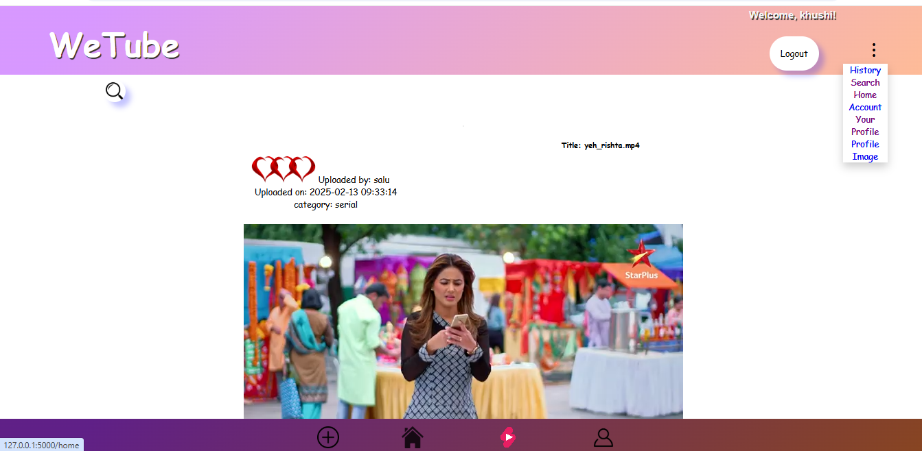

Slide 10
