Slide 1
Secure-Data-hiding-in-images-using-steganography
CAPSTONE PROJECT
Presented By: NavaThaReddy E
Student Name : NavaThaReddy E
College Name & Department : VCIWU/Computer Science

Slide 2
OUTLINE
Problem Statement
Technology used
Wow factor
End users
Result
Conclusion
Git-hub Link
Future scope

Slide 3
Problem Statement
As Digital Communication grows, Safeguarding sensitive Data is increasing vital. While traditional
Encryption offers security, it is often vulnerable to detection. This project utilizes steganography to
Securely embed messages within images, making them undetectable to the naked eye. The method
Ensures confidential Communication remains hidden during transmission.

Slide 4
Technology used
Programming Language: Python
Libraries:
OpenCV for image processing
Idle Python
Platform: Cross-Platform (Windows/Linux)
Tools: Visual Studio Code

Slide 5
Wow factors
Leverages state-of-the-art image processing techniques, ensuring high efficiency while preserving the original integrity of the image.
Provides customizable encryption options, giving users flexibility in choosing their desired level of data security.
Transforms everyday images into secure data carriers, making it nearly impossible for unauthorized users to detect hidden messages.

Slide 6
End users
Journalists and activists needing private communication.
Security experts looking for hidden ways to protect data.
Students and researchers interested in learning about cybersecurity and data security.
Everyday users wanting to keep their information safe.

Slide 7
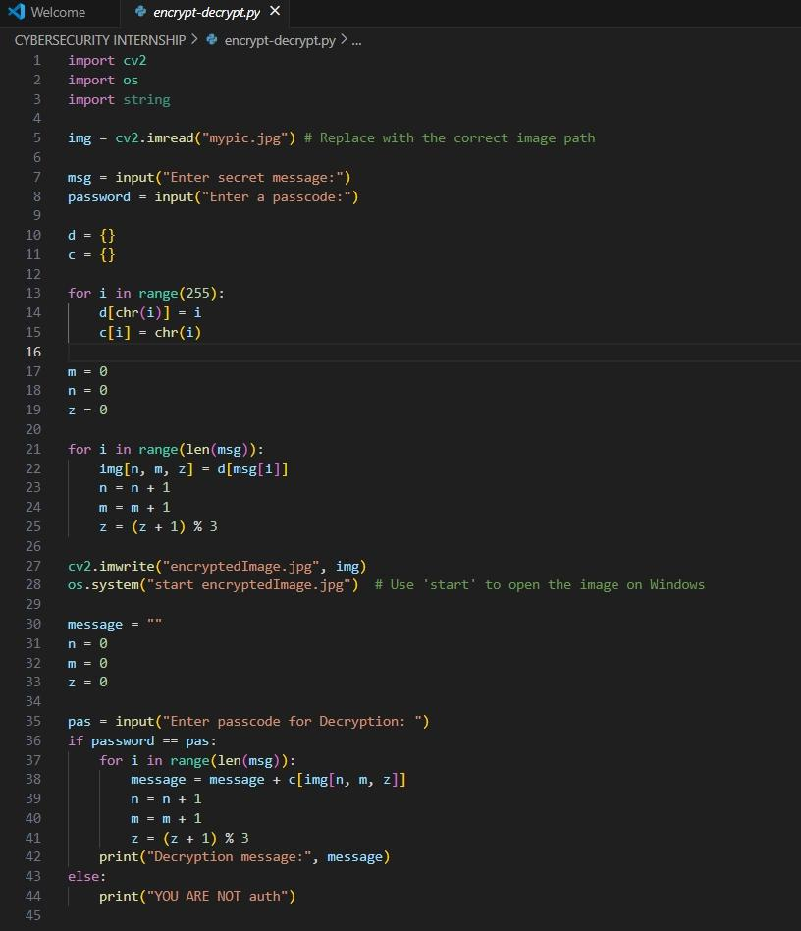
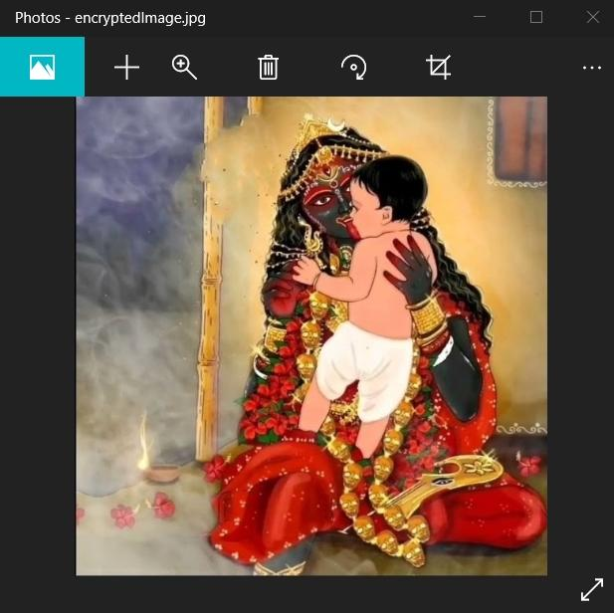


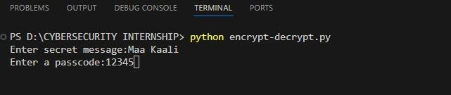
Results

Slide 8
Conclusion
This project offers a secure and efficient way to hide data in images, ensuring privacy through LSB steganography.
By embedding essential details like passcodes and message lengths, the method guarantees safe data transmission.
The intuitive design makes the encryption and decryption process straightforward, even for non-technical users.
Our approach contributes to enhancing digital privacy, providing an innovative solution for secure and covert communication.

Slide 9
GitHub Link
https://github.com/gopii-24/Secure-Data-Hiding-In-Images-Using-Steganography

Slide 10
Future scope(optional)
Expand to other file formats like videos and audio for broader applications.
Integrate advanced encryption for enhanced security alongside steganography.
Enable real-time encryption/decryption for live, secure communication.
Implement automatic detection of suspicious activities for added protection.

Slide 11
THANK YOU

