Slide 1


DIGITAL PORTFOLIO
STUDENT NAME: GOPIKA.S
REGISTER NO AND NMID: ASTVU346M24630 DEPARTMENT:B.SC. COMPUTER SCIENCE COLLEGE/UNIVERSITY: M.M.E.S. WOMEN’S ARTS AND SCIENCES COLLEGE

Slide 2




PROBLEM STATEMENT PROJECT OVERVIEW END USERS TOOLS AND TECHNOLOGIES PORTFOLIO DESIGN AND LAYOUT FEATURES AND FUNCTIONALITY RESULTS AND SCREENSHOT CONCLUSION GITHUBLINK

Slide 3
PROBLEM STATEMENT
In today’s digital era, traditional resumes alone are not enough to showcase skills and project effectively. Many students and professionals lack a structured online presence to highlight their work.Adigital portfolio provides an interactive and accessible platform to present achievement, skills and experience.

Slide 4
PROJECT OVERVIEW
• • •
Brief summary of my project What my portfolio contains (about me, projects, skills, contact). Main idea: showcase personal achievement, skills, and projects.

Slide 5
WHO ARE THE END USERS?
• • • •
Students (academic projects, resumes). Job seekers (to share with recruiters).
Freelancers (to show clients). Professionals(to highlight experience and achievement).

Slide 6
TOOLS AND TECHNIQUES
• • • •
Html: structure (pages, sections). CSS: styling (colours, layouts, responsiveness). JavaScript: interactively(navigation menu, animation, from validation). Mention code editor (VS code)or CODEPEN and hosting platform (GitHub pages).

Slide 7
PORTFOLIO DESIGN AND LAYOUT
• • • • • •
Sections included: Home/ about me
Projects Skills
Contact Responsive layout (mobile+desktopview).

Slide 8
FEATURES AND FUNCTIONALITY
• • • • •
Navigation bar with smooth scrolling. Project showcase with images/details. Interactive elements (hover effects, animation). Contact form (with validation).
Responsive design for all devices.

Slide 9
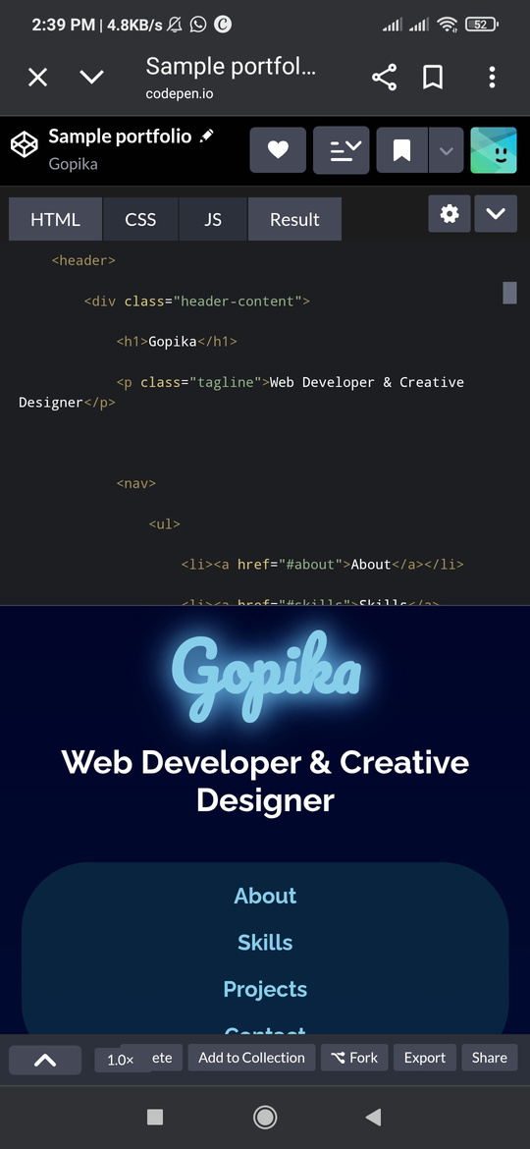
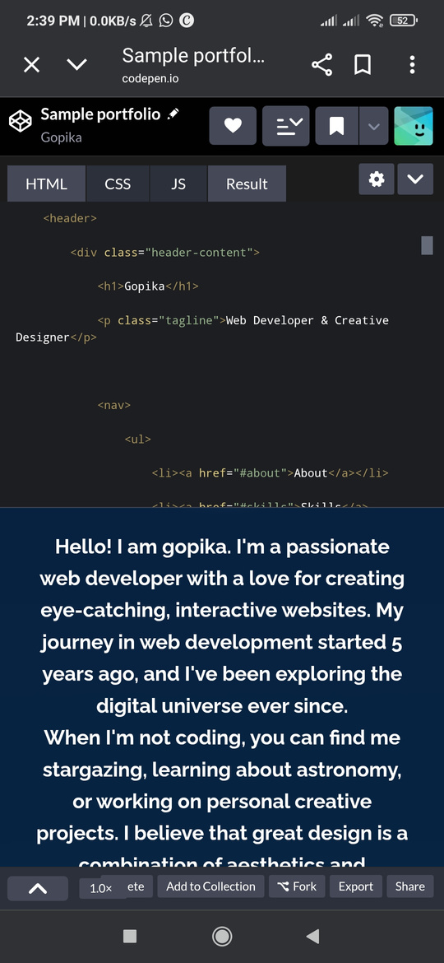
RESULT AND SCREENSHOT
• •
Screenshots of each section Before vs after (plain HTML: with CSS&JS).

Slide 10
CONCLUSION
• • •
Highlights of my project Final summary
Benefits of society

Slide 11
THANK YOU

