Slide 1
TAYLOR SERIES

Slide 2
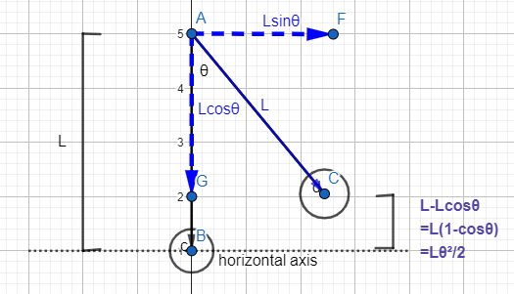

$\cos{x=1−\frac{x^{2}}{2!}}$ $+$ $\frac{x^{4}}{4!}$ $−\frac{x^{6}}{6!}$ $+$ $\frac{x^{8}}{8!}$ $……..$ For small angles, $\cos{x≈1−\frac{x^{2}}{2!}}$ 1$−$ $\cos{x≈\frac{x^{2}}{2!}}$
Consider a simple pendulum with rod length, ‘L’ oscillating in small angles about point A from point B to point C. Suppose we have to find the height of point C above the horizontal axis. So we split the vertical and horizontal components of length vector and took the difference. We substituted cosine term with its Taylor expansion for small angles.
Now the simplified term makes further derivation easy.

Slide 3
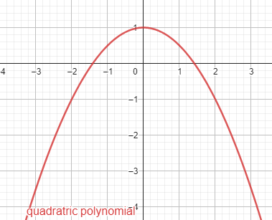
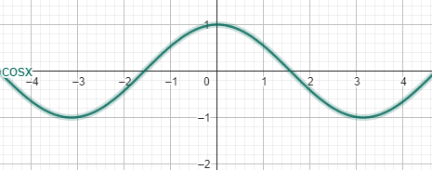
How a trigonometric function can be equated to a polynomial function?

Slide 4
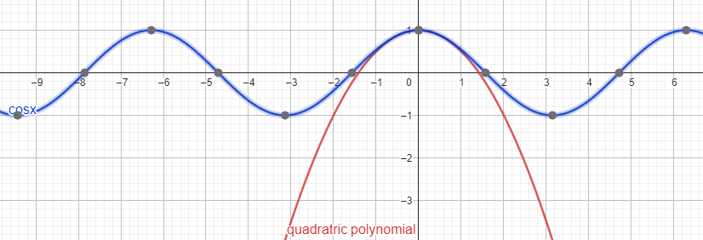
If we look carefully, we can see both the graphs overlapping at zero and points near zero
The pendulum shown in previous example exhibits small oscillations i.e. the value of theta is nearly zero, hence the substitution by this quadratic polynomial is justifiable.

Slide 5

What is the significance of other terms in Taylor series? $\cos{x=1−\frac{x^{2}}{2!}}$ $+$ $\frac{x^{4}}{4!}$ $−\frac{x^{6}}{6!}$ $+$ $\frac{x^{8}}{8!}$ $……..$ upto n terms: Taylor’s polynomial upto infinity: Taylor’s series

Slide 6
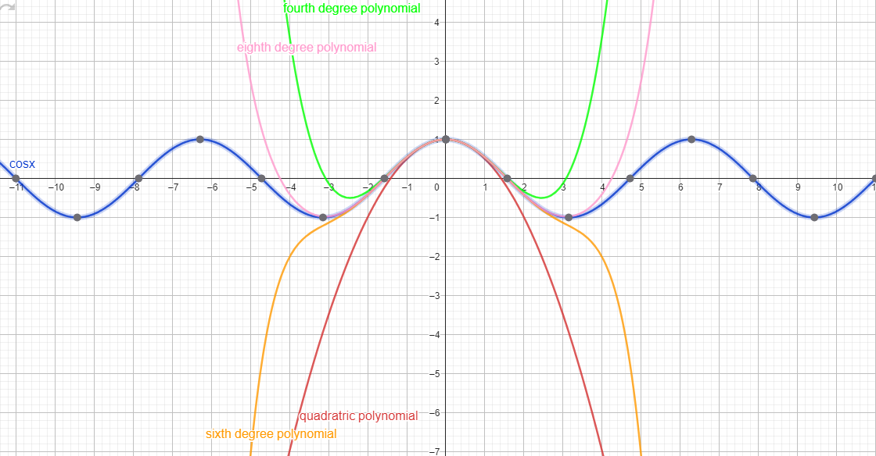
More the number of terms taken into account as taylor polynomial, more the graph of that particular polynomial coincides with cos(x).

Slide 7
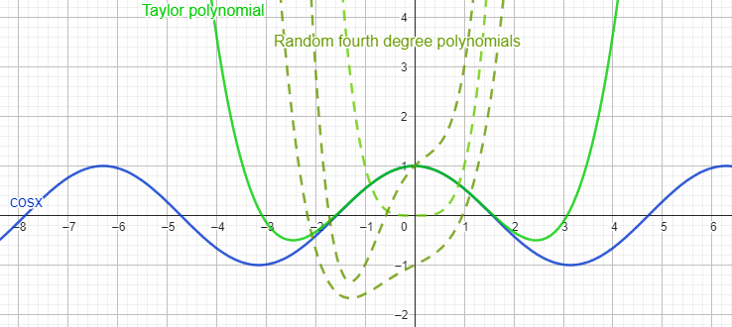
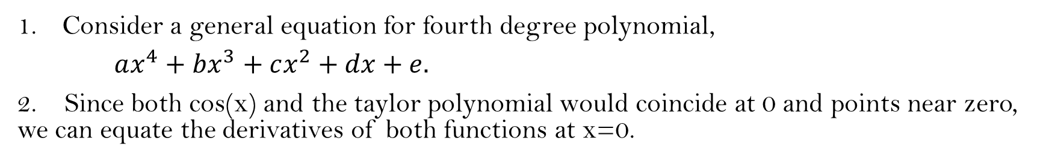
How did we find this exact equation, more specifically how did we find the exact coefficients?
Consider a general equation for fourth degree polynomial,
$ax^{4}+bx^{3}+cx^{2}+dx+e.$
2. Since both cos(x) and the taylor polynomial would coincide at 0 and points near zero, we can equate the derivatives of both functions at x=0.

Slide 8
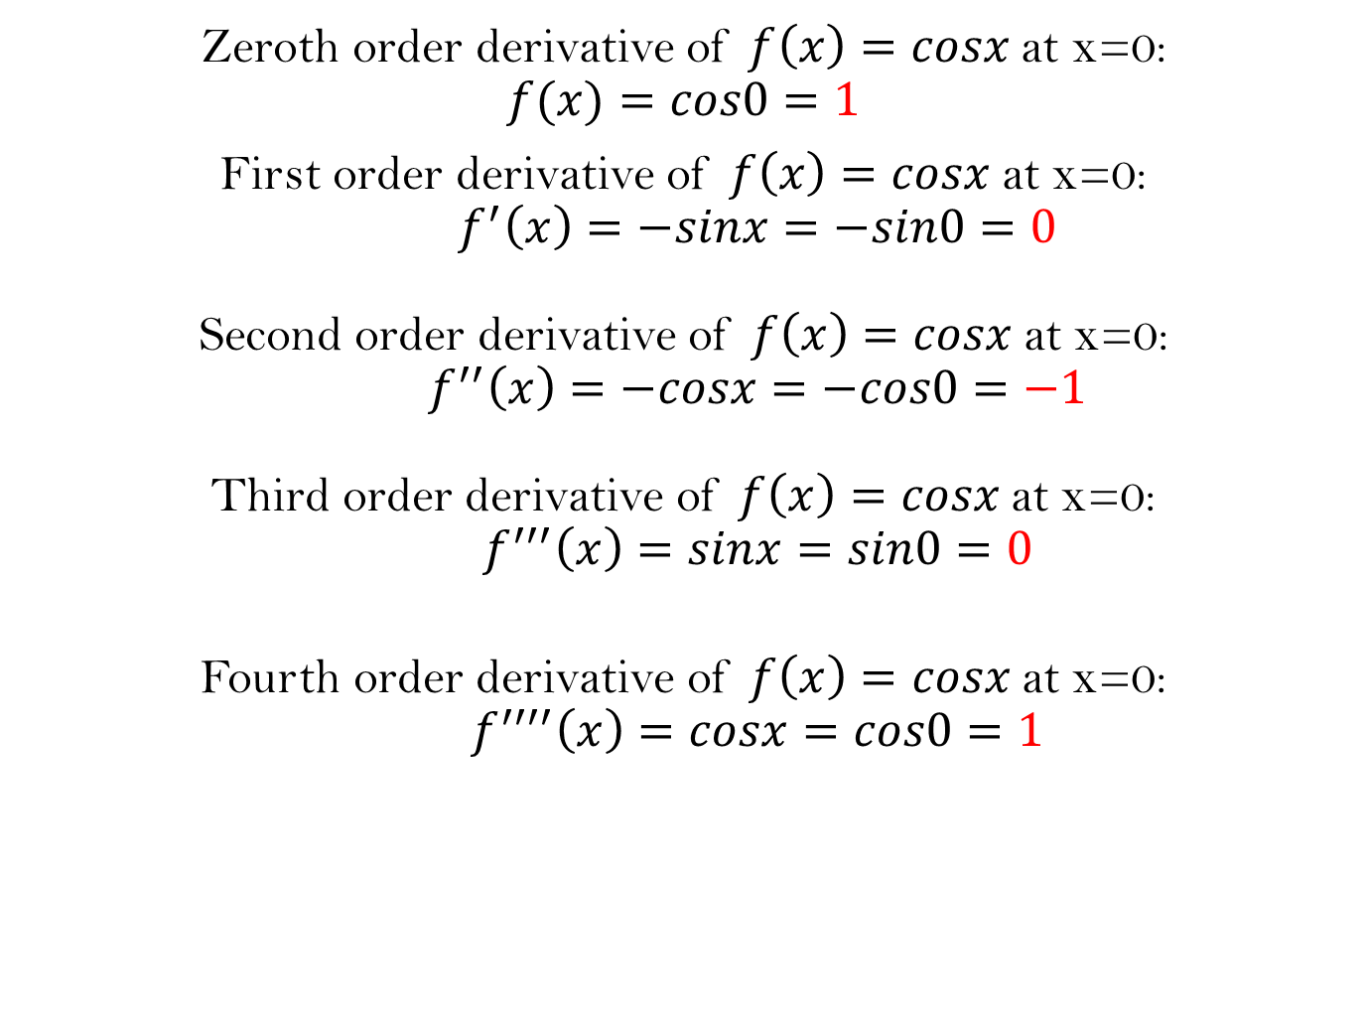
Zeroth order derivative of $f\left(x\right)=cosx$at x=0:
$$f(x)=cos0=1$$
First order derivative of $f\left(x\right)=cosx$at x=0: $f^{′}\left(x\right)=−sinx=−sin0=0$ Second order derivative of $f\left(x\right)=cosx$at x=0: $f^{′′}\left(x\right)=−cosx=−cos0=−1$ Third order derivative of $f\left(x\right)=cosx$at x=0: $f^{′′′}\left(x\right)=sinx=sin0=0$
Fourth order derivative of $f\left(x\right)=cosx$at x=0: $f^{′′′′}\left(x\right)=cosx=cos0=1$

Slide 9
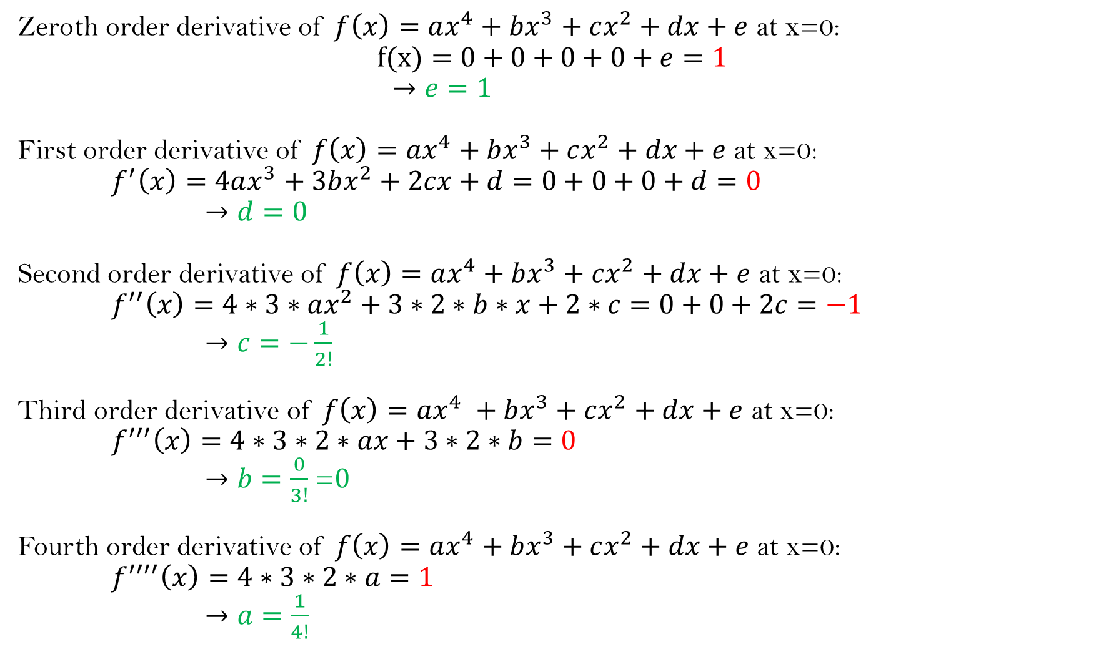
Zeroth order derivative of $f\left(x\right)=ax^{4}+bx^{3}+cx^{2}+dx+e$ at x=0: $$f(x)=0+0+0+0+e=1$$ $→e=1$ First order derivative of $f\left(x\right)=ax^{4}+bx^{3}+cx^{2}+dx+e$ at x=0: $f^{′}\left(x\right)=4ax^{3}+3bx^{2}+2cx+d=0+0+0+d=0$ $→d=0$ Second order derivative of $f\left(x\right)=ax^{4}+bx^{3}+cx^{2}+dx+e$ at x=0: $f^{′′}\left(x\right)=4∗3∗ax^{2}+3∗2∗b∗x+2∗c=0+0+2c=−1$ $→c=−\frac{1}{2!}$ Third order derivative of $f\left(x\right)=ax^{4} +bx^{3}+cx^{2}+dx+e$ at x=0: $f^{′′′}\left(x\right)=4∗3∗2∗ax+3∗2∗b=0$ $→b=\frac{0}{3!}$ =$0$ Fourth order derivative of $f\left(x\right)=ax^{4}+bx^{3}+cx^{2}+dx+e$ at x=0: $f^{′′′′}\left(x\right)=4∗3∗2∗a=1$ $→a=\frac{1}{4!}$

Slide 10
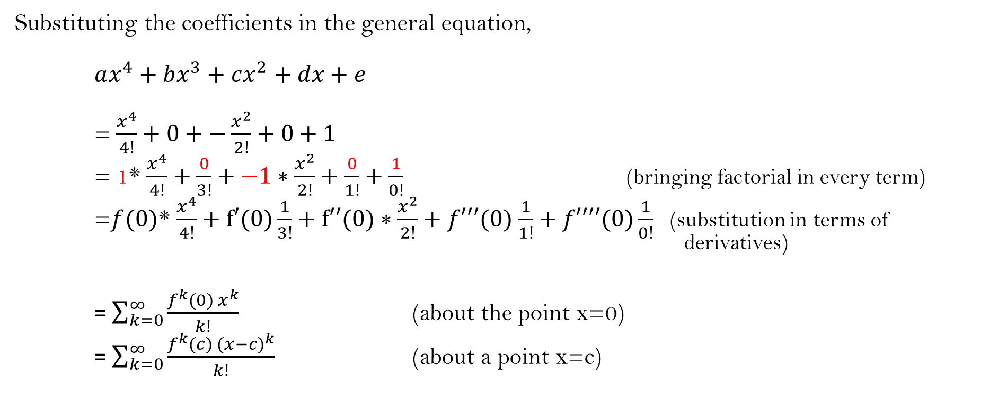
Framing a general series equation that works for all the analytic functions(trigonometric, exponential , logarithmic , etc.) :
Substituting the coefficients in the general equation,
$ax^{4}+bx^{3}+cx^{2}+dx+e$
= $\frac{x^{4}}{4!}$ $+$ $0+$ $−\frac{x^{2}}{2!}+$ $0+1$
= 1* $\frac{x^{4}}{4!}$ $+$ $\frac{0}{3!}+$ $−1∗\frac{x^{2}}{2!}+$ $\frac{0}{1!}+\frac{1}{0!}$ (bringing factorial in every term)
=$f(0)$* $\frac{x^{4}}{4!}$ $+$ $f′(0)\frac{1}{3!}+$ $f′′(0)∗\frac{x^{2}}{2!}+f′′′(0)$ $\frac{1}{1!}+f′′′′(0)\frac{1}{0!}$ (substitution in terms of derivatives)
= $\sum_{k=0}^{∞}{\frac{f^{k}{(0) x}^{k}}{k!}}$ (about the point x=0)
= $\sum_{k=0}^{∞}{\frac{f^{k}{(c) (x−c)}^{k}}{k!}}$ (about a point x=c)

Slide 11

Let f be a function defined on some open interval containing c. If f possesses derivatives of all orders at c, then the series $$\sum_{k=0}^{∞}{\frac{f^{k}{(c) (x−c)}^{k}}{k!}}$$ is called the Taylor series for f about c.

Slide 12
End.

