Slide 1
Bird Migration Analysis in Excel

Slide 2



INTRODUCTION AND PROJECT OVERVIEW
Why study migration
What bird migration is
Birds travel seasonally to reach better weather, food,
and breeding areas.
These recurring journeys create patterns that can be
tracked and compared.
Why it matters
Migration insights support wildlife conservation and habitat protection decisions.
They also strengthen environmental monitoring and
biodiversity management planning.
What this project does
It uses Excel to turn migration records into clear, practical
insights.
The goal is to make key trends easy for anyone to explore.

Slide 3



Migration Project Goals
Map key migration patterns
Compare movements by species, region, month, habitat, and weather.
Track performance and success
Use distance, duration, and average speed to assess journeys.
Summarize outcomes using overall migration success indicators.
Explain what drives outcomes
Link interruptions and failures to reasons like storms or injury.
Make insights easy to explore
Build an interactive Excel dashboard for quick public exploration.

Slide 4

DATASET AND DATA PREPARATION
What the dataset captures
Each record links bird tracking details with its migration outcome.
Dataset size and structure
10,000 observations organized across 42 information fields.
Tools used in Excel
Power Query supported preparation, and Pivot Tables powered summaries.
Why this matters
The scale enables comparisons across species, regions, and seasons.

Slide 5
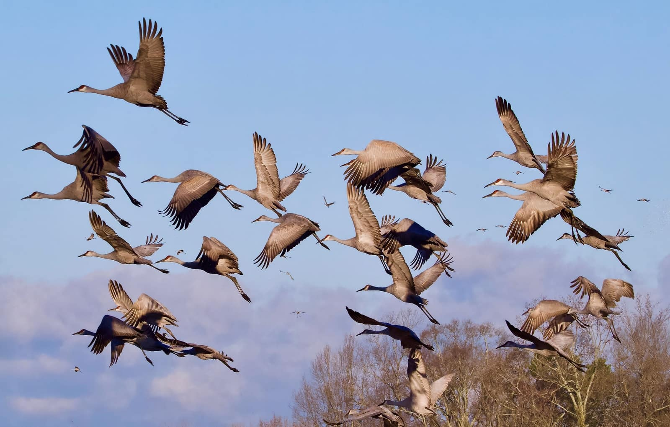
Who and where is tracked
Key Data Fields
Each record links a Bird_ID to its species, region, and habitat.
Weather_Condition captures the conditions birds faced during travel.
Timing and purpose
Migration_Reason records why birds moved (breeding, feeding, and more).
Migration_Start_Month shows when journeys began across the year.
Journey performance and outcomes
Flight_Distance_km, Flight_Duration_hours, and Average_Speed_kmph measure effort.
Migration_Interrupted, Interrupted_Reason, and Migration_Success summarize results.

Slide 6




Data Cleaning Steps
Prepare the dataset
Imported the migration file into Power Query for structured cleaning.
Fix missing and messy values
Checked blanks and handled missing entries across key
fields.
Filled null “Interrupted
Reason” values using a custom column.
Keep only what matters
Removed unnecessary
columns to keep analysis focused and consistent.
Load and analyze in Excel
Loaded the cleaned table into Excel and built Pivot Tables for
the dashboard.

Slide 7

ANALYSIS AND INSIGHTS
What the dashboard compares
It breaks results down by species, region, and start month.
It also groups journeys by habitat, weather, and migration reason.
Interruptions are tracked, including whether and why they occurred.
How results are shown
Pie and donut charts summarize distributions at a glance.
Bar charts compare regions and interruption reasons side by side.
A line chart shows how migration changes across months.
Why this helps
It quickly reveals where migration concentrates and what triggers it.
It highlights the biggest disruption drivers, guiding focus areas.

Slide 8
ANALYSIS AND INSIGHTS
Where Migration Clusters
01.
02.
Species hotspots
Regional concentration
Hawks show the highest migration activity among the species tracked.
South America records the largest overall volume of migration journeys.
03.
04.
Seasonal peaks
What this implies
Hawk migration is strongest in March, showing a clear seasonal spike.
Across birds, January also stands out as a high-migration month.
Migration clusters around specific species and months, not evenly spread.

Slide 9
ANALYSIS AND INSIGHTS
Performance & Success
01.
02.
Top migration performance
Highest migration success
Storks achieved the highest speed and longest travel distance.
Warblers delivered the most successful migrations overall.
03.
04.
Where success is most common
Key takeaway
Successful journeys occurred most often in North America.
Peak performance and peak success do not always align.

Slide 10

Disruption Hotspots
Top interruption trigger
Storms were the most common reason migrations got interrupted.
Who fails most often
The highest failure counts were seen in hawks and eagles.
Where failures concentrate
Failed migrations were reported most frequently in South America.
Weather linked to activity
A large share of migration activity occurred during foggy conditions.

Slide 11

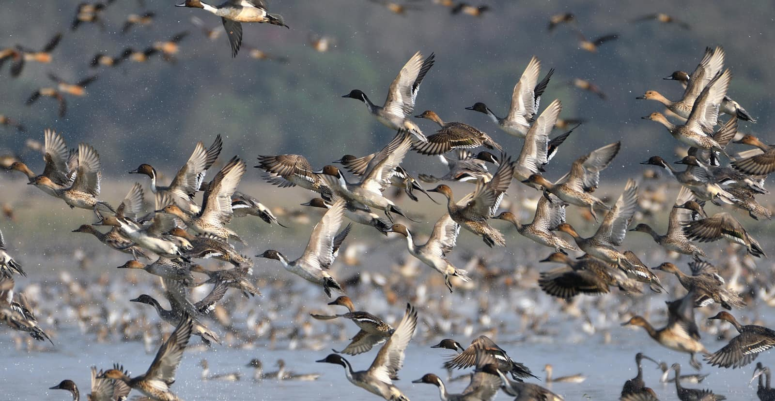

ANALYSIS AND INSIGHTS
Reasons & Next Steps
Why birds migrate most
The top driver was avoiding predators, ahead of climate, breeding, and feeding.
When migration is most common
January stands out as the busiest start month, both solo and ﬂock ﬂights.
What we should do next
Protect key habitats used for breeding, feeding, and migration routes.
Track weather conditions closely to help support safer journeys.
Expand GPS and modern tracking for continuous migration monitoring.
Reduce human disturbance and strengthen public awareness efforts.

