Slide 1
Git and Git hub

Slide 2
Agenda
1. GIT
2. What is GITHUB
3.Install GIT/GITHUB
4.Add files/folders to the git
5. Creating repository in git hub
6. Branching and Merging
7.How to send email from Git Hub

Slide 3

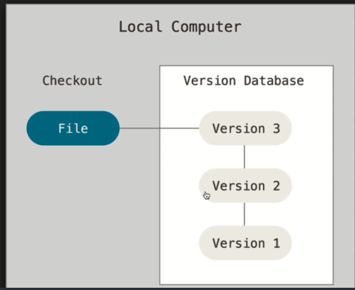
Git
Git is a distributed version-control system for tracking changes in source code during software development. It is designed for coordinating work among programmers, but it can be used to track changes in any set of files.
It is used to track changes in the source code. It allows multiple developers to work together. A VCS allows you to keep every change you make in the code repository.
It is free and open source.

Slide 4

GitHub
GitHub is a web-based hosting service for version control using Git. It is mostly used for computer code. It offers all of the distributed version control.
  GitHub offers unlimited private repositories to all plans, including free .i Git repository hosting service, but it adds many of its own features.

Slide 5
Install git/GitHub
Git:
Step 1: go to https://git-scm.com
Step 2: Down load for windows version
Step 3: double click on .exe file and install it.
Step 4: After installation of git go to the command prompt and type
        git --version to know the whether installed or not

Slide 6
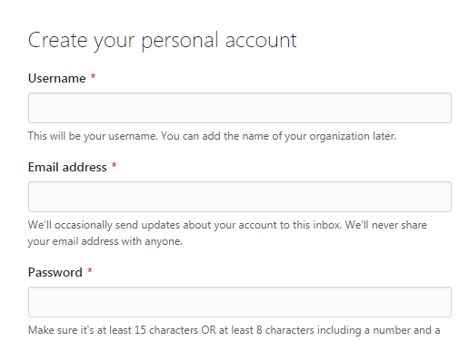
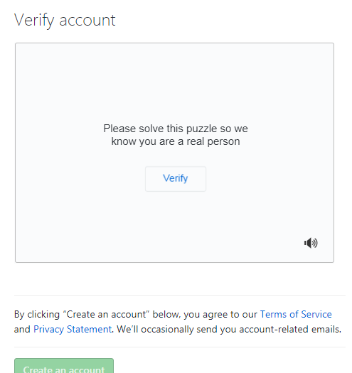
GitHub:
Step 1: go to the https://github.com
Step 2: Go to sigh up
Step 3: Create free account on github
Step 4: set our user name and password globally to know particular user who was changed.
Git config –global user.email “gopikanair189@gmail.com”
Git config –global user.name “gopika3”

Slide 7

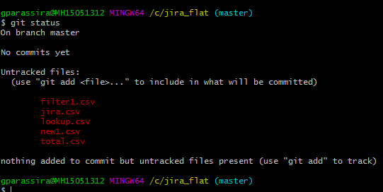
Adding file/folders to the git
Go to the location of the folder/project on terminal
Initialize the folder using git init command.
        To know the status type git status
        We can see the files present in my folder

Slide 8
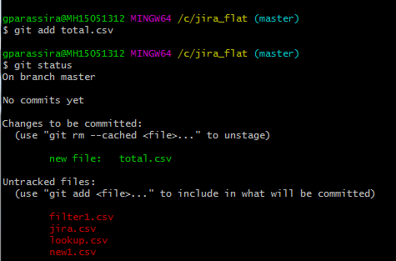
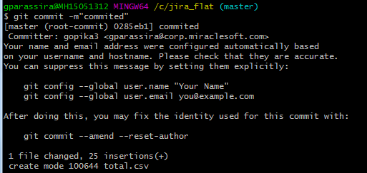
Add a file to the git using git add total.csv
Now see the status using git status command
you can see the total.csv in green color means
that file was added to the git.
Now commit the added file in the git using
commit -m “committed”

Slide 9
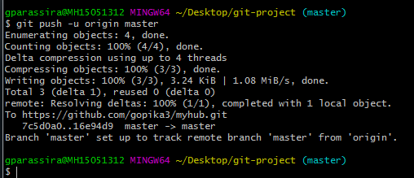
After committing the file in git you need to push into github for that you need to add the repository path in git by using
Git remote add origin https://github.com/gopika3/myhub.git
Push the file using git push -u origin master

Slide 10
Commands:
Gitinit
Git status
Git add gp.txt
Git commit -m “commited”
Git remote add origin https://github.com/gopika3/myhub.git
Git push -u origin master
Git config –global user.email “gopikanair189@gmail.com”
Git config –global user.name “gopika3”

Slide 11
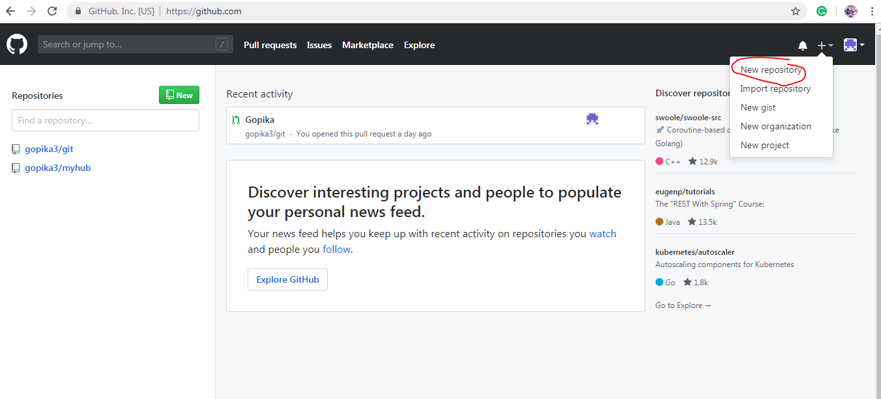
Creating repository in github
Sign up in your github account.

Slide 12
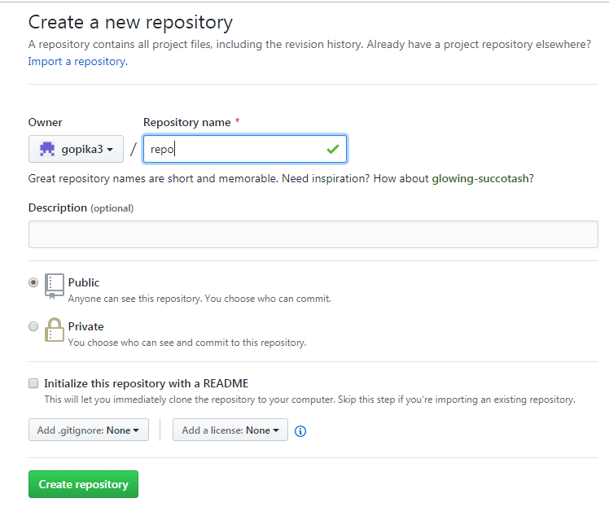
Click on new repository to create a repository.

Slide 13
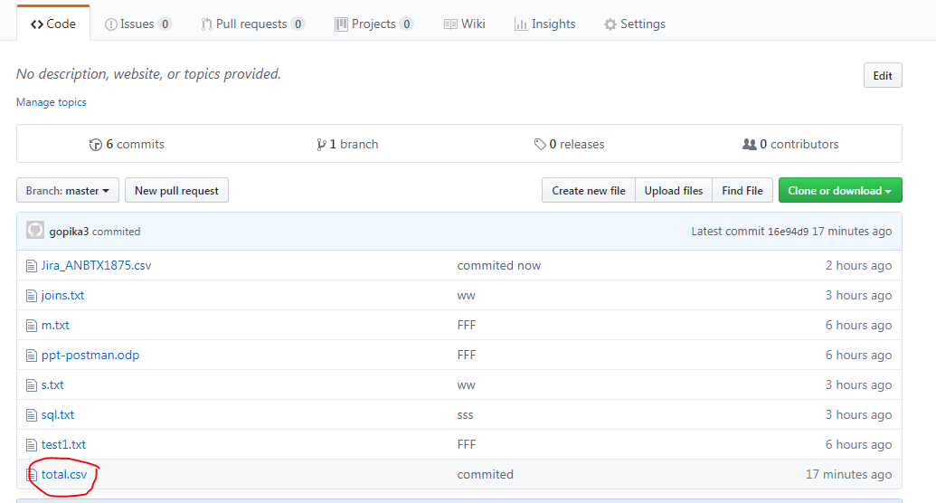
Click on create repository
Repository was created and push your files from git to repository.from below image you can see the all files moved from git

Slide 14
                Branching/merging
    Create branch:
      open the terminal and give create branch command
        git branch branchname
    Check out branch,push file into branch:
        git checkout branchname
        Push the file into branch
        git push -u mybranch

Slide 15
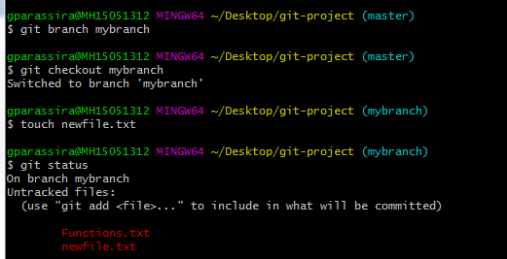
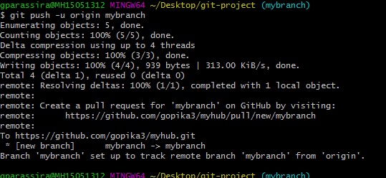
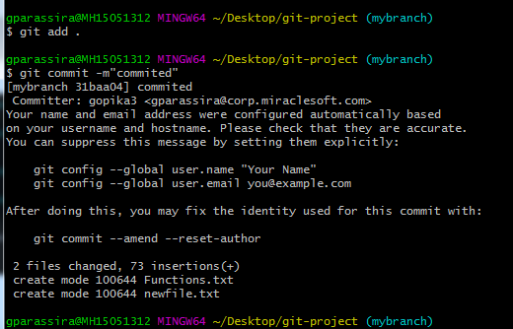

Slide 16
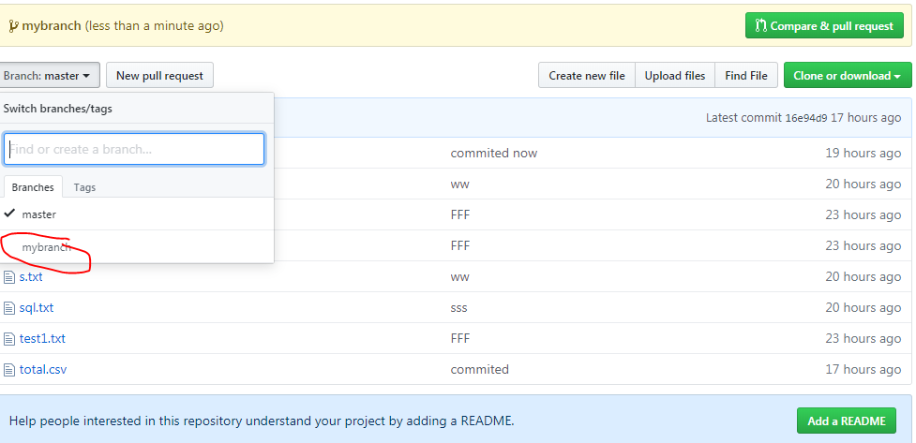

Slide 17
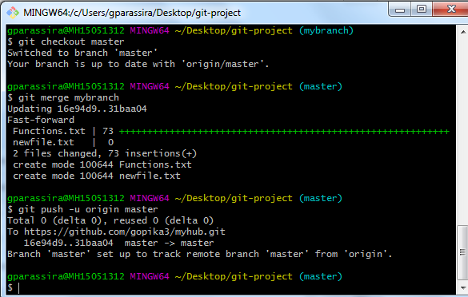
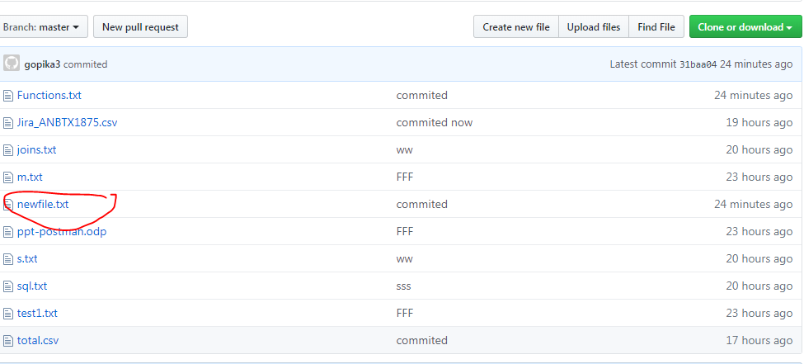
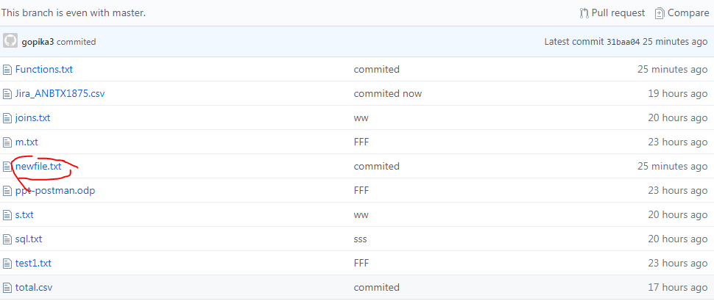

Slide 18
Thank you

