Slide 1
Git and Git hub

Slide 2
Agenda
1.Introduction about git
2.Installing /Updating postman
3.HTTP(Hypertext Transfer Protocol ) Basics
4.Creating requests in Postman
5.

Slide 3

Git
Git is a distributed version-control system for tracking changes in source code during software development. It is designed for coordinating work among programmers, but it can be used to track changes in any set of files.
It is used to track changes in the source code. It allows multiple developers to work together. A VCS allows you to keep every change you make in the code repository.

Slide 4
Git
Git is a distributed version-control system for tracking changes in source code during software development. It is designed for coordinating work among programmers, but it can be used to track changes in any set of files.
It is used to track changes in the source code. It allows multiple developers to work together. A VCS allows you to keep every change you make in the code repository.

Slide 5
What is an API?
API stands for Application Programming Interface. Talking in technical terms an API is a set of procedures, functions, and other points of access which an application, an operating system.
It makes available to programmers in order to allow it to interact with other software
An API takes your requests from the device and fetch the response from the server
APIs help you fetch a particular response according to the particular request

Slide 6
        HTTP(Hypertext Transfer Protocol ) Basics
The Hypertext Transfer Protocol (HTTP) Is an application-level protocol for distributed, collaborative, hypermedia information systems.
Most populared Application protocol used in the internet(Web)
An HTTP client sends a request message to an HTTP server,The server In turns returns a response message.
HTTP stateless protocol .In other words the current request doesn't know what has been
done in the previous requests.
.

Slide 7
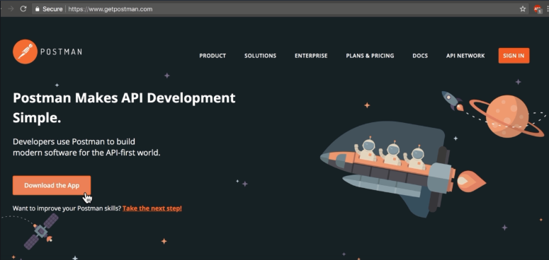
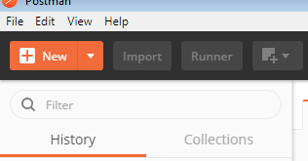
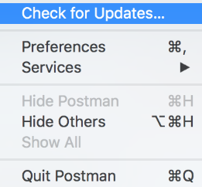
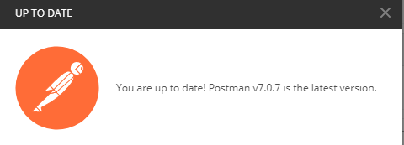
Installing /Updating postman
“Login to the www.getpostman.com and download the postman Application.
Chrome extension application also available but it is no longer up to date what we using now a days.
In application Check for update option is available in the help section. We can check whether we are using updated version or not.

Slide 8
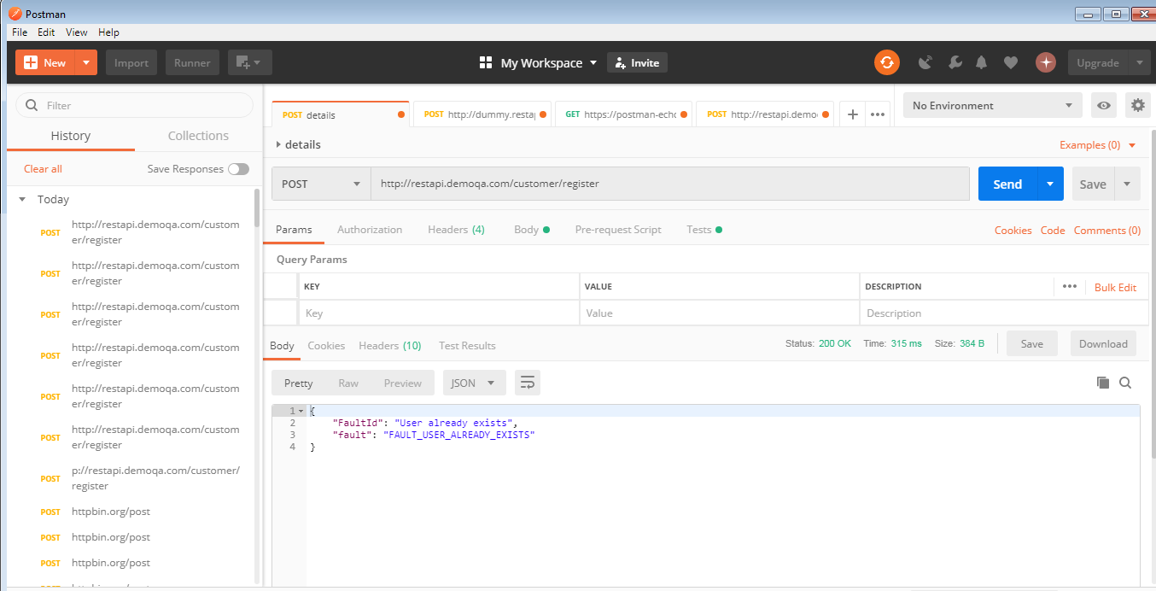

Slide 9
Request methods
GET- The GET method is used to extract information from the given server using a given URI. While using GET request, it should only extract data and should have no other effect on the data.
POST- A POST request is used to create a new entity. It can also be used to send data to the server, for example, customer information, file upload, etc. using HTML forms.
PUT- Create a new entity or update an existing one.
DELETE- Removes all current representations of the target resource given by a URI.

Slide 10
GET http://dummy.restapiexample.com/api/v1/employees
POST http://dummy.restapiexample.com/api/v1/create
PUT http://dummy.restapiexample.com/api/v1/update/21
DELETE http://dummy.restapiexample.com/api/v1/update/2

Slide 11
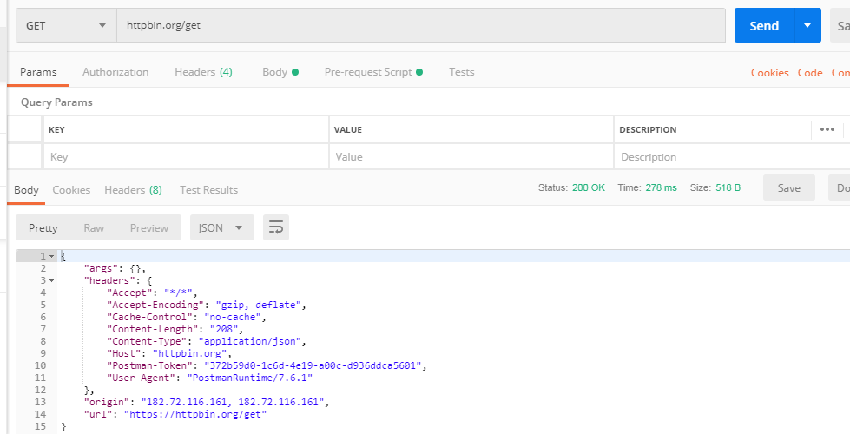
Creating requests in Postman
https://httpbin.org/

Slide 12
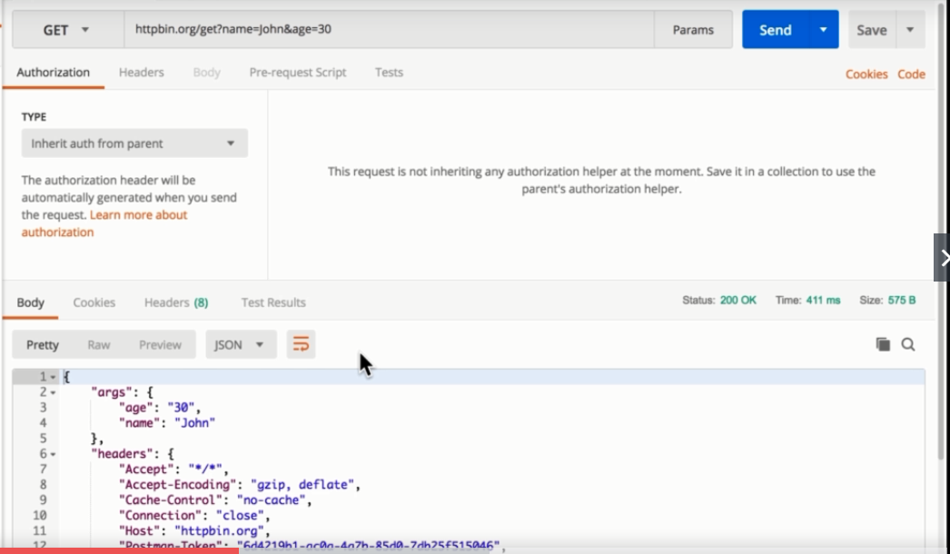
Passing data with your requests
We can pass the query parameters by using ?
This kind of response is called JSON response. Postman can understand lots of different responses
You can give parameters as a key value.you can enable and disable the parameters.

Slide 13
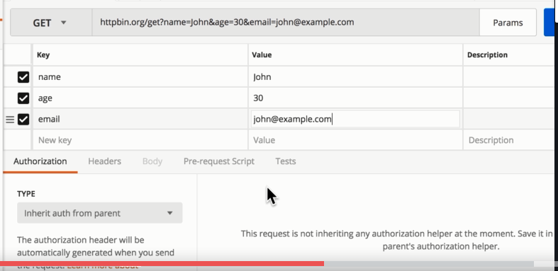
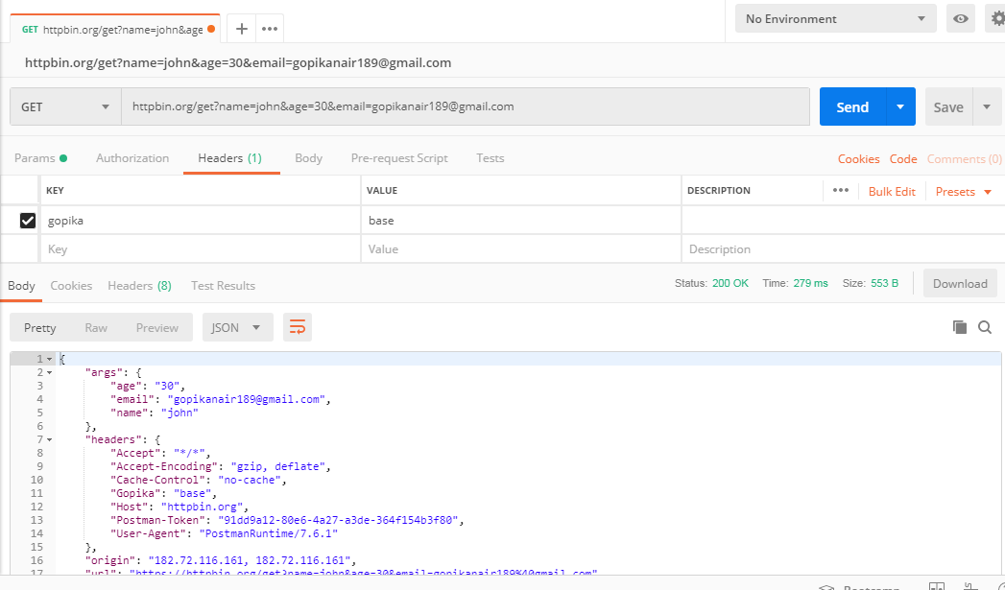

Adding parameter value Adding Header value

Slide 14
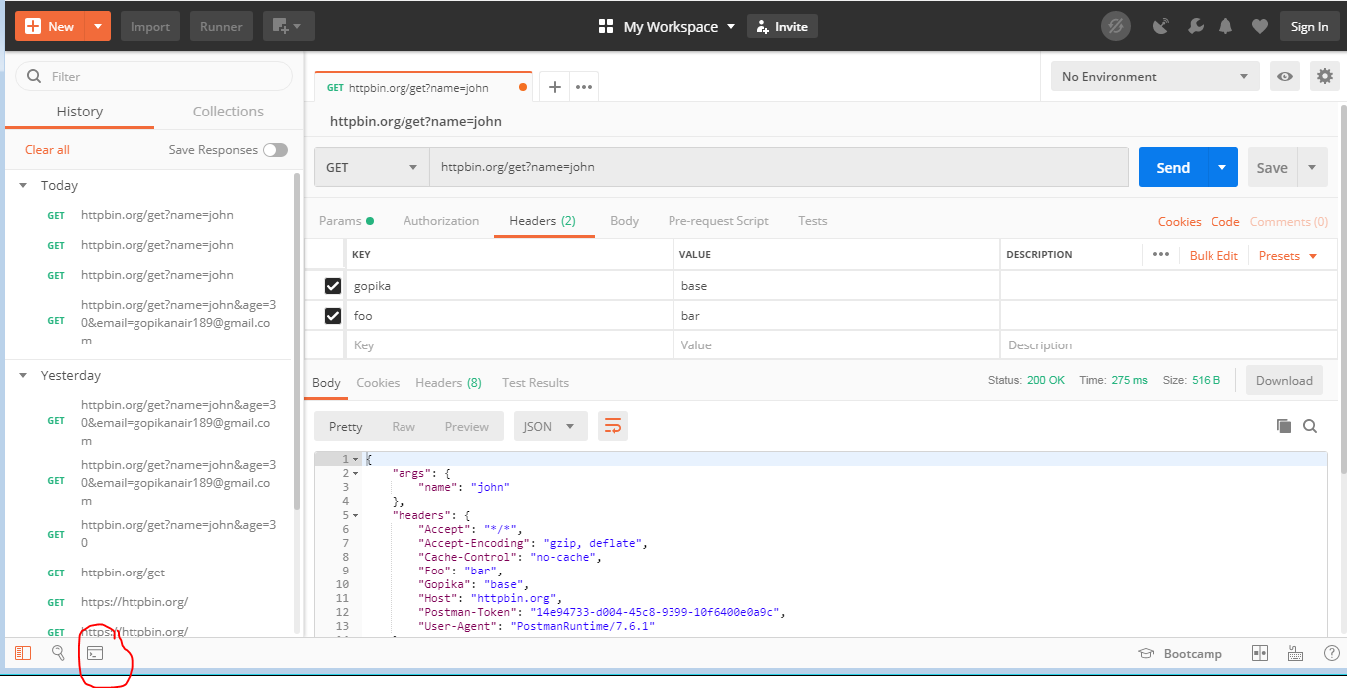
        Debugging Requests
Sometimes in postman you do not get the response and you are not sure what was header exactly sent,We need another way to find out to see how exactly request looks like. Thats is postman console
You can find it in left corner click on it. Window will pop up and go back to the request see it again.
.

Slide 15
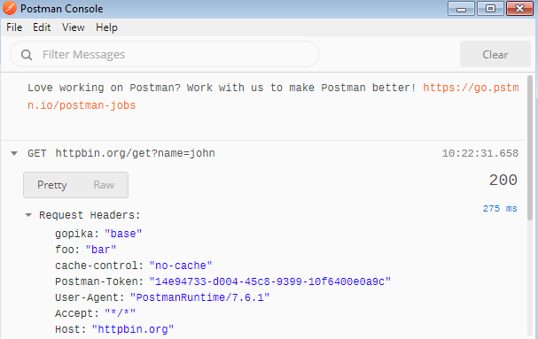
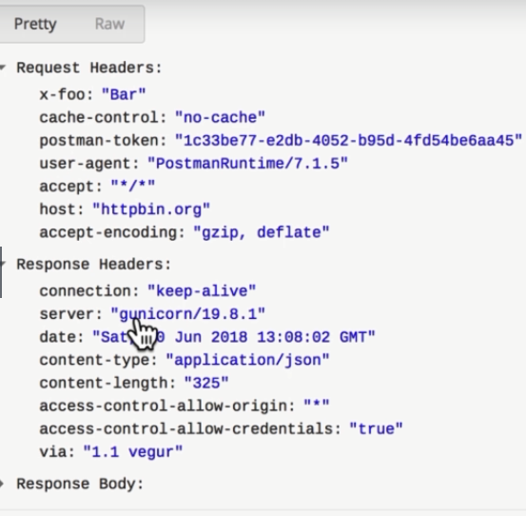
We can see the HTTP request going out and Http request coming in.
.

Slide 16
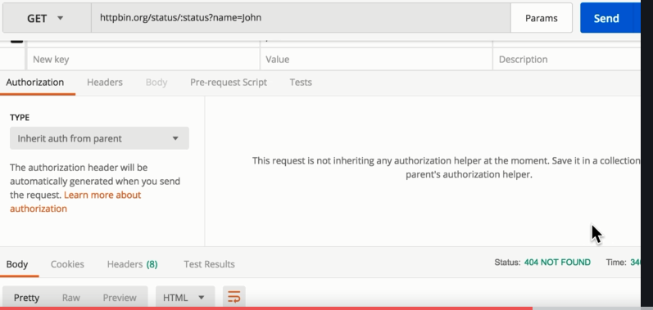
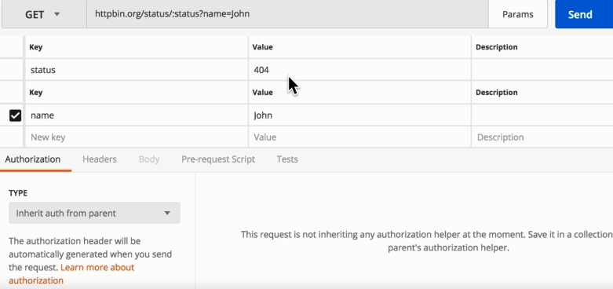
Passing data with your requests (continued)
You can specify the path variables before the ?
Before ? Every thing is path variables and after the ? We can specify the query parameters
Status codes:
404-file not found
200-Successful
401-UN authorized Access.
503-Server is not available

Slide 17
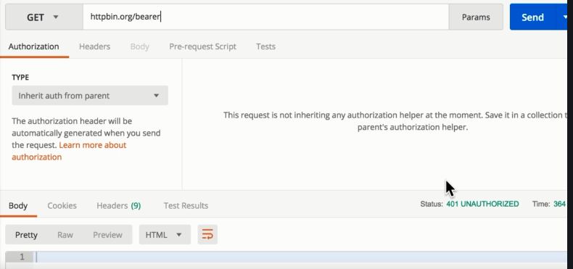
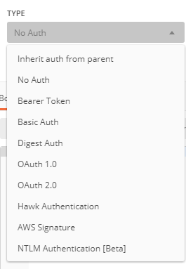
Authentication
When we try to send end point
URL without Authorization access
It throws an error 401 unauthorized error
Below are the authentication types available in postman

Slide 18
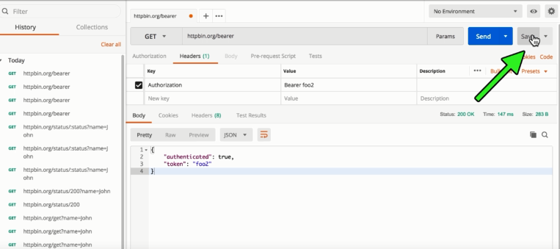
    Saving and Sharing your Requests
Request that you want to keep for later we have save option to saving request for later need.

Slide 19
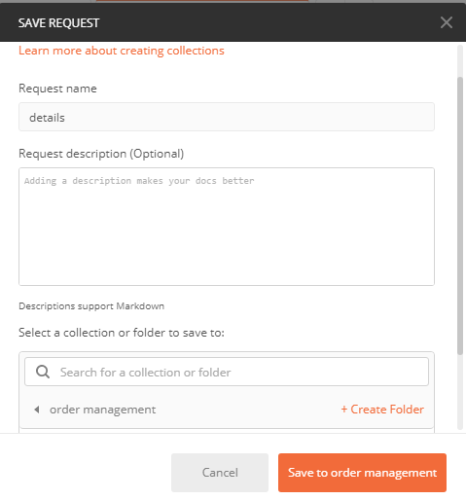
Give your request name
Create a collection/folder to
save the request
Click on save to folder name
Request saved successfully

Slide 20
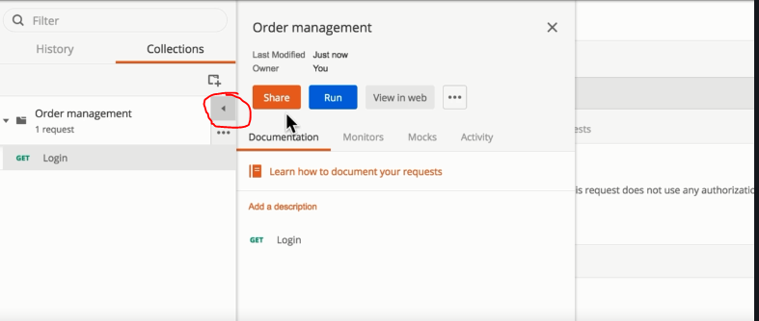
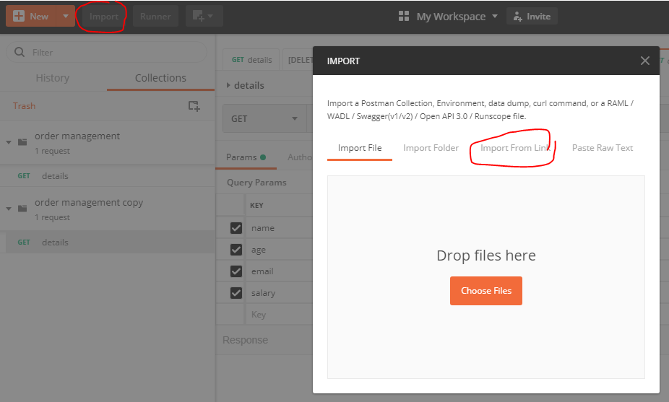
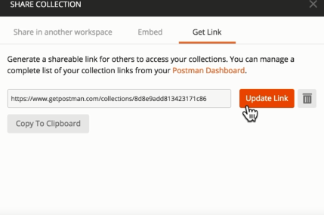
You can get share option to share Your collection
Click on the share option you can get Get link option
You can get link for your collection.
Copy the link and import it.
If you updated the old link save and click on update
link option automatically new link will update.

Slide 21
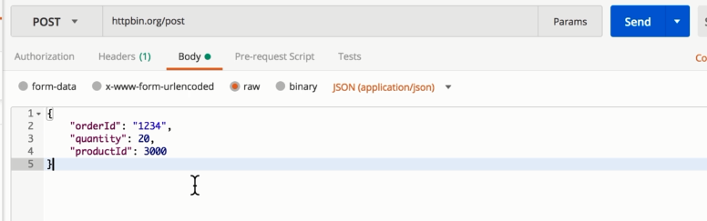
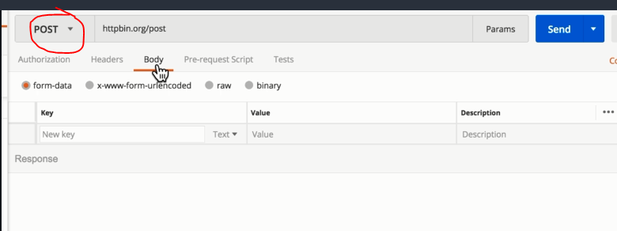
Creating a POST request with a JSON
We can request in post method by using JSON format
After sending the post request click on body
Click on raw option
Select JSON format
Type code in JSON format and send request

Slide 22
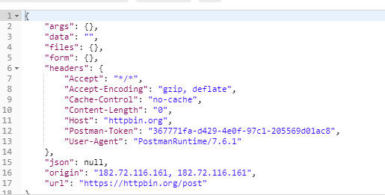
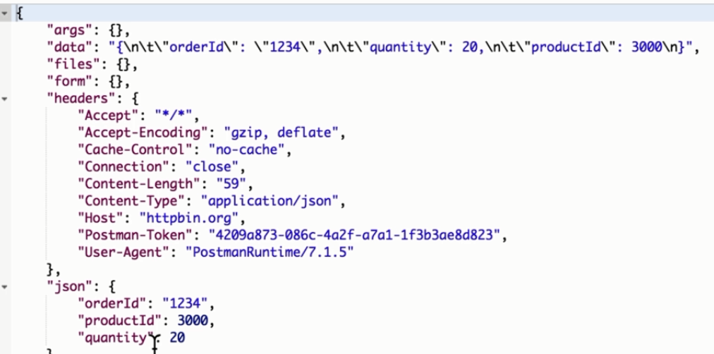
Without JSON body With JSON body
From below pictures we can observe the difference

Slide 23
Passing data between your requests
We can pass the information between two requests.
To do this we need to set global variable&store the information which we need to pass
Send one request in post method another one in get method
Now we need to pass the information from get request to post request
In tests tab define a global variable and pass the information through this variable
You can see the information in quick environment look
In first request body section you need to define that variable in {{}}
Send the request and you can compare the orderId between two requests

Slide 24
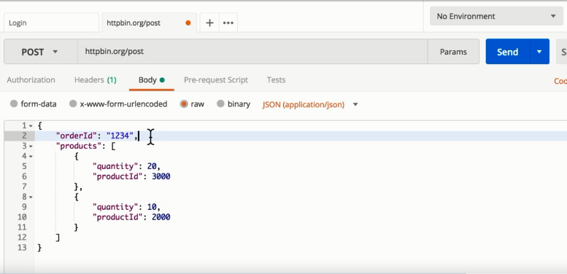
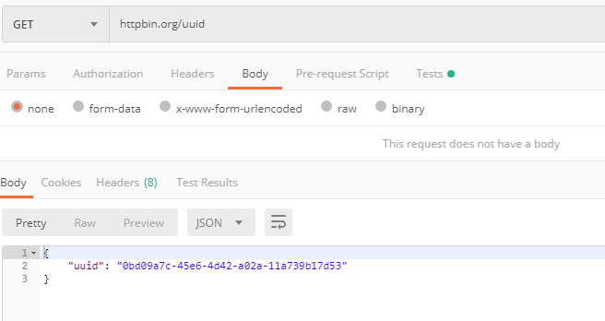
First Request second request
https://httpbin.org/

Slide 25
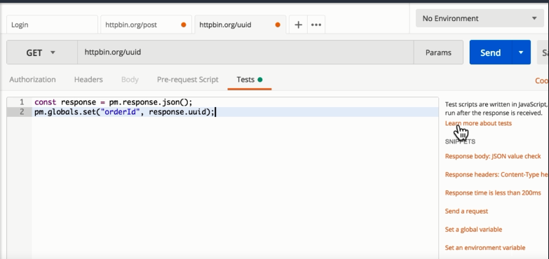
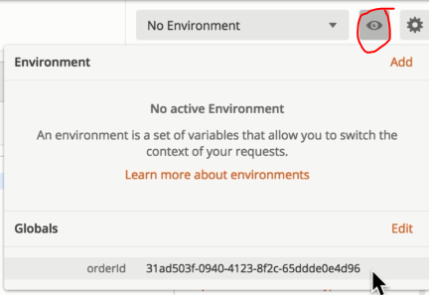
Set global variable in tests to pass the information to another request and you can see that information in environment quick view section

Slide 26
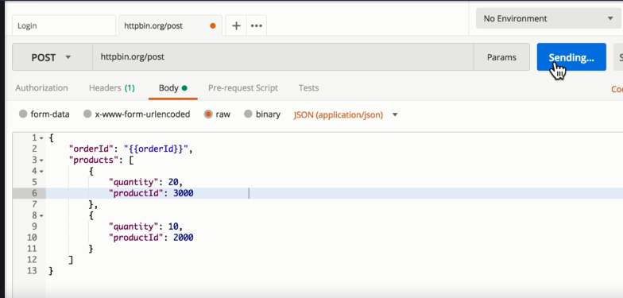
Below is the first request body section you need to place variable which we mentioned in the second request inside {{}}.
Sending request

Slide 27
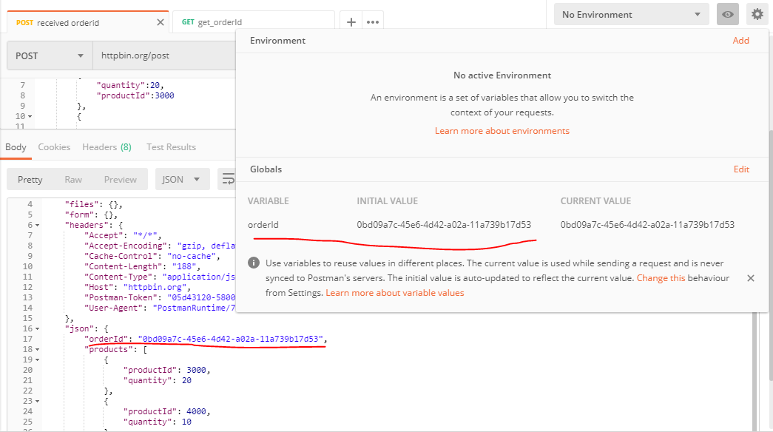
Now you can observe order id of first request and second request both are same

Slide 28
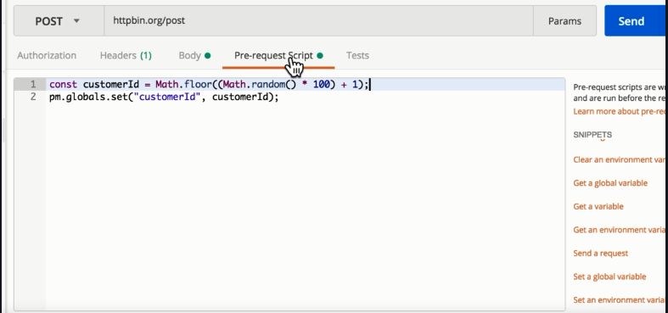
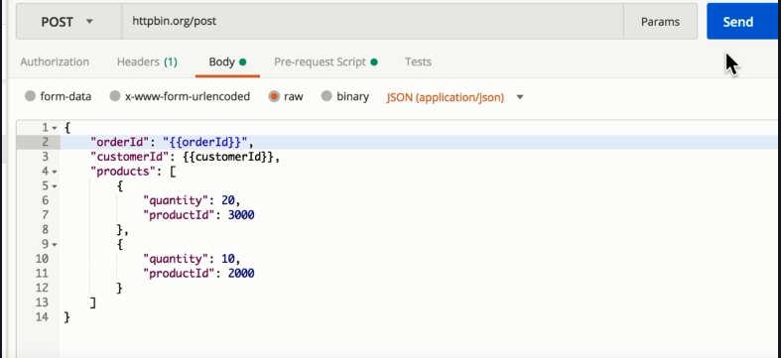
Generating dynamic data
We need to set variables in pre request script to get the data dynamically
It will execute before the script.
After writing the script set the variable in body section between {{}}
Send a request You will get data dynamically

Slide 29
Thank you

