Slide 1

Overview of API testing over Postman
P. Gopika Nair

Slide 2
Agenda
1.Introduction
2.Installing /Updating postman
3.HTTP(Hypertext Transfer Protocol ) Basics
4.Creating requests in Postman
5.Passing data with your requests
6.Debugging Requests
7.Passing data with your requests (continued)
8.Authentication

Slide 3
9.Saving and Sharing your Requests
10.Creating a POST request with a JSON
11.Passing data between your requests
12. Generating dynamic data

Slide 4

What is postman?
Postman is a great Application for prototyping APIs, and it also has some powerful testing features. We use this API for Interacting with HTTP APIs. It presents you with a friendly GUI for constructing requests and reading responses.
Postman makes API development faster, easier, and better. Powerful, simple to use GUI
        Saved history of API requests
        Flexible API monitoring, for up time, performance&accuracy.

Slide 5
What is an API?
API stands for Application Programming Interface. Talking in technical terms an API is a set of procedures, functions, and other points of access which an application, an operating system.
It makes available to programmers in order to allow it to interact with other software
An API takes your requests from the device and fetch the response from the server
APIs help you fetch a particular response according to the particular request

Slide 6
        HTTP(Hypertext Transfer Protocol ) Basics
The Hypertext Transfer Protocol (HTTP) Is an application-level protocol for distributed, collaborative, hypermedia information systems.
Most populared Application protocol used in the internet(Web)
An HTTP client sends a request message to an HTTP server,The server In turns returns a response message.
HTTP stateless protocol .In other words the current request doesn't know what has been
done in the previous requests.
.

Slide 7
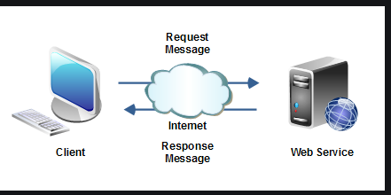
Client
The HTTP client sends a request to the server in the form of a request method, URI, and protocol version
Server
The HTTP server responds with a status line, including the message's protocol version and a success or error code.

Slide 8
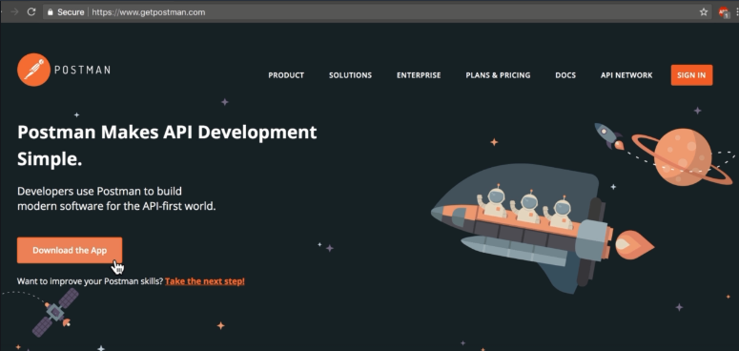
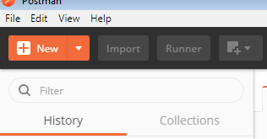
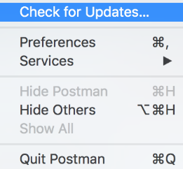
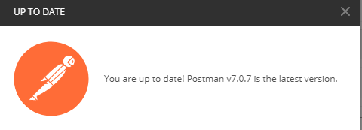
Installing /Updating postman
“Login to the www.getpostman.com and download the postman Application.
Chrome extension application also available but it is no longer up to date what we using now a days.
In application Check for update option is available in the help section. We can check whether we are using updated version or not.

Slide 9
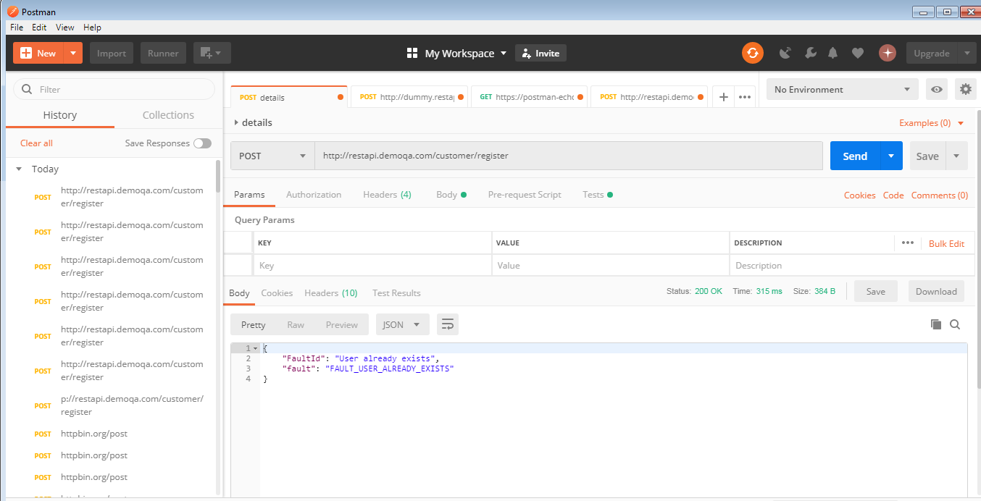

Slide 10
Request methods
GET- The GET method is used to extract information from the given server using a given URI. While using GET request, it should only extract data and should have no other effect on the data.
POST- A POST request is used to create a new entity. It can also be used to send data to the server, for example, customer information, file upload, etc. using HTML forms.
PUT- Create a new entity or update an existing one.
DELETE- Removes all current representations of the target resource given by a URI.

Slide 11
GET http://dummy.restapiexample.com/api/v1/employees
POST http://dummy.restapiexample.com/api/v1/create
PUT http://dummy.restapiexample.com/api/v1/update/21
DELETE http://dummy.restapiexample.com/api/v1/update/2

Slide 12
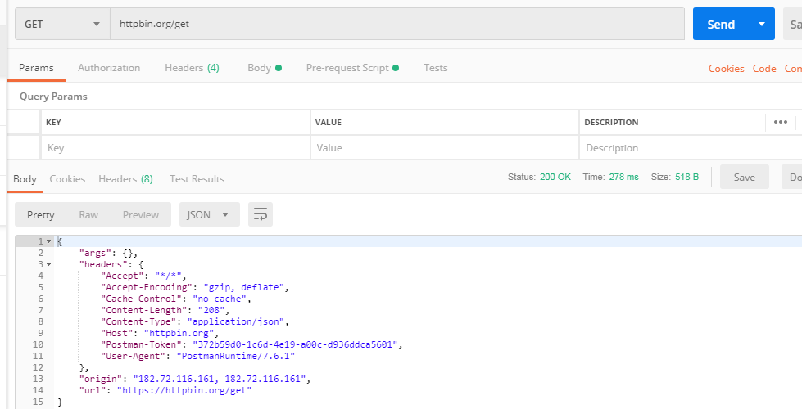
Creating requests in Postman
https://httpbin.org/

Slide 13
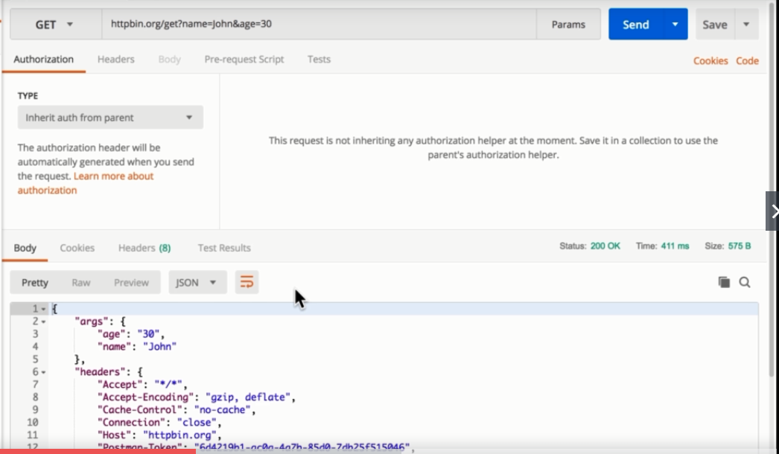
Passing data with your requests
We can pass the query parameters by using ?
This kind of response is called JSON response. Postman can understand lots of different responses
You can give parameters as a key value.you can enable and disable the parameters.

Slide 14
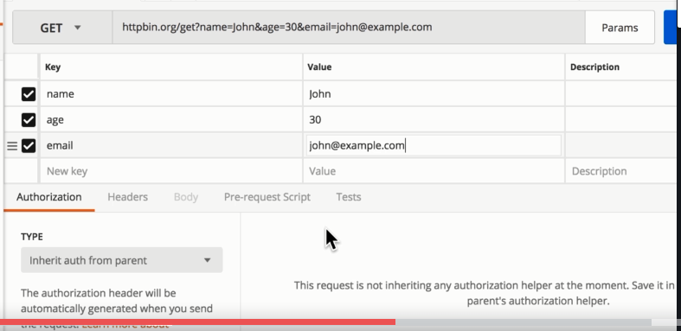
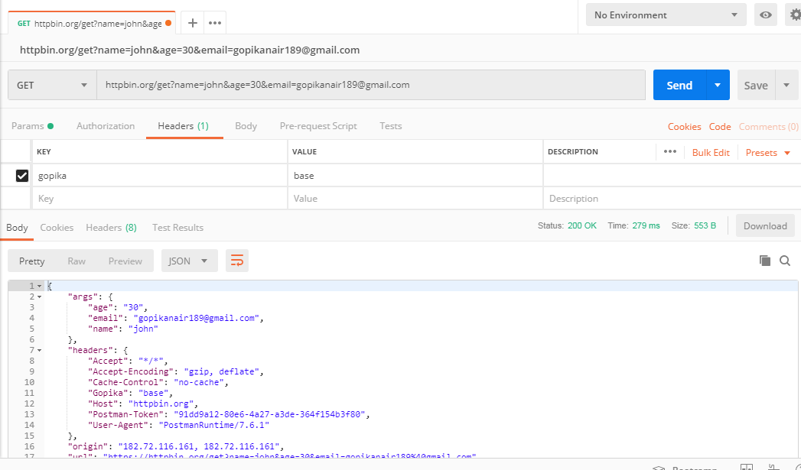

Adding parameter value Adding Header value

Slide 15
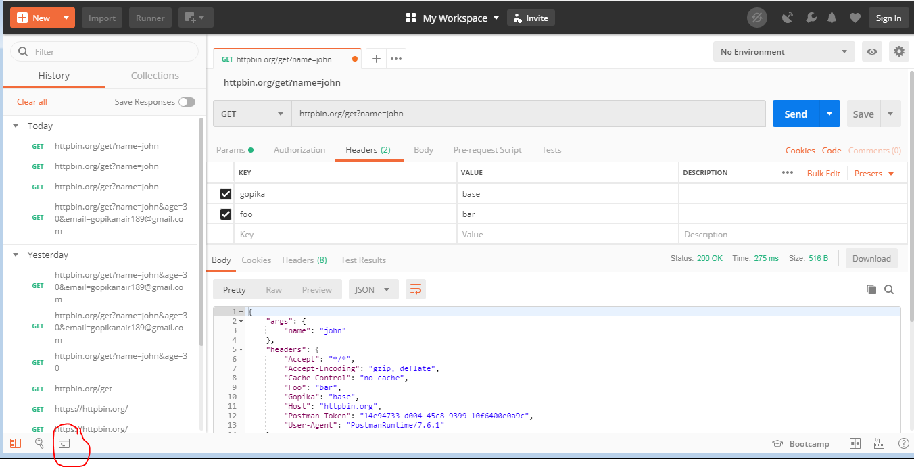
        Debugging Requests
Sometimes in postman you do not get the response and you are not sure what was header exactly sent,We need another way to find out to see how exactly request looks like. Thats is postman console
You can find it in left corner click on it. Window will pop up and go back to the request see it again.
.

Slide 16
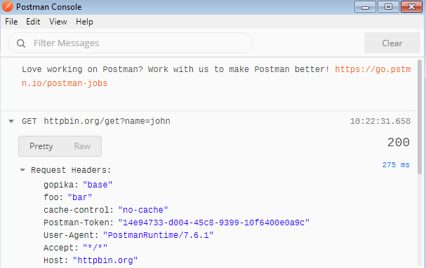
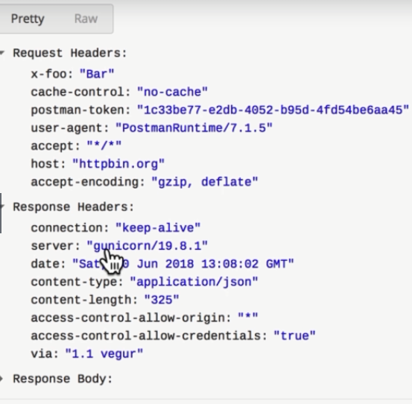
We can see the HTTP request going out and Http request coming in.
.

Slide 17
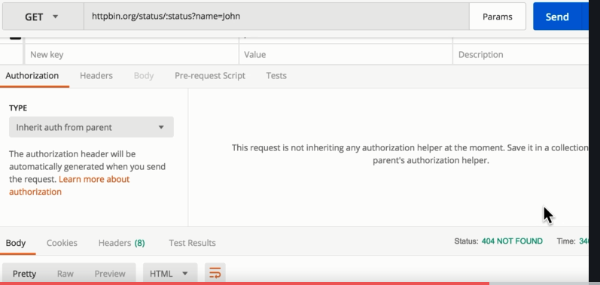
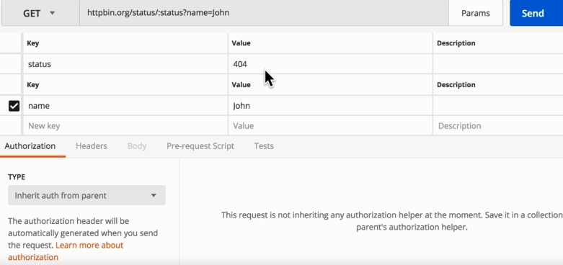
Passing data with your requests (continued)
You can specify the path variables before the ?
Before ? Every thing is path variables and after the ? We can specify the query parameters
Status codes:
404-file not found
200-Successful
401-UN authorized Access.
503-Server is not available

Slide 18
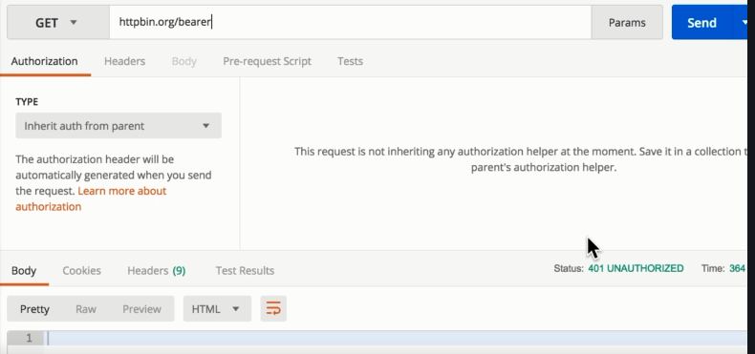
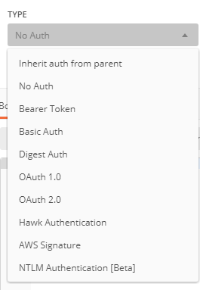
Authentication
When we try to send end point
URL without Authorization access
It throws an error 401 unauthorized error
Below are the authentication types available in postman

Slide 19
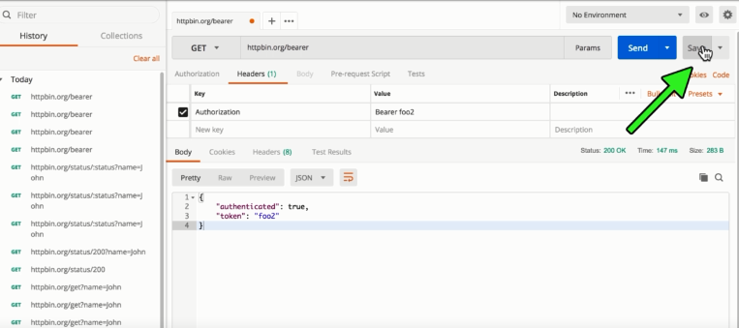
    Saving and Sharing your Requests
Request that you want to keep for later we have save option to saving request for later need.

Slide 20
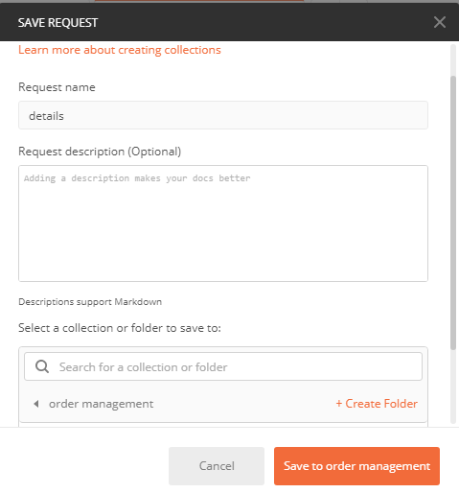
Give your request name
Create a collection/folder to
save the request
Click on save to folder name
Request saved successfully

Slide 21
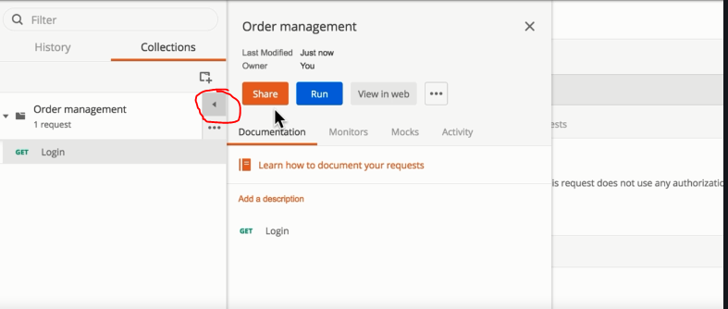
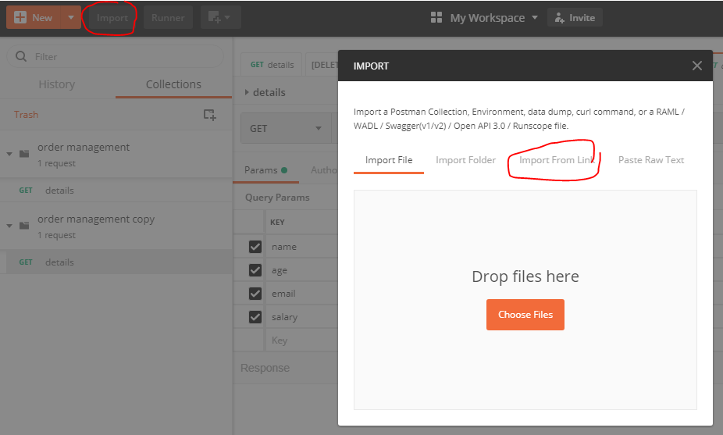
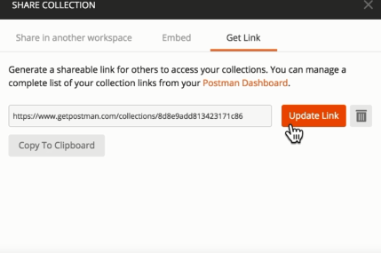
You can get share option to share Your collection
Click on the share option you can get Get link option
You can get link for your collection.
Copy the link and import it.
If you updated the old link save and click on update
link option automatically new link will update.

Slide 22
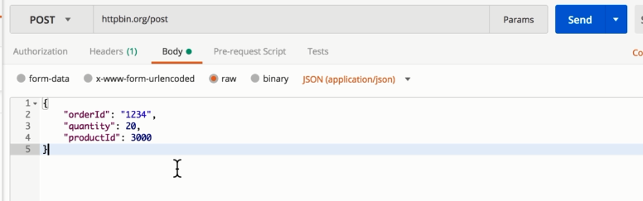
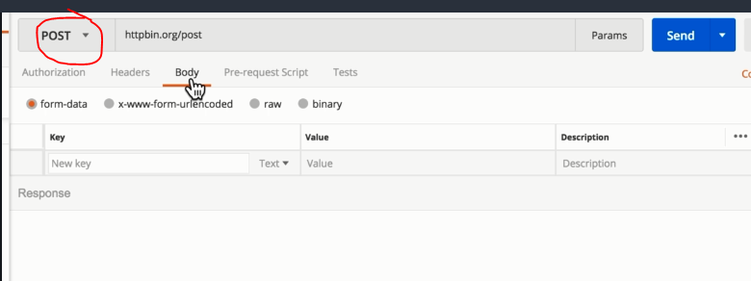
Creating a POST request with a JSON
We can request in post method by using JSON format
After sending the post request click on body
Click on raw option
Select JSON format
Type code in JSON format and send request

Slide 23
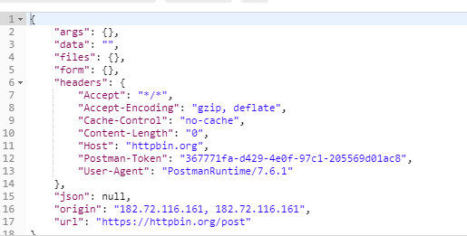
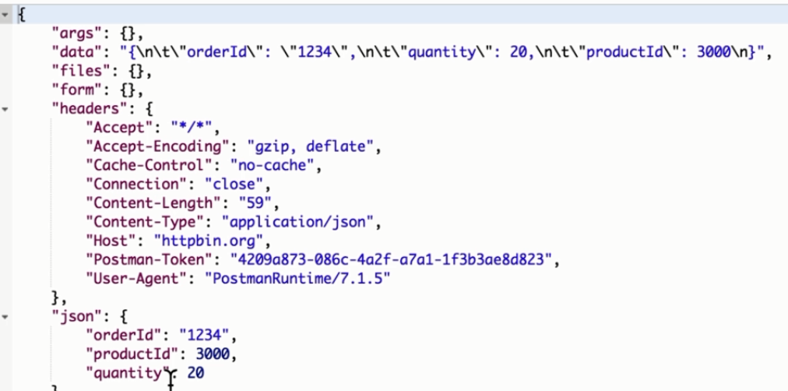
Without JSON body With JSON body
From below pictures we can observe the difference

Slide 24
Passing data between your requests
We can pass the information between two requests.
To do this we need to set global variable&store the information which we need to pass
Send one request in post method another one in get method
Now we need to pass the information from get request to post request
In tests tab define a global variable and pass the information through this variable
You can see the information in quick environment look
In first request body section you need to define that variable in {{}}
Send the request and you can compare the orderId between two requests

Slide 25
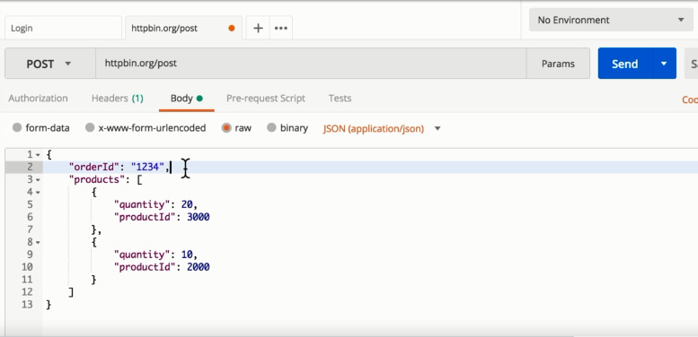
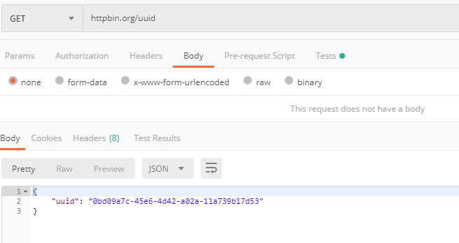
First Request second request
https://httpbin.org/

Slide 26
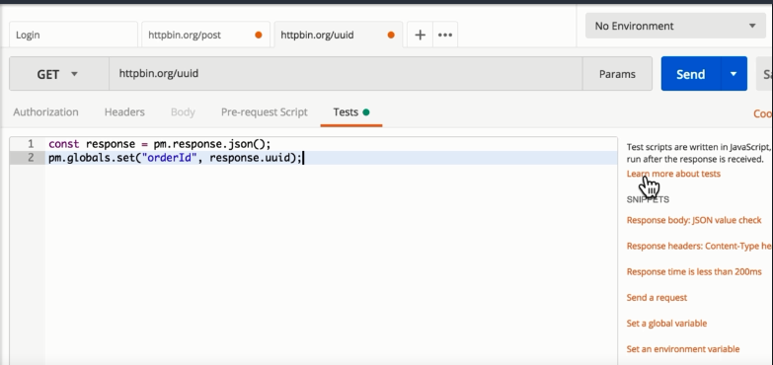
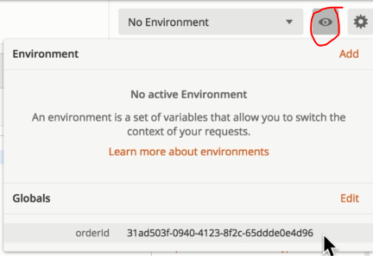
Set global variable in tests to pass the information to another request and you can see that information in environment quick view section

Slide 27
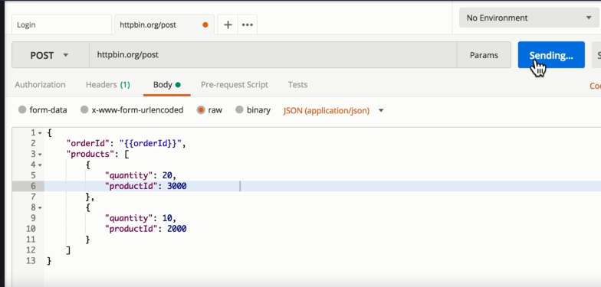
Below is the first request body section you need to place variable which we mentioned in the second request inside {{}}.
Sending request

Slide 28
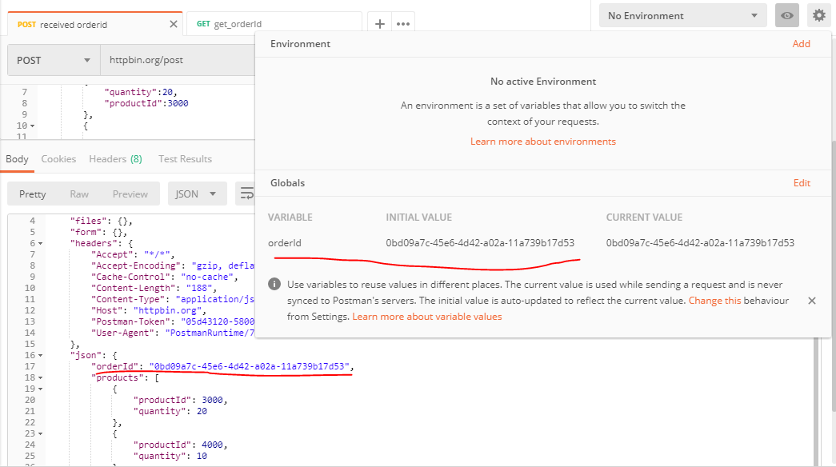
Now you can observe order id of first request and second request both are same

Slide 29
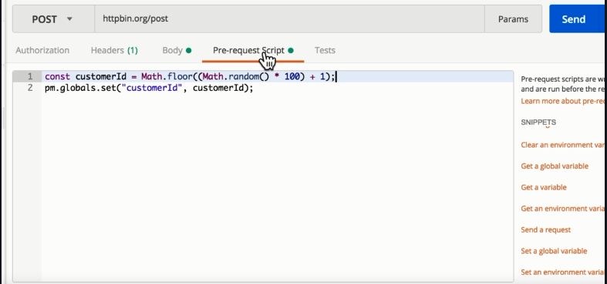
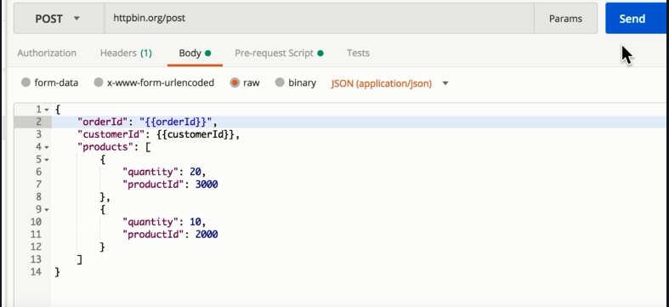
Generating dynamic data
We need to set variables in pre request script to get the data dynamically
It will execute before the script.
After writing the script set the variable in body section between {{}}
Send a request You will get data dynamically

Slide 30
Thank you

