Slide 1

Amazon Sales Data Analysis.
GOPIKA R NAMBIAR

Slide 2
Problem Statement
Sales management has gained importance to meet increasing competition and the need for improved methods of distribution to reduce cost and to increase profits. Sales management today is the most important function in a commercial and business enterprise.
To find the Sales-trend: month-wise, year-wise, yearly month-wise.

Slide 3
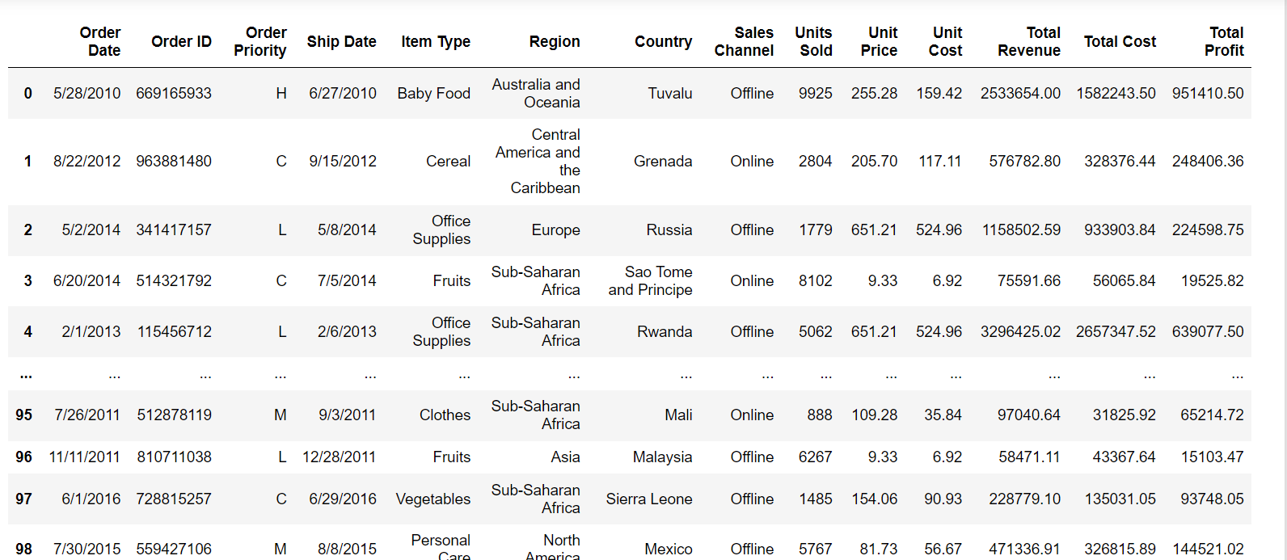
Data Used

Slide 4
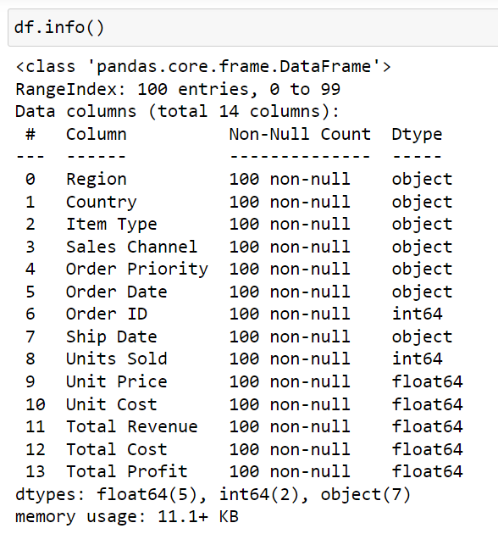
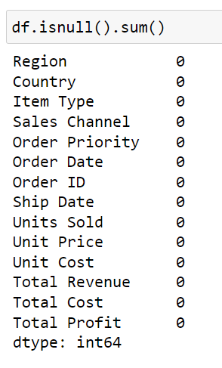
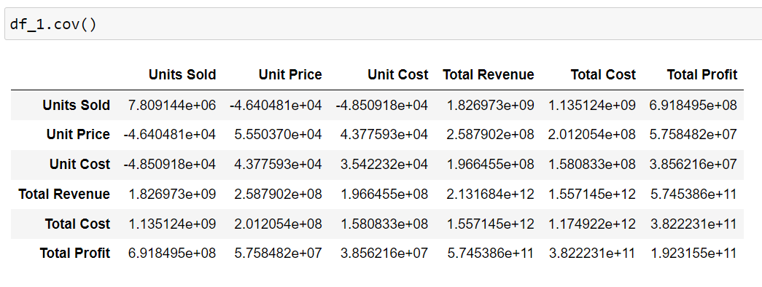
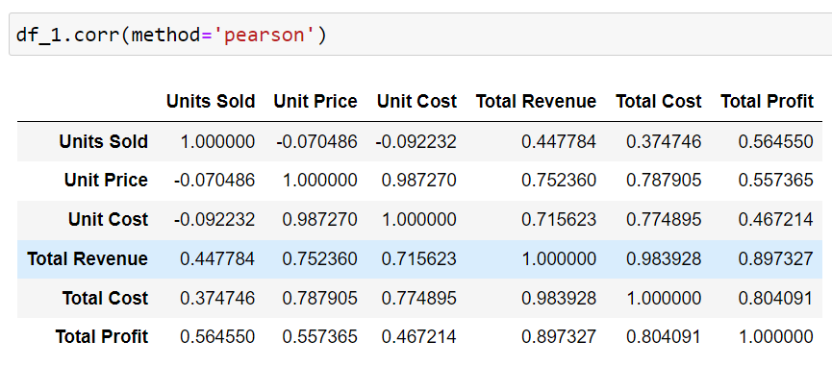
Data Information.

Slide 5
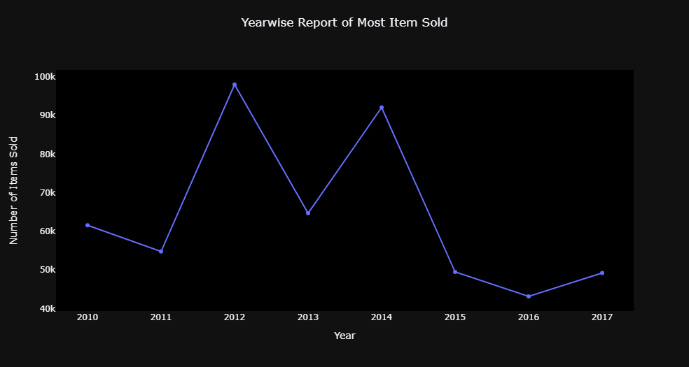
Yearly Report of Items Sold
Most items were sold in 2012. There is decline in sales from 2014.

Slide 6
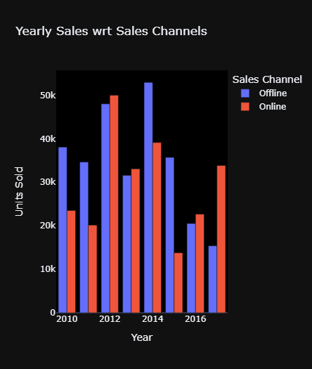
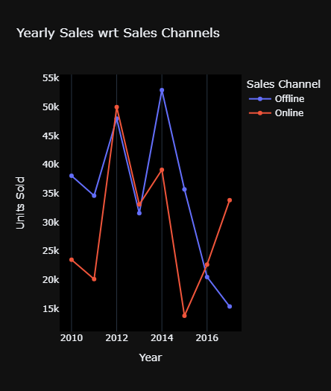
From both the bar chart and line plot we can understand that in 2014 and 2012 most units were sold and mostly the offline channels we helpful for this. But from 2016 there is a sudden increase in online channel and decrease in offline channels.

Slide 7
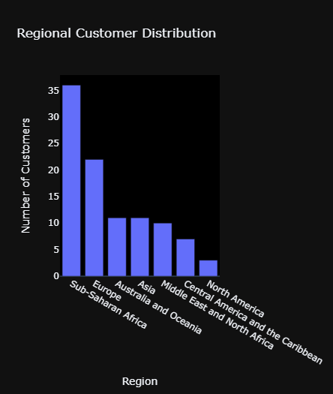
Regional Customer Distribution
We can see that Sub-Saharan Africa Region has the top number of customers followed by Europe and Australia.

Slide 8
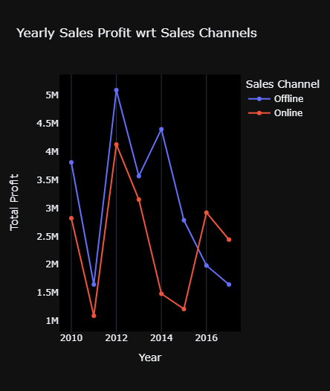
Yearly Profit wrt Sales Channels
From this, we can say that the highest profit was recorded in 2012. However, there has been a decline in profit since 2014.

Slide 9
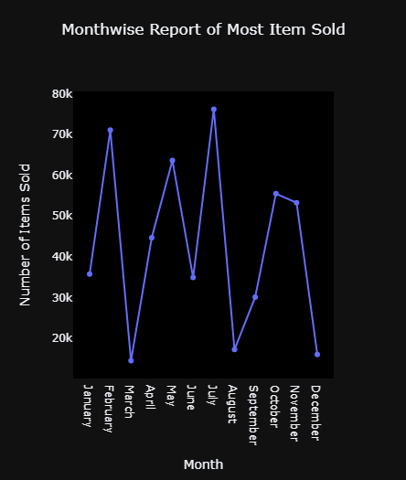
Monthly Report of Items Sold
July and February seems to have the highest sales according to the data. Lowest in the months of January and December

Slide 10
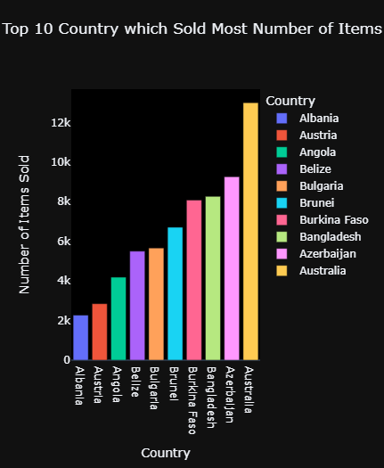
Top 10 Countries which Sold Most number of Items
Australia is recorded to have the most number of sales, followed by Azerbaijan and Bangladesh

Slide 11
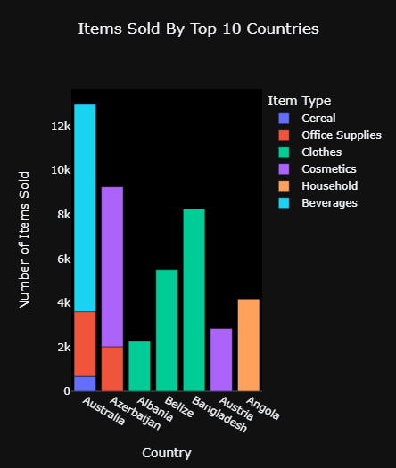
Popular Items sold by Countries
We can see beverages were the most sold item in Australia; cosmetics in Azerbijan,Austia; clothes in Albania, Belize and Bangladesh and household items in Angola.

Slide 12
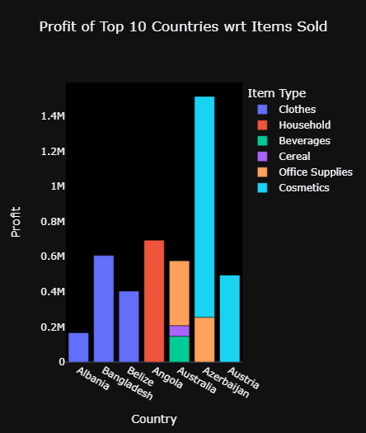
Profit to Top 10 Countries wrt Items Sold
Even though most items were sold in Australia Azerbaijan is recorded to have more profit. It is profiting mainly on cosmetics.

Slide 13
Final report
Sales and Channels Overview
Sales Peaks: The data indicates that the most units were sold in the years 2012 and 2014. During these years, offline channels played a significant role in driving sales.
Shift to Online Channels: From 2016 onwards, there has been a notable increase in sales through online channels, accompanied by a decline in offline channel sales.
Regional Customer Distribution
Sub-Saharan Africa: This region has the highest number of customers.
Europe and Australia: Following Sub-Saharan Africa, Europe and Australia have significant customer bases.

Slide 14
Profit Analysis
Peak Profit: The highest profit was recorded in 2012.
Profit Decline: There has been a decline in profit since 2014.
Sales and Item Analysis by Country
Australia: Recorded the highest number of sales overall. Beverages were the most sold items in this region.
Azerbaijan: Although it had fewer sales compared to Australia, Azerbaijan recorded higher profits, mainly from cosmetics.
Bangladesh: Also recorded a high number of sales, with clothes being the most sold items.
Final Conclusion:
This analysis highlights the trends in Amazon's sales data, showing a shift from offline to online channels post-2016 and identifying key regions and products contributing to sales and profit. Australia leads in total sales, while Azerbaijan excels in profitability, particularly in cosmetics. The Sub-Saharan Africa region has the largest customer base, followed by Europe and Australia.

Slide 15
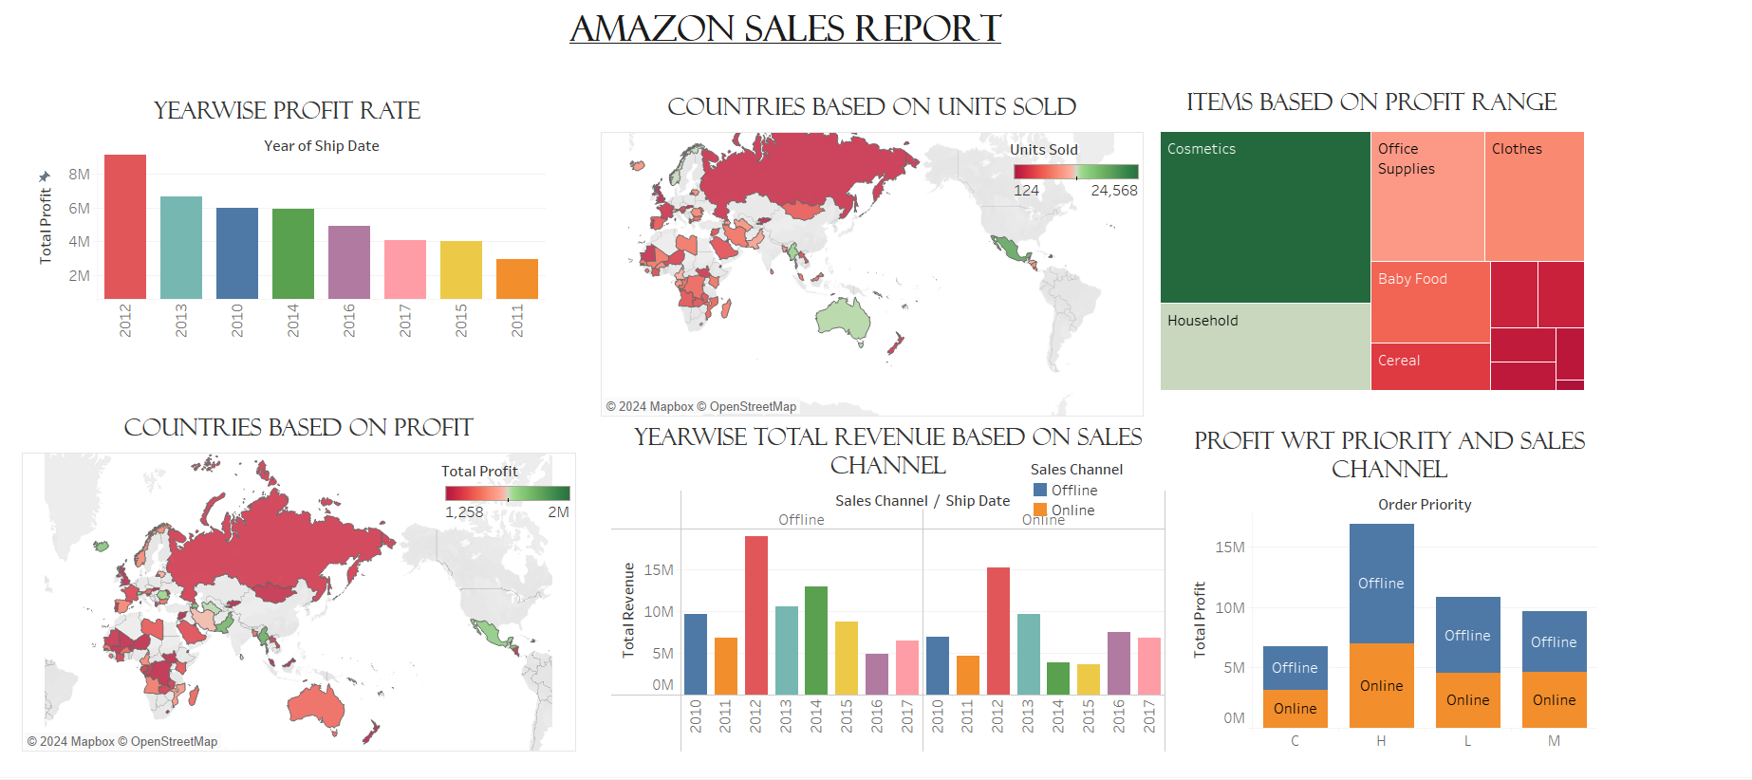
TABLEU DASHBOARD.

