Slide 1
Data Visualization of Bird Strikes between 2000 – 2011
GOPIKA R NAMBIAR

Slide 2
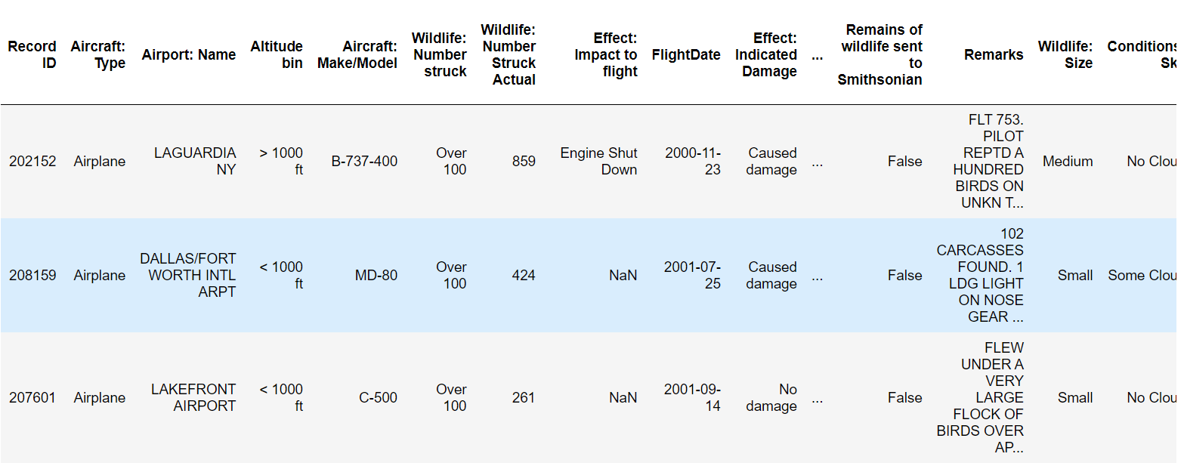
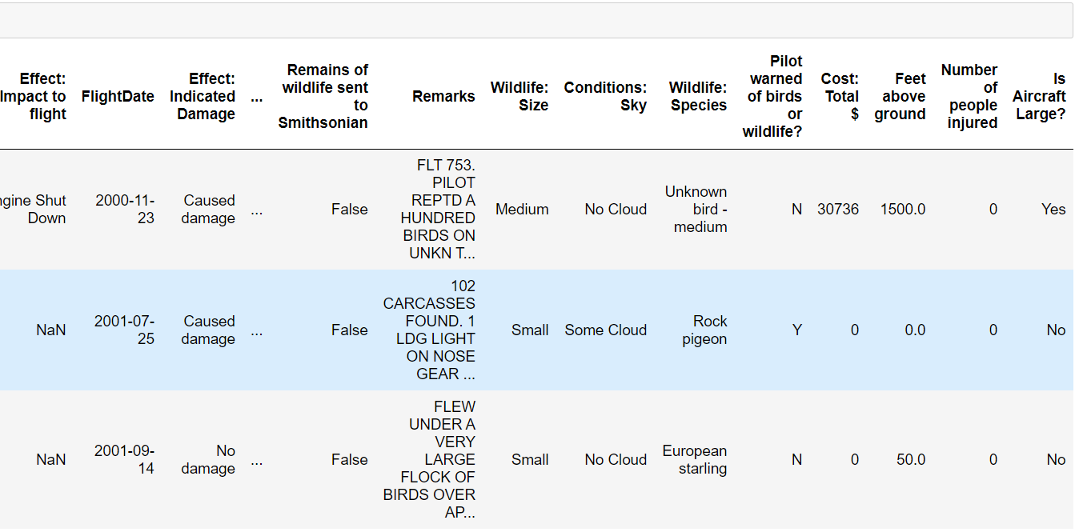
the power of communication
DATA OVERVIEW:

Slide 3
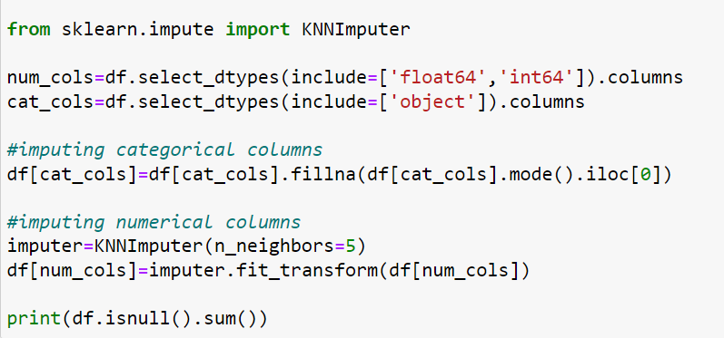
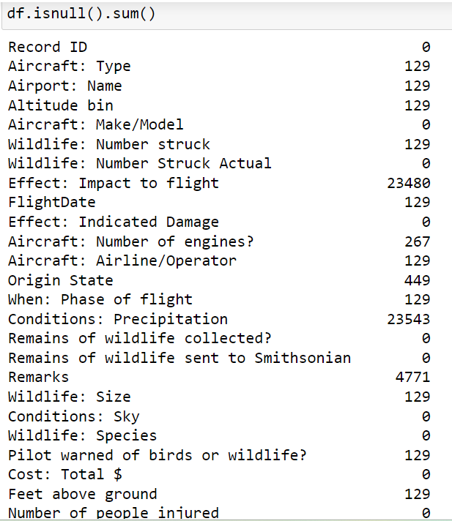
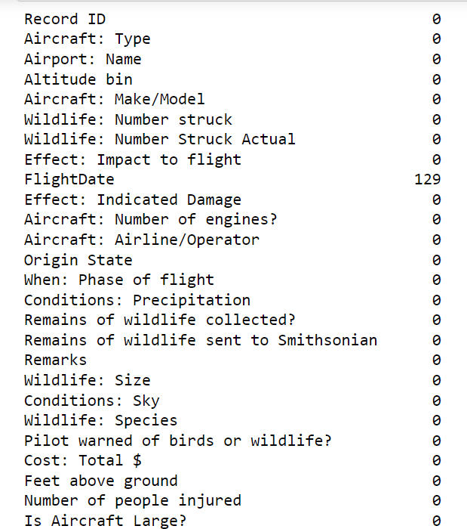
DATA CLEANING:

Slide 4
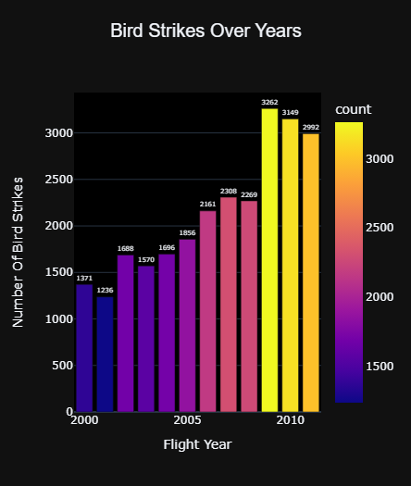
Visuals Depicting the Number of Bird Strikes

Slide 5
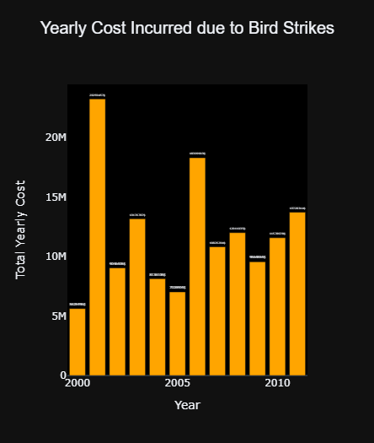
Yearly Cost Incurred due to Bird Strikes

Slide 6
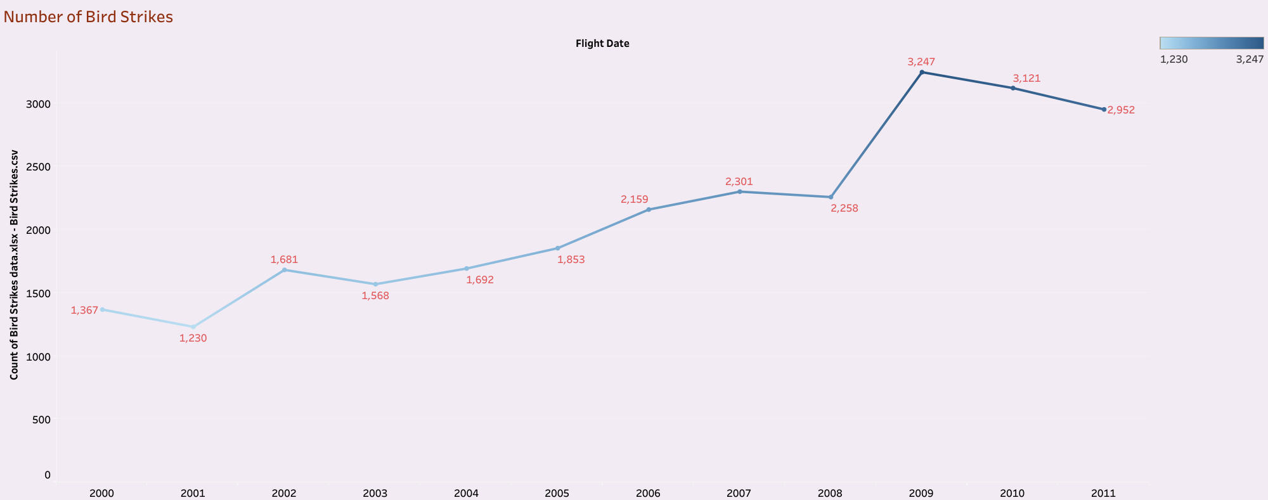
Yearly Analysis & Bird Strikes in the US

Slide 7
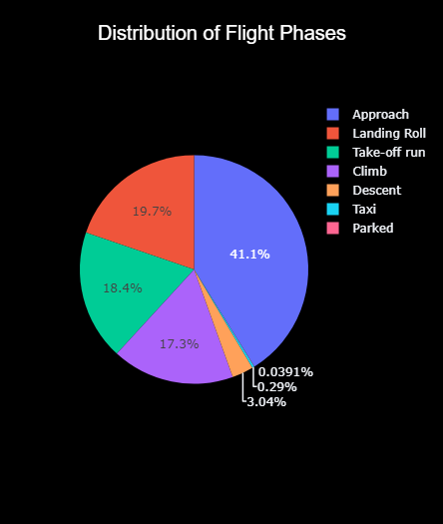
When do most bird strikes occur?

Slide 8
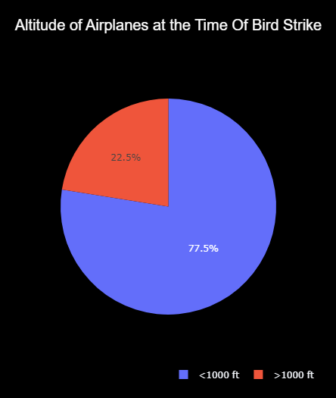
Altitude of aero planes at the time of strike

Slide 9
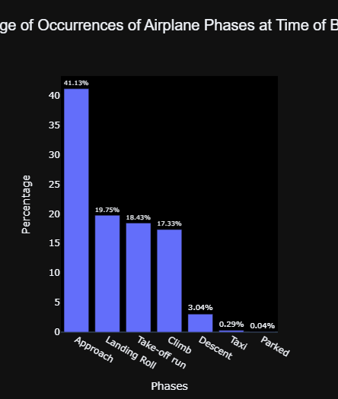
Phase of flight at the time of the strike.

Slide 10
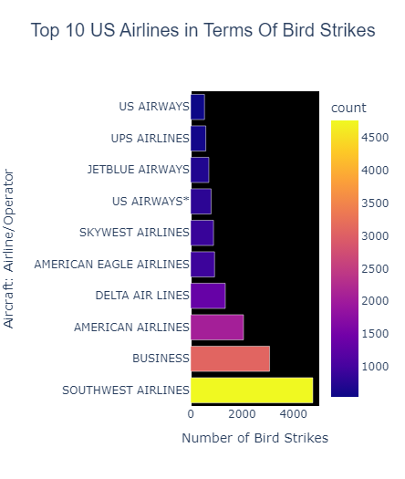
Top 10 US Airlines in terms of having encountered bird strikes

Slide 11
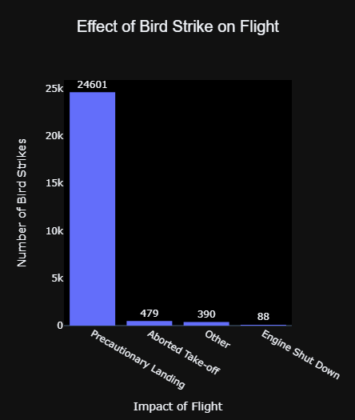
Effect of Bird Strikes & Impact on Flight

Slide 12
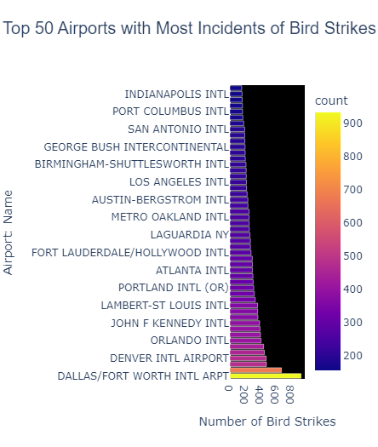
Airports with most incidents of bird strikes – Top 50

Slide 13
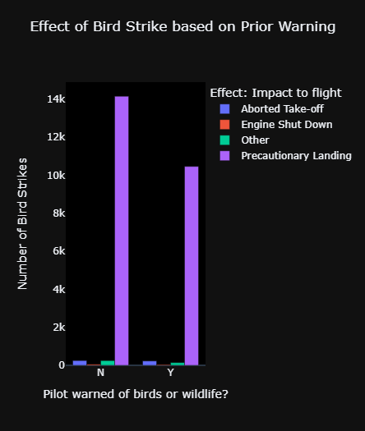
Were Pilots Informed? & Prior Warning and Effect of Strike Relation

Slide 14
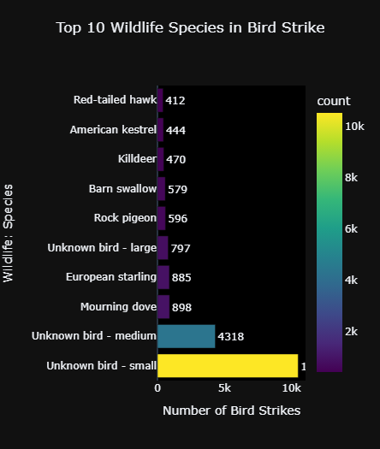
Top 10 Wildlife Species in Bird Strike

Slide 15
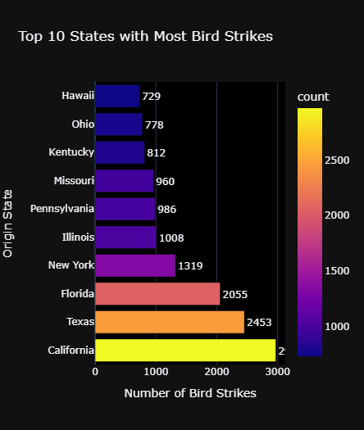
Top 10 States with Most Bird Strikes

Slide 16
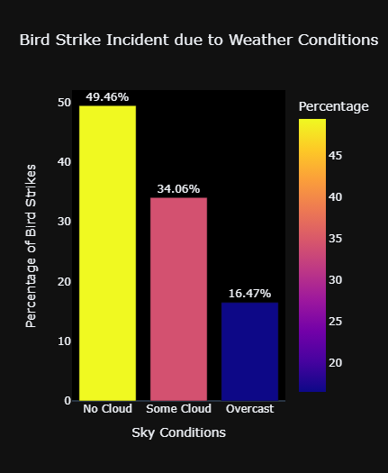
Bird Strike Incident due to Weather Conditions

Slide 17
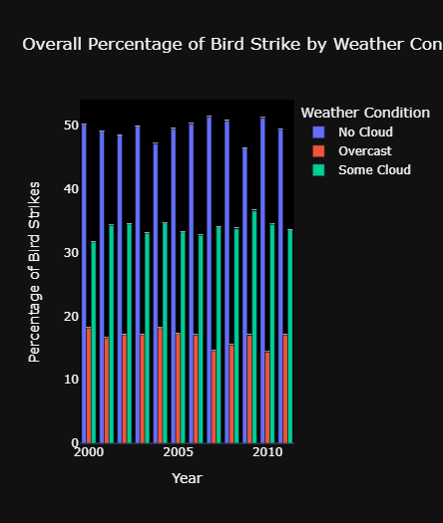
Overall Percentage of Bird Strike by Weather Conditions

Slide 18
FINAL REPORT.
Bird strikes increased gradually every year but maximum between 2009 and 2010.
Pilots weren’t informed most of the time .So this can be an additional reason for damages caused for birds, people and flights.
Whenever Pilots were informed they did precautionary landing.
Most of the Bird Strike happened when the flights are in approach phase.
Small birds are about to get struck mostly.
Bird strikes happen mostly when there are no clouds.
California, Texas, Florida has the most bird strikes as per record.

Slide 19
Thank you

