Slide 1
Digital Portfolio
DIGITAL PORTFOLIO
STUDENT NAME: A GOPIKA
REGISTER NO:astvu36336324U18012
NMID:2AB78F9308B14E8BAB34BD6D46324AC9
DEPARTMENT:BSC(COMPUTER SCIENCE)
COLLEGE: SREE ABIRAAMI ARTS AND SCIENCE COLLEGE FOR WOMEN/THIRUVALLUVAR UNIVERSITY

Slide 2
PROJECT TITLE DIGITAL POTFOLIO IN FRONT END DEVELOPMENT
PROJECT TITLE
DIGITAL PORTFOLIO IN FRONT END DEVELOPMENT

Slide 3
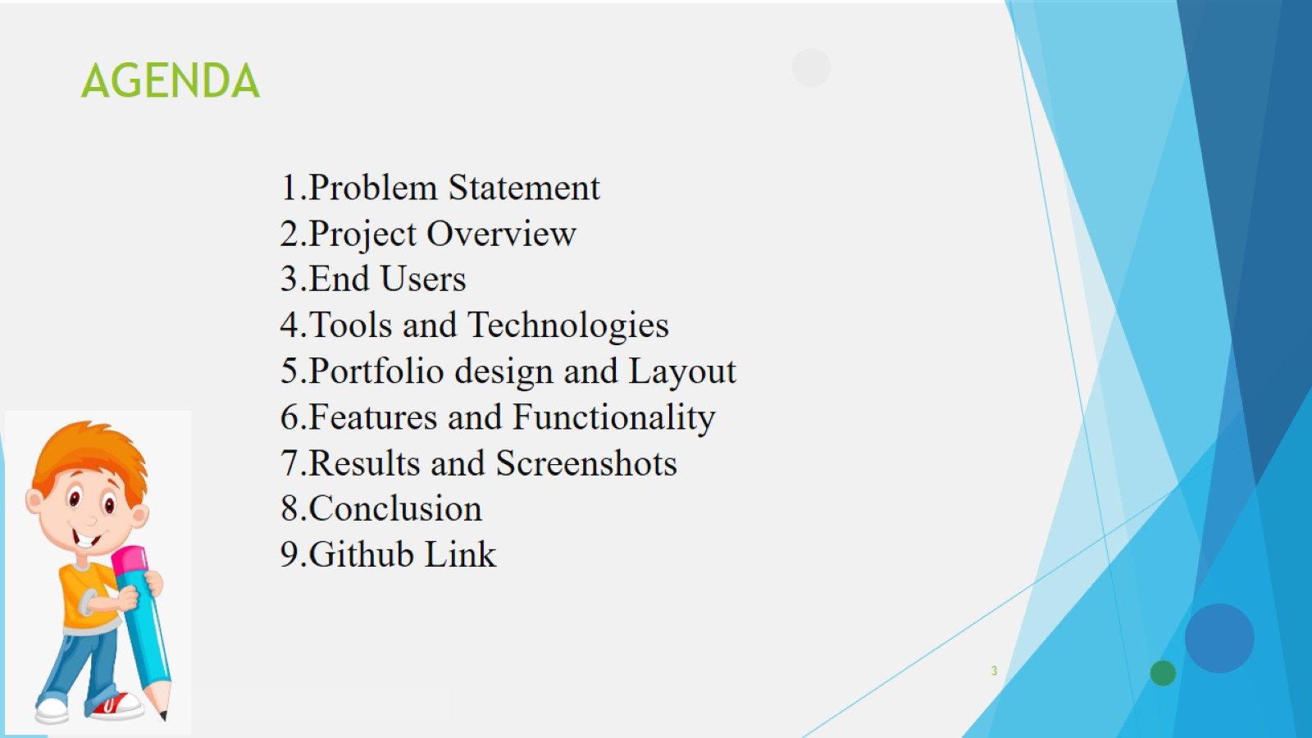
AGENDA

Slide 4
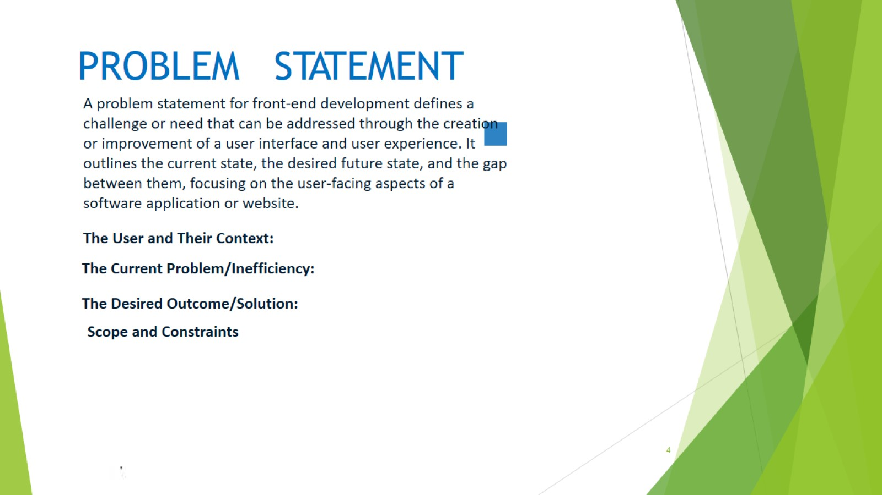
PROBLEM STATEMENT

Slide 5
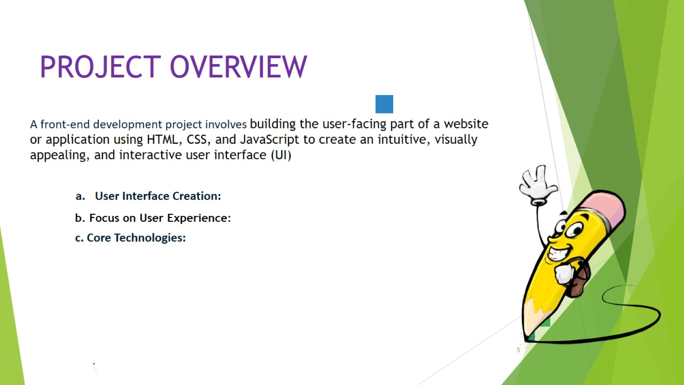
PROJECT OVERVIEW

Slide 6
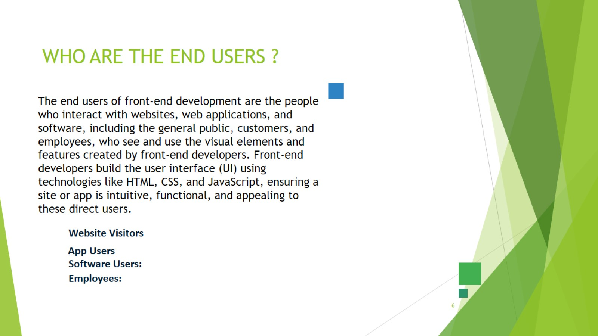
WHO ARE THE END USERS ?

Slide 7
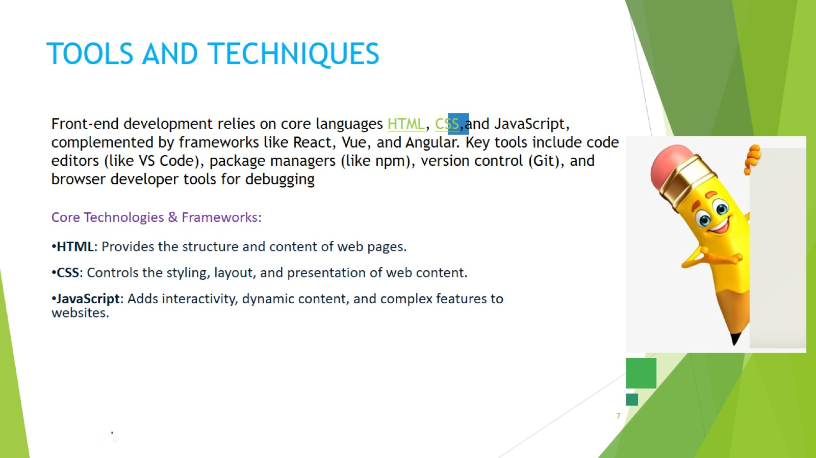
TOOLS AND TECHNIQUES

Slide 8
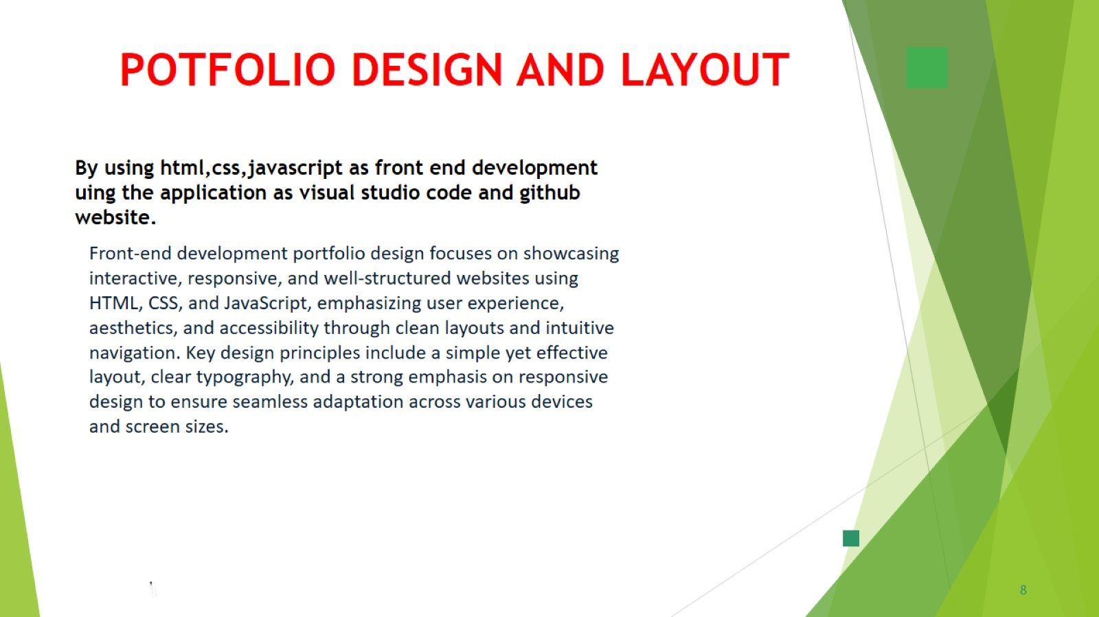

Slide 9

FEATURES AND FUNCTIONALITY

Slide 10

RESULTS AND SCREENSHOTS

Slide 11
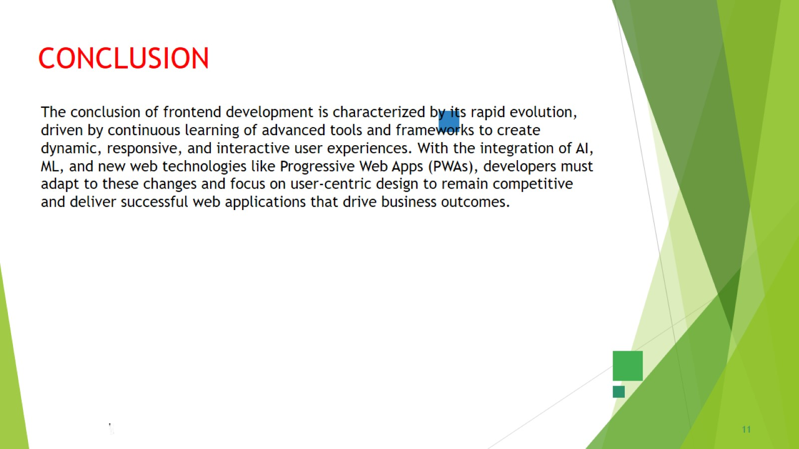
CONCLUSION

Slide 12

GITHUB LINK

