Slide 1
A SYSTAMATIC SOLUTION FOR ORGANIZATION
TEAM PULSE
Done BY
gopika k g
mca s4

Slide 2
ABSTRACT
Team Pulse is an easy-to- use project management tool that supports agile best practices and enables developers and non-developers to work seamlessly, across projects and departments, providing a clearer picture of tasks and priorities. Team Pulse is a periodical survey of team members. It provides leaders and teams a simple and on going view into important team dynamics such as collaboration and decision making. Weekly or monthly micro-surveys allow leaders and teams to view the teams perceived performance and facilitate discussions on working together effectively.

Slide 3
MODULES
The different modules are:
Project Creation
Task
Users
Report Generation
Settings

Slide 4
SCOPE
Improved processes and methodologies; increasing productivity.
A central repository for information and customer feedback.
Realignment of priorities, based on demand and workload.
OBJECTIVE
The main objective of team pulse is to improve the productivity of an organization.

Slide 5
CHALLENGE
The Challenge Company was tracking there are several more active requests at any given time. The company needed to be able to prioritize, based on demand. Further, it wanted a central system where critical information could be housed for easy access and analysis. This included customer feedback that would be vital to future product and service direction.

Slide 6
SOLUTION
Team Pulse is an easy-to-use project management tool that supports agile best practices and enables developers and non-developers to work seamlessly, across projects and departments, providing a clearer picture of tasks and priorities.
Prioritizing backlogs for effective development.
Estimating duration of each task.
Reports for tasks history and completed tasks.
Managing the members for each task.
Cost estimation.

Slide 7
RESULT
The Result Within the first several months of implementing Team Pulse, the company has:
• Improved project release cycles, minimizing missed deadline.
• Faster reaction time to issues.
• Increased client confidence.
Team Pulse provides a ‘big picture’ view, letting the team look cross project. This has streamlined efforts, ensuring that developers are on the right involvement in the project. It also provides a dashboard to ensure that people aren’t focusing on one project to the harm of another. It helps to identify where efforts are best spent through simple tracking and analysis. Team Pulse has helped to start the enforcement of these efforts, getting the internal teams to move more quickly and effectively.

Slide 8
TECHNOLOGIES
Backend - NetBeans
Language - PHP
Framework - Yii2
Database - XAMPP(MySQL)

Slide 9
NETBEANS
NetBeans is an integrated development environment (IDE) for Java. NetBeans allows applications to be developed from a set of modular software components called modules.
NetBeans runs on Microsoft Windows, mac OS, Linux and Solaris.
In addition to Java development, it has extensions for other languages like PHP,C, C++ and HTML5, Java doc and Javascript.
Applications based on NetBeans, including the NetBeans IDE, can be extended by third party developers.

Slide 10
PHP
The PHP Hypertext Pre Processor (PHP) is a programming language that allows web developers to create dynamic content that interacts with databases. PHP is basically used for developing web based software applications.
Yii2
The Yii2 framework is an open-source PHP framework for rapidly-developing, modern Web applications. It is built around the Model-View-Controller composite pattern. Yii provides secure and professional features to create robust projects rapidly.

Slide 11
Yes It Is !!
Yii features include
Model-View-Controller (MVC) design pattern.
Internationalization and localization(I18N and L10N), comprising message translation, date and time formatting, number formatting, and interface localization.
Layered caching scheme, which supports data caching, page caching, fragment caching and dynamic content. The storage medium of caching can be changed.
Error handling and logging.

Slide 12
XAMPP
XAMPP is a free and open source cross-platform web server solution stack package developed by Apache Friends,consisting mainly of the Apache HTTP Server, Maria DB database, and interpreters for scripts written in the PHP and Perl programming languages.
XAMPP stands for Cross-Platform (X), Apache (A), MariaDB (M), PHP (P) and Perl (P). It is a simple, lightweight Apache distribution that makes it extremely easy for developers to create a local web server for testing and deployment purposes.
XAMPP is also cross-platform, which means it works equally well on Linux, Mac and Windows. Since most actual web server deployments use the same components as XAMPP, it makes transitioning from a local test server to a live server extremely easy as well.

Slide 13
MYSQL
MySQL is the most popular Open Source Relational SQL Database Management System. MySQL is one of the best RDBMS being used for developing various web-based software applications. MySQL is developed, marketed and supported by MySQL AB, which is a Swedish company.

Slide 14
FLOW CHART

Slide 15
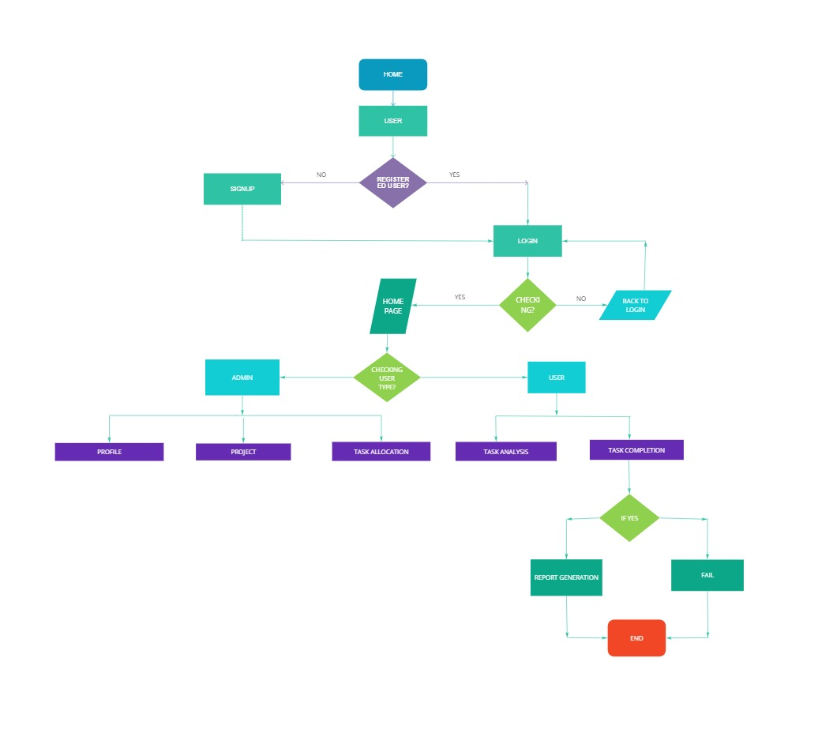
FLOW CHART

Slide 16
TABLES Table-1: user Primary key: id
FIELD NAME | DATA TYPE | DESCRIPTION
id | INT(11) | Primary key
user_role_id | INT(11) | Foreign key
firstname | Varchar(50) | First Name
last_name | Varchar(50) | Last Name
email | Varchar(50) | Email
dob | date | Date Of Birth
profile_image | Varchar(50) | Profile Image

Slide 17
status | Smallint(6) | Status
phno_ | Int(10) | Phone Number
gender | Varchar(50) | Gender
address | Varchar(50) | Address
user_name | Varchar(50) | User Name
password_hash | Varchar(50) | Password

Slide 18
Table-2: user_role Primary key: id
FIELD NAME | DATA TYPE | DESCRIPTION
id | INT(11) | Primary key
role_name | Varchar(50) | RoleName

Slide 19
Table-3: project Primary key: id
FIELD NAME | DATA TYPE | DESCRIPTION
id | INT(11) | Primary key
project_name | Varchar(50) | Project Name
start_date | date | Start Date
end_date | date | End Date

Slide 20
created_date | date | Created Date
created_by | Varchar(50) | Created By
updated_date | date | Updated Date
updated_by | Varchar(50) | Updated By
status | INT(2) | Status

Slide 21
Table-4: task Primary key: id
FIELD NAME | DATA TYPE | DESCRIPTION
id | INT(11) | Primary key
project_id | INT(11) | Foreign key
assigned_to | INT(11) | Foreign key
duration | timestamp | Duration
task_desc | Varchar(50) | Task Description

Slide 22
created_date | date | Created Date
created_by | Varchar(50) | Created By
updated_date | date | Updated Date
updated_by | Varchar(50) | Updated By
status | INT(2) | Status

Slide 23
Table-4: task History Primary key: id
FIELD NAME | DATA TYPE | DESCRIPTION
id | Int(11) | Primary key
assigned_to | Int(11) | Foreign key

Slide 24
SCREEN SHORTS

Slide 25
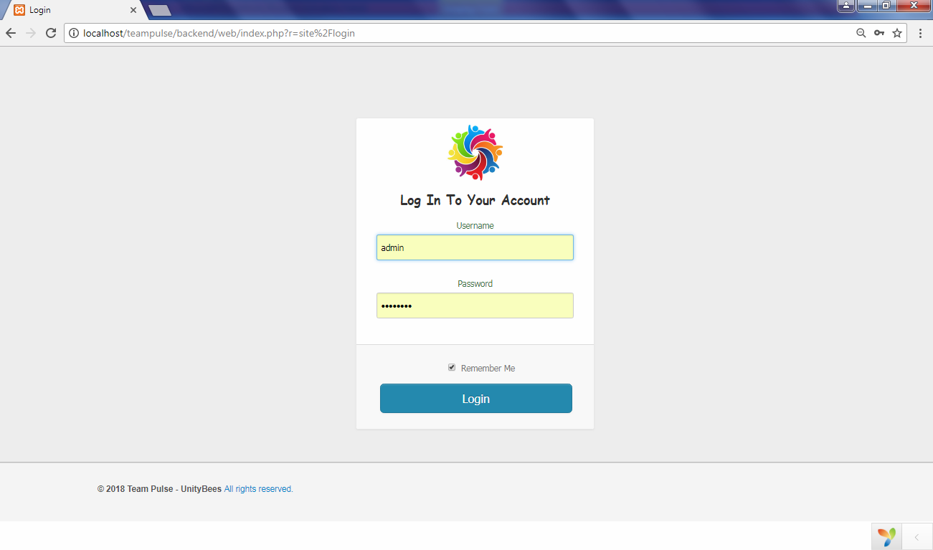
Log In

Slide 26
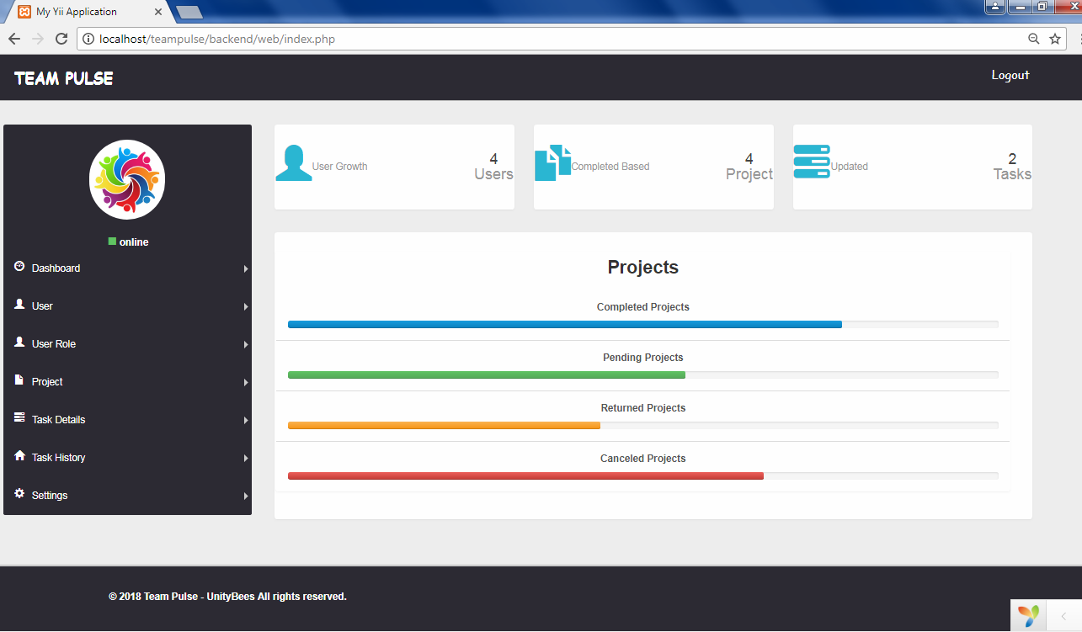
Dash Board

Slide 27
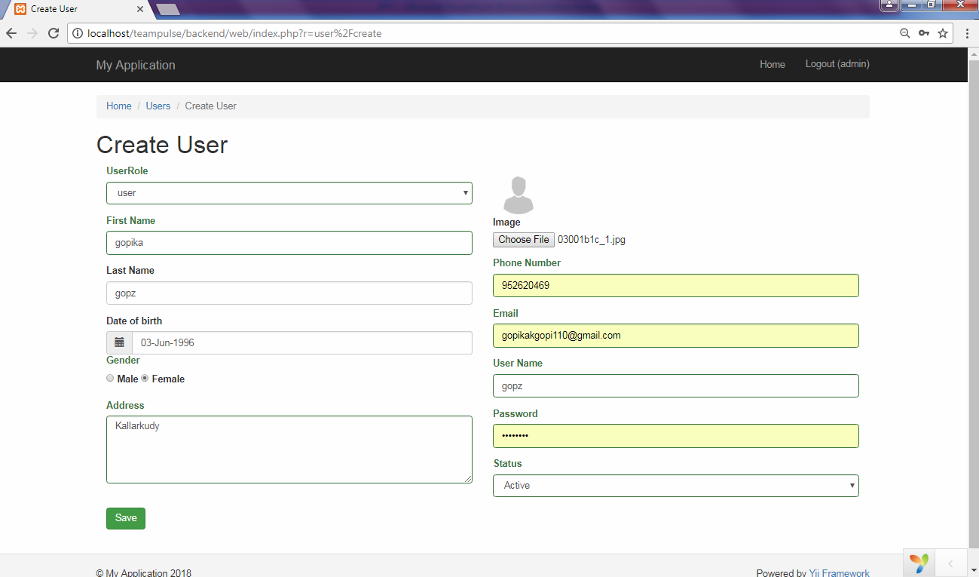
Create User

Slide 28
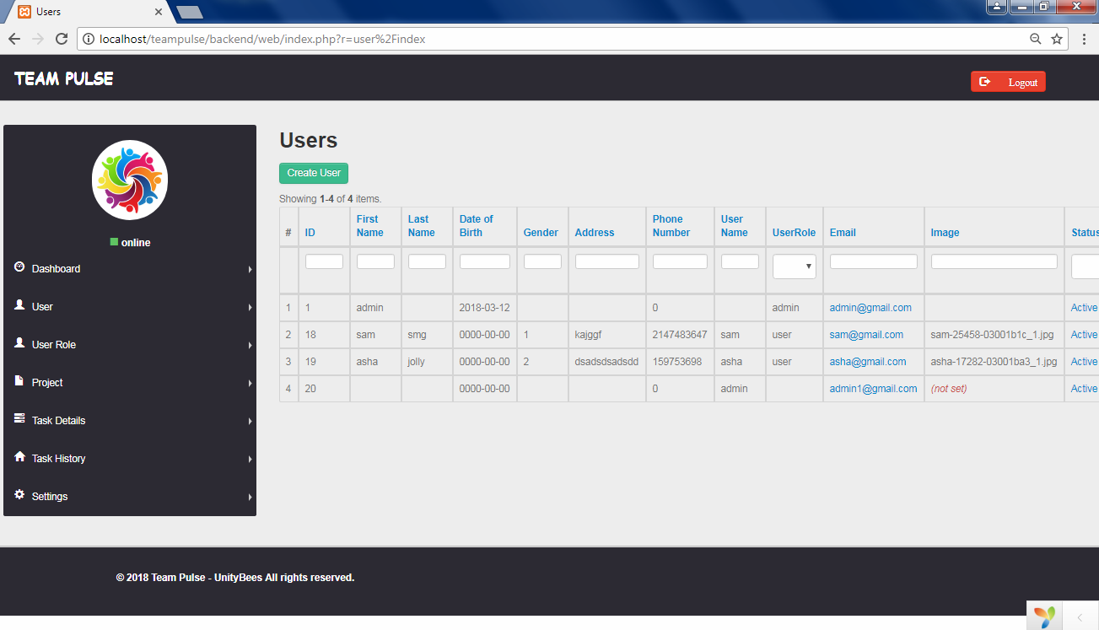
User

Slide 29
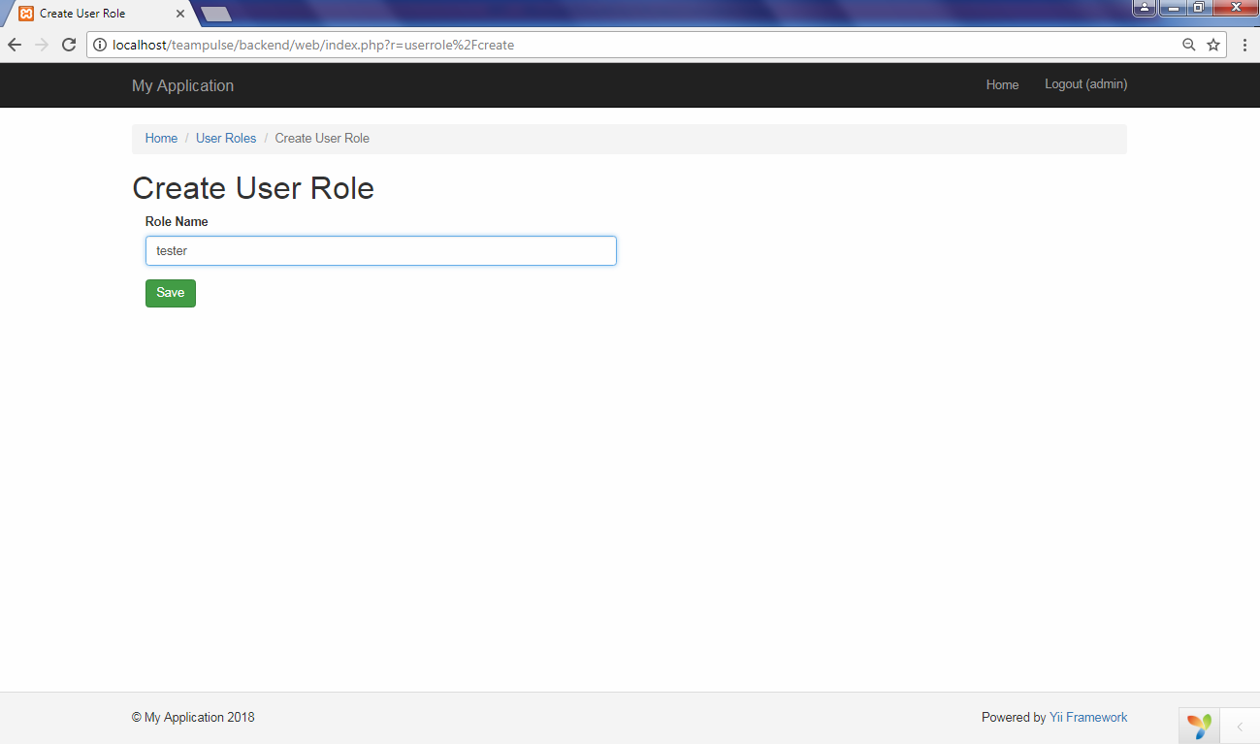
Create User Role

Slide 30
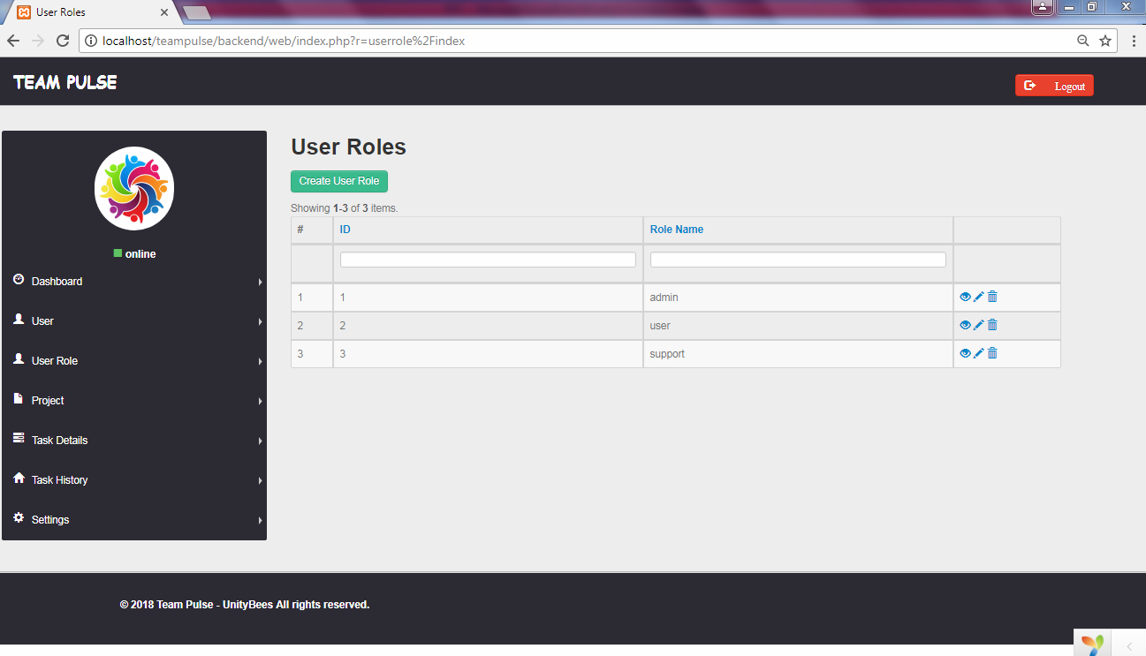
User Role

Slide 31
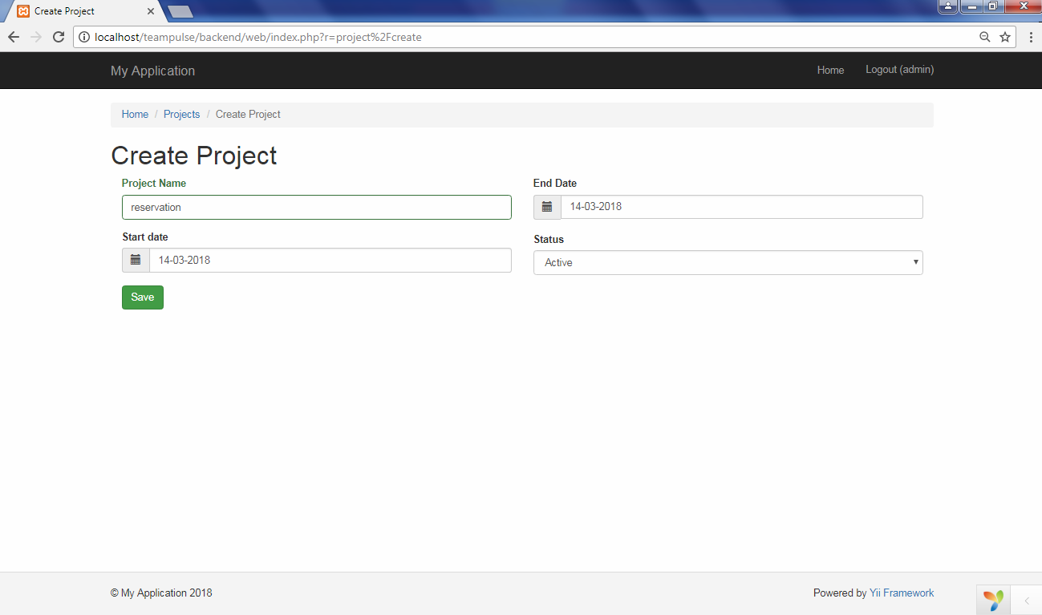
Create Project

Slide 32
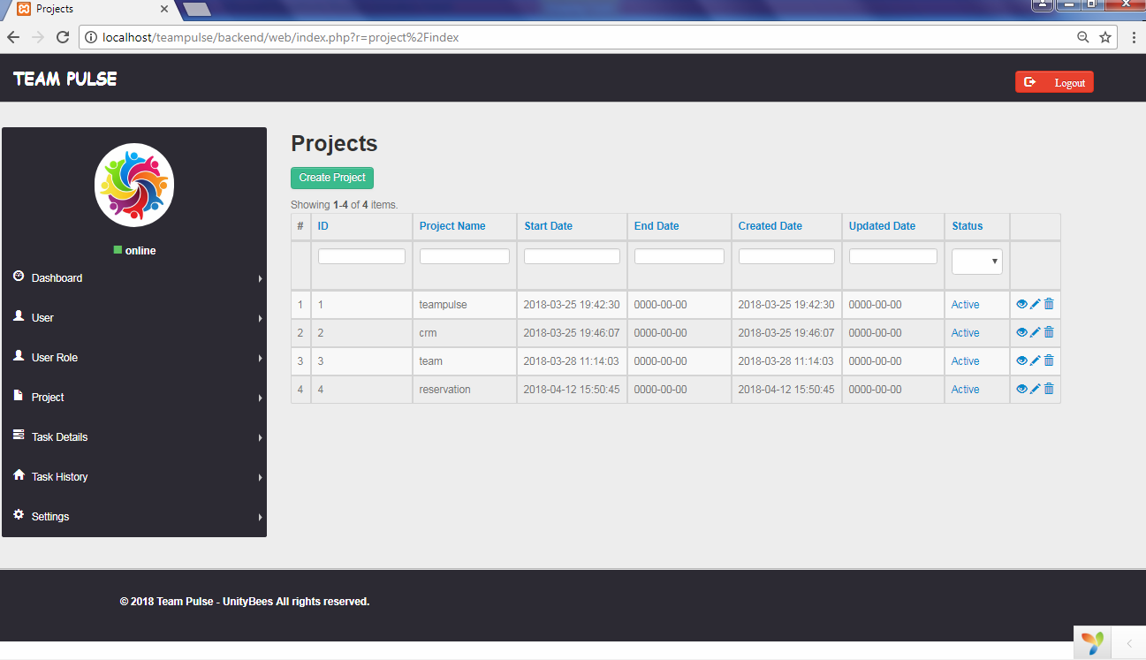
Project

Slide 33
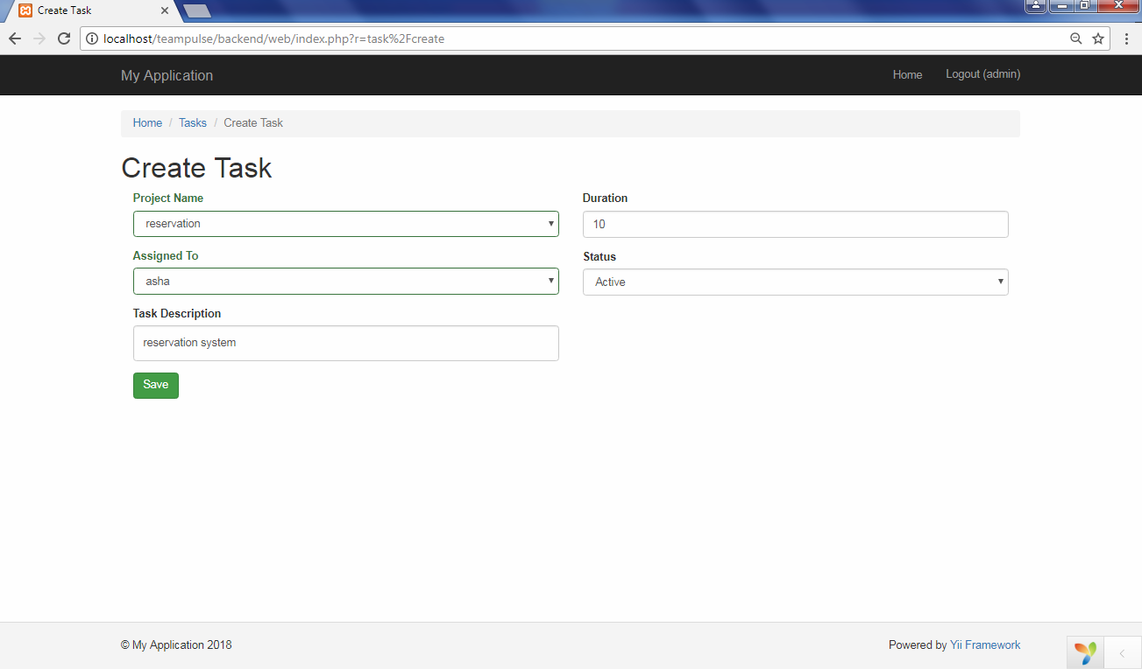
Create Task

Slide 34
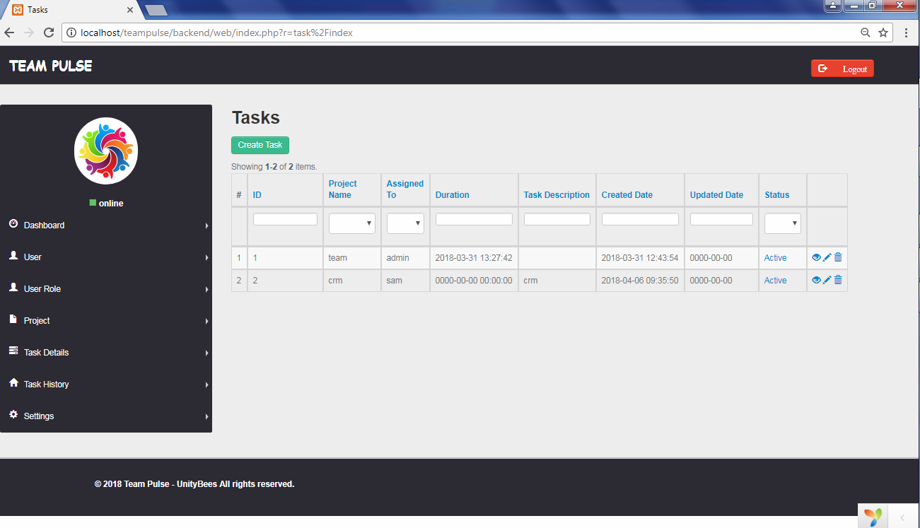
Task

Slide 35
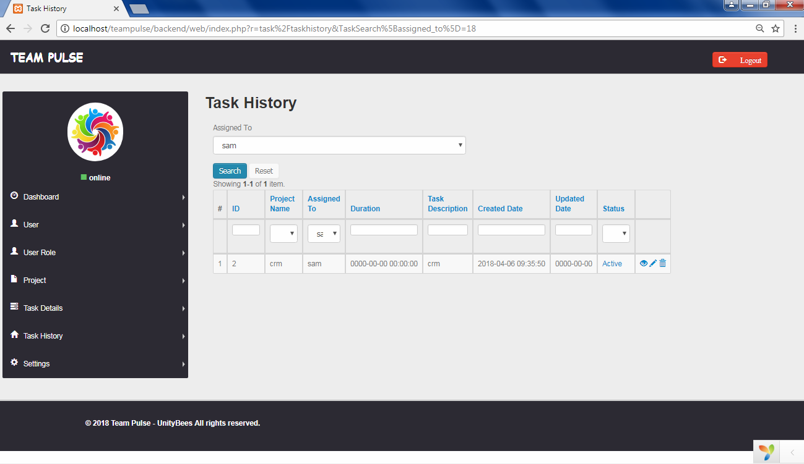
Task History

Slide 36
BIBLIOGRAPHY
www.teamwork.com
www.google.com

Slide 37



