Slide 1
Slide 1
Wine Selection
- An Exploratory Analysis of Wine Reviews from around the world -

Slide 2



Performance of wine varieties by continents
North America Vs Europe
Variety | Points |  | Price |  | PPR |  | Reviews
 | NA | EU | NA | EU | NA | EU | NA | EU
Bordeaux-style Red Blend | 89.3 | 89.5 | 57 | 19.6 | 0.6 | 0.2 | 1838 | 5014
Pinot Noir | 88.9 | 89.2 | 41.6 | 54.2 | 0.5 | 0.6 | 10358 | 2346
Syrah | 88.4 | 89.4 | 33.3 | 56 | 0.4 | 0.6 | 4279 | 803
Malbec | 88 | 89.1 | 31.2 | 24.9 | 0.4 | 0.3 | 415 | 521
Bordeaux-style Red Blend
NA
EU
89.31
89.54
PINOR NOIR
88.88
89.22
SYRAH
88.36
89.37
MALBEC
Lesser PPR better for consumers
88.01
89.12

Slide 3

Winery prestige index
PRESTIGE INDEX
Prestige Index = Points + Price + High rating wines
Continent | Winery | Points | Price | Wines | Prestige Index
Europe | Gérard Bertrand | 89.49 | 66 | 12 | 0.52
Europe | Planeta | 89.48 | 30.6 | 12 | 0.49
Europe | Marchesi Antinori | 92.75 | 97.1 | 6 | 0.49
North America | Cayuse | 95.12 | 57.8 | 10 | 0.62
North America | Joseph Phelps | 91.99 | 98.1 | 12 | 0.61
North America | Charles Smith | 94.62 | 93.4 | 7 | 0.6
12k+ Wineries narrowed down to 3500
Selecting only wineries where Avg price is affordable and among top 10 in the continent)
Cayuse and Phelps are prestige anchors. Syncline and Barnard Griffin offer broad-market appeal

Slide 4
Geographical hierarchy
LOCATION | PARENT | LEVEL | REVIEWS | POINTS
Spain |  | Country | 8268 | 86.65
Spain > Andalucia | Spain | Province | 200 | 88.92
Spain > Andalucia > Jerez | Spain > Andalucia | Region | 149 | 89.36
Spain > Andalucia > Jerez > Barbadillo | Spain > Andalucia > Jerez | Winery | 1 | 89
Spain > Andalucia > Jerez > Bodegas Dios Baco S.L. | Spain > Andalucia > Jerez | Winery | 32 | 89.81
Spain > Andalucia > Jerez > Bodegas Hidalgo | Spain > Andalucia > Jerez | Winery | 1 | 89
Spain > Andalucia > Jerez > Bodegas Yuste | Spain > Andalucia > Jerez | Winery | 2 | 89

Slide 5
Emerging wine countries
1
2
3
Luxury
Emerging Potential
Rising Contenders
ENGLAND, HUNGARY
Low Reviews, High Score, High price
ISRAEL, INDIA, SERBIA
High Score, Affordable
CANADA, SWITZERLAND
Good scores, Moderate presence

Slide 6

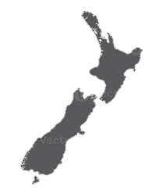
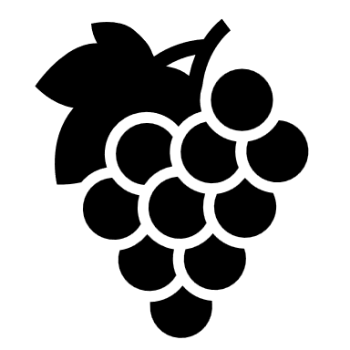
RECOMMENDATION SYSTEM
If a user enjoys high valued Pinot Noir from Oregon what similar wines can they try?
Martinborough
Gewürztraminer
Pinot Noir
Pinot Gris
Riesling
Central Otago
Pinot Noir
Chardonnay
NEW ZEALAND

Slide 7

Slide 6
DATA SOURCE: KAGGLE
https://www.kaggle.com/datasets/zynicide/wine-reviews

Slide 8
Slide 10
THANK YOU

