Slide 1



Garbage Classification

Slide 2

Learning Objectives
Understand how to apply transfer learning using pre-trained deep learning models (EfficientNetV2, DenseNet) for real-world image classification tasks.
Perform data preprocessing and augmentation
Learn to train and fine-tune CNN models (EfficientNetV2B2, B3, and DenseNet201) and evaluate them using classification metrics.
Build an interactive Streamlit web application for real-time garbage classification.
GOAL
Sorce :
www.freepik.com/

Slide 3
Tools and Technology used
Programming Language: Python
Deep Learning Framework: TensorFlow / Keras
Pre-trained Models: EfficientNetV2B2, EfficientNetV2B3, DenseNet201
Model Evaluation: Scikit-learn (classification report, confusion matrix)
Deployment: Streamlit
Environment: Google Colab (for training), VS Code (for app)
Libraries: NumPy, Matplotlib, PIL, Pandas

Slide 4
Methodology
Dataset: Garbage images (6 classes), resized to 124×124, normalized
Split: Train, Validation, Test sets created
Models Used: EfficientNetV2B2, EfficientNetV2B3, DenseNet201
Training: Applied class weights to handle imbalance
Evaluation: Accuracy, Confusion Matrix, Classification Report
Best Model: EfficientNetV2B3 (~94% accuracy)
Deployment: Final model deployed using Streamlit web app(Also tested with Gradio for quick UI preview
of EfficientNetV2B2

Slide 5
Problem Statement:
To explore and implement improvements using other transfer learning architectures to achieve higher accuracy and better model performance.

Slide 6
Solution:
Analyzed the baseline model (EfficientNetV2B2) provided for garbage classification
Applied transfer learning using alternative pre-trained models: EfficientNetV2B3
DenseNet201
Trained and evaluated each model on the same dataset
Compared model performance and plotted a bar chart of accuracy
Selected the best-performing model (EfficientNetV2B3 ~94% accuracy)
Deployed final model using Streamlit for real-time classification

Slide 7
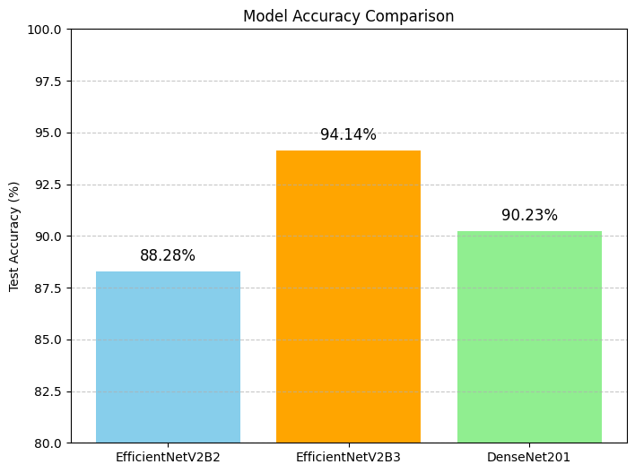
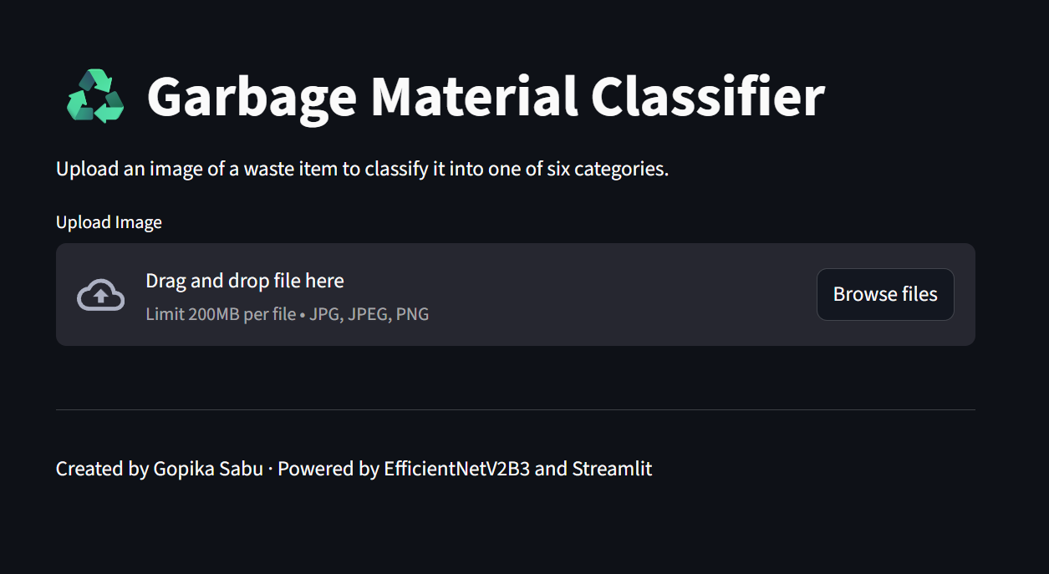
Screenshot of Output:

Slide 8
Conclusion:
Successfully improved the performance of the baseline garbage classification model
Identified EfficientNetV2B3 as the best model with ~94% test accuracy
Compared multiple transfer learning models on the same dataset
Used evaluation metrics like accuracy, confusion matrix, and classification report
Deployed the model using Streamlit for real-time predictions

