Slide 1
AI PRODUCT MANAGEMENT · CAPSTONE PROJECT
WorkRadar
One ranked radar for everything that needs the product manager
Slack · Jira · GitHub · Gmail · Calendar → one prioritised list that links back to the source
Gopi Krishna
Cohort 40 · AIR Tribe · AI Product Management (AIPM)
Notes:
[0:00–0:20] Hi, I'm Gopi Krishna from Cohort 40 of the AIR Tribe AI Product Management program. This is WorkRadar: one ranked radar that brings everything needing a product manager's attention from Slack, Jira, GitHub, Gmail and Calendar into a single prioritised list, with every item linking back to the original message.

Slide 2
The PM's day is scattered across five tools
117
153
Every morning the PM must answer, unaided:
1
What is my top work today?
emails received per worker, per day
chat messages per worker, per day
2
What happened since yesterday?
275
~1,200
3
What needs my attention now?
4
Who is blocked, and on what?
interruptions per working day
app switches a day (≈ 4 h a week)
Sources: Microsoft research via UNLEASH (2025); Harvard Business Review app-toggling study (2022)
Notes:
[0:20–1:00] The problem: a startup PM coordinates with up to 50 people across five tools. Research shows a worker gets about 117 emails and 153 chat messages a day, is interrupted 275 times, and switches apps around 1,200 times. The few items that really need the PM — a blocker, an approval, an escalation — are buried and found late. Every morning the PM has to answer these four questions alone, and it takes one to two hours of scrolling.

Slide 3

Built first for one startup product manager
TAM
≈ $290M / yr
Priya Sharma
Product Manager · 50-person B2B SaaS startup, Bengaluru
1.6M product managers worldwide × $15 per seat a month
SAM
≈ $50M / yr
Works with 25 engineers, 4 designers, sales, support and 2 founders
Coordinates 5 to 50 people a day, so we design for the busiest day
Jobs: triage asks, unblock teammates, approve, schedule, report
PMs at 20–500-person software firms in the US, India and Europe
SOM
$0.5–1M ARR
1–2% of SAM in 3 years with self-serve and founder-led sales
“The work isn't hard. Finding it is.”
B2B · buyer is the founder or CTO · next beachhead: 50–250-person scale-ups
Notes:
[1:00–1:35] I built it first for one user: Priya, a product manager at a 50-person startup. She coordinates anywhere from 5 to 50 people a day, so I designed for the busiest day. It's B2B — the founder or CTO buys it. Sized on PMs alone, the serviceable market is about 50 million dollars a year; a realistic three-year share is half a million to a million in ARR, with 50 to 250-person scale-ups as the next beachhead.

Slide 4





Four tools hide the same seven jobs
Slack
mentions, DMs, incidents
Ask
Blocker
Approval
Jira
assigned, blocked, P1 issues
Meeting request
Escalation
Update
GitHub
reviews, failing checks
FYI noise · counted, never listed
Gmail + Calendar
escalations, invites
Decision: aggregate, never replace. Teams stay in their tools; WorkRadar reads what concerns the PM and links back.
Notes:
[1:35–2:10] Discovery: I broke down what Slack, Jira, GitHub and email each do. They look different, but the PM does the same seven jobs in all of them: answer asks, clear blockers, approve, schedule, handle escalations, track updates, and ignore noise. That led to the key decision: don't replace any tool — nobody can make a whole company switch. WorkRadar aggregates and links back.

Slide 5





Five decisions shaped the product
Radar, not reader
One line per item: who, what, why, by when
WHAT ONE RADAR ITEM LOOKS LIKE
P1 Critical
Blocked
Link to the exact message
Reply in Slack, Jira, GitHub or Gmail, not in WorkRadar
Rahul waiting on SSO API keys from Platform Security
@pm tags for the team
@pm blocker · @pm decision · @pm sync beat guessing from chat
why: waiting 2 days · sprint goal at risk
JIRA · AUTH-221
Open in Jira ↗
Privacy by design
Read only PM-addressed items; never store message bodies
Nothing is deleted
Every action has Undo; the Activity Log can restore anything
Five seconds to read · one click to act in the right tool
Notes:
[2:10–2:50] Five decisions shaped the product. It's a radar, not a reader: each item is one line — who, what, why and by when. Every item links to the exact message so the PM replies in the original tool. Teams can tag @pm blocker, decision or sync, which is far more reliable than AI guessing from chat. It only reads what's addressed to the PM and never stores message bodies. And nothing is deleted — every action can be undone.

Slide 6
A transparent score decides what comes first
Type
Urgency
Sender
Waiting
Impact
Escalation 35 · Blocker 32 · Approval 25 · Ask 18 · Meeting 15
Overdue 25 · Today 20 · Tomorrow 12 · This week 6
Founder or customer 15 · Leadership 10 · Lead 5 · @pm tag +5
2–8 h 5 · 8–24 h 10 · 1–2 days 15 · over 2 days 20
Release or revenue 15 · Sprint goal 10 · One person 5
P1 Critical
score 70 or more
P2 High
40 to 69
P3 Normal
below 40 · collapsed
Worked example
Rahul blocked on SSO keys
32 + 6 + 5 + 20 + 10 = 73 → P1
The two biggest parts become the “why” on every row, so the PM can see why an item ranks where it does.
Notes:
[2:50–3:25] Ranking is a transparent formula, not a black box: type plus urgency plus who sent it plus how long it has waited plus what it blocks, capped at 100. Seventy or more is P1, 40 to 69 is P2, below 40 is P3 and collapsed. Rahul's blocker scores 73, so it's P1. The two biggest parts appear as the 'why' on every row — that's what builds trust.

Slide 7
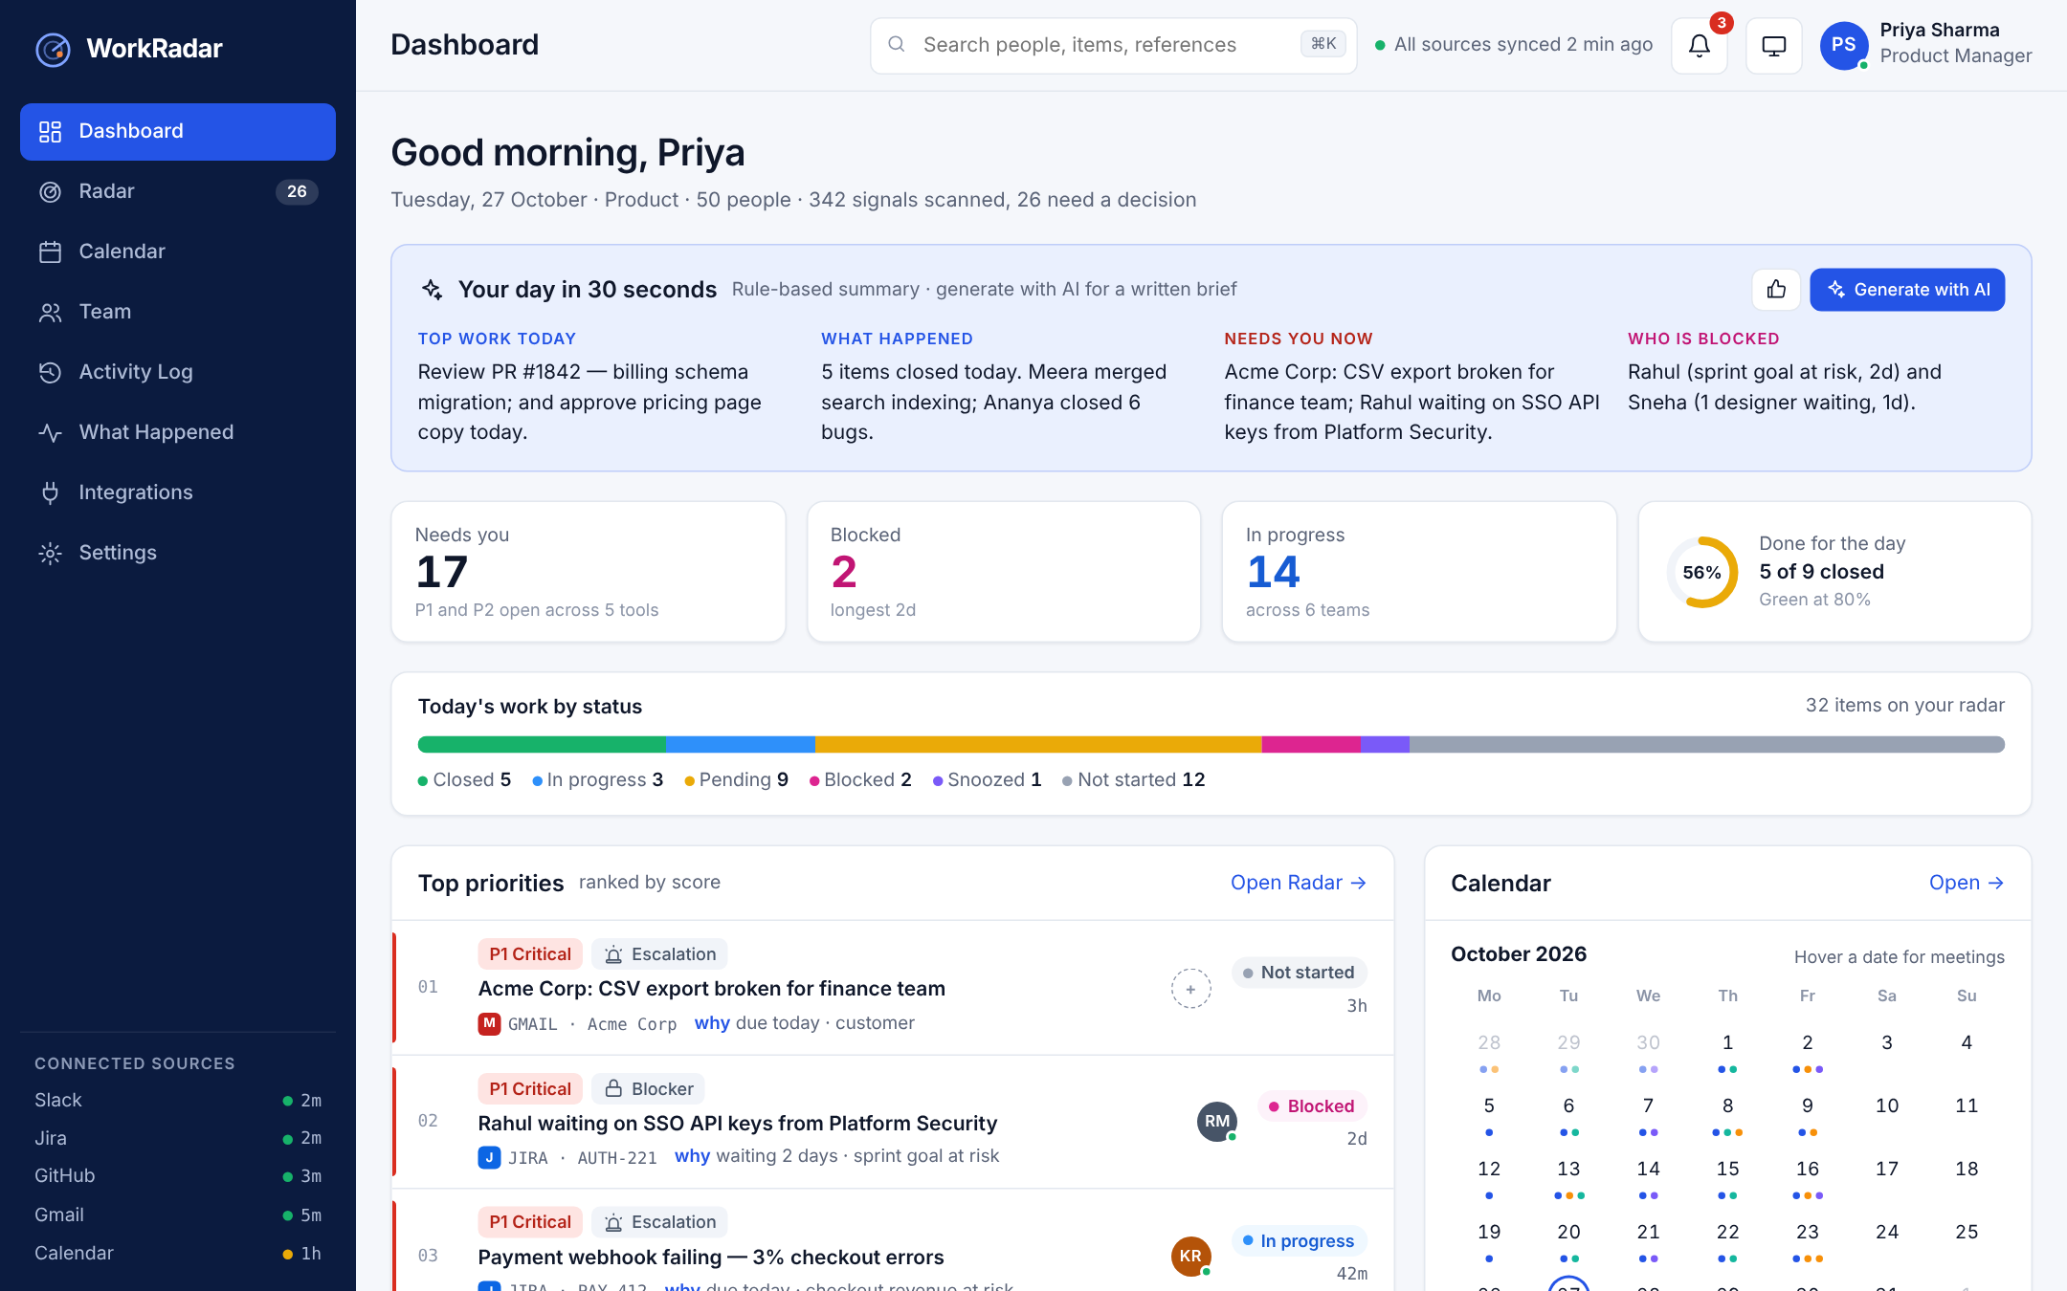
The live MVP answers all four questions on one screen
1
AI daily brief
Top work, what happened, needs you, who is blocked. Falls back to rules if AI fails.
2
Done for the day
Priority items closed vs due: green at 80% or more.
3
Ranked priorities
P1 to P3 with a reason and source link on every row.
4
Calendar and blockers
Meeting dots with hover details; who is stuck and for how long.
Notes:
[3:25–4:10] Here's the live MVP. One screen answers all four questions. The AI brief at the top gives the day in 30 seconds — and if AI is down, it falls back to a rule-based summary. The ring shows done for the day: priority items closed versus due, green at 80 percent. Below are the ranked priorities with a reason and source link, and on the right the calendar with meeting dots and who's blocked. [If presenting live: open the app, click Generate with AI, then open a P1 item.]

Slide 8
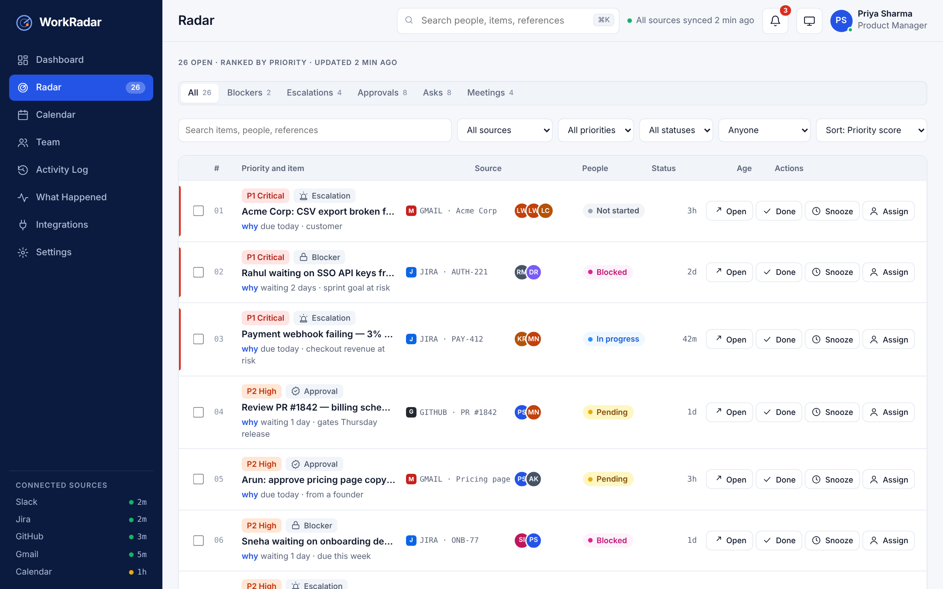
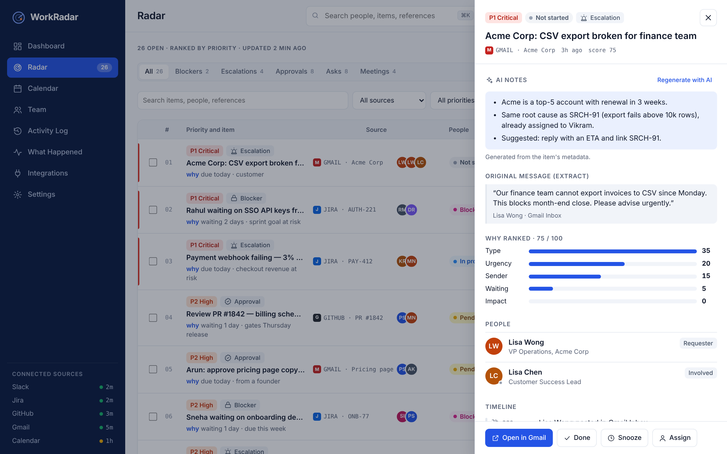
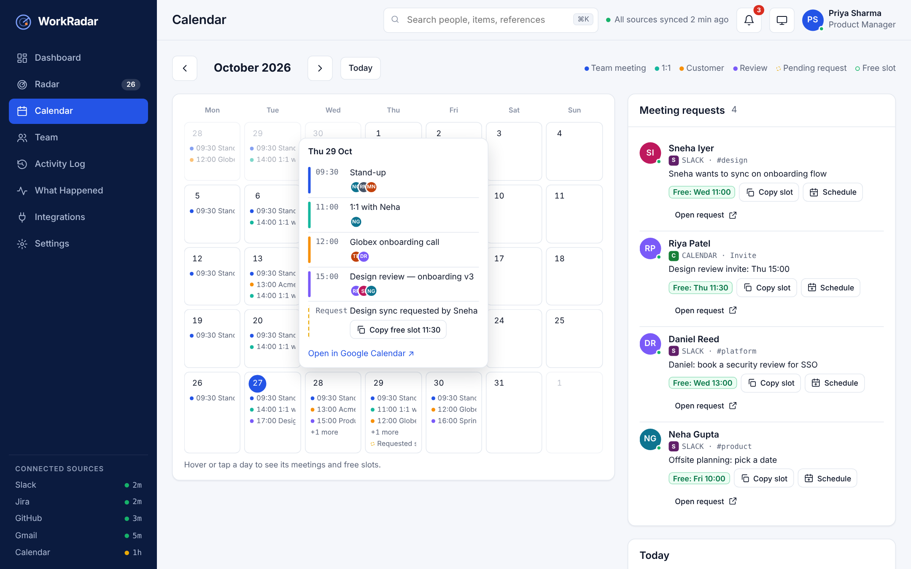
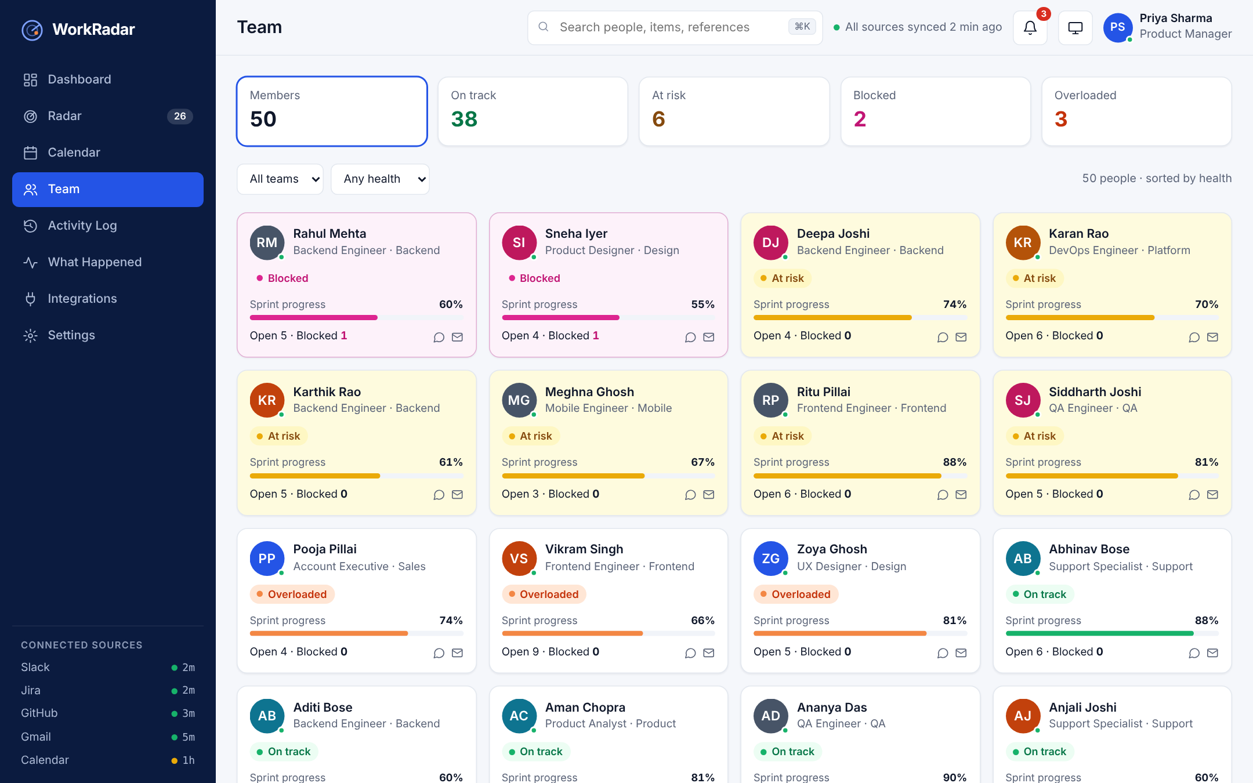
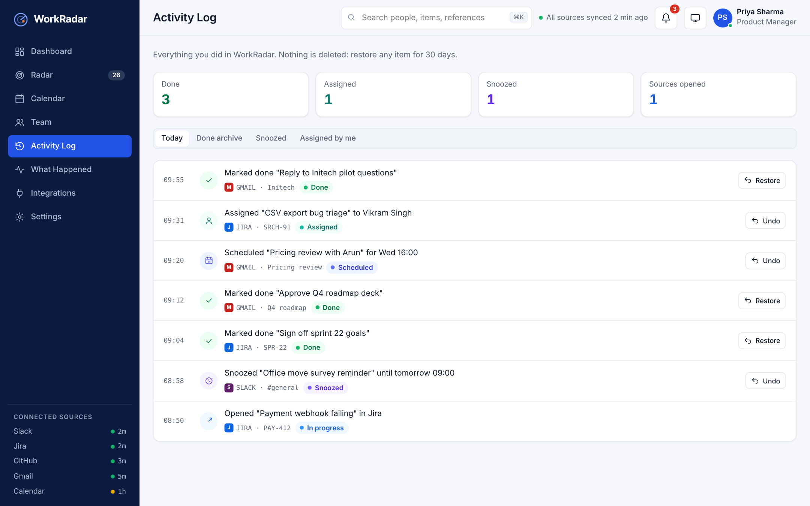
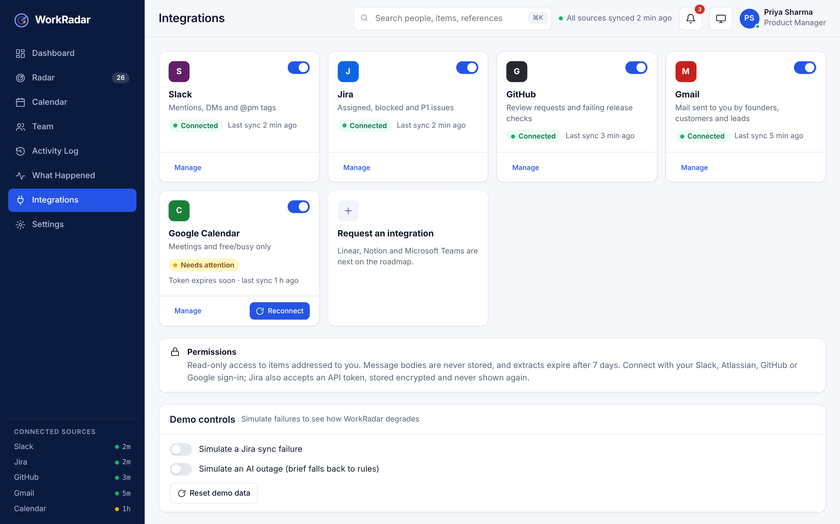
Every required screen works, with mock data for 50 people
Radar · ranked feed with filters
Item detail · score and AI notes
Calendar · dots, hover, free slots
Team · health at a glance
Activity Log · undo and restore
Integrations · status and demo controls
Notes:
[4:10–4:45] All the required screens work: the Radar with filters and five sort orders, the item detail with the score breakdown and AI notes, the calendar with hover details and free slots, team health, the Activity Log where every action can be undone or restored, and integrations — including demo controls that simulate a Jira or AI outage to show how the app degrades safely. Assign, Mark Done and Snooze all work with undo.

Slide 9



Success means clarity in minutes and nothing missed
NORTH STAR
DONE FOR THE DAY
Leading
P1 opened in source within 2 h > 70% · @pm tag use > 40%
< 5 min
82%
Lagging
Triage time and blocker wait time down 50%
Time to daily clarity: from opening WorkRadar to naming the top three. Baseline is 60+ minutes.
Priority items closed ÷ due today. Green ≥ 80% · amber 50–79% · red < 50%
Guardrails
Missed P1 < 5% · ≤ 20 min a day in app · zero privacy complaints
Notes:
[4:45–5:15] How we measure success: the North Star is time to daily clarity — under five minutes, down from an hour. The daily outcome is 'done for the day': priority items closed versus due, green at 80 percent. Leading metrics track whether P1s get opened fast and whether teams use the tags; guardrails make sure we never miss a P1, never become another inbox, and never create a privacy problem.

Slide 10
Ship the core now, live integrations next
MVP · MUST HAVE (built)
VERSION 2 · SHOULD HAVE
Ranked radar with reasons and source links
Blocked panel and calendar with meeting dots
AI daily brief and item notes, with fallback
Done, Snooze, Assign with undo; Activity Log
Search, team health, themes, error states
Live read-only connectors for all five tools
Write-back of Assign and Done to Jira and GitHub
Suggested meeting slot inserted into replies
Slack bot confirms tagged items
Morning digest; cross-tool de-duplication
Converged with Kano, RICE, impact vs effort and MoSCoW. Top RICE: exact-message links 360 · why-ranked 320 · blocked panel 192
Notes:
[5:15–5:40] Prioritisation: I converged Kano, RICE, impact-versus-effort and MoSCoW. The MVP ships the must-haves — the ranked radar, blocked panel, calendar, AI brief with fallback, actions with undo. Version 2 brings live read-only connectors and write-back to Jira and GitHub. The highest RICE scores were exact-message links and the 'why ranked' reason — cheap to build and core to trust.

Slide 11
AI built it fast; I made the product calls
Claude
Claude Docs
Web research
Google Stitch
Hosted AI runtime
Rendered checks
AI GENERATED
WHAT I CHANGED
Research on all four tools and the market
Strategy, 5 Whys, Kano, RICE, metrics
PRD drafts and the UI/UX specification
Google Stitch prompts for every screen
The MVP code, tested on desktop and phone
Engineering manager
→
Startup product manager
AI summarises everything
→
Rank and link to the exact message
AI guesses blockers
→
@pm tags, AI only as fallback
Average day
→
Designed for 50 people, 60 items
Actions without history
→
Undo plus a no-delete Activity Log
Notes:
[5:40–6:15] On the AI workflow: I used Claude as guide and builder for research, strategy, the PRD, the UX spec and the MVP code, plus Google Stitch for the screens. AI was fast, but the product calls were mine. I changed the user from an engineering manager to a startup PM, replaced 'AI summarises everything' with a privacy-safe radar that links out, swapped AI blocker-guessing for simple team tags, designed for the busiest day, and added undo with a no-delete history.

Slide 12
Next: prove it on live data
MVP · now
V2 · pilot
V3 · scale
One PM, mock data; radar, brief, actions; usability test with 5 PMs
One startup on live read-only data; write-back; slot suggestions
50–250-person teams; multi-PM and founder views; Teams and Outlook
Gate: SUS ≥ 75 · task success ≥ 90%
Gate: clarity < 5 min · missed P1 < 5%
Gate: paying teams retained 3 months
Thank you
Gopi Krishna · Cohort 40 · AIR Tribe AIPM
Deliverables: PRD · AI Workflow · UI/UX spec and Stitch designs · live MVP and source code
Notes:
[6:15–6:40] Next steps: the MVP proves the experience with mock data. Version 2 pilots with one startup on live, read-only data, and only moves forward when time to clarity is under five minutes and missed P1s are under five percent. Version 3 scales to larger teams. Thank you — I'm Gopi Krishna, Cohort 40, AIR Tribe AIPM. Happy to take questions.

