Slide 1
Agenda
1
CONTEXT
2
Bokeh Overview
3
challenges faced & Their resolutions
4
Tips Based on my experience
5
Q&A

Slide 2
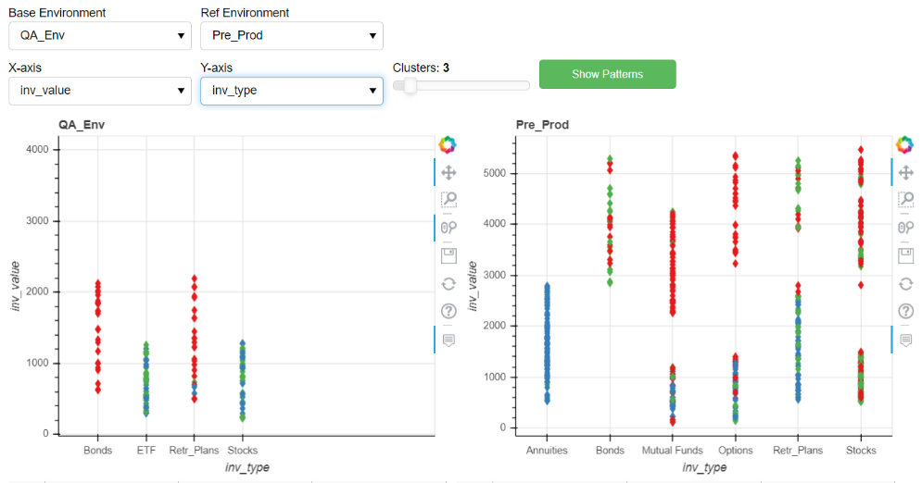
Context
Need for web UI for backend Python programs
Skill factor
My expectations from UI
Options I explored

Slide 3
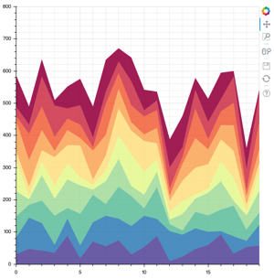
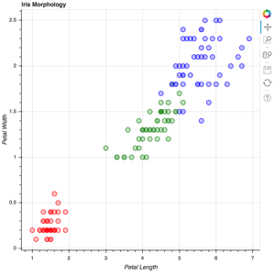
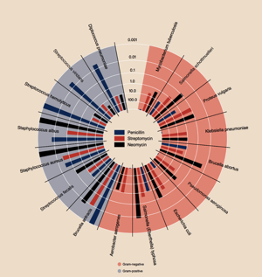
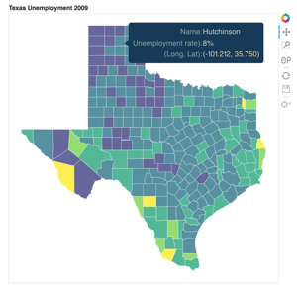
Bokeh - Overview
Visualization + Interaction

Slide 4
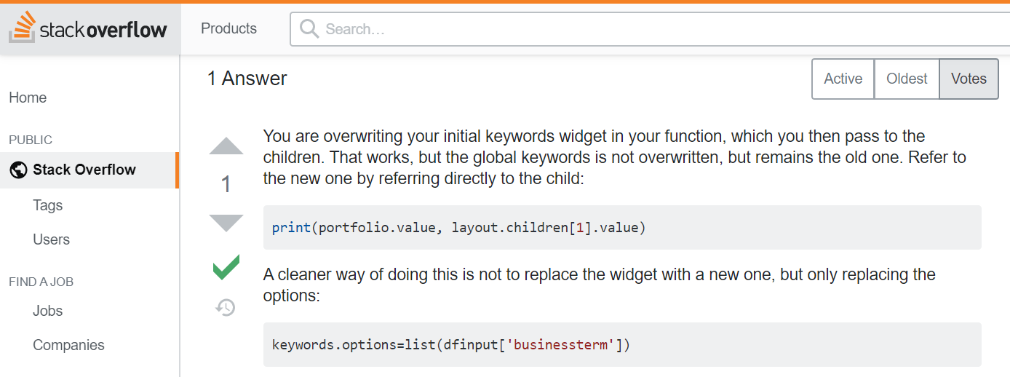
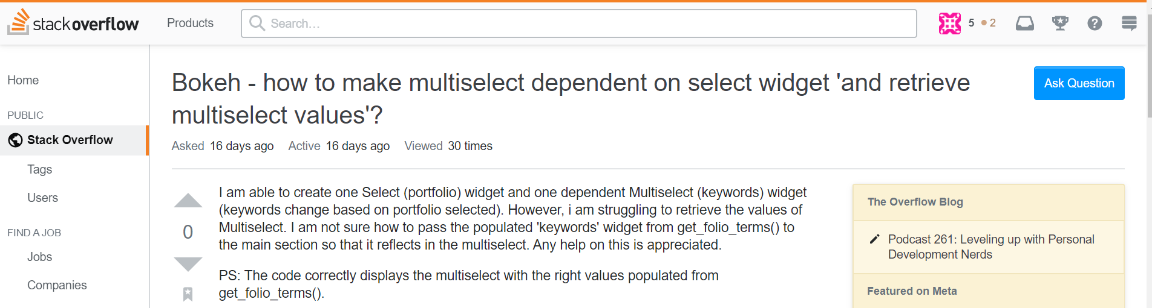
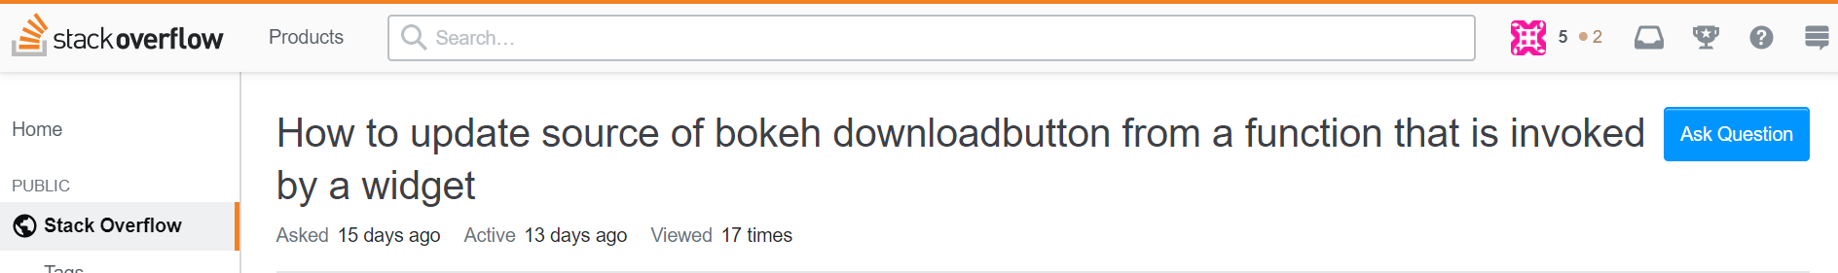
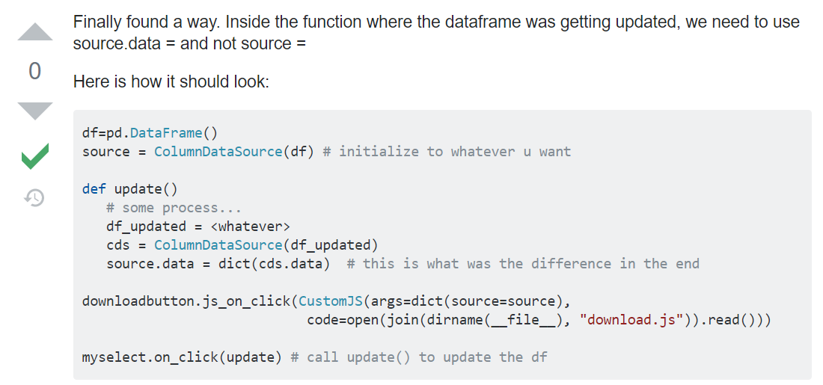
Sample challenges faced and their resolutions
Samples shown here … more will be covered during presentation

Slide 5
Tips based on my experience
1. Handling layout components
row0 = row(envsel1, envsel2)
row1col1 = row(parmsel1, parmsel2, cluster_slider, plotbutton)
row2col1 = row(org_p, ref_p)
tablerow = row(data_table1, data_table2)
dlfiller = Paragraph(width=10)
dlmenu = column(row(numrecs, dlfiller, dlenv), genbutton, dwlbutton)
lay_out1 = column(row0, row1col1, row2col1, tablerow, dlmenu)
lay_out1.width = 1000
fillerspace = Paragraph()
fillerspace.height = 60
lay_out2 = column(fillerspace, row(optenvsel, optbutton), opt_p)
lay_out = row(lay_out1, lay_out2)
lay_out_master = column(layout_kw, lay_out, clustersel,gen2button,dwl2button)
curdoc().add_root(lay_out_master)
Sample shown here … more will be covered during presentation

