Slide 1
ZENCUBE
ZAMIS V1
Dashboard development, measures and validation
Five Power BI dashboards built from 18 domain tables · snapshot 21 September 2026

Slide 2
Data sources, model and assumptions
Sources and model
18 domain CSVs from data_inventory_1000.csv, one row per candidate (1,000).
Student_Member is the hub; 16 satellite tables relate 1:1 on Candidate ID.
Institution_CoE (12 institutions) relates 1:many into Student_Member.
Single-direction relationships; satellites never join each other.
Calculated columns: Risk Flag, Completion Band, Blocked Flag. Helper tables: Attempt, Risk Reason.
Assumptions and data quality
The source is a candidate-level summary, so Batch stands in for time.
Scales differ: most scores run 0-100, sprint quality 0-10.
A blank compares as lower than any number, so each risk signal checks ISBLANK.
Active, inactive, delayed and overdue each have two definitions across pages.
Offers and interviews are counts, not people; count students separately.

Slide 3
Common patterns and differences
Dashboard | Type and audience | Pattern it relies on
CEO Overview | Summary page, leadership | KPI card strip, slicers, snapshot date
Student 360 | Drillthrough, PM and experts | SELECTEDVALUE text cards, helper table
Student Progress | Cohort trend, academic teams | AVERAGE by Batch, Batch as time proxy
Project Performance | Delivery view, PM and experts | Banded columns, 100% stacked bars
At-Risk Students | Worklist, Program Manager | Risk Flag column, conditional formatting
Keep maintenance simple
One theme file for colours and fonts on every page.
One measure per business term, reused everywhere: Total Students feeds all five pages.
Same header band, slicers and snapshot card on each page.
Spaced measure names (Project Count), so they never clash with source columns.

Slide 4
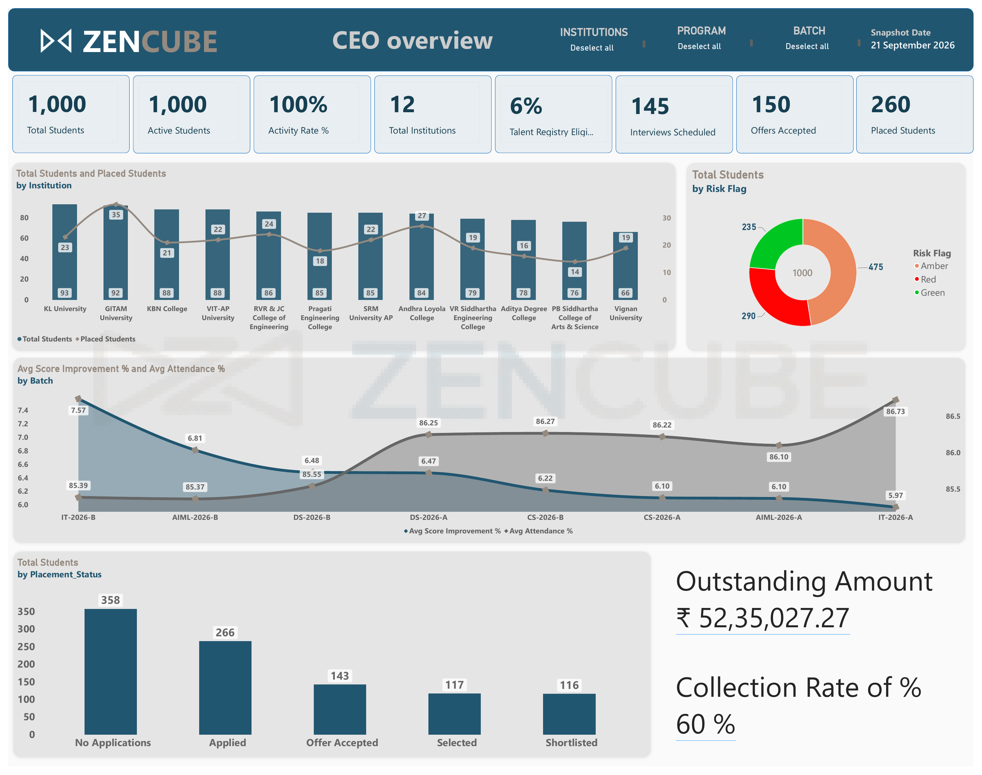
CEO Overview: build steps
Data sources and model notes
Student_Member hub, plus Institution_CoE, Jobs_Placement, Talent_Registry, Attendance_Engagement, Assessment and Commercial_Payments.
Slicers: Institution, Program, Batch, with a Snapshot Date card.
Step-by-step build
Relate the tables, then create explicit measures (counts, rates, revenue).
Add slicers and the Snapshot Date card.
Build 8 KPI cards, the institution combo chart, risk donut, batch trend and status columns.
Sort batches by cohort and statuses in funnel order.
Drill the donut through to the At-Risk page.

Slide 5
CEO Overview: measures and checks
Visual | Measures | Business question
KPI cards | Total, Active, Placed Students; Activity, Eligible % | How big and how engaged is the program?
Combo chart | Total Students, Placed Students by Institution | Which institutions convert to placements?
Risk donut | Total Students by Risk Flag | How healthy is the cohort?
Batch trend | Avg Score Improvement %, Avg Attendance % | Are newer batches doing better?
Status and fees | Students by Placement_Status; Outstanding, Collection % | Where do students stall; is money coming in?
Placed Students =
CALCULATE ( [Total Students],
Student_Member[Placement_Status]
IN { "Selected", "Offer Accepted" } )
Placement % =
DIVIDE ( [Placed Students], [Total Students] )
Validation checklist
Active (1,000) conflicts with Dashboard 5 inactive (1,000).
Placed 260 = Selected 117 + Offer Accepted 143.
Risk counts 475 + 290 + 235 add to 1,000.
Fix the card title "Collection Rate of %".
Placed counts Selected and Offer Accepted students (260). Dividing by all 1,000 gives 26%.

Slide 6
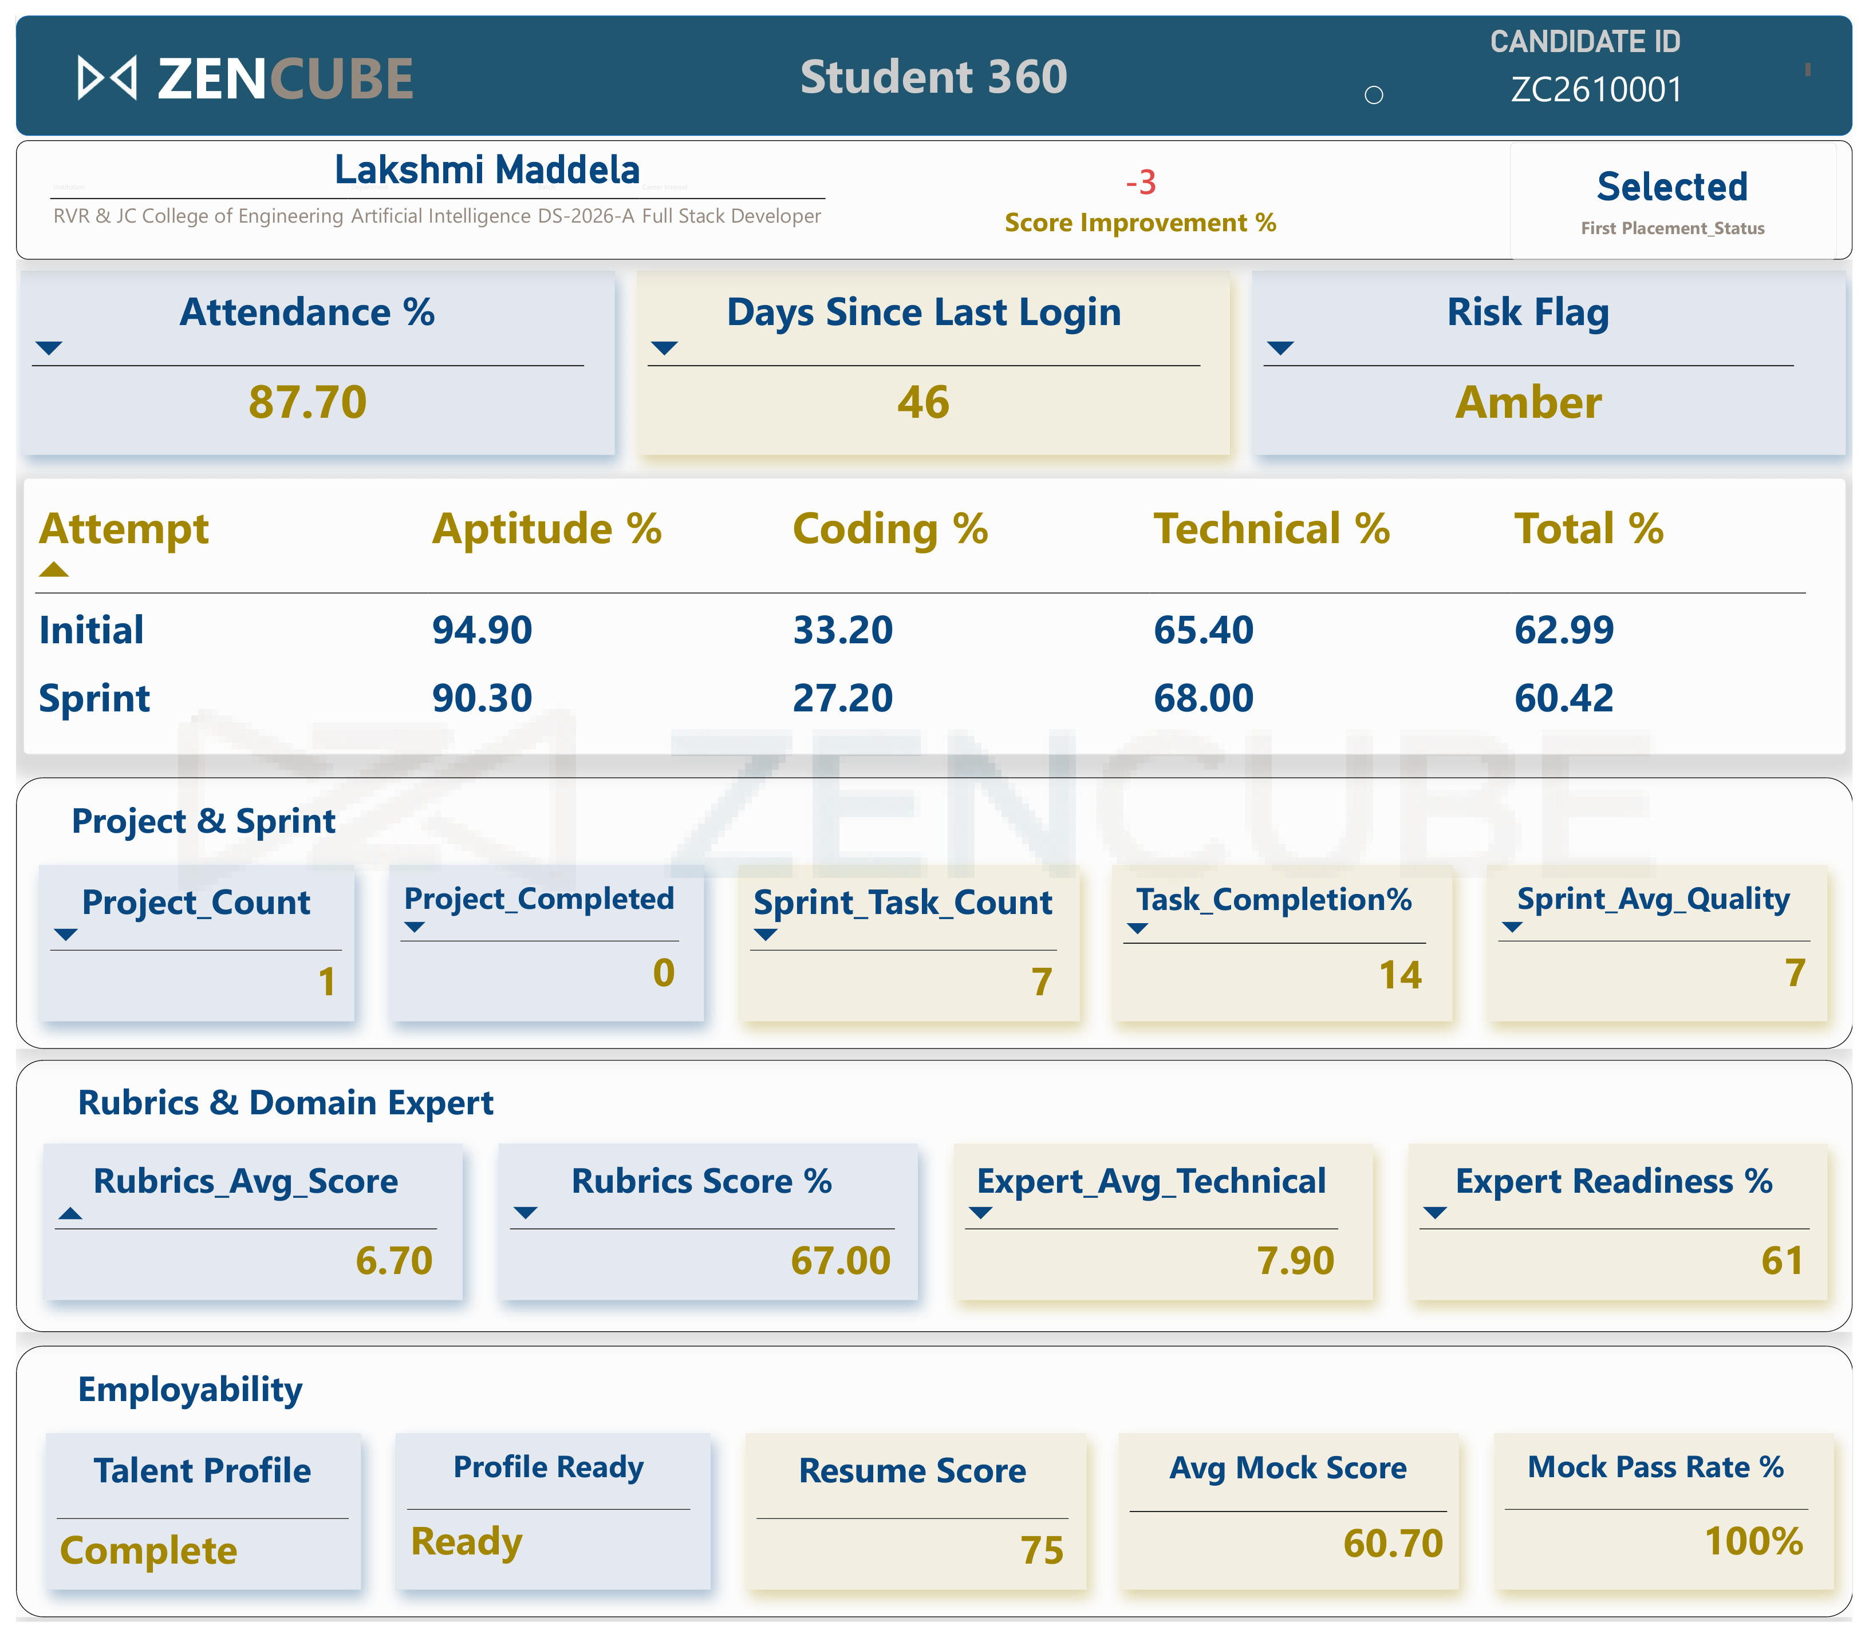
Student 360: build steps
Data sources and model notes
Drillthrough page on Student_Member[Candidate ID]; one row per student across eight satellite tables.
Text fields need SELECTEDVALUE measures because cards accept only measures.
Step-by-step build
Add Candidate ID to the Drill through field well.
Create the text and numeric card measures.
Build the Attempt helper table (Initial, Sprint) for the assessment table.
Group cards: project and sprint, rubrics and expert, employability.
Build the placement stepper from Funnel Stage Reached.
Test by drilling through from a table on another page.

Slide 7
Student 360: measures and checks
Visual | Measures | Business question
Header cards | Full Name, Institution, Batch, Placement Status | Who is this student?
Health cards | Attendance %, Days Since Last Login, Risk Flag | Is the student at risk now?
Assessment table | Aptitude, Technical, Coding, Total % by Attempt | Did the student improve?
Card groups | Project, rubric, expert, mock and resume measures | Is the student delivering and job-ready?
Stepper | Funnel Stage Number | How far has placement progressed?
Aptitude % =
SWITCH ( SELECTEDVALUE ( Attempt[Attempt] ),
"Initial", AVERAGE ( Assessment[Initial Aptitude %] ),
"Sprint", AVERAGE ( Assessment[Sprint Aptitude %] ) )
Validation checklist
Score Improvement shows -3 but total moved 62.99 to 60.42.
A header showing Multiple means the drillthrough filter is missing.
The placement stepper is not on the page yet.
Compare one student against the source CSV.
The Attempt helper table supplies the row labels; SWITCH picks the matching columns for each row.

Slide 8
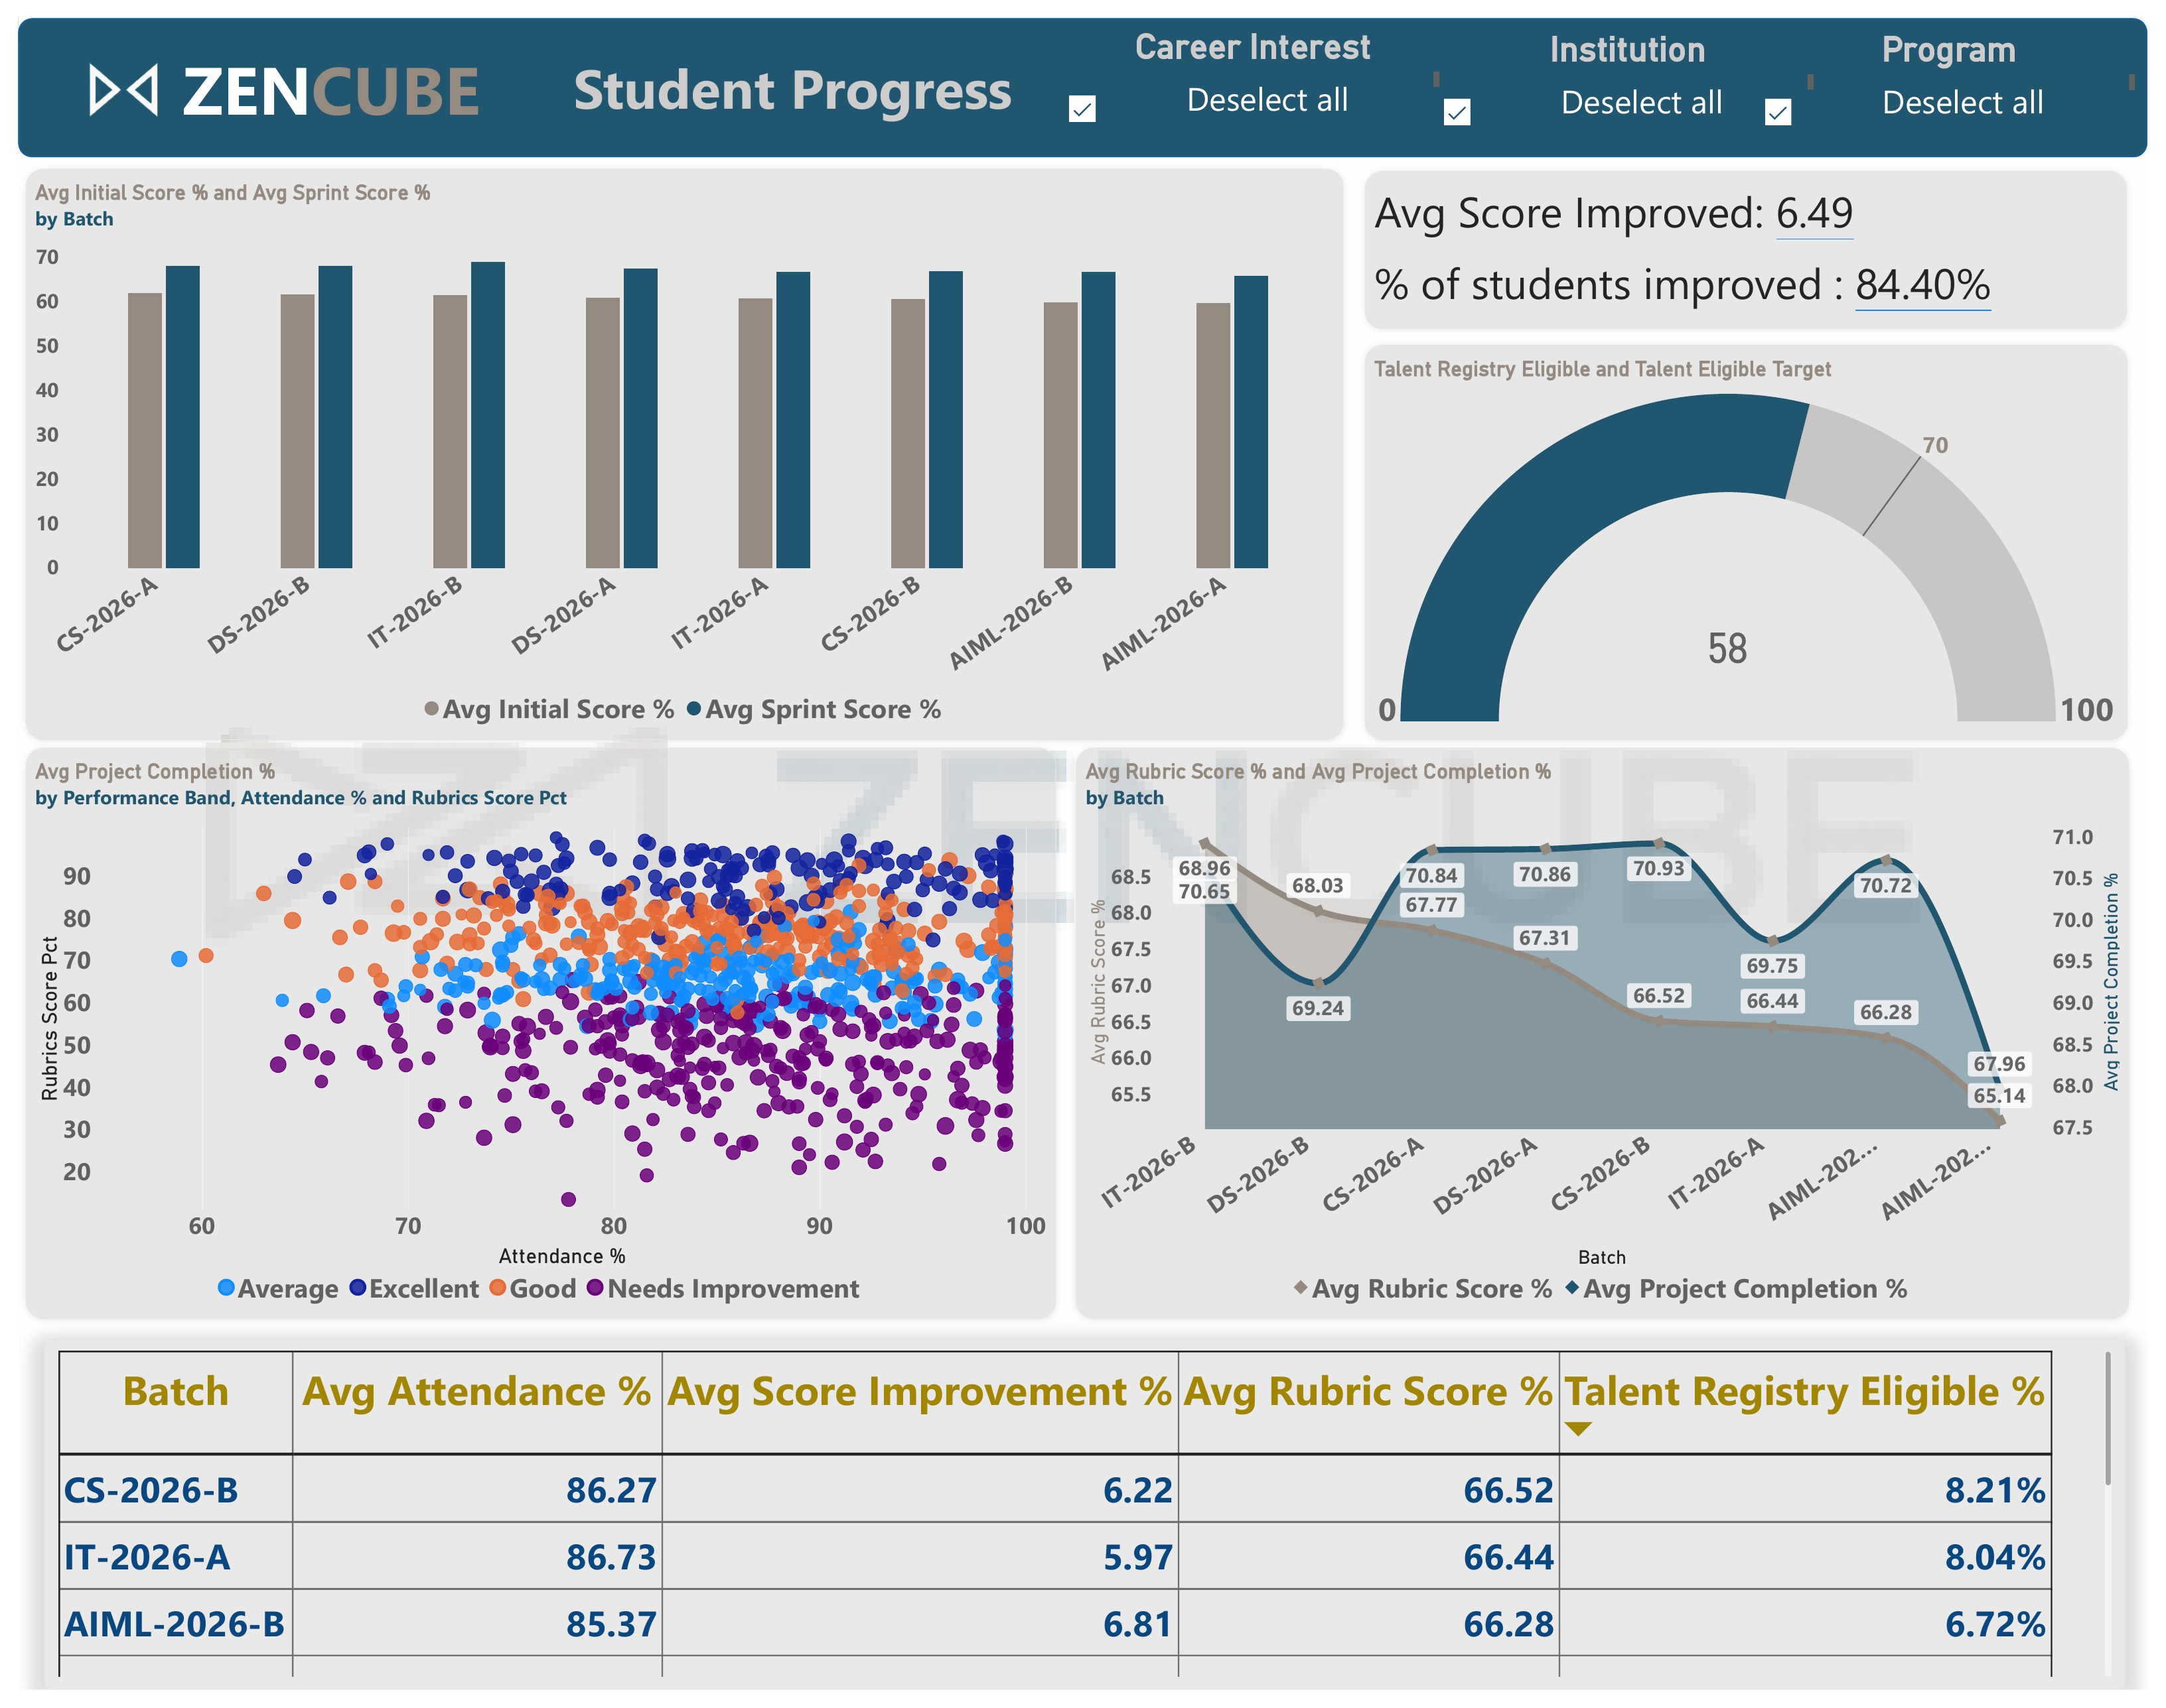
Student Progress: build steps
Data sources and model notes
Assessment, Attendance_Engagement, Rubrics_Reviews, Projects and Talent_Registry through Student_Member.
Slicers: Career Interest, Institution, Program. Batch stands in for time, as there is no weekly history.
Step-by-step build
Create the per-batch averages (initial, sprint, rubric, project).
Add the clustered column chart of initial vs sprint score.
Add the KPI lines: average improvement and % students improved.
Add the gauge with a value and a target measure.
Add the scatter with Candidate ID in Values and Performance Band as legend.
Add the area chart and the batch rollup table.

Slide 9
Student Progress: measures and checks
Visual | Measures | Business question
Clustered columns | Avg Initial Score %, Avg Sprint Score % | Do students improve after sprints?
KPI lines | Avg Score Improvement %, % Students Improved | How broad is the improvement?
Gauge | Talent Eligible Students vs Target | Are we on track for job-ready talent?
Scatter | Attendance % vs Rubrics Score %, by band | Does attendance track quality?
Area chart, table | Avg Rubric Score %, Project Avg Completion | Which cohorts lead or lag?
% Students Improved =
DIVIDE (
CALCULATE ( COUNTROWS ( Assessment ),
Assessment[Score Improvement %] > 0 ),
COUNTROWS ( Assessment ) )
Validation checklist
Gauge reads 58 of 100 while Dashboard 1 shows 6%; align the unit.
Batch table is clipped; show all 8 batches.
Batch table averages agree with the cards.
Sort batches by cohort order, not by value.
Counts students with an improvement above zero, divided by all assessed students. The report shows 84.40%.

Slide 10
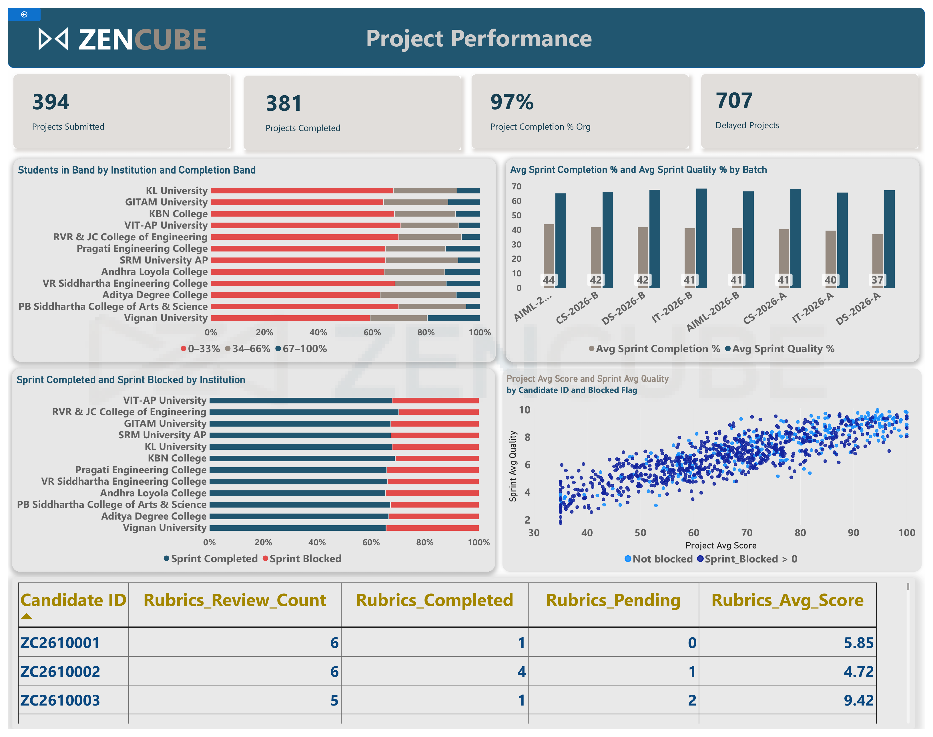
Project Performance: build steps
Data sources and model notes
Projects, Sprint_Task, Rubrics_Reviews and Project_Registry_Artifacts through Student_Member.
Completion Band and Blocked Flag are calculated columns; Institution comes from Institution_CoE.
Step-by-step build
Create Completion Band and its sort-order column.
Add the four KPI cards (submitted, completed, completion %, delayed).
Add the 100% stacked bar of students by band and institution.
Add the sprint column chart; multiply quality by 10 to match the % scale.
Add completed vs blocked per institution, sorted by blocked.
Add the scatter (Blocked Flag legend) and the rubric backlog table.

Slide 11
Project Performance: measures and checks
Visual | Measures | Business question
KPI cards | Projects Submitted, Completed, Completion %, Delayed | Are projects getting delivered?
Band bars | Students in Band by Completion Band | How is completion spread by institution?
Sprint columns | Avg Sprint Completion %, Avg Sprint Quality % | Which batches deliver quality work?
Stacked bar | Sprint Completed, Sprint Blocked | Where are blockers concentrated?
Scatter, table | Project Avg Score vs Sprint Avg Quality; Rubrics Pending | Do blocked students score lower?
Avg Sprint Quality % =
AVERAGE ( Sprint_Task[Sprint_Avg_Quality] ) * 10
Project Completion % Org =
DIVIDE ( [Projects Completed], [Projects Submitted] )
Validation checklist
Delayed Projects 707 exceeds 394 submitted.
Band chart (all students) and the 97% card use different bases.
Rubric table shows Candidate ID; the spec says Batch.
Make blocked and not-blocked dots clearly different colours.
Quality is stored 0-10, so x10 matches the percentage scale. 381 of 394 projects gives 97%.

Slide 12
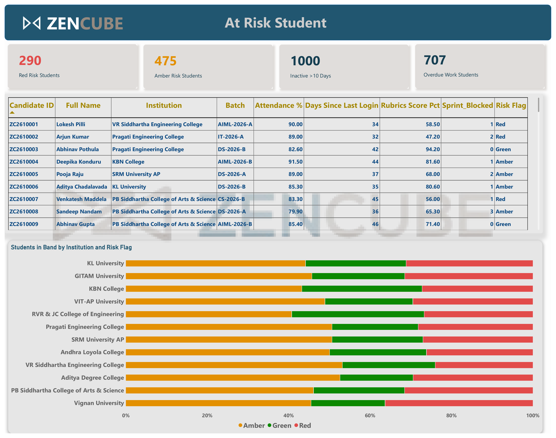
At-Risk Students: build steps
Data sources and model notes
Risk Flag is a calculated column on Student_Member built from RELATED columns in Attendance, Rubrics and Sprint_Task.
Slicers: Institution, Program, Batch, Risk Flag. Helper table: Risk Reason.
Step-by-step build
Build the Risk Flag and Risk Order columns.
Add the Red, Amber, Inactive and Overdue cards.
Add the worklist table; set numeric fields to Don't summarize.
Sort Red first with Sort by column on Risk Flag.
Add the 100% stacked bar of risk by institution.
Add the reason matrix, the action card and the drillthrough to Student 360.

Slide 13
At-Risk Students: measures and checks
Visual | Measures | Business question
KPI cards | Red, Amber, Inactive > 10 Days, Overdue Work | How big is the intervention load?
Worklist table | Student fields plus Risk Flag, sorted Red first | Who do I contact today?
Stacked bar | Students by Institution and Risk Flag | Is risk concentrated anywhere?
Reason matrix | Students Failing Criterion | Why was each group flagged?
Action card | Recommended Action | Where do I start?
RiskPoints =
IF ( Att < 70, 1, 0 ) + IF ( DaysIdle > 10, 1, 0 )
+ IF ( Rub < 60, 1, 0 ) + IF ( Blocked > 0, 1, 0 )
Risk Flag =
SWITCH ( TRUE (), RiskPoints >= 3, "Red",
RiskPoints = 2, "Amber", "Green" )
Validation checklist
Inactive is 1,000: every visible student last logged in 32-46 days ago.
Table is sorted by Candidate ID, not Red first.
290 + 475 + 235 add to 1,000.
Reason matrix and action card are not built yet.
One point per failed signal: 0-1 Green, 2 Amber, 3-4 Red. Blanks score nothing.

Slide 14
Release checklist for any new dashboard
Accuracy
Cards reconcile with source row counts (1,000 students, 12 institutions).
Numbers repeated across pages agree.
One student checked end to end.
Refresh
Snapshot date is visible and correct.
Scheduled refresh succeeds with unchanged row counts.
Slicers reset to Select all before publishing.
Security
Row-level security by institution if teams are separate.
Names and IDs only for roles that need them.
Workspace and app permissions reviewed.
Accessibility
Never rely on colour alone for risk; show the text.
Readable contrast and font sizes.
Alt text, titles and tab order set.
Performance: explicit measures, single-direction 1:1 relationships, hidden helper columns, under 10 visuals per page, and a check with Performance Analyzer.

