Slide 1
Labs
Hands on learning

Slide 2
Lab 1
Logging into aws
Creating an EC2 instance

Slide 3
Steps i)
Go to Services
1
EC2
2
Launch Instance
3
Select AMI
4

Slide 4
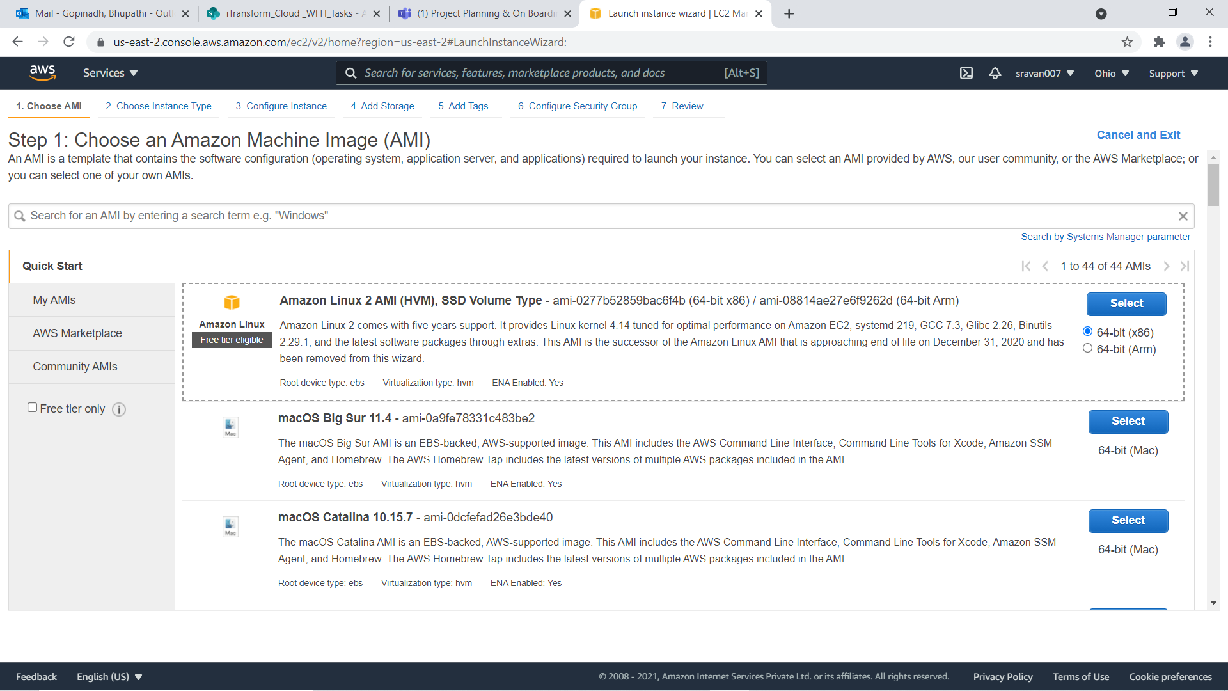

Slide 5
Step ii)
Choose Instance Type
General Purpose-t2.micro 1 gb ram
Then press Next button

Slide 6
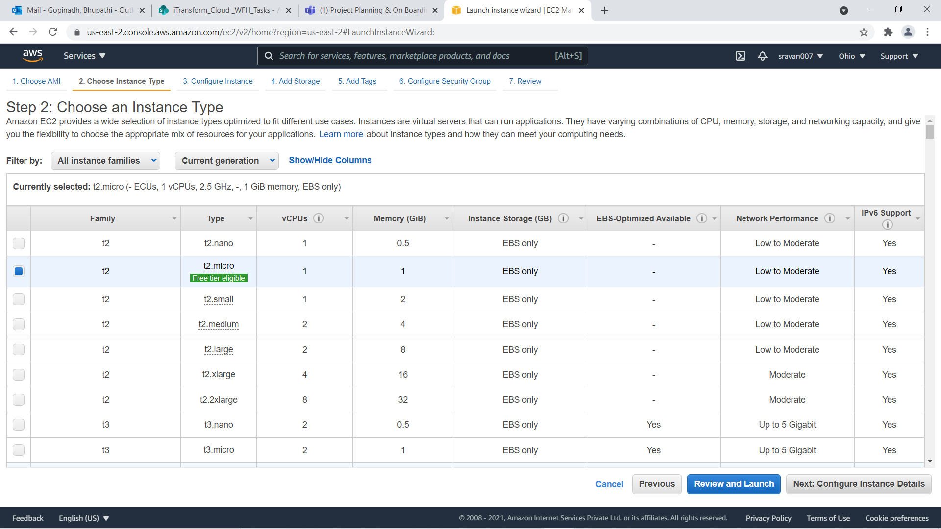

Slide 7
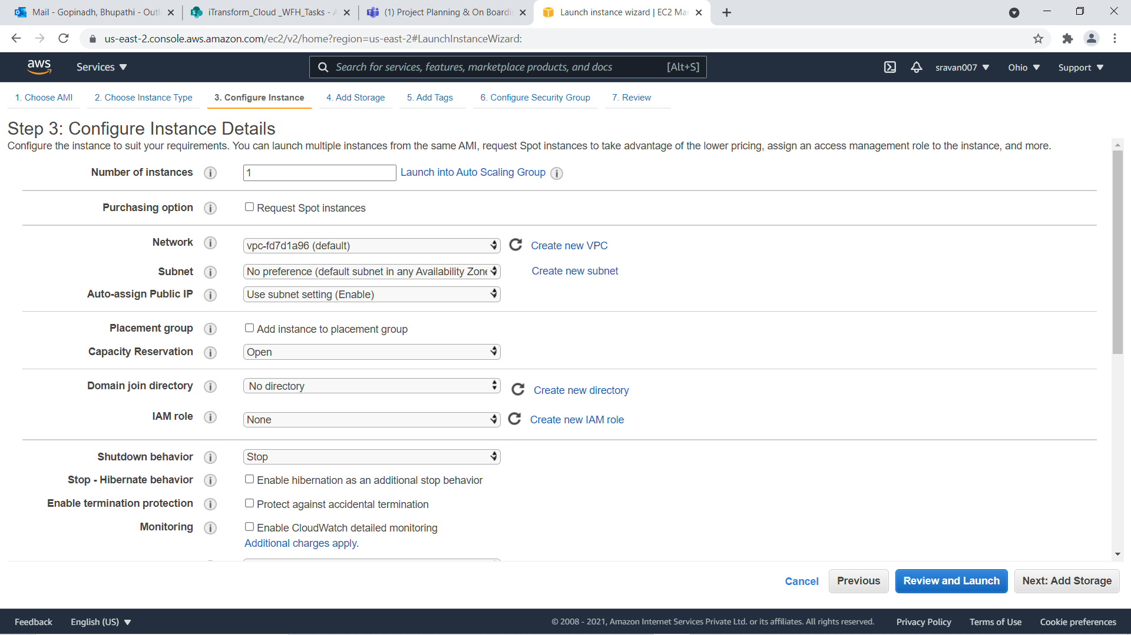
Step iii)
Configure Instance Details

Slide 8
Step iii)
IAM : It will give ability to all aws service without using access keys
Tenancy: Whether you are sharing host or not
T2/T2 : CPU utilization

Slide 9
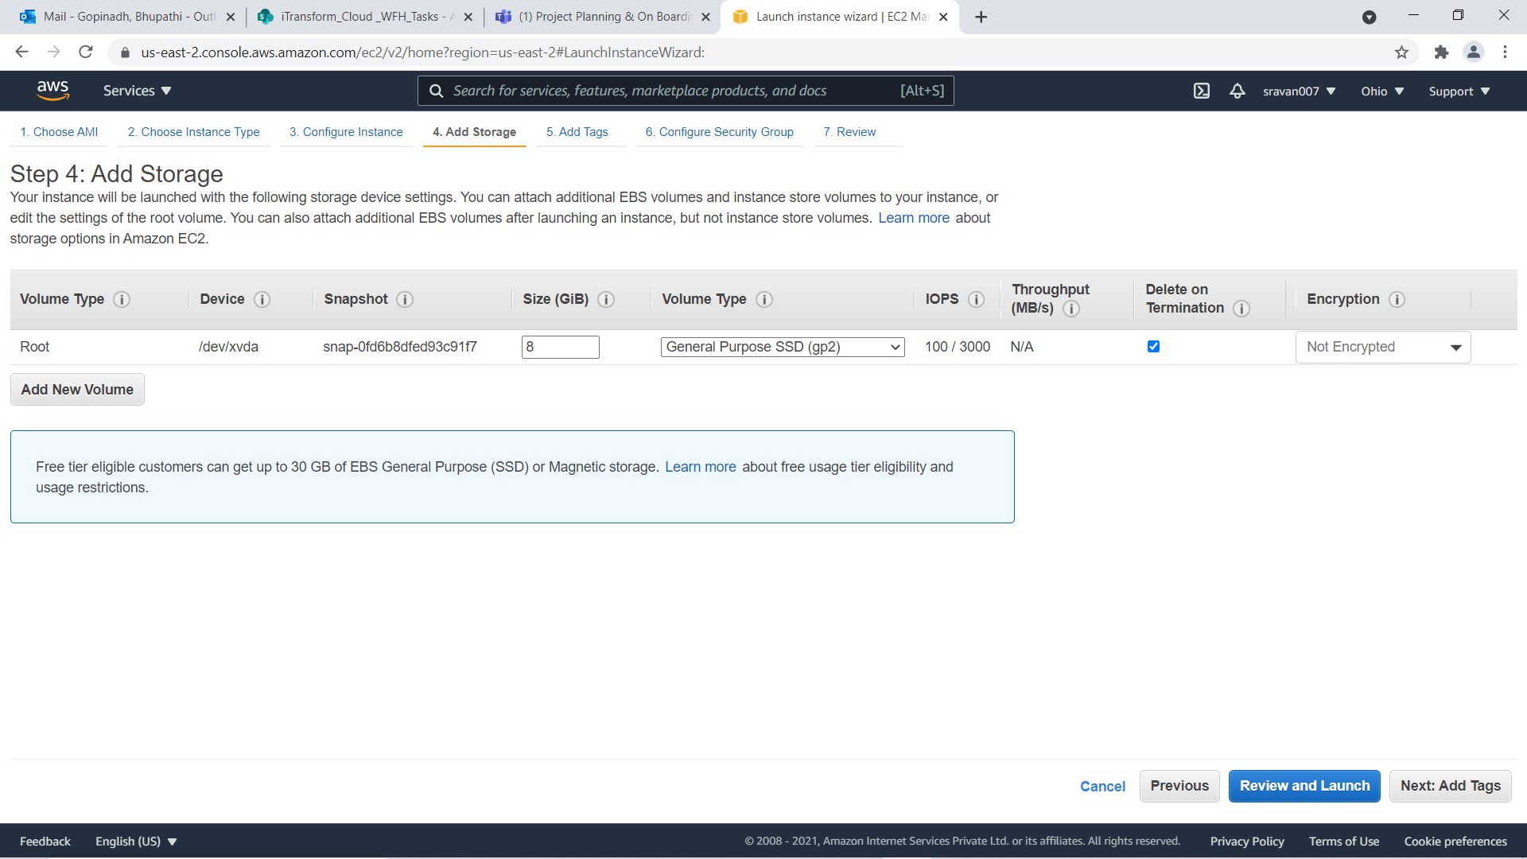
Step iv)
Add Storage

Slide 10
step iv Contd..
Here we can attach or detach volumes according to our need

Slide 11
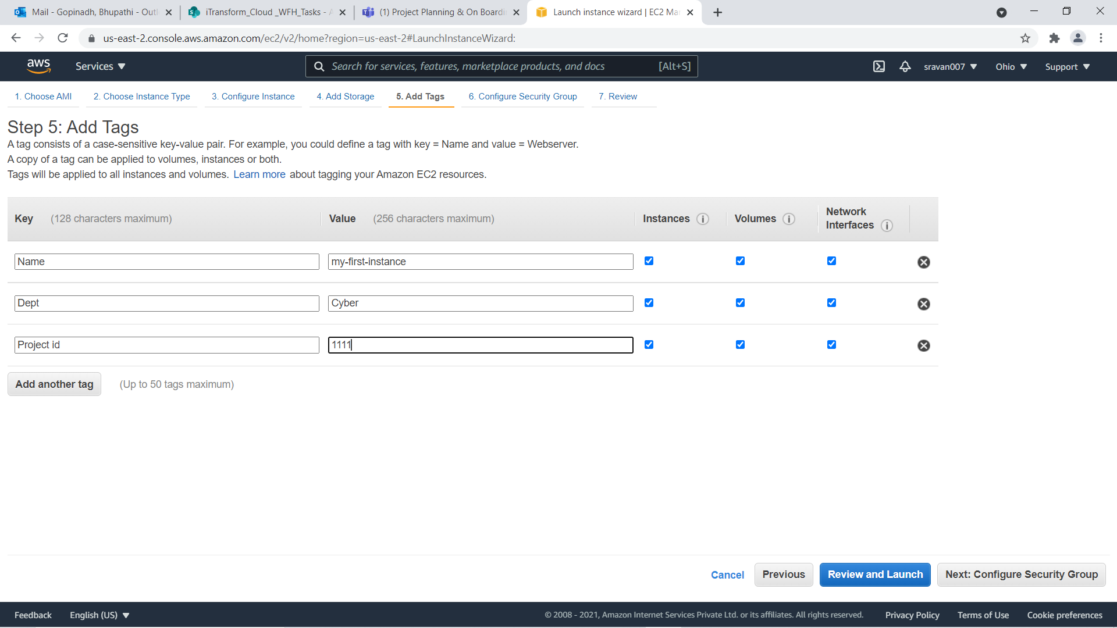
Step v
Add Tags

Slide 12

Step vi Configure Security Groups
It is a Set of firewall rules that control the traffic for your instance.

Slide 13
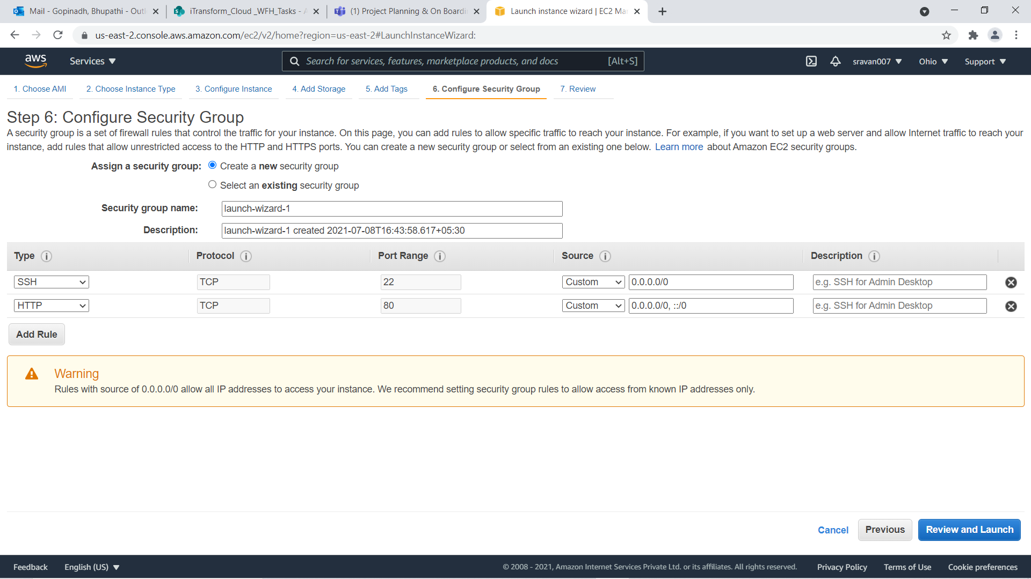

Slide 14
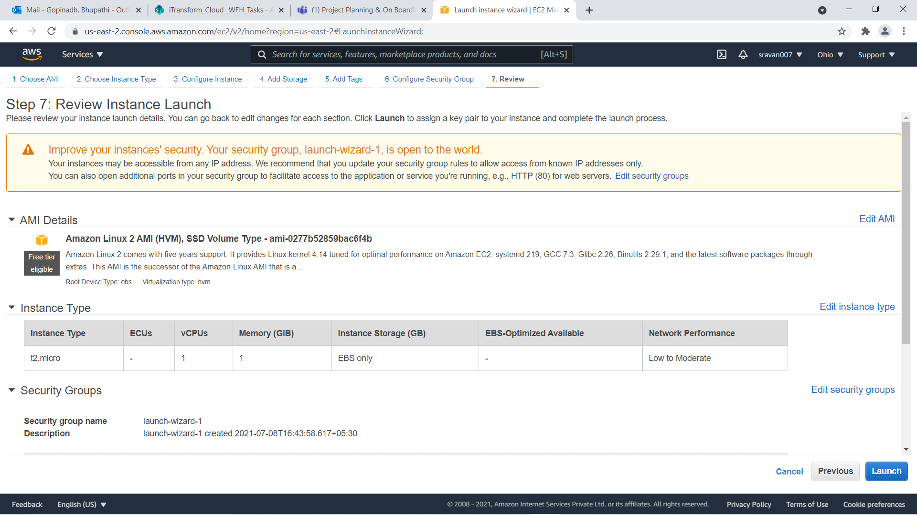
Finally Review and Launch

Slide 15
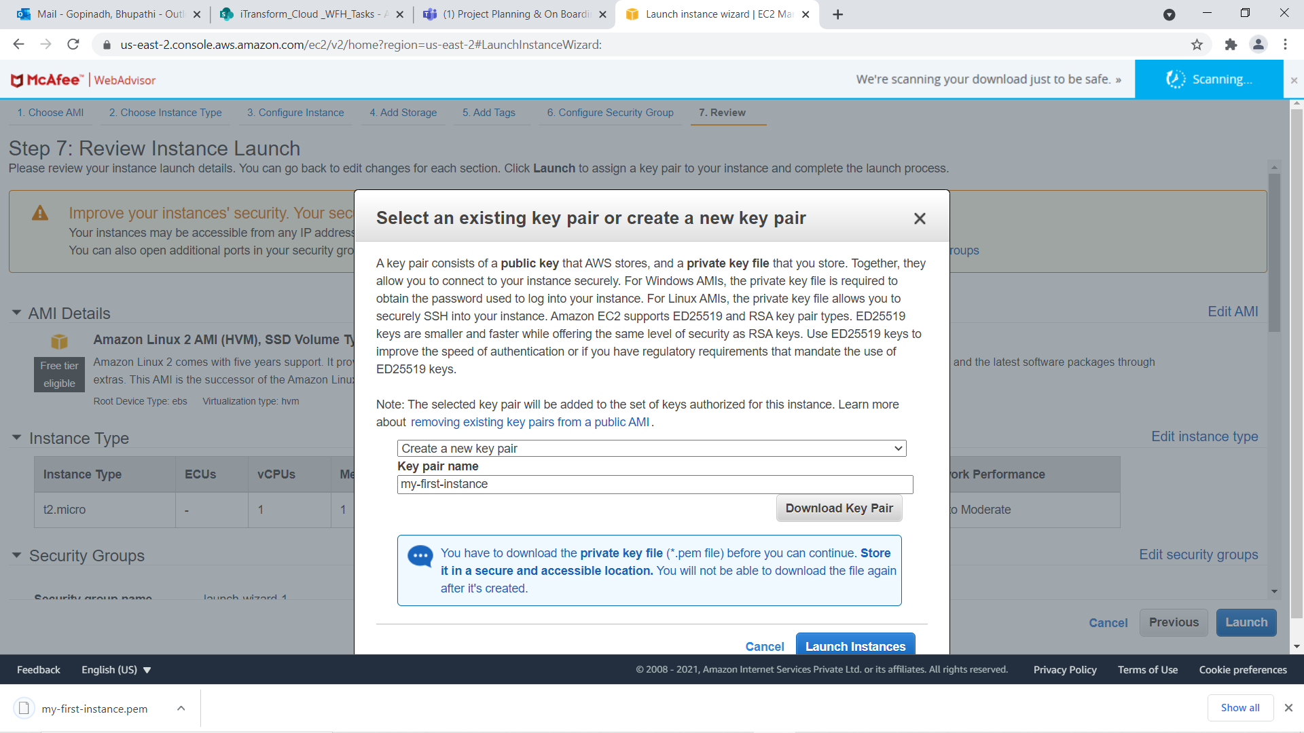
Downld Key pairs and Launch

Slide 16
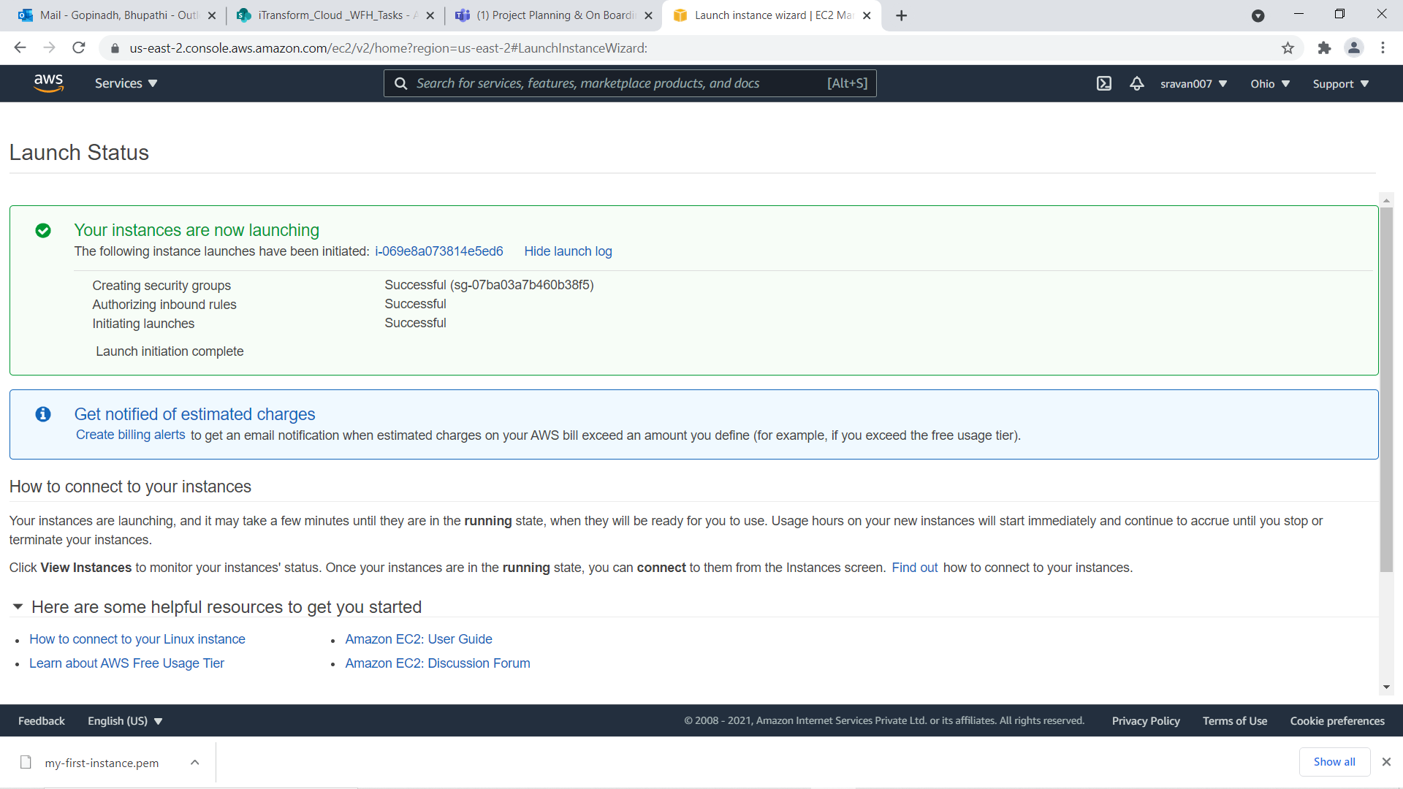

Slide 17
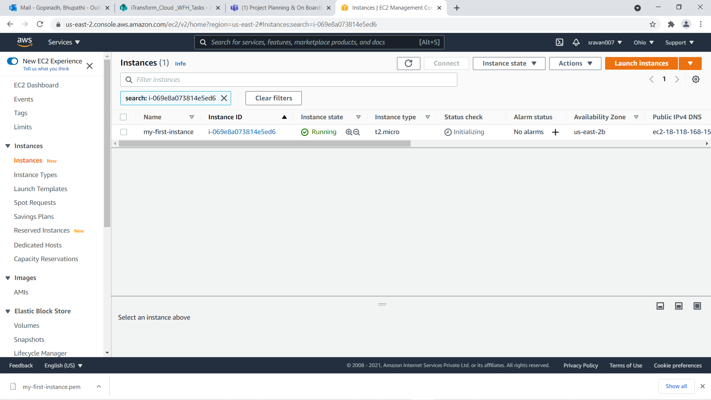

Slide 18
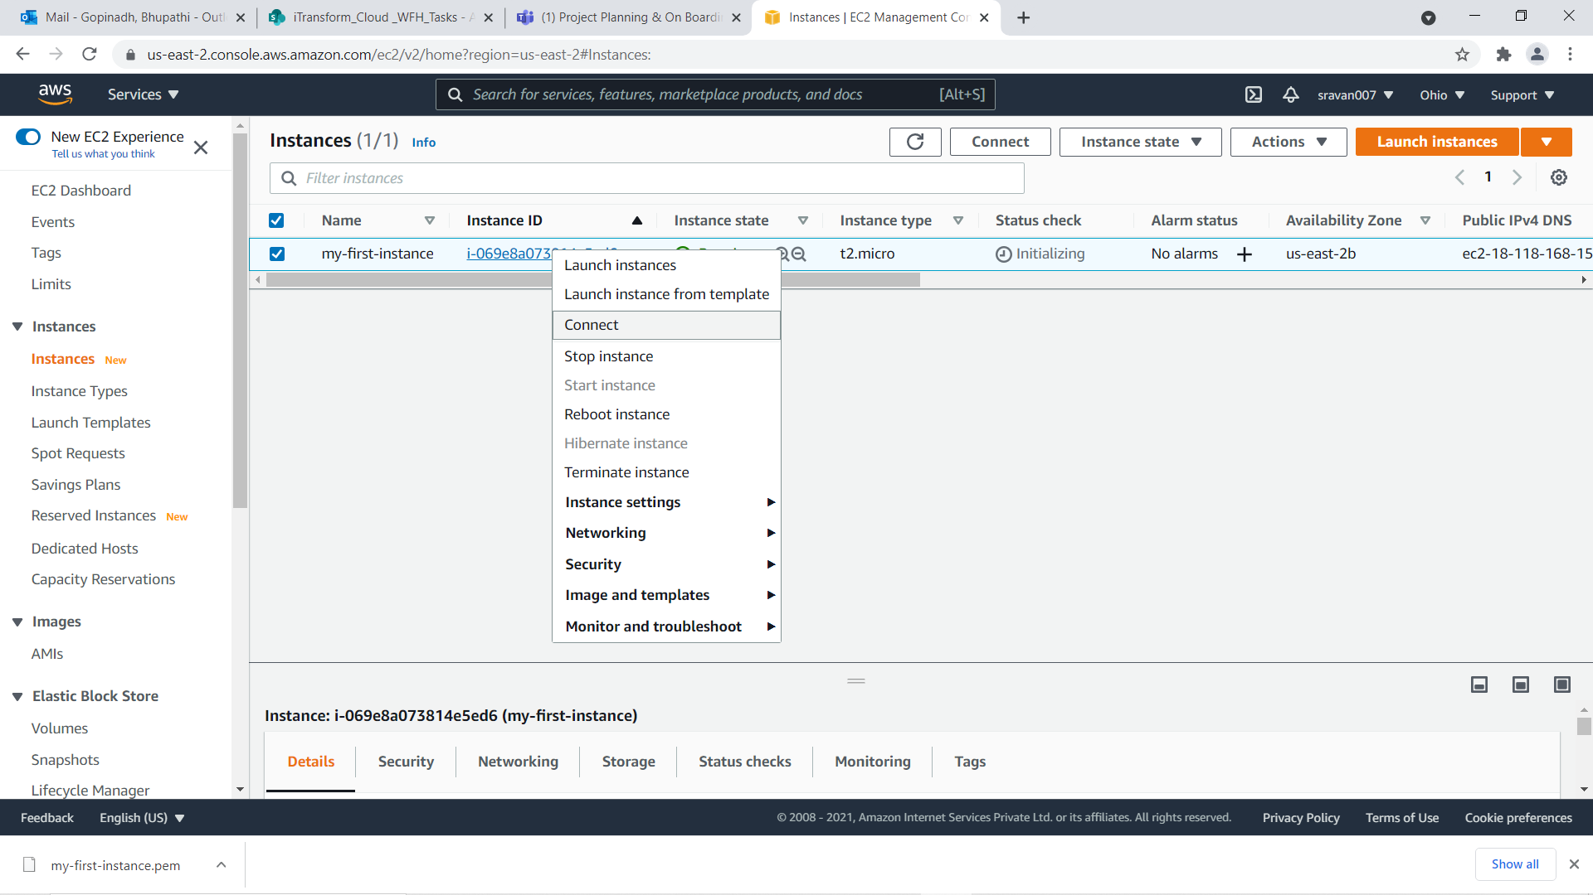

Slide 19
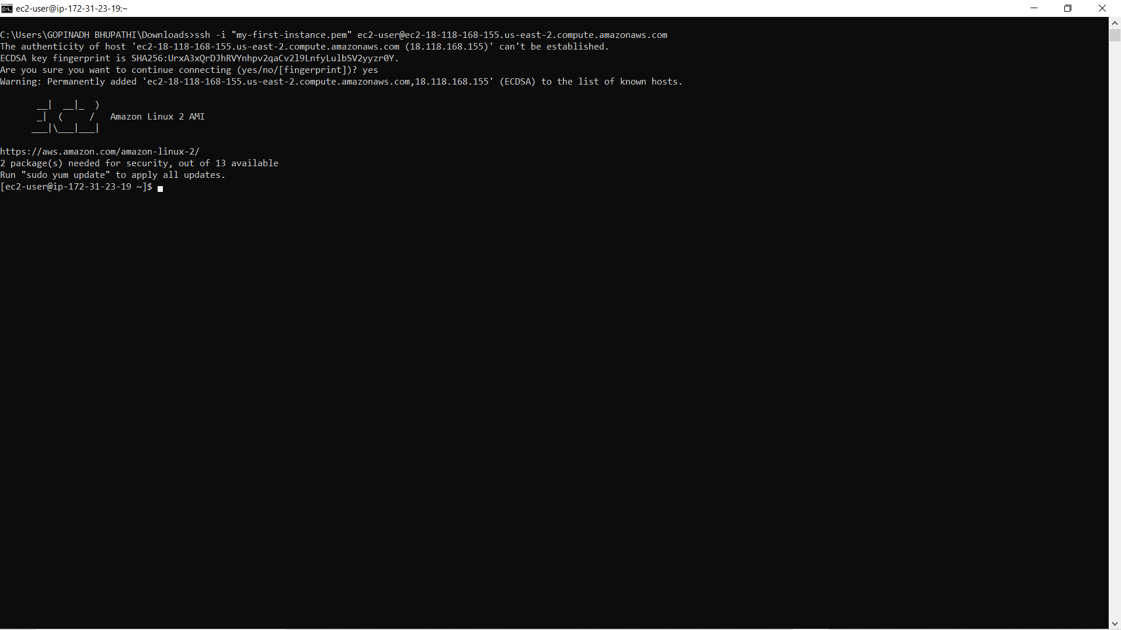

Slide 20

Thank you

