Slide 1
LAB 2
Creating Windows instance and logging through RDP

Slide 2
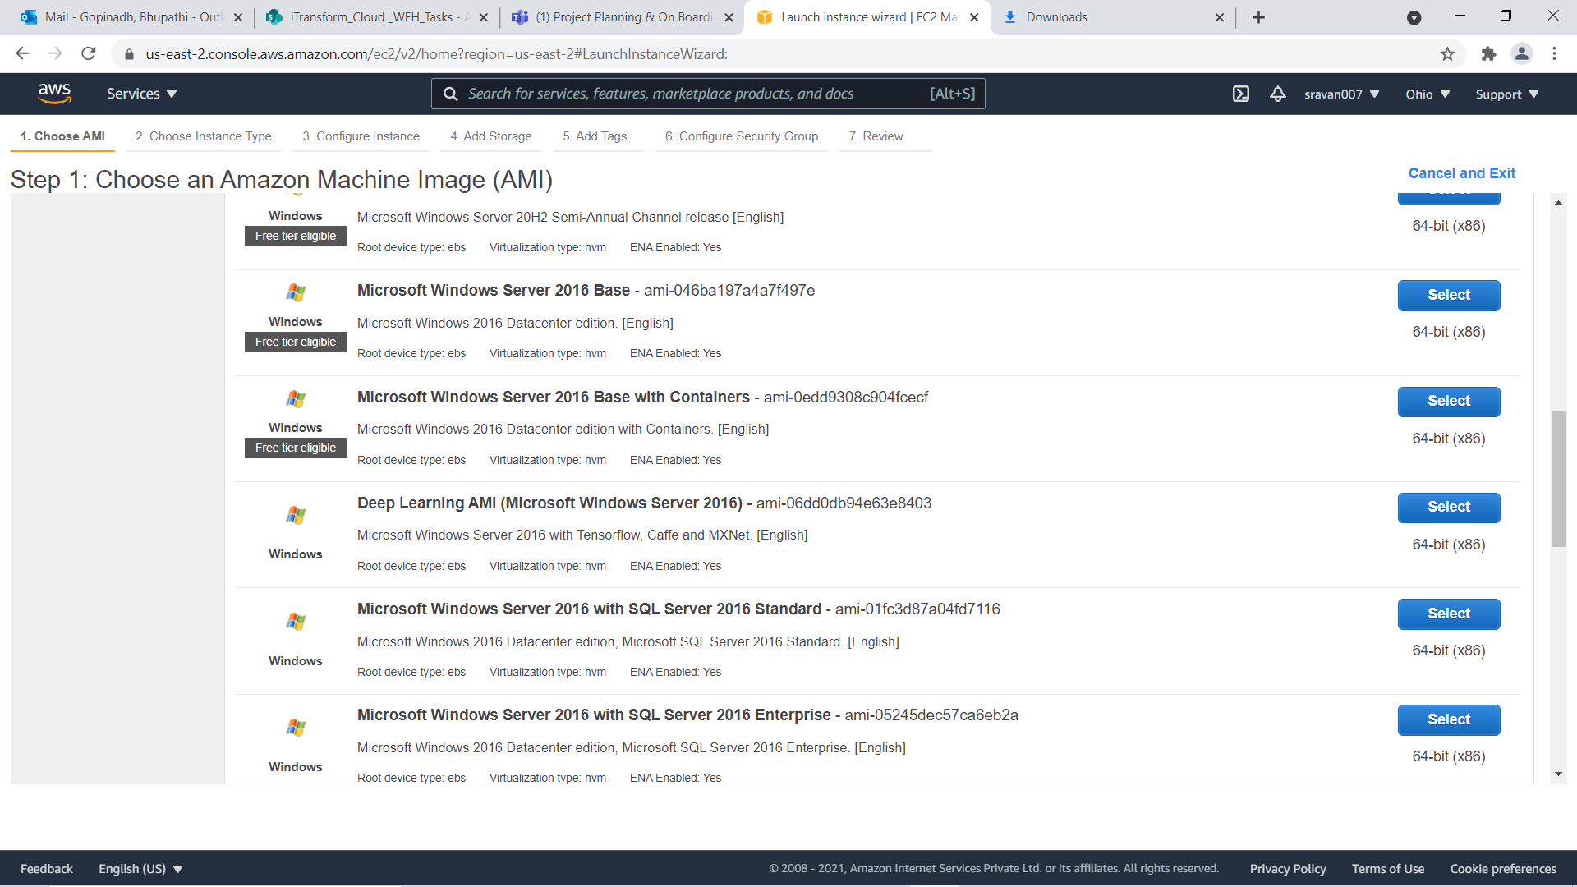

Slide 3
Select Microsoft Windows 2016 server 2016 Base AIM
All the remaining steps are same as in Lab1 until launching the instance.
While selecting key pair Choose existing one.

Slide 4
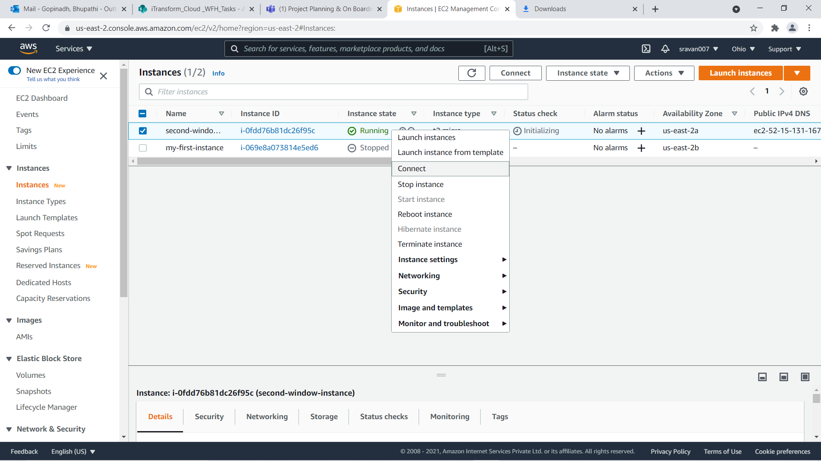

Slide 5
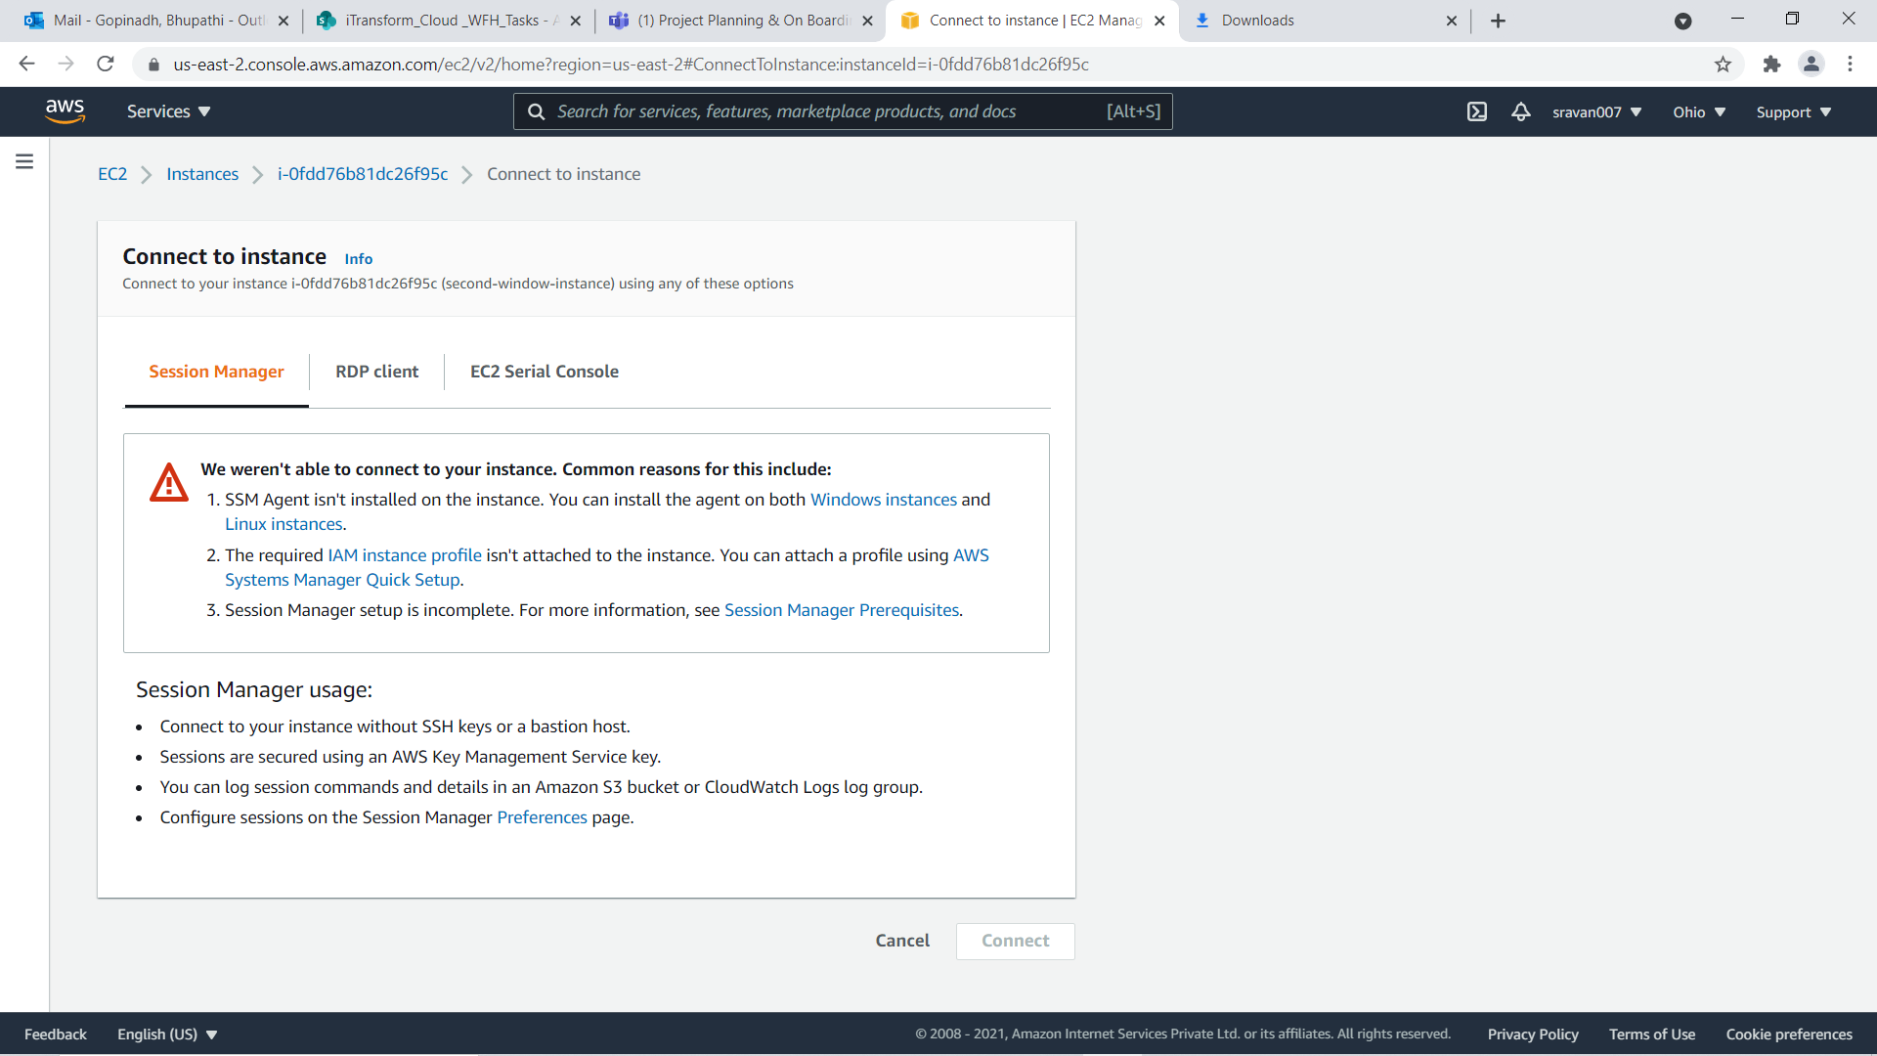

Slide 6
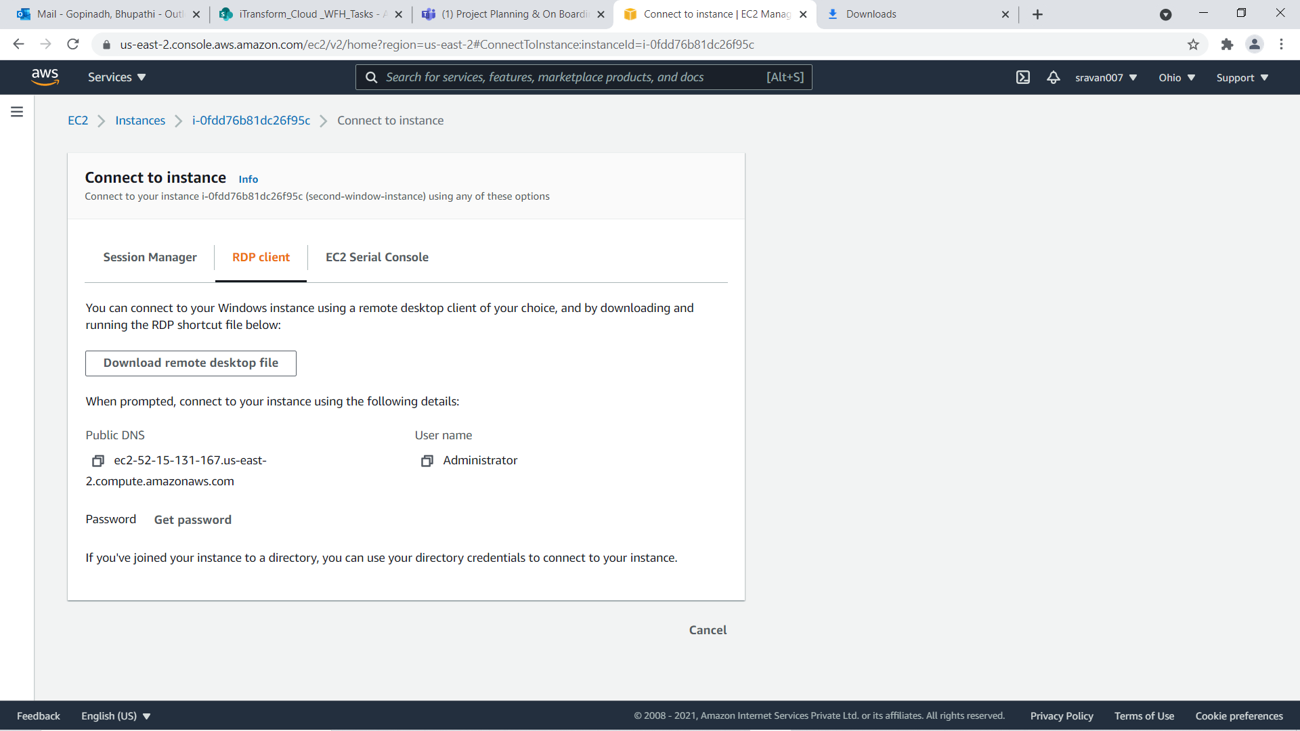
Go to RDP client and click on get password

Slide 7
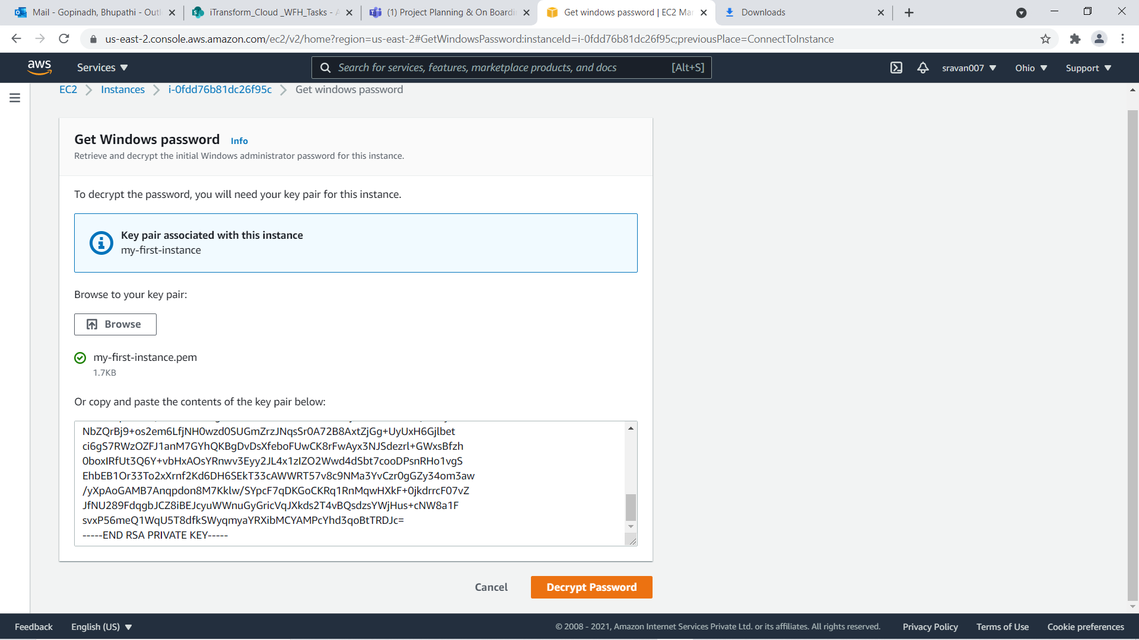
Now Browse .pem file and Decrypt password

Slide 8
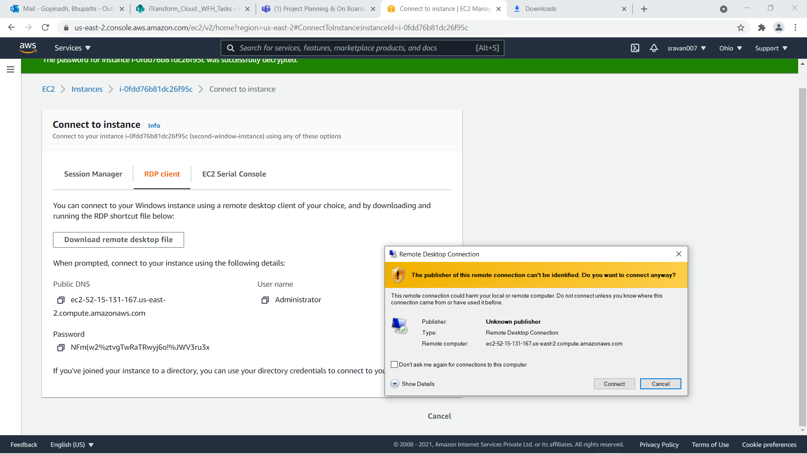
After getting password Download click on Download Remote Desktop file and double click on it

Slide 9
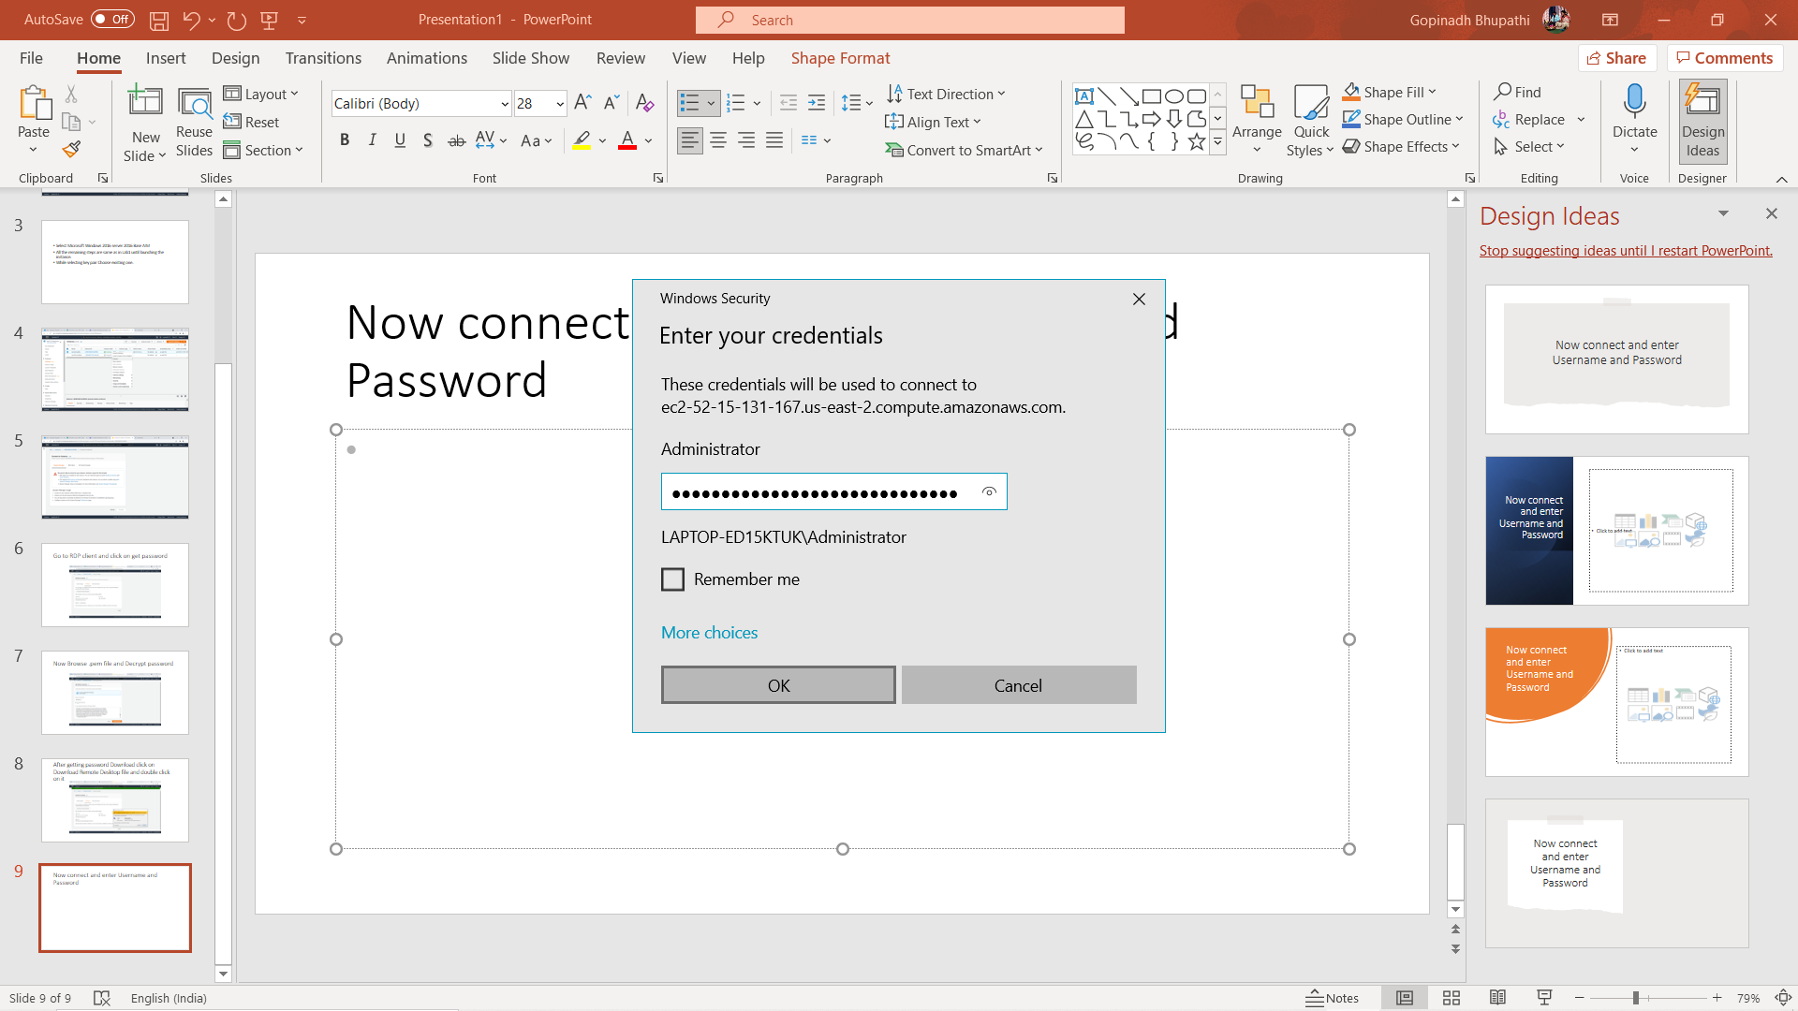
Now connect and enter Username and Password

Slide 10
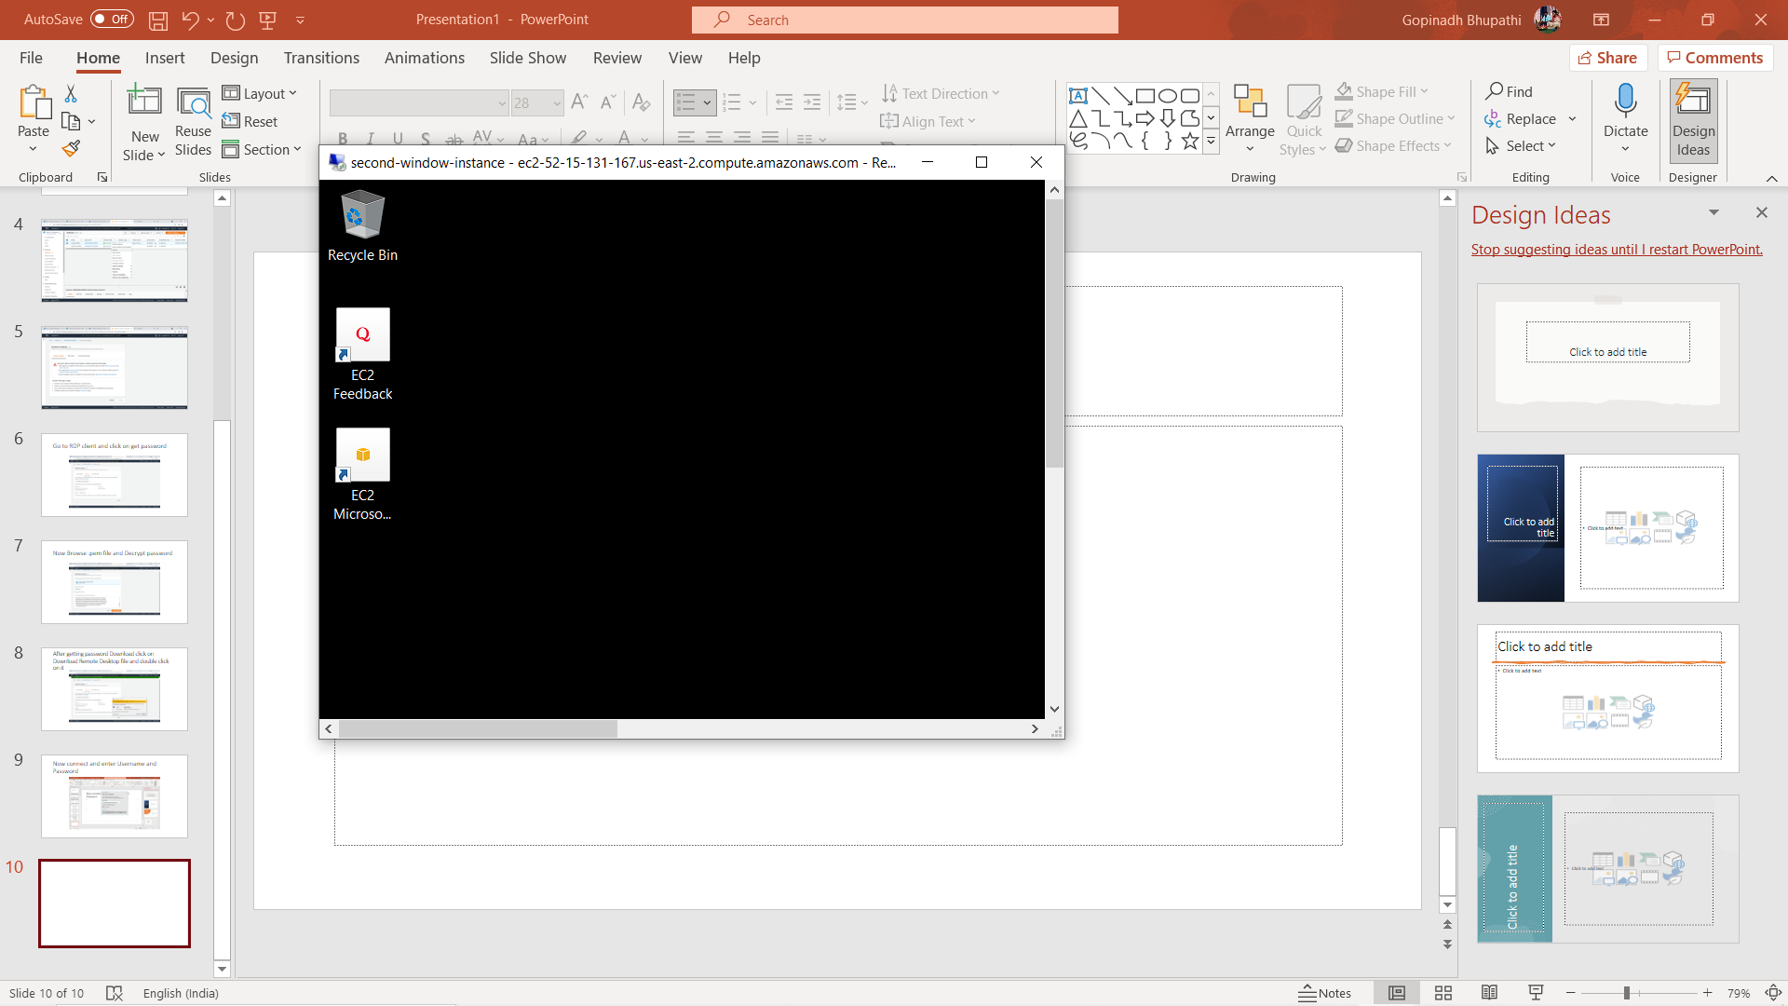
Entered into Windows Machine

Slide 11

Thank You

