Slide 1
Lab 3
Installing Apache Webserver in EC2 instance and Golden Image

Slide 2
Connect through ssh to EC2
Be a root user using command “sudo su”
Now enter “yum –y install httpd” or “sudo yum –y install httpd”

Slide 3
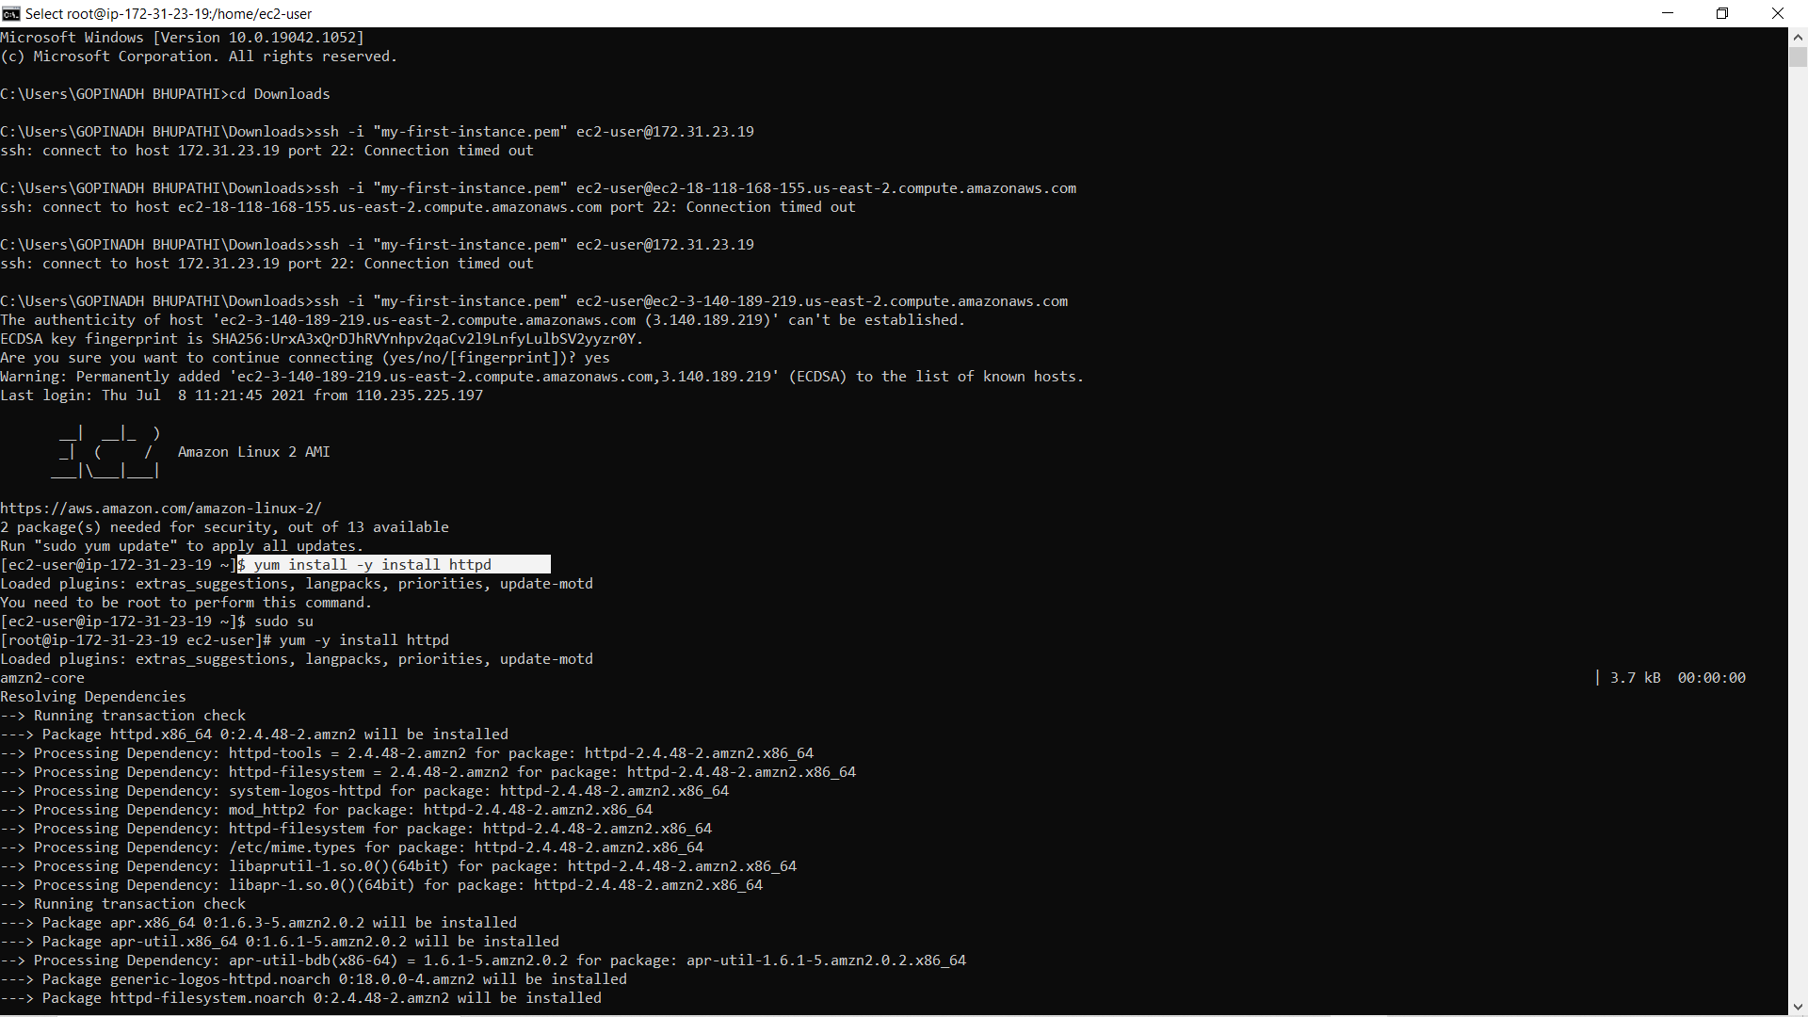

Slide 4
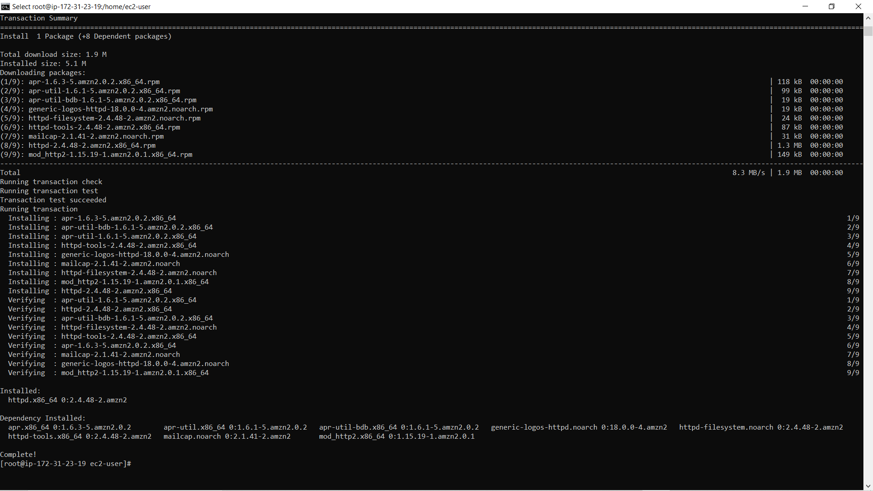

Slide 5
Now Start httpd service
sudo service start httpd
Check status of the service using ”systemctl status service”
To enable HTTPD server on start up use command “sudo chkconfig httpd on”
Now go to the instance page and copy the public ip address and paste it in browser.
Now you can see a web page

Slide 6
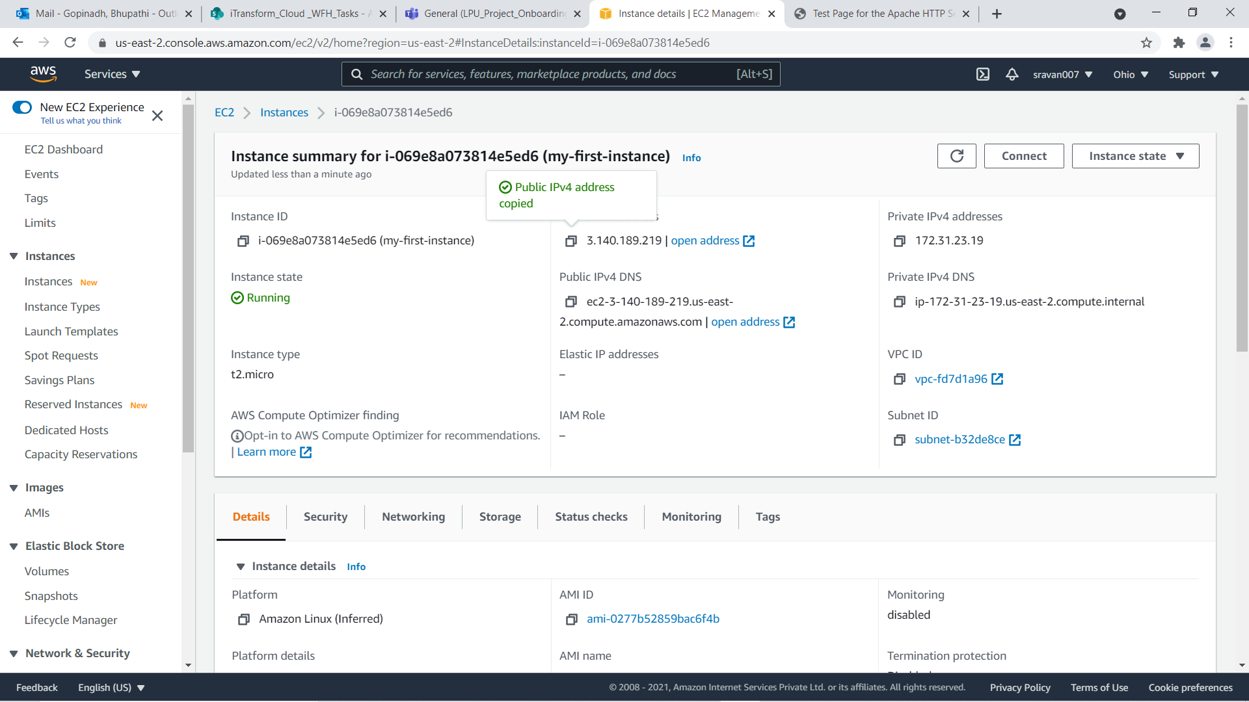

Slide 7
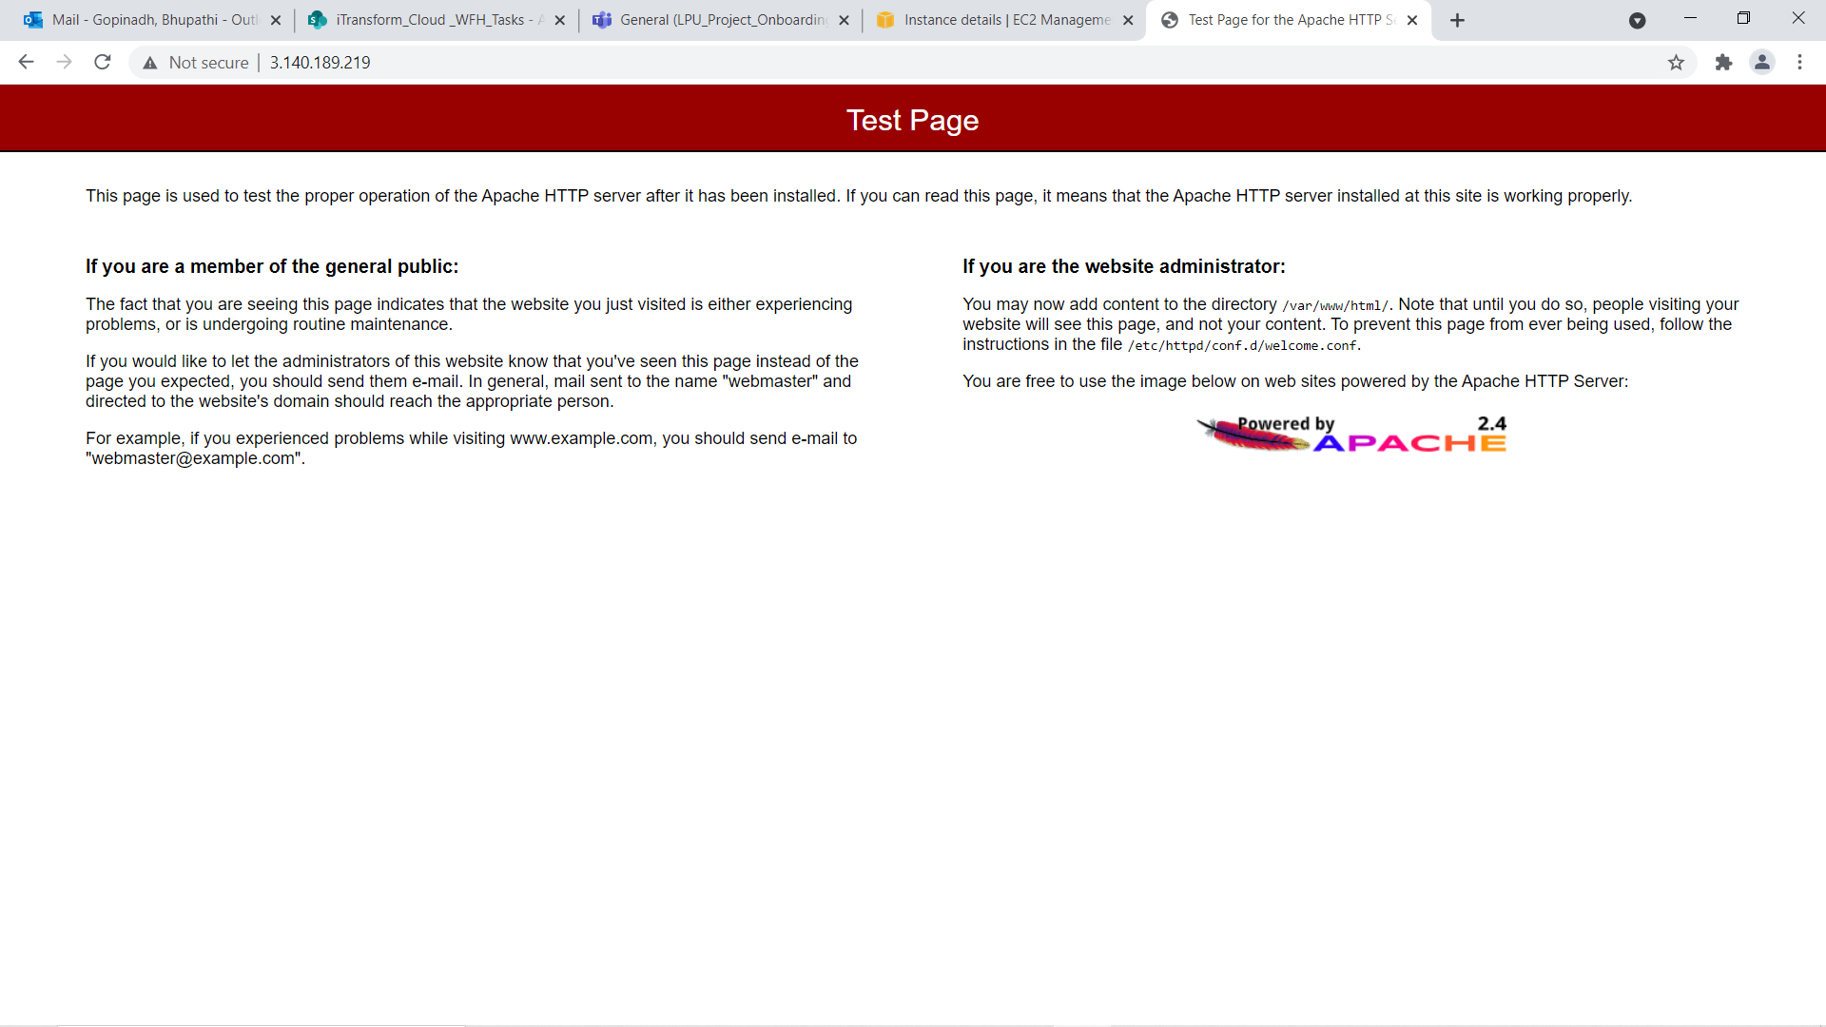

Slide 8
Now we can edit the hompage
Just add content in /var/www/html/index.html file in the system
Command :
echo “This website belongs to Gopinadh Bhupathi” > /var/www/html/index.html”
Now reload the browser…

Slide 9
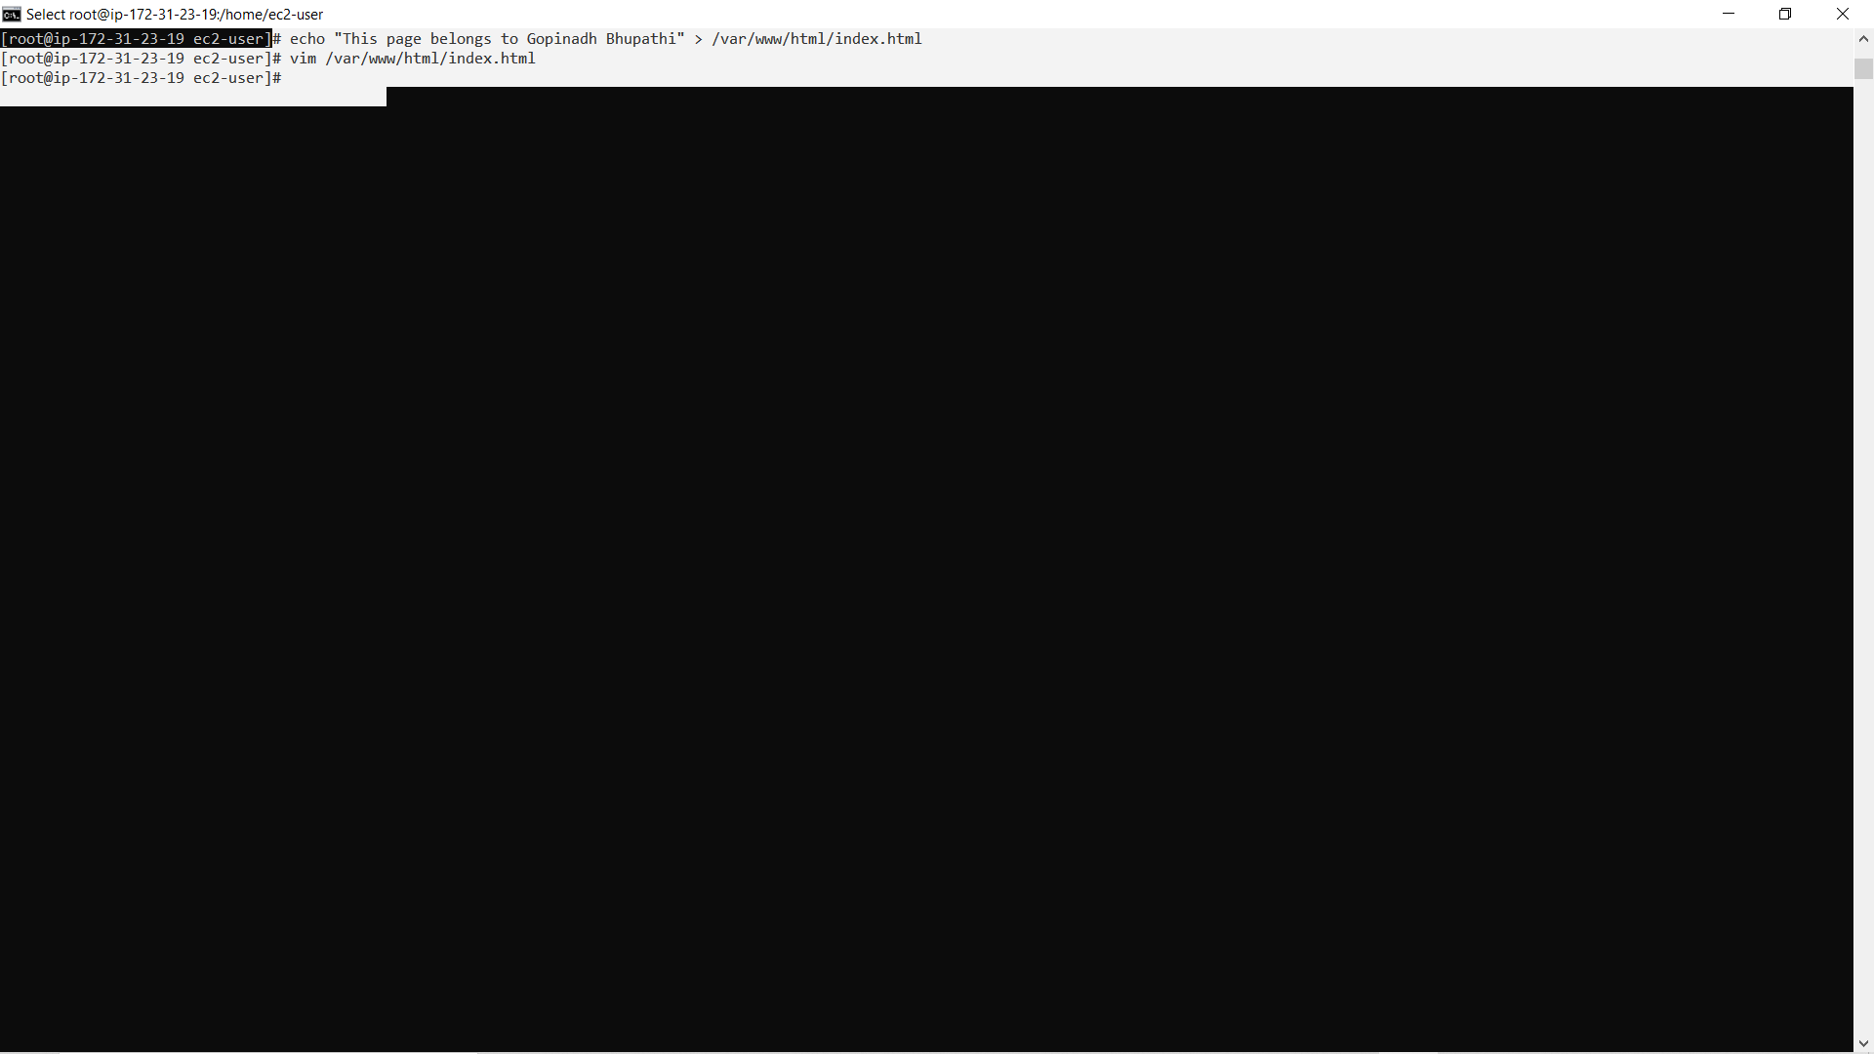

Slide 10
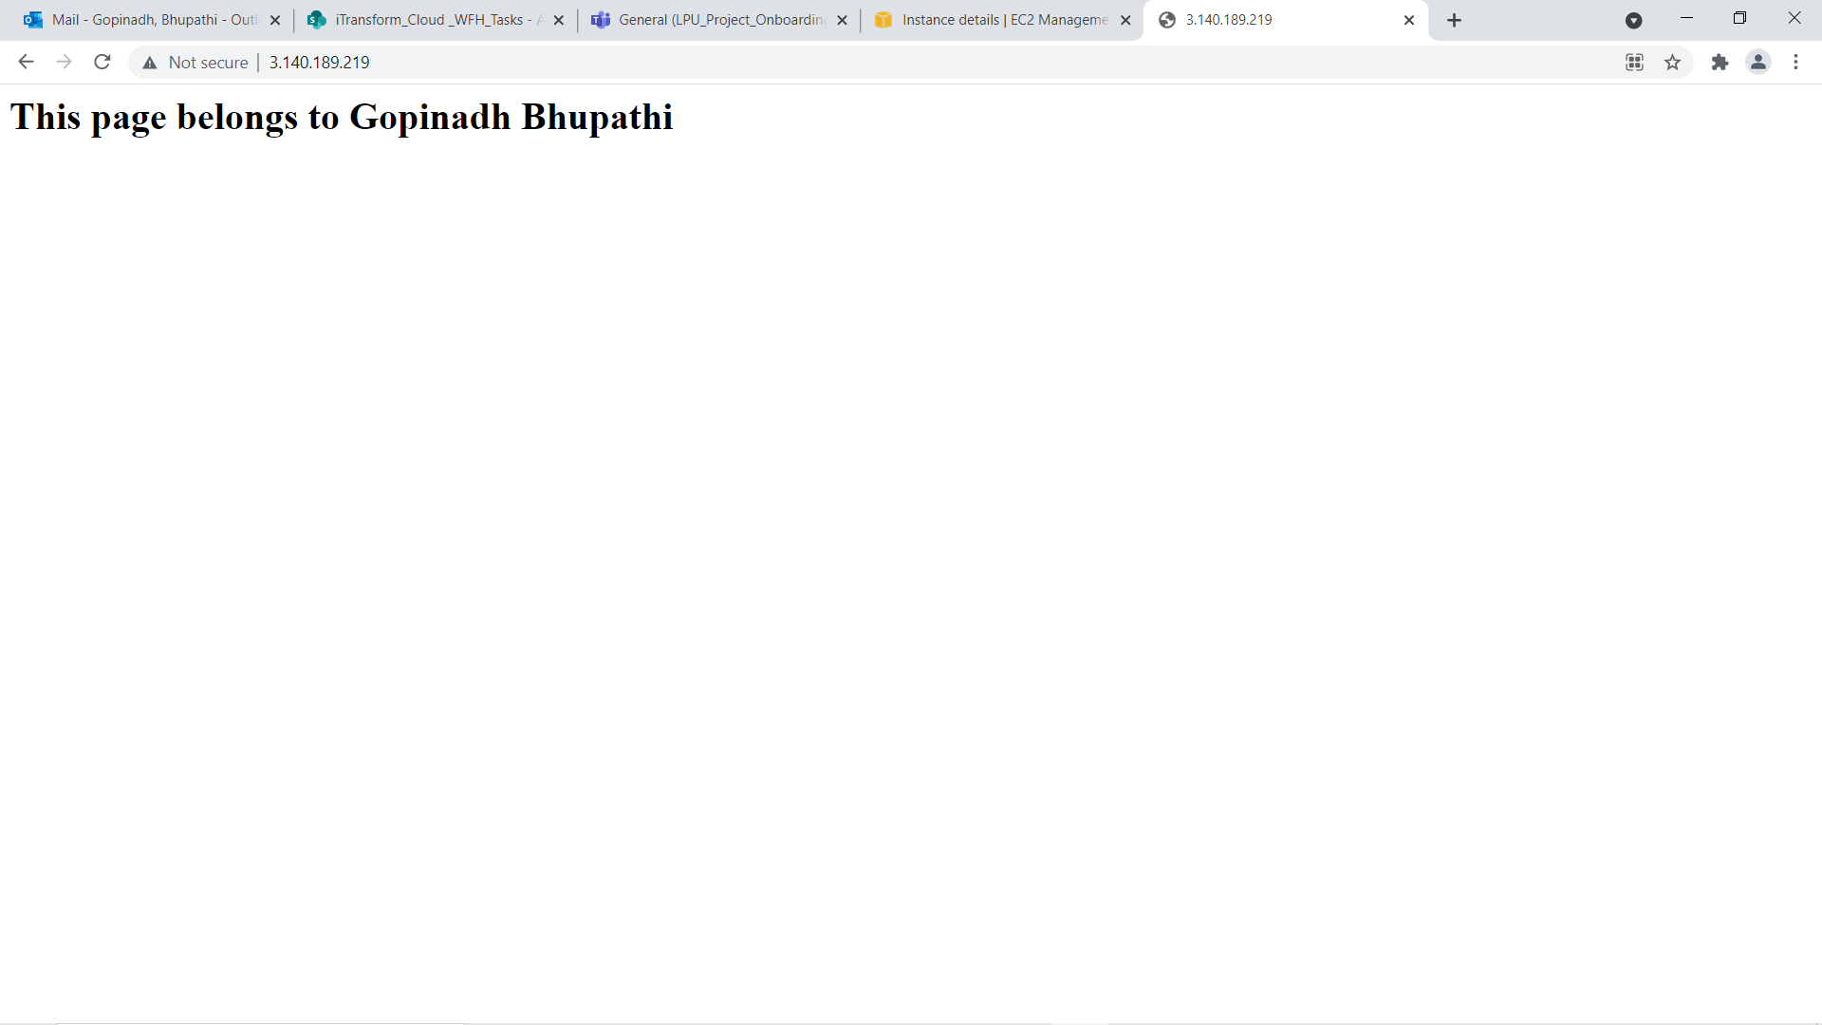

Slide 11
Creating Golden Image from our instance
It is an image that we custom create it

Slide 12
Steps
Go
Go to instance
Click on
Click on Actions
Select
Select Images
Create
Create Image

Slide 13
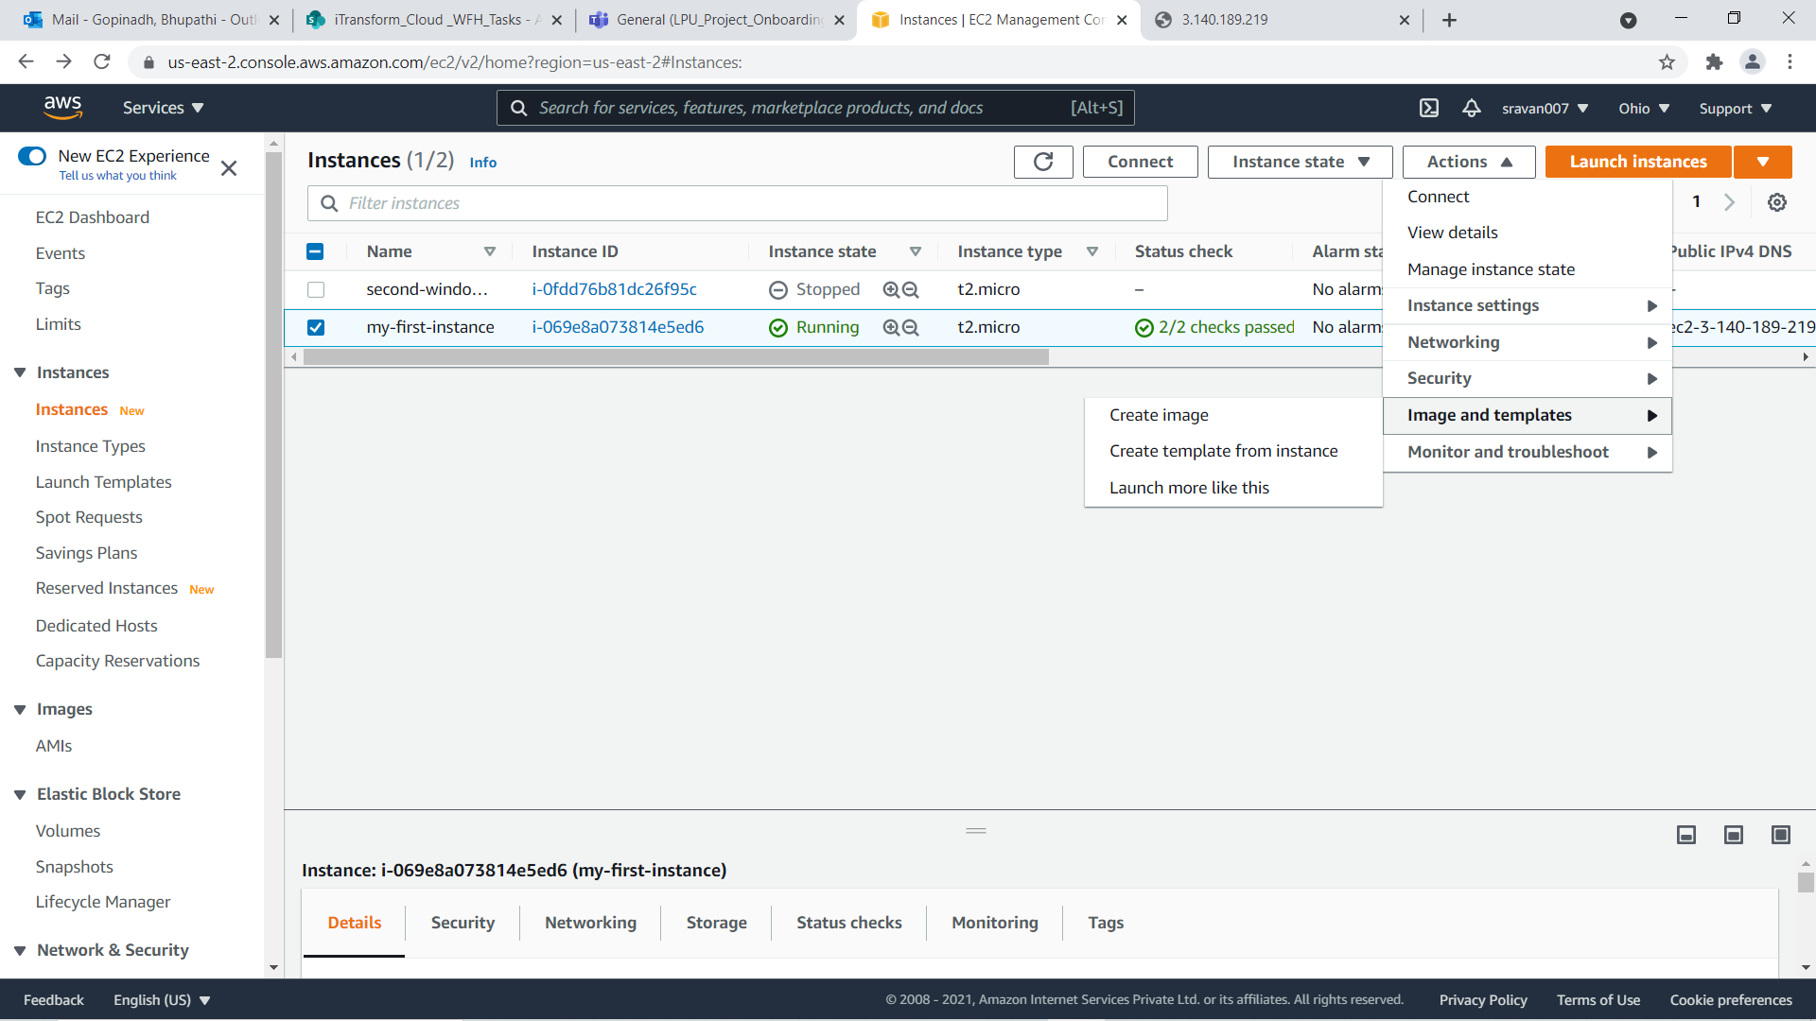

Slide 14
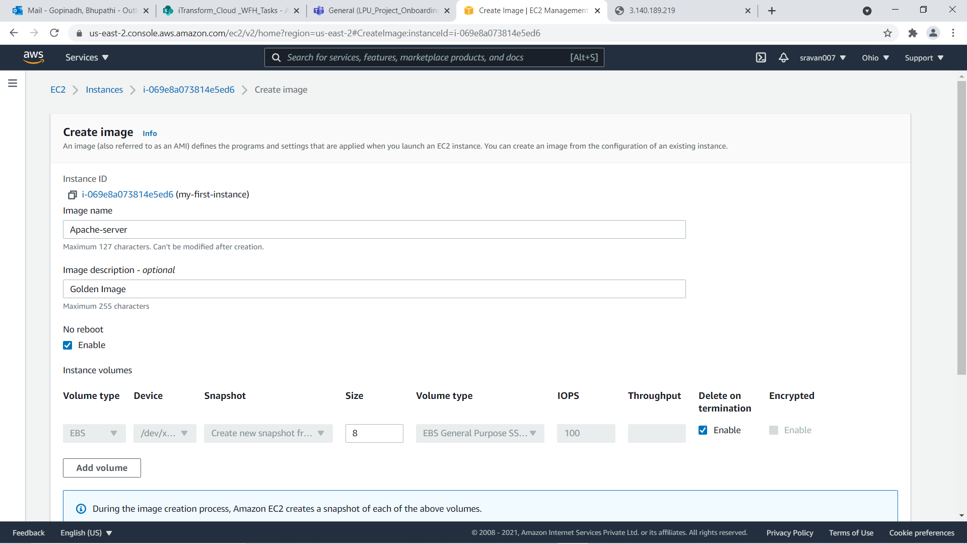

Slide 15
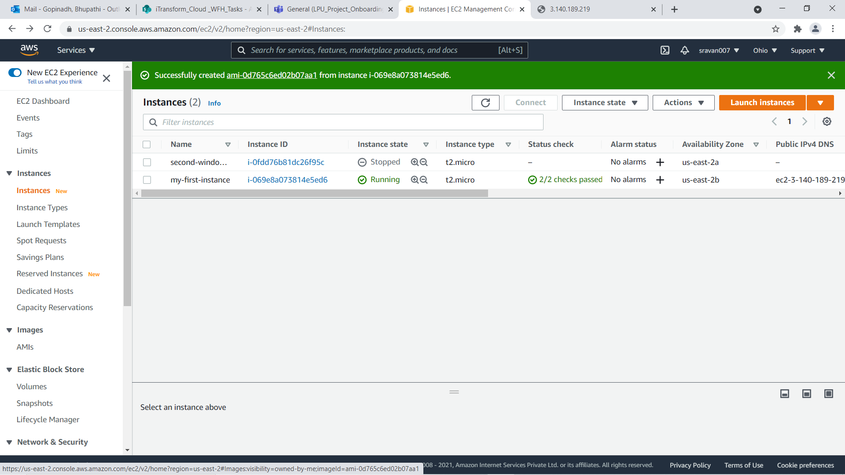

Slide 16
Launch the Golden Image
Now copy and paste public ip in browser we can see same web page there

Slide 17
