Slide 1


GMR Institute of Technology, Rajam
Department of CSE-(Artificial Intelligence & Machine Learning)
Collaborative skill sharing(swapify)
13-Mar-25
1
13-Mar-25
1

Slide 2
Collaborative skill sharing(swapify)
Gopi(21341A4260)
Jayendra (21341A4263)
Haritha(21341A4211)
Jathin(21341A4239)
Siva Kumar(21341A4249)
Under the guidance of
Dr. V. Srinadh
Associate Professor
GMR Institute of Technology

Slide 3
Abstract
Collaborative skill sharing is a dynamic platform designed to revolutionize digital collaboration and communication through its diverse and user-friendly functionalities. The application allows users to create personalized profiles and virtual rooms for discussions, brainstorming, and project management. Its powerful search and filtering tools enable users to locate relevant topics and discussions efficiently, while the recent activities feature provides a comprehensive log of interactions. Collaborative skill sharing enhances collaboration with tools like file sharing, supporting various formats such as images and PDFs, along with real-time text and video chatting capabilities. Users can actively participate in discussions, join rooms effortlessly, and rate their experiences based on quality and relevance. An innovative AI-powered discussion summarization feature ensures that key points from lengthy discussions are highlighted, enabling better understanding and decision-making. Notifications keep users updated about new activities and discussions, ensuring seamless engagement. With its robust and AI-enhanced features, Collaborative skill sharing is an ideal platform for professional, educational, and personal use, fostering productivity and connectivity in the digital age.

Slide 4
​Keywords: collaborative learning, web application, video chatting, files sharing, room summarization

Slide 5
Objectives
Facilitate Meaningful Connections: Enable users to create personalized profiles and connect with relevant communities, fostering collaboration among professionals, educators, and enthusiasts.
Enhance Collaboration: Provide virtual rooms and tools for discussions, brainstorming, and project coordination, ensuring streamlined and productive teamwork.
Improve Accessibility and Efficiency: Implement powerful search and filtering tools for locating topics and discussions quickly, along with a recent activities log for tracking engagement.

Slide 6
Old Model Defects for Collaborative Skill Sharing
Limited Search Functionality
Defect: Inefficient or rudimentary search tools that fail to filter or locate relevant discussions quickly.
Improvement: Introduce advanced search and filtering options to pinpoint topics or rooms with ease.
Lack of Personalization
Defect: Inability to customize user profiles or tailor experiences to individual needs.
Improvement: Offer personalized profiles and room creation to align with user preferences and collaboration goals.
Fragmented Collaboration Tools
Defect: Separate or disconnected tools for discussions, file sharing, and communication, leading to inefficiencies.
Improvement: Integrate all tools (file sharing, real-time chatting, video conferencing) into a unified platform for seamless interaction.

Slide 7
INTRODUCTION
The Collaborative Skill-Sharing App is a revolutionary platform designed to empower individuals by creating an ecosystem where knowledge and expertise are freely exchanged. In today's fast-evolving world, continuous learning and skill development are crucial for personal and professional growth. This app serves as a bridge that connects people from diverse backgrounds, allowing them to share their expertise and acquire new skills in a highly engaging and interactive environment.
At the heart of this platform lies the concept of skill exchange, where users can offer their knowledge in a particular area while simultaneously learning something new in return. Whether it’s technical skills like coding and data analysis, creative skills like photography and music production, or soft skills like leadership and communication, the web app provides a space where individuals can teach, learn, and grow together. By encouraging this reciprocal learning process, the platform fosters a dynamic and mutually beneficial community where knowledge is freely shared, and learning becomes a collaborative journey.
To ensure a personalized and effective learning experience, the app supports both one-on-one mentorship and group interactive sessions. One-on-one sessions allow for personalized guidance, enabling learners to receive tailored support from mentors or peers. On the other hand, group sessions create a collaborative atmosphere, where multiple individuals can engage in discussions, share insights, and participate in hands-on activities that enhance the overall learning experience. These interactive features ensure that different learning preferences are accommodated, making the platform inclusive and adaptable to a wide range of users.

Slide 8
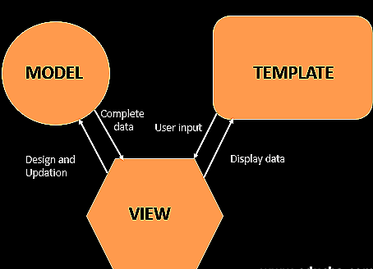
SYSTEM ARCHITECTURE

Slide 9
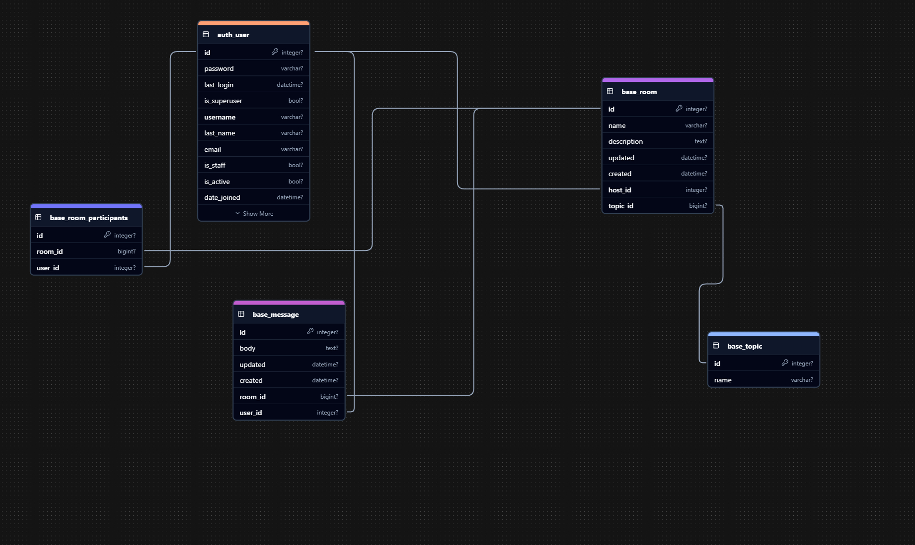
DATABASE SCHEMA

Slide 10
[1] Emmanuel, O. K., Grace, J., & John, M. (2024). Collaborative Learning Tools.
LITERATURE SURVEY
The paper on collaborative learning tools highlights various aspects of these digital platforms, emphasizing their significance in both educational and professional settings.
Collaborative learning tools are designed to facilitate teamwork, knowledge sharing, and joint problem-solving. They enable individuals to collaborate in real-time or asynchronously, overcoming geographical and temporal barriers.
The paper mentions several widely-used collaborative tools, including:
Google Workspace: For real-time document editing.
Slack: For team communication.
Trello: For project management.
Kahoot!: For interactive learning
These tools promote active participation through real-time collaboration and interactive features, making learning more engaging.

Slide 11
[2] Ok, E., Grace, J., & John, M. (2024). Advanced Use Cases and Innovations.
This paper highlights the transformative potential of advanced use cases and innovations across various industries, including healthcare, finance, education, and manufacturing. It emphasizes the role of emerging technologies such as AI, blockchain, and IoT in enhancing efficiency and personalization.
The review also addresses the ethical, regulatory, and technical challenges that accompany these advancements, stressing the need for interdisciplinary collaboration and responsible innovation.
Furthermore, it discusses the importance of addressing issues like data privacy, workforce adaptation, and regulatory complexities to harness the full potential of these technologies for a sustainable and equitable future.

Slide 12
[3] Oliveira, A., Lopes, I., & Costa, C. (2015). Tools for online collaboration: do they contribute to improve teamwork?. Tools for online collaboration: Do they contribute to improve teamwork?, 105-112.
This paper highlights the transformation in communication due to advancements in Information and Communication Technologies, which have facilitated the rise of virtual teams. It discusses the characteristics of virtual teams, emphasizing their cultural and organizational diversity, and the challenges they face, such as distance, technology, and trust issues.
It also examines the role of collaboration tools, noting that while tools like e-mail and file sharing enhance communication, they may lack the richness of face-to-face interactions, potentially leading to misunderstandings.
The review underscores the importance of effective communication and trust in enhancing productivity and creativity within virtual teams.

Slide 13
[4] Bissaliyev, M. S. (2017). The effectiveness of collaboration tools on virtual project management. International Journal of Applied Engineering Research, 12(21), 10747-10755.
This paper discusses on various collaborative frameworks and services, including voice and videoconferencing and collaboration platforms, which enhance business productivity and operations.
It highlights that team members can access these services through multiple devices, such as cell phones, tablets, PCs, and laptops.
The review notes a significant market growth in collaboration services, from approximately 42 billion in 2012 to an estimated 80 billion by 2018.
It identifies five types of collaboration services: self-managed, managed, hosted, cloud, and outsourced services, each with distinct characteristics and advantages.

Slide 14
[5] Karl, K. A., Peluchette, J. V., & Aghakhani, N. (2022). Virtual work meetings during the COVID-19 pandemic: The good, bad, and ugly. Small group research, 53(3), 343-365.
This paper focuses on the challenges and benefits of videoconferencing as a communication medium, particularly during the COVID-19 pandemic. It examines user opinions on difficulties encountered in remote work meetings, emphasizing the need for understanding the 'good, the bad, and the ugly' aspects of videoconferencing.
The review incorporates media naturalness theory and meeting science to frame the analysis of user experiences.
It highlights common frustrations related to technology, participant behavior, and the unique circumstances of working from home, drawing parallels with issues faced in face-to-face meetings.

Slide 15
[6] Menzies, Rachel, and Mark Zarb. "Professional communication tools in higher education: A case study in implementing Slack in the curriculum." 2020 IEEE Frontiers in Education Conference (FIE). IEEE, 2020.
The literature review in this paper highlights several key themes regarding the use of professional communication tools in higher education, particularly focusing on social networks and their implications for learning environments.
The paper emphasizes the rising trend of using tools like Slack in the computing industry, suggesting that integrating these tools into educational settings can prepare students for professional environments
Previous studies indicate that while tools like Slack can enhance communication and transparency, challenges such as excessive direct messaging and unbalanced participation can arise. These issues can be mitigated by setting clear expectations for users.

Slide 16
[7] Wang, Sheng, and Raymond A. Noe. "Knowledge sharing: A review and directions for future research." Human resource management review 20.2 (2010): 115-131.
The authors conducted a narrative review instead of a meta-analysis due to the diverse disciplines involved in knowledge sharing research and the limited number of empirical studies on specific factors. This approach allowed for a broader understanding of the various theories underpinning knowledge sharing.
The paper points out significant limitations in the quantitative studies, such as reliance on self-reported data and the potential for common method variance. It emphasizes the need for future research to incorporate both subjective and objective measures of knowledge sharing.

Slide 17
[8]Minhas, Shahid, et al. "Exploring students online learning: A study of zoom application." Gazi University Journal of Science 34.2 (2021): 171-178.
The paper titled "EXPLORING STUDENTS ONLINE LEARNING: A STUDY OF ZOOM APPLICATION" investigates the experiences of students using the Zoom application for online learning.
Surry et al. (2005) emphasize that the integration of educational innovations, such as online learning platforms, often encounters challenges. These include technological architecture, students' competencies, technical quality, and instructors' motivation. The effectiveness of any educational tool is significantly diminished without proper application and support.
The literature also addresses security issues associated with the Zoom application. Reports of unauthorized access to meetings and potential breaches of confidential information have raised concerns about the platform's security measures. The introduction of features like waiting rooms and password protection is suggested as a means to enhance user privacy and security.

Slide 18
[9] Helic, Denis. "Managing collaborative learning processes in e-learning applications." 2007 29th International Conference on Information Technology Interfaces. IEEE, 2007.
The paper "Managing Collaborative Learning Processes in E-Learning Applications" addresses significant gaps in current E-Learning methodologies, particularly the lack of a process-oriented approach.
The paper identifies three primary approaches in E-Learning: content-oriented, tool-oriented, and task-oriented. Each of these approaches has limitations.
Content-oriented approach: Focuses on managing learning content, which includes authoring and sharing materials, but often neglects the collaborative aspect of learning.
Tool-oriented approach: Centers around specific collaborative tools, which can lead to a narrow focus on technology rather than the learning process itself.
Task-oriented approach: Involves simple sequences of learning activities, lacking the depth and structure needed for effective collaborative learning

Slide 19
[10]Law, Q. P., H. C. So, and J. W. Chung. "Effect of collaborative learning on enhancement of students’ self-efficacy, social skills and knowledge towards mobile apps development." American Journal of Educational Research 5.1 (2017): 25-29.
The literature survey in this paper focuses on several key themes related to collaborative learning, self-efficacy, social skills, and mobile app development.
The paper discusses self-efficacy as a crucial factor in academic success. It references Bandura's theory, which states that self-efficacy influences students' engagement and persistence in tasks. The literature indicates that students with high self-efficacy are more likely to perform better academically
The concept of collaborative learning is explored as a method to improve students' self-efficacy and social skills. The literature suggests that collaborative learning allows students to engage actively with course material, fostering a sense of responsibility and enhancing their learning experience

Slide 20
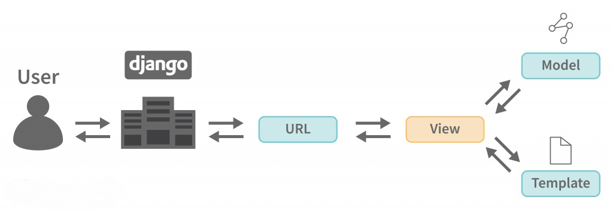
Methodology
This Django-based video conferencing application follows Agile methodology, ensuring iterative development, continuous integration, and user feedback-driven improvements. It aims to provide a scalable, secure, and user-friendly platform with real-time video/audio conferencing, messaging, and scheduling.
Backend: Built with Django for authentication, data management, and server-side logic. Django Channels enables real-time communication.
Frontend: Uses Bootstrap for a responsive UI, avoiding JavaScript-heavy frameworks like React.
Database: MySQL/Sqlite3 for efficient data storage.
Development Process: Includes requirement gathering, system design, database modeling, coding, integration, and testing (unit, integration, and load testing) to ensure reliability and performance.

Slide 21
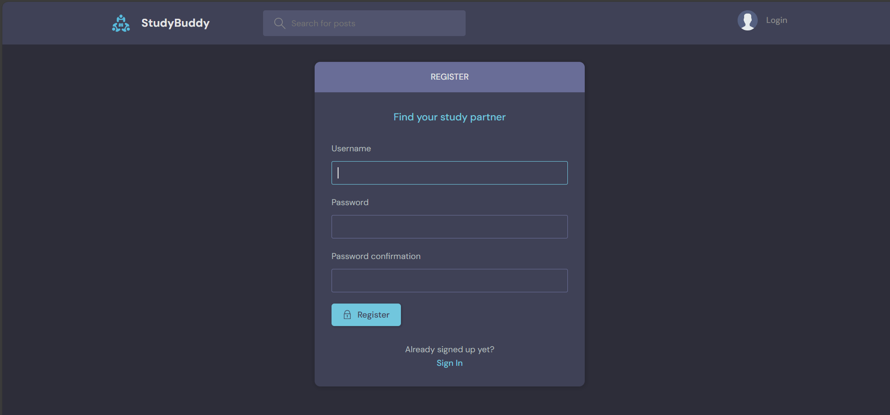
First, we register if we don’t have an account or login if we have an existing account

Slide 22
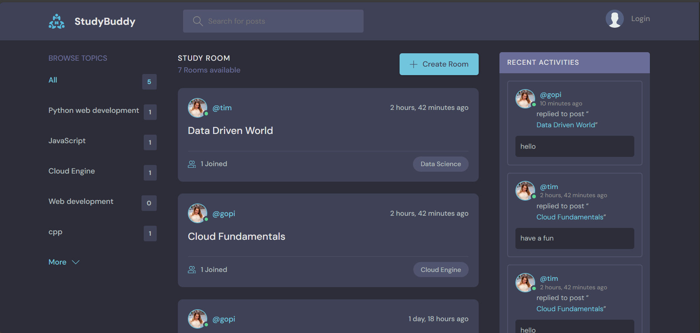
After that we see existing rooms based on specific topic beside on the left side bar and recent activities on the right-side bar and also a create room icon on the top for creating a new room and an optimized search bar. In between there are rooms we can join and chat.

Slide 23
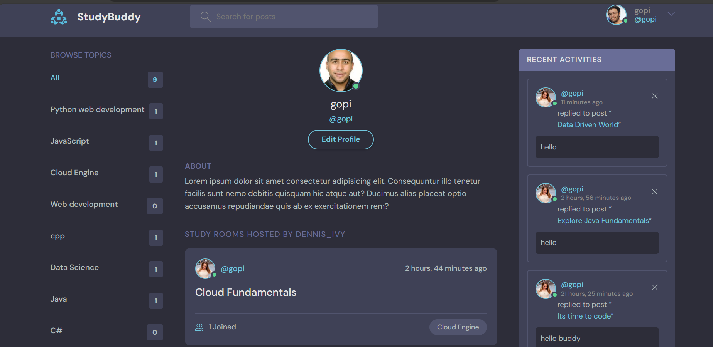
The profile view of the user

Slide 24
REFERENCES
[1] Emmanuel, O. K., Grace, J., & John, M. (2024). Collaborative Learning Tools.
[2] Ok, E., Grace, J., & John, M. (2024). Advanced Use Cases and Innovations.
[3] Oliveira, A., Lopes, I., & Costa, C. (2015). Tools for online collaboration: do they contribute to improve teamwork?. Tools for online collaboration: Do they contribute to improve teamwork?, 105-112.
[4] Bissaliyev, M. S. (2017). The effectiveness of collaboration tools on virtual project management. International Journal of Applied Engineering Research, 12(21), 10747-10755.
[5] Karl, K. A., Peluchette, J. V., & Aghakhani, N. (2022). Virtual work meetings during the COVID-19 pandemic: The good, bad, and ugly. Small group research, 53(3), 343-365.

Slide 25
REFERENCES
[6] Menzies, Rachel, and Mark Zarb. "Professional communication tools in higher education: A case study in implementing Slack in the curriculum." 2020 IEEE Frontiers in Education Conference (FIE). IEEE, 2020.
[7]Wang, Sheng, and Raymond A. Noe. "Knowledge sharing: A review and directions for future research." Human resource management review 20.2 (2010): 115-131.
[8] Minhas, Shahid, et al. "Exploring students online learning: A study of zoom application." Gazi University Journal of Science 34.2 (2021): 171-178.
[9] Helic, Denis. "Managing collaborative learning processes in e-learning applications." 2007 29th International Conference on Information Technology Interfaces. IEEE, 2007.
[10] Law, Q. P., H. C. So, and J. W. Chung. "Effect of collaborative learning on enhancement of students’ self-efficacy, social skills and knowledge towards mobile apps development." American Journal of Educational Research 5.1 (2017): 25-29.

