Slide 1
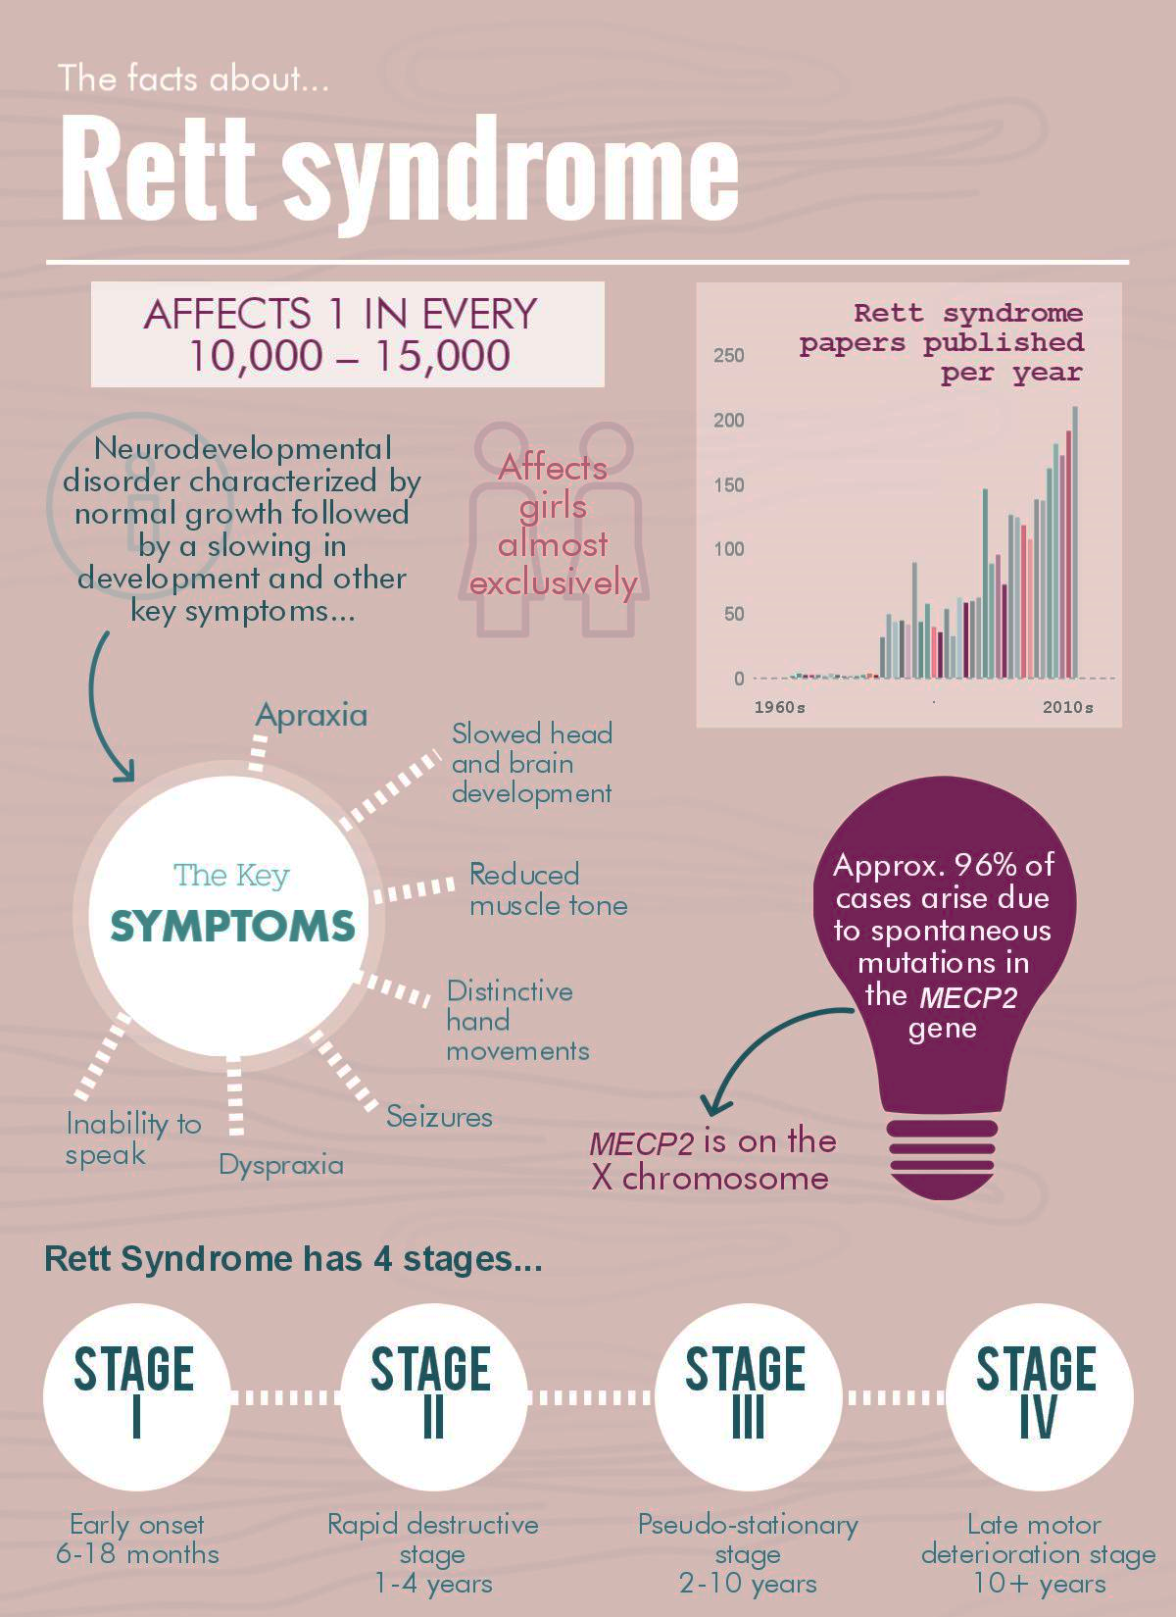
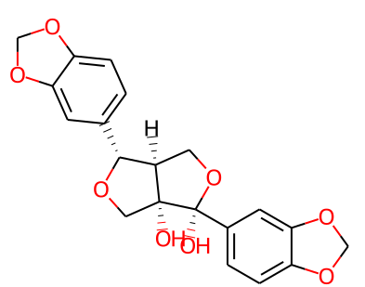
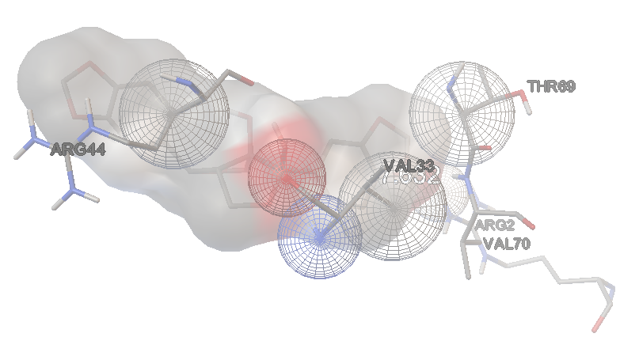
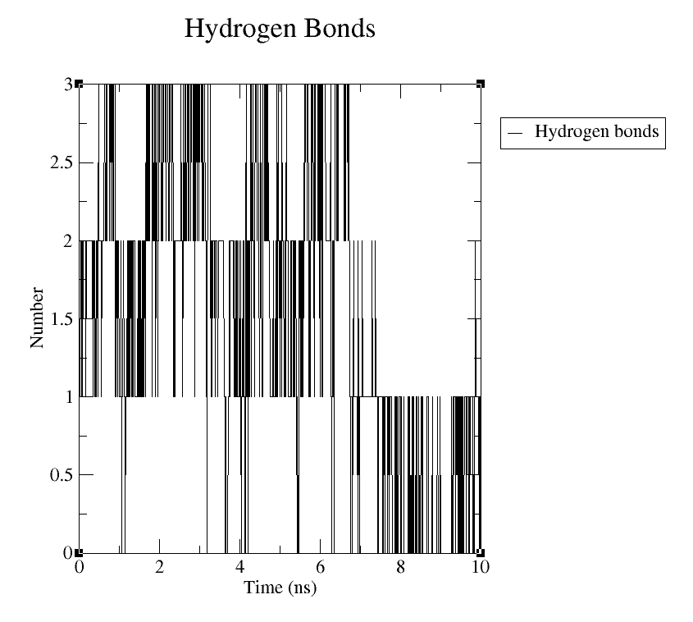
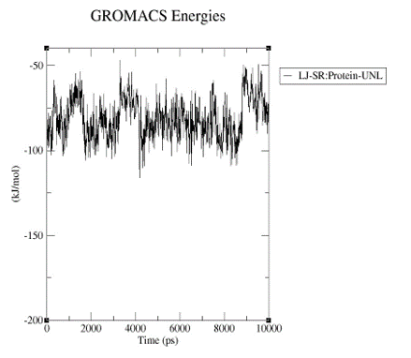
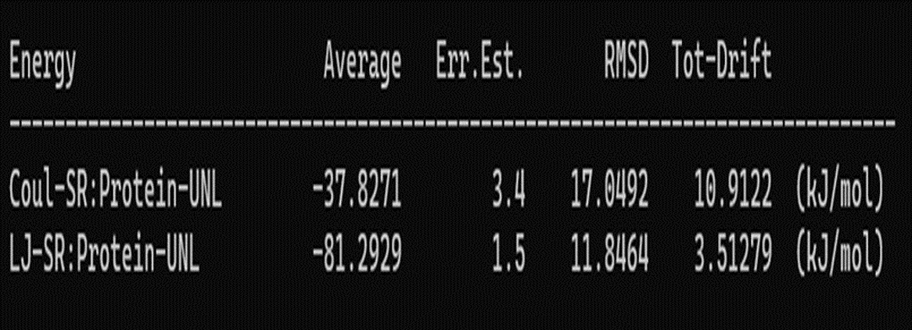
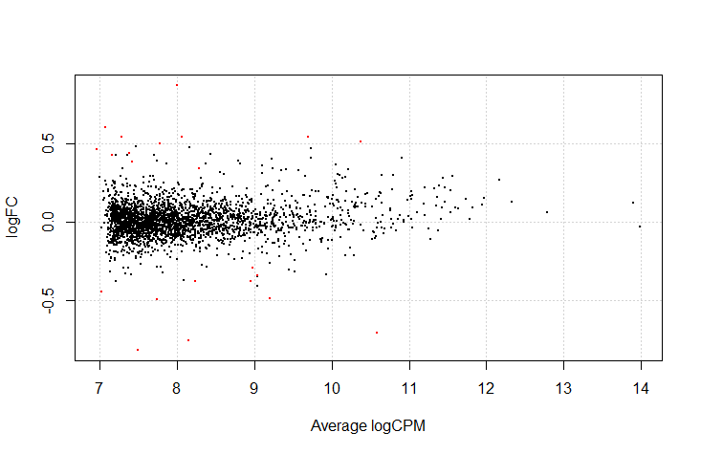
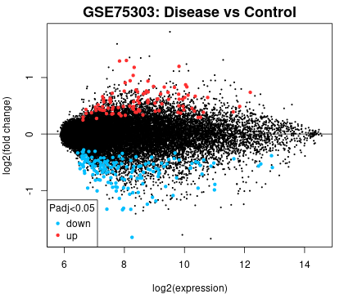
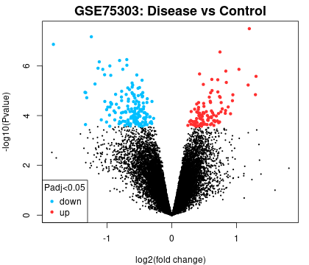

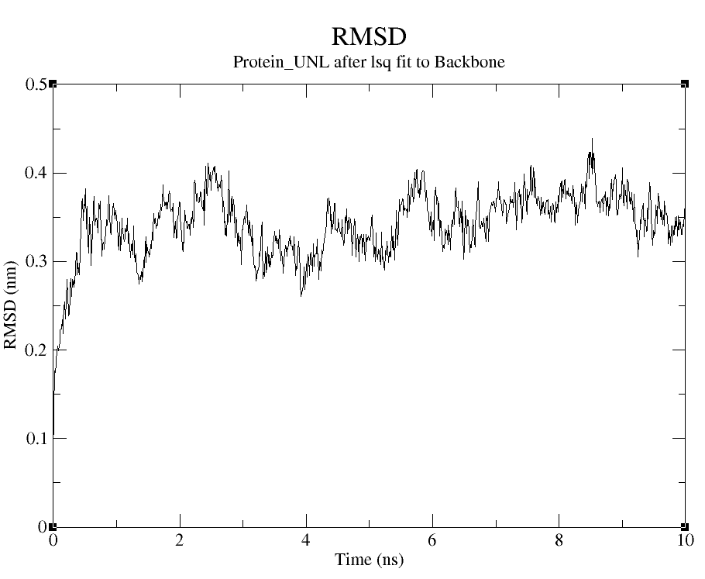
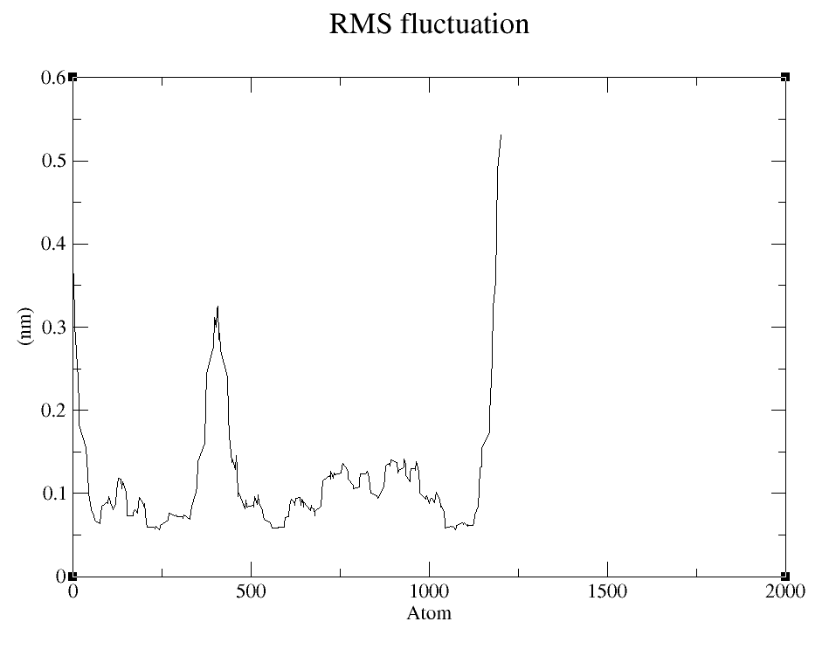
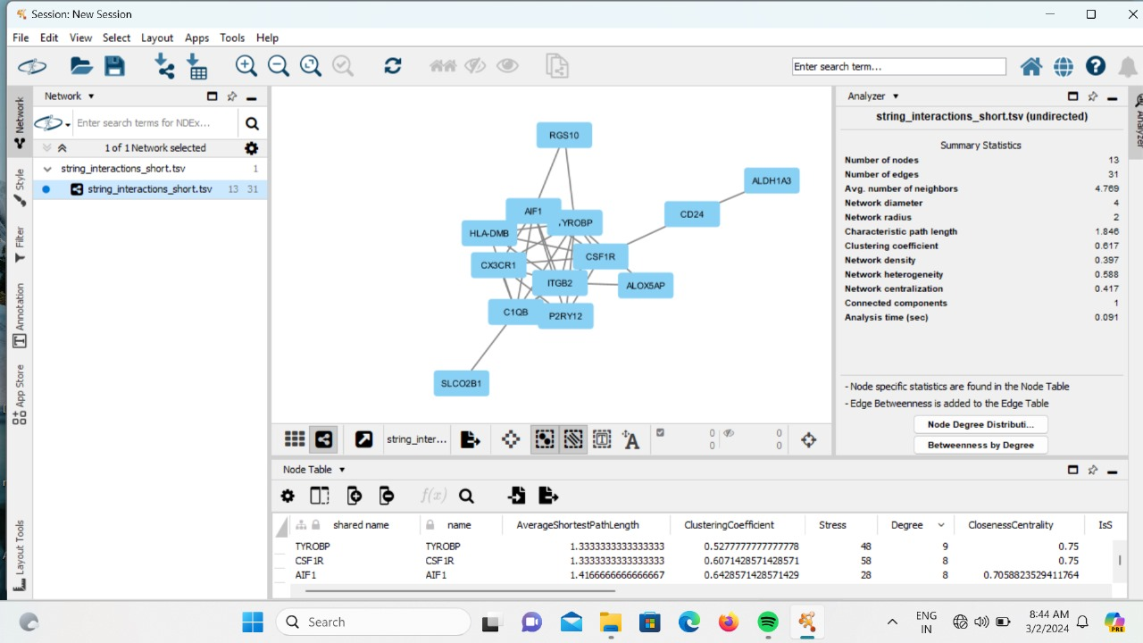
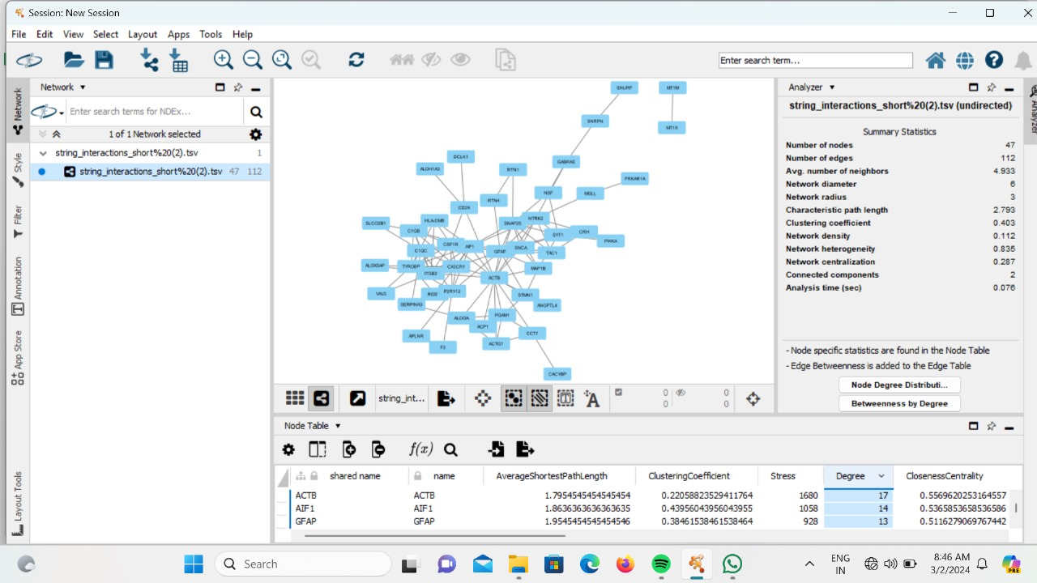
GENE TARGET IDENTIFICATION FOR EPIGENETIC DISORDERS USING MICROARRAY DATA
Naga Anjana Gopinath Meda#, Likhitha Priya Naidu# and Dr. Viswajit Mulpuru*
Department of Bioinformatics,
Vignan’s Foundation for Science Technology and Research (Deemed to be University)
This project employs a multidisciplinary approach to investigate Rett Syndrome (RTT) pathogenesis and identify therapeutic targets.
It begins with a literature review to identify biogenic markers and retrieves microarray data from the GEO database, focusing on MECP2.
Statistical analysis using the edgeR package identifies DEGs associated with RTT.
A drug discovery pipeline, including homology modeling and docking studies, predicts potential drug candidates interacting with targets. Molecular dynamics simulations assess protein-drug complex stability.
Network analysis using STRING and Cytoscape elucidates molecular interactions, aiding in candidate gene prioritization.
This integrated approach aims to enhance understanding of RTT's mechanisms and develop precision medicine strategies for improved patient outcomes.
Diseases known as epigenetic disorders are defined by modifications in gene expression without variations in DNA sequence.
Mutations in the MECP2 gene are responsible for the neurodevelopmental epigenetic disease known as Rett syndrome.
The CTCF gene was found to have a strong correlation with Differential Gene Expression (DEG) study.
Drug design for Rett syndrome that targets the CTCF protein is investigated using molecular docking, homology modeling, and molecular dynamics (MD) simulations.
"Arboreol" was discovered to be a viable candidate medication with a strong affinity against 100 phytochemicals.
Upcoming research will employ STRING and Cytoscape for network analysis in order to better identify potential genes.
Introduction
Abstract
Methodology
Conduct a literature search for biogenic markers associated with Rett’s syndrome.
Retrieve the Micro array data regarding MeCP2 from GEO database.
Microarray data analysis using edgeR package of R Programming.
Drug Discovery (Homology Modelling, Docking studies, Molecular Dynamic(MD) Simulations).
Network analysis using STRING & Cytoscape
Top 10 Docked Phytochemicals with protein
Sl. No. | IMPATT ID | Phytochemical Name | Affinity (kcal/mol)
1 | IMPHY003954 | Arboreol | -7.632
2 | IMPHY007572 | Ophiopogonanone A | -7.493
3 | IMPHY013734 | Wodeshiol | -7.407
4 | IMPHY011147 | Styraxin | -7.288
5 | IMPHY003529 | 3,3'-Bisjuglone | -7.283
6 | IMPHY011238 | Methyl ophiopogonanone A | -7.279
7 | IMPHY001304 | Eryvarin A | -7.267
8 | IMPHY003137 | Paulownin | -7.264
9 | IMPHY003597 | Cinnamonol | -7.242
10 | IMPHY004212 | Isoarboreol | -7.169
Results
Protein with Arboreol
Microarray data analysis of GEO dataset GSE214548 identified under-expression of the CTCF gene, implicating its involvement in Rett Syndrome.
Drug designing for the CTCF protein involved homology modeling to create a 3D protein structure using Modeller.
Docking studies against 100 phytochemicals from the IMPATT database adhered to Lipinski's rule, Veber's rule, Ghose's rule, and Egan's rule, with "Arboreol" exhibiting the highest affinity of -7.632 kcal/mol.
Molecular Dynamics (MD) simulations provided deeper insights into the interaction energy between Arboreol and the CTCF protein, showing favorable RMSD and RMSF plots.
Analysis of another dataset (GSE75303) yielded a list of significant genes, leading to further network analysis using STRING and Cytoscape tools.
ACTB and AIF1 were identified as genes with the highest degree of interaction and stress values within the network, suggesting their potential significance in the context of the study.
Conclusion

