Slide 1

Introduction to ReactJs
Gopinath Rajendran

Slide 2
Agenda
Introduction
JSX – brief
Components
Props & validation
State
Data Flow
Virtual Dom
Component Lifecycle
Keys
Router
Flux pattern(Additional.)

Slide 3
Introduction
React is a JavaScript library for creating user interfaces by Facebook and Instagram
Not an another JS framework but a library for creating user interfaces
React is only View layer (“V” in MVC)
Build Components not templates
Re-render on update, don’t mutate
Fast Virtual DOM (and events)

Slide 4
Why React?
Simple
Declarative
Reduce coupling, increase cohesion
Reusable Components
Composable Components
Avoid expensive DOM operations
Minimize access to the DOM

Slide 5
JavaScript Syntax Extension(JSX)
Optional HTML-like markup
Concise and familiar syntax
Declarative description of the UI inlined in JS Code.
It is intended to be used by various preprocessors(transpilers) to transform xml tokens to standard ECMA script
It is optional to use but found JSX syntax easier to use than Plain JavaScript

Slide 6
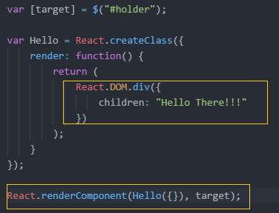
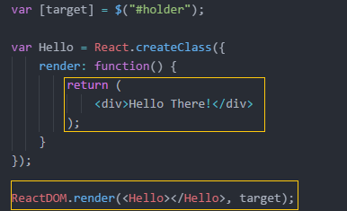
React Components
React is all about modular, composable components.
React Componets are always go by first letter uppercase to diff with html tags
Component can be created by either plain JavaScript or JSX
Components are created by React.CreateClass();

Slide 7
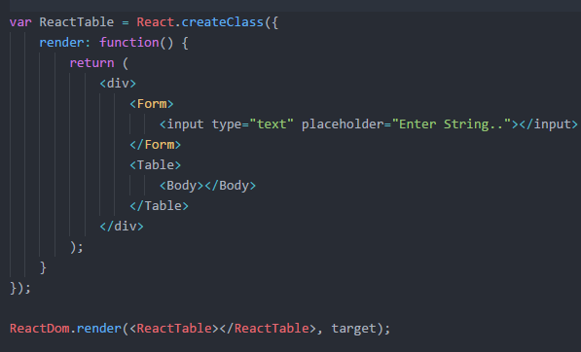
Multiple Components
When designing interfaces, break down the common design elements into small reusable components with well defined interfaces.
React Component can carry multiple other components

Slide 8
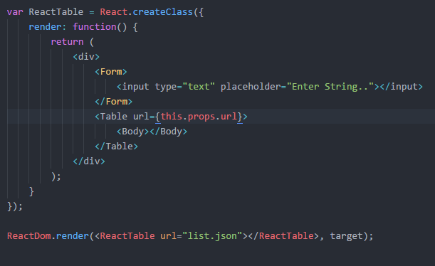
Props
Date passed in from parent component is available as “property” on the child component.
“property” is accessed through “this.props”.
Props are immutable.

Slide 9
Prop validation
As our App grows, we need to ensure that components are used correctly. This can be done by “propTypes”
Proptype object allows you to validate props being passed to our components.
To get all the props once component is invoked, use getDefaultProps

Slide 10
State
State are mutable property to the components
State are private to the component.
State are accessed through “this.state”
When the state updates, component re-render itself.
Can be changed by this.setState();

Slide 11
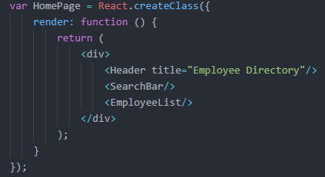
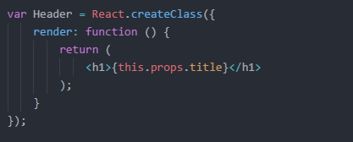
Data Flow – Parent to child
Properties passed by the parent are available in this.props in the child component.
Props are immutable.

Slide 12
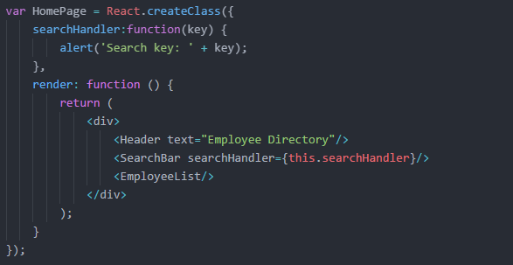
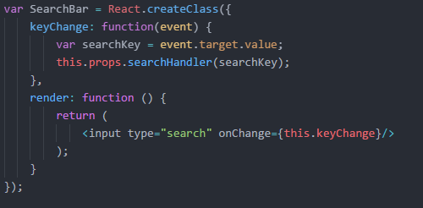
Data Flow – Child to Parent
Pass event handler as a property

Slide 13
Virtual Dom
Re-render everything on every update:
Create lightweight description of component UI
Difference it with old one.
Compute minimal chages to apply/refresh DOM
Batch executes all the updates

Slide 14
Virtual Dom Benefits
1. Clean
Clear and descriptive programming model
2. Fast
Optimized dom updates and less reflows.

Slide 15
Lifecycle Methods
componentWillMount
componentDidMount
componentWillReceiveProps
shouldComponentUpdate
componentWillUpdate
componentDidUpdate
componentWillUnmount

Slide 16
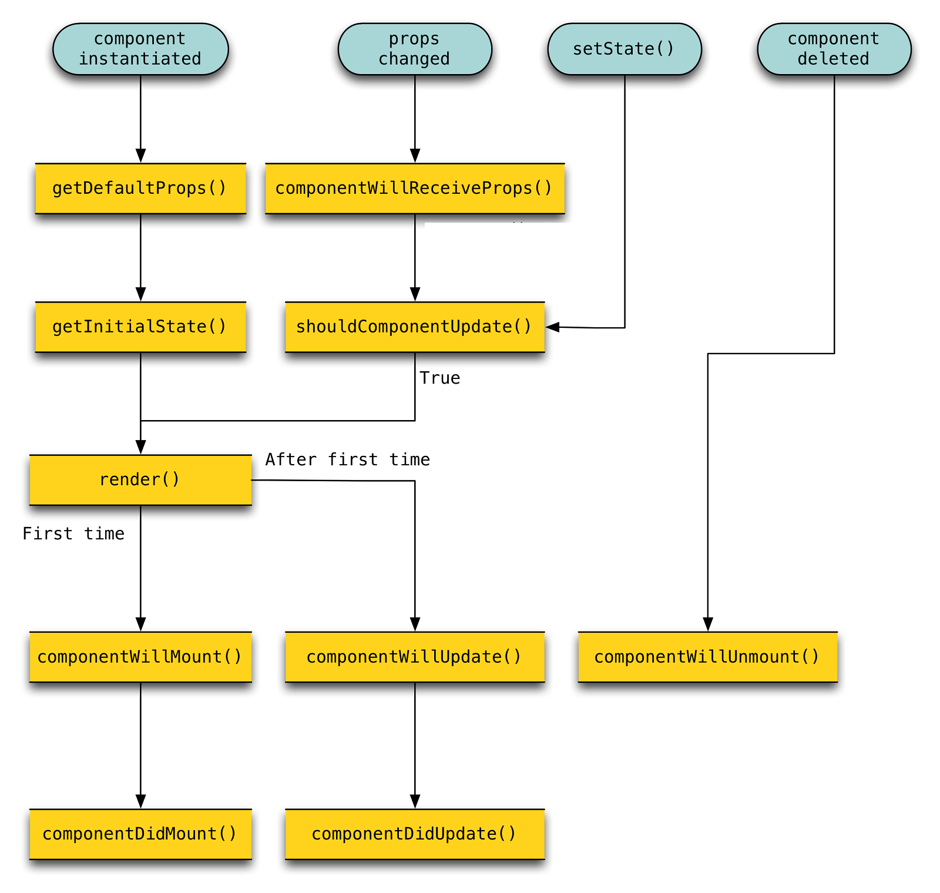
Lifecycle Methods

Slide 17
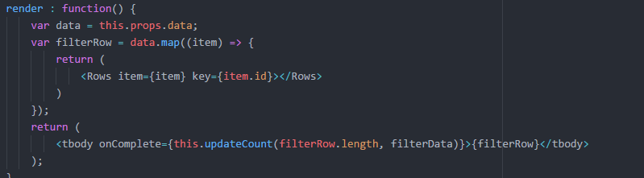
Keys
Keys are important property when creating dynamic children in component.
When React reconciles the keyed children, it will ensure that any child with key will be reordered (instead of clobbered) or destroyed (instead of reused).

Slide 18
Router
Routing is possible in React by additional add-on called “React Router”
It routes components based on the configured url.

Slide 19
Flux
Flux is programing concept/pattern where the data is “uni-directional”.
Flux Elements:
Actions − Actions are sent to dispatcher to trigger the data flow.
Dispatcher − This is central hub of the app. All the data is dispatched and sent to the stores.
Store − Store is the place where the application state and logic are held. Every store is maintaining particular state and it will update it when needed.
View − The view will receive data from the store and re render the app.

Slide 20
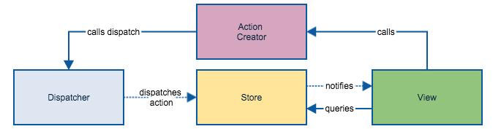
Flux pros
Single directional data flow is easy to understand.
The app is easier to maintain.
The app parts are decoupled.

Slide 21


Slide 22
Thank You

