Slide 1

Welcomes you to the World of Software Solutions!
Part of the Quadsel Group. Bluebase Software Services is engaged in Development customized IT Solutions. We have built web-based applications and mobile applications to meet the customer requirements. We cater to the needs of customers to their satisfaction. We use open source technologies to lower the cost of ownership without compromising Quality, Security and Ease of use.

Slide 2
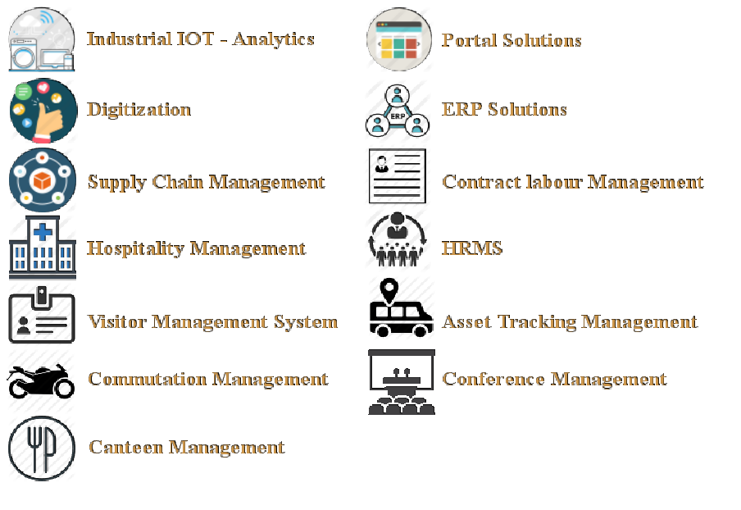
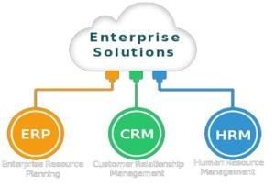
Our Solutions

Slide 3

Brand Building
www.bluebase.in

Slide 4
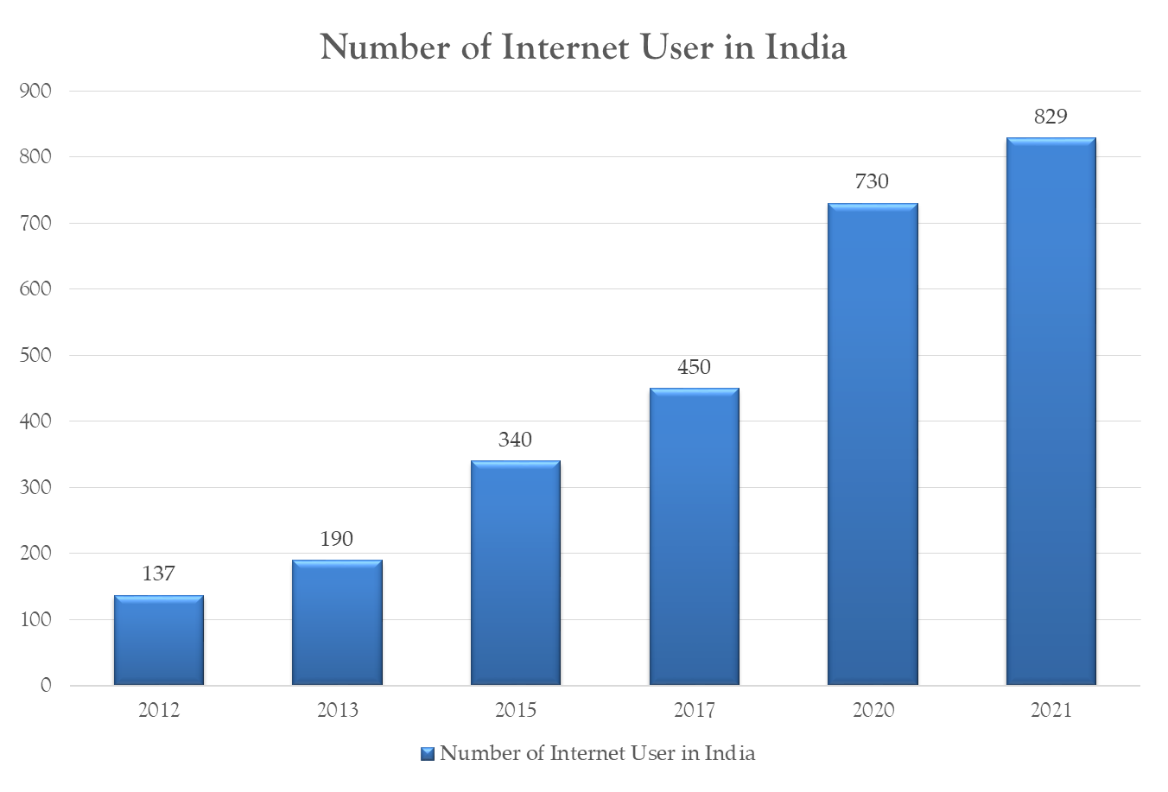
*Values mentioned in Million*
www.bluebase.in

Slide 5
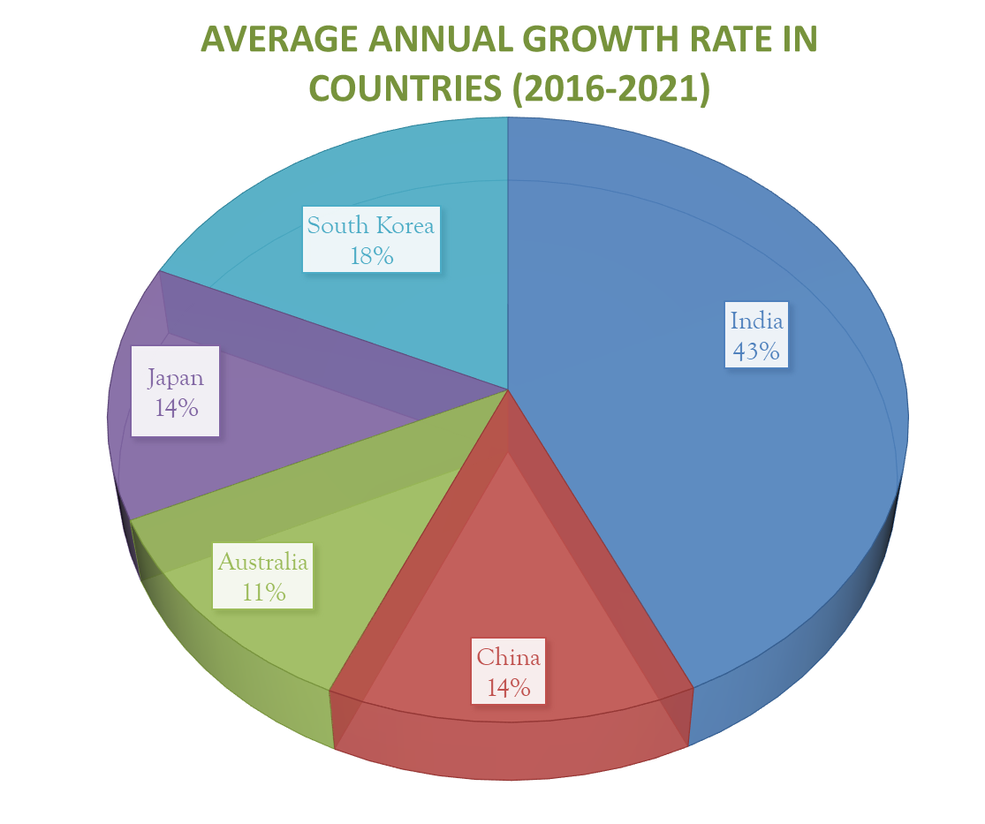
www.bluebase.in

Slide 6
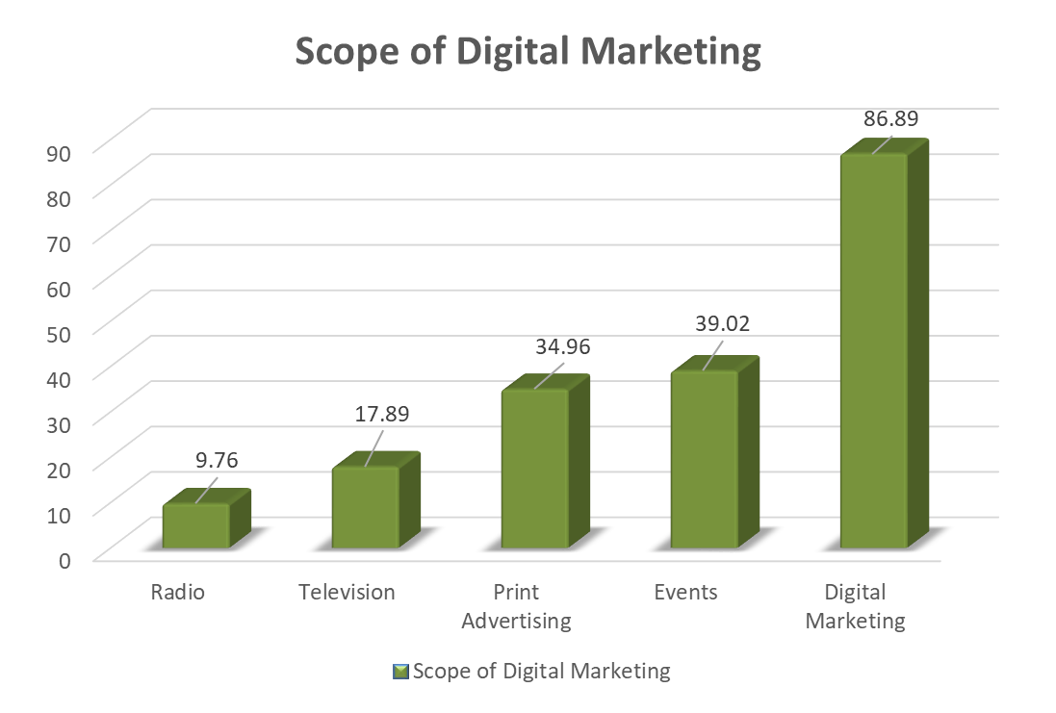
www.bluebase.in

Slide 7




CONTENT WRITING
WEBSITE DEVELOPMENT / REVAMPING
SEARCH ENGINE OPTIMISATION / MARKETING
SOCIAL MEDIA OPTIMISATION / MARKETING
www.bluebase.in

Slide 8


SMO Post Content
Services Post
Inspirational Quote Post
Fact Post
Blog Post
About us / Contact us Post
Website Content Development
SEO Based Content
Blogs Writing
Blogs for Site
Blog Post
CONTENT WRITING
www.bluebase.in

Slide 9


Slide 10

New Responsive
Website Development (SEO Based)
Exsiting Website Revamping (SEO Based)
www.bluebase.in

Slide 11

www.bluebase.in

Slide 12
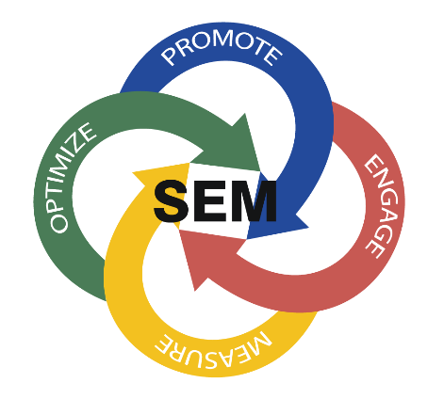
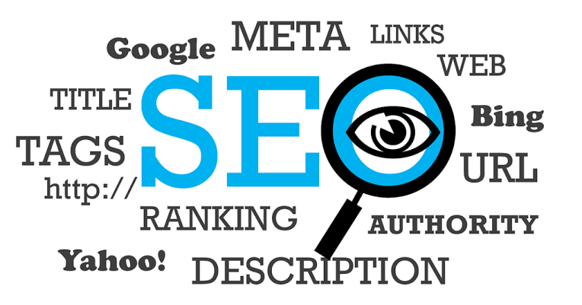
SEO & SEM
SEO – Search Engine Optimisation
Search engine optimization (SEO) is the process of optimizing your online content so that a search engine likes to show it as a top result for searches of a certain keyword
SEM – Search Engine Marketing
In Internet marketing, search advertising is a method of placing online advertisements on web pages that show results from search engine queries. Through the same search-engine advertising services, ads can also be placed on Web pages with other published content.
www.bluebase.in

Slide 13

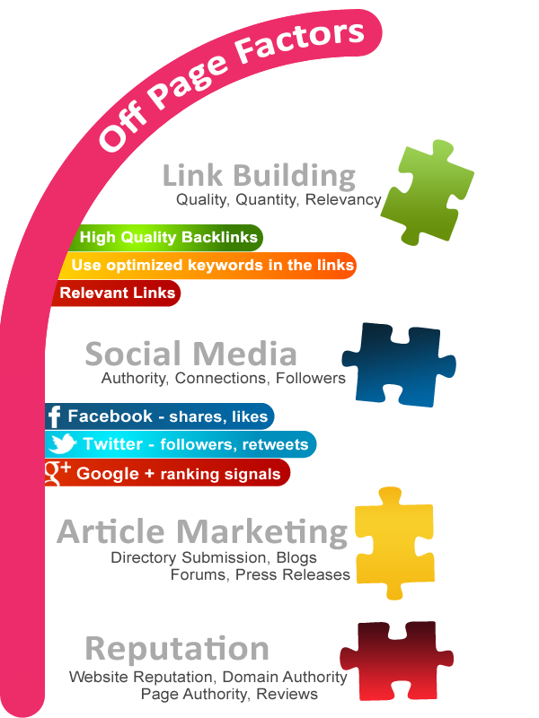
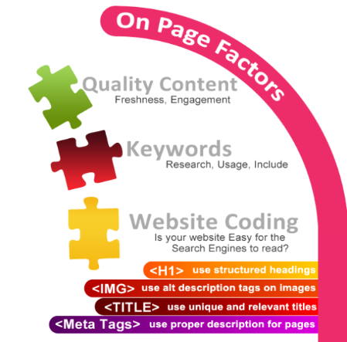
www.bluebase.in

Slide 14


SMO & SMM
Social media optimization (SMO) is the process of increasing the awareness of a product, brand or event by using a number of social media outlets and communities to generate viral publicity.
Social media marketing refers to the process of gaining traffic or attention through social media sites. Social media itself is a catch-all term for sites that may provide radically different social actions.
www.bluebase.in

Slide 15
WHY BLUEBASE?
You
Your Customer
Customer
Business
Communication
Satisfaction
We
Brand Building
Brand Awareness
Customer Engagement
User Experience
www.bluebase.in

Slide 16


Awareness is best at launching a new company, new flavor or a new model. It’s also great at introducing a current brand into a new market or product category.
Brand Building is most effective at keeping current customers “in love” with your brand and to deepen your value in their hearts that goes beyond the commodity and price wars.
www.bluebase.in

Slide 17
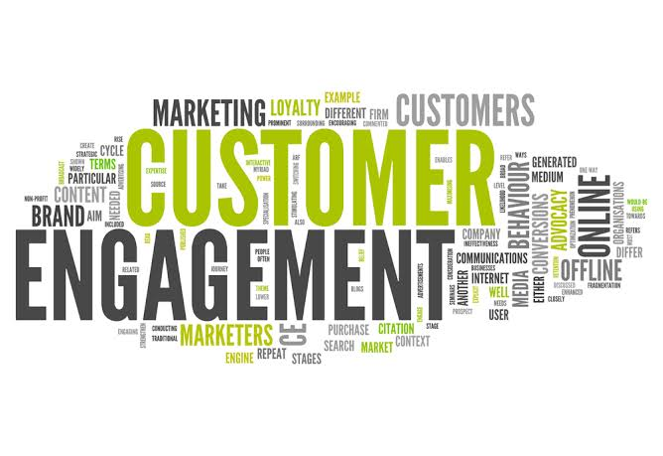

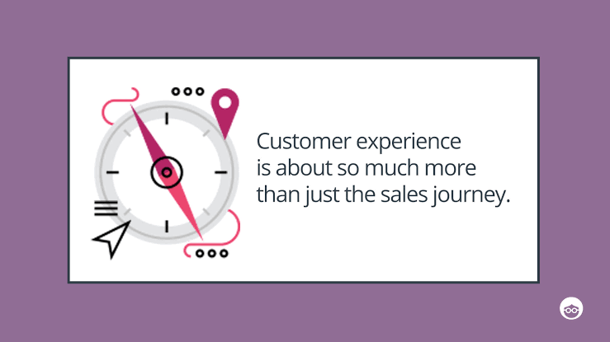
Customer engagement, if it happens, occurs earlier in the timeline. Customer satisfaction usually (but not always) is a result of customer engagement.
www.bluebase.in

Slide 18

Our Team
Qualifications
Capabilities
Application Development.
Web : HTML, CSS
Frameworks : Phonegap, Android
Programming : PHP, Javascript
Library : Jquery
DB : MySQL, MongoDB, MS SQL.
Value ADD
Integration capabilities viz. Access control, PLC, RFID etc.
SAP Consulting, Support and maintenance.
Create Dashboards integrating your existing application data.
Post graduates
45%
Post Graduates
55%
Engineering Graduates
……………………………………………………
Experience Development
>10 Yrs
30%
0 – 5 Years
70%

Slide 19













Our Esteemed Customers
The logos shown here are purely for illustration purposes and belong to the respective owners

Slide 20

THANK YOU!!!
Bluebase Software Systems Private Limited
+91 98410 16631
www.bluebase.in

