Slide 1
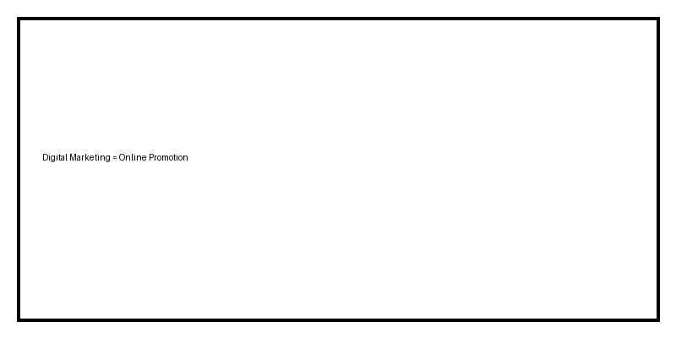
Digital Marketing & Leads
Introduction

Slide 2
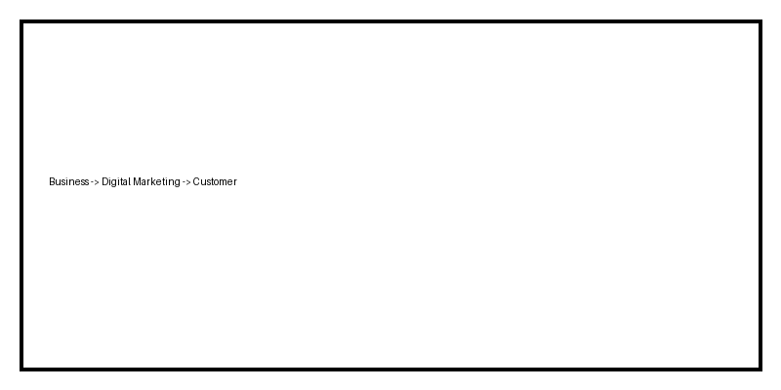
What is Digital Marketing?
Online promotion using internet

Slide 3
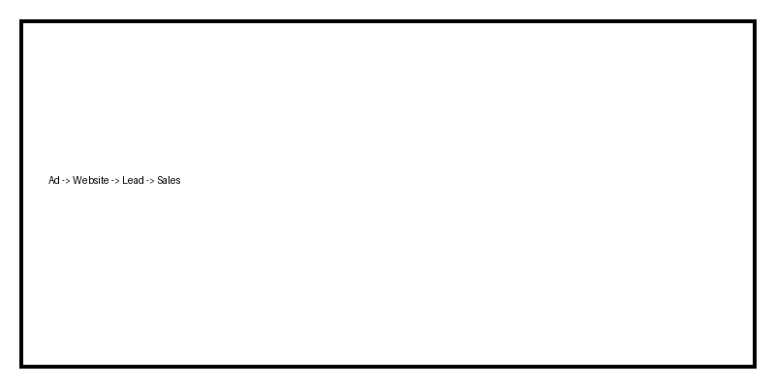
Importance of Digital Marketing
Business growth

Slide 4
What is a Lead?
Interested customer

Slide 5
Lead Generation Process
From ad to sales

