Slide 1
LEAD_SCORING_GROUP_CASE_STUDY_BY_GOPINATH AND NIKHIL

Slide 2
Problem Statement:
An education company named X Education sells online courses to industry professionals. The company requires you to build a model wherein you need to assign a lead score to each of the leads such that the customers with higher lead score have a higher conversion chance and the customers with lower lead score have a lower conversion chance. The CEO, in particular, has given a ballpark of the target lead conversion rate to be around 80%.

Slide 3
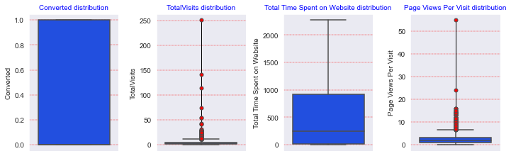
Plotting boxplot for outlier

Slide 4
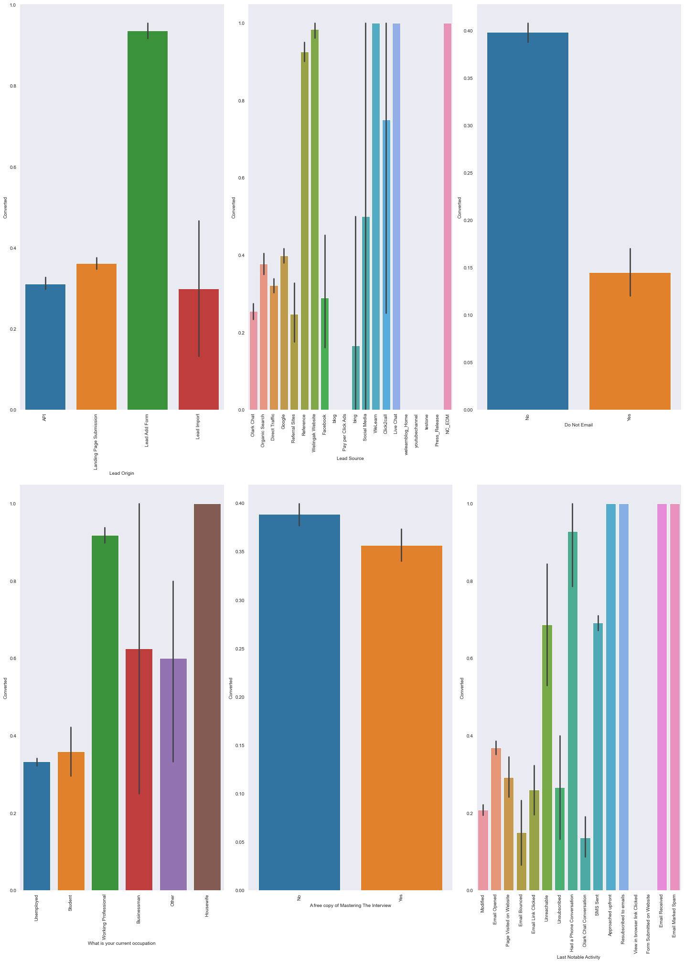
‘Converted’ column has been chosen as target variable. So, bivariate analysis of important variables has been performed with respect to the target variable. ▪ Lateral students and the visitors showing interest on next batch have higher chances of getting converted. ▪ Lead quality tagged with “High in Relevance” has high conversion rate history. ▪ Lead originated through “Lead Add Form” and “Quick Add Form” has high possibility of getting converted. ▪ Lead belongs to Welingak Website, WeLearn, Live Chat and NC_EDM converts more than any other sources

Slide 5
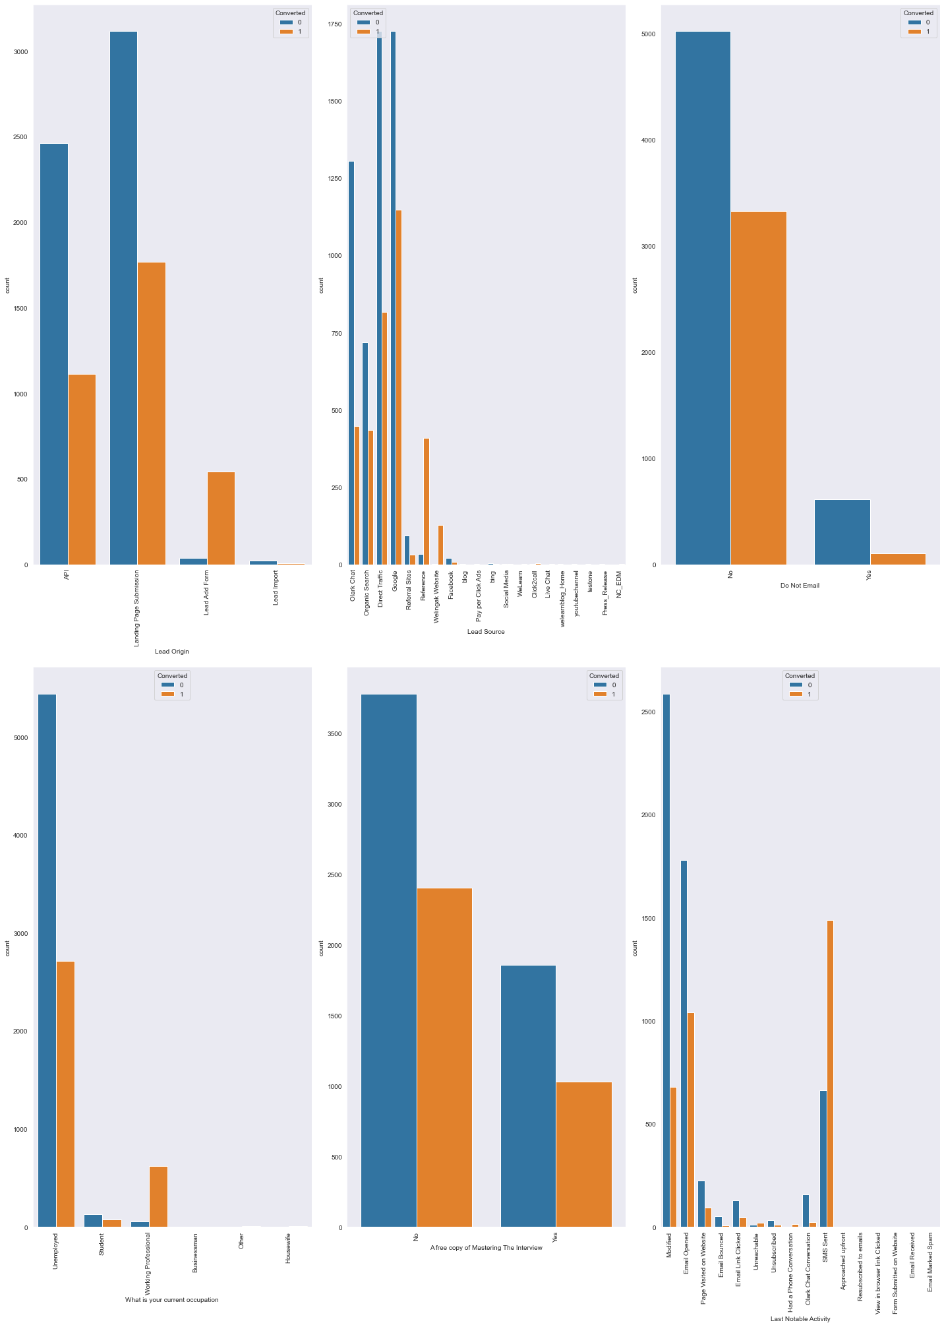
In Lead Origin, "Landing Page Submission" is good indicator ie. lead convert into yes
In Lead Source, "Google" is best source to lead convert into yes
In occupation, Unemployed and working professional are more convert into yes
In Last Notable Activity, "SMS Sent" is good indicator

Slide 6
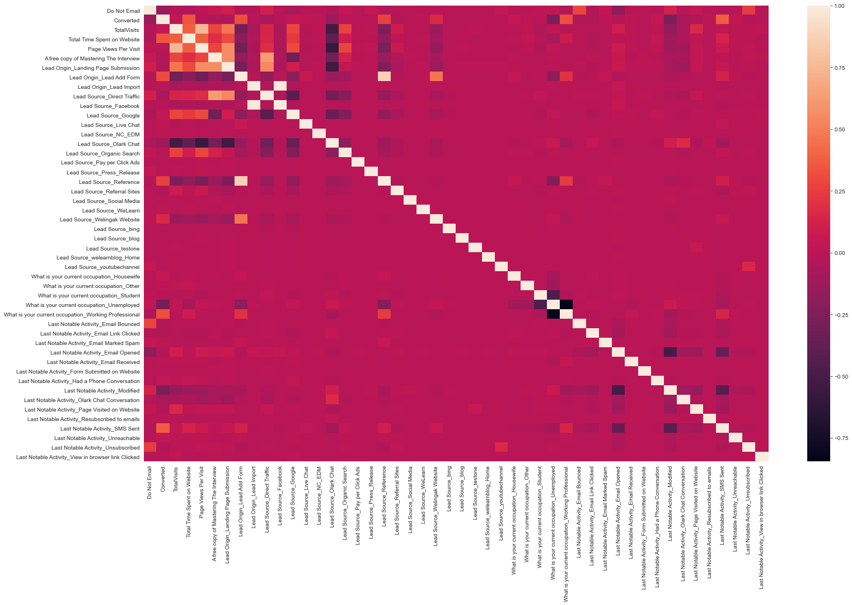
▪ Following group of columns are positively highly correlated with each other: 1. Search 2. Newspaper Article 3. X Education 4. Digital Advertisement 5. Through Recomendations ▪ Another set of columns are also positively highly correlated with each other: 1. TotalVisits 2. Total Time Spent on Website 3. Page Views Per Visit • There is a strong positive correlation between Asymmetrique Activity Index and Asymmetrique Profile Index.

Slide 7
Final Model and Interpretation
• Final model contains 14 most important features which satisfy all the selection criteria.
• Lead score having conversion probability greater than 0.3 are being predicted as “Converted”.
• Using this probability threshold value (0.3), the leads from the test dataset have been predicted whether they would get converted or not.
• Confusion matrix with cut-off 0.3 has been created to calculate evaluation metrics.
• Confusion matrix: [[3330 420]
[ 691 1513]]
• Evaluation metrics:
• Accuracy: 0.8134 • Sensitivity: 0.6864 • Specificity: 0.888 • Precision: 0.8083

Slide 8
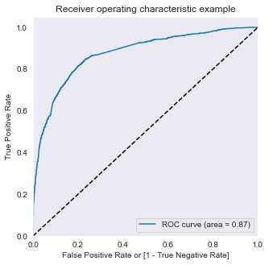
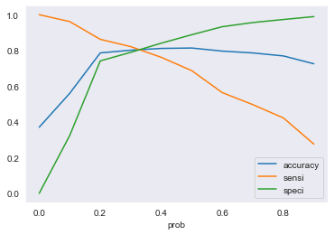
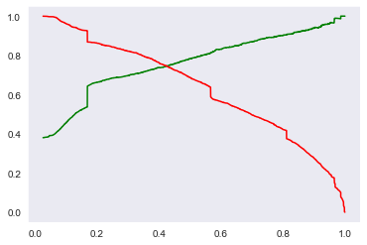
• Receiver Operating Characteristics (ROC) Curve: • By determining the Area Under the Curve (AUC) of the ROC curve, the goodness of the model is determined. • Since the ROC curve is close to the upper left part of the graph, it means this model is a very good model. • The value of AUC for our model is 0.87. • Plot accuracy sensitivity and specificity: • Tradeoff between sensitivity and accuracy can be observed (cutoff = 0.3). • Precision and Recall plot: • Ideal cutoff of 0.4 is observed from recall and precision plot. • We will use both the cutoff and evaluate results for further predictions.

Slide 9
Conclusion and Recommendations:
• Followings are top three features that contribute to decision which mean the conversion probability of a lead increases with increase in values of these features:
• Lead Origin
• What is your current occupation
• Last Activity
• Top three categories that contribute to decision
• Lead Origin ==> Lead Add Form
• What is your current occupation ==> Working Professional
• Last Activity ==> SMS Sent

