Slide 1



Cyber Security Foundation SAST Plan 2025
July 2, 2025

Slide 2
Agenda
Why
What
How
Who
When
Q & A

Slide 3
Why = Internal Audits
Internal Audit team assessed several Bayer internet facing web applications
Found several vulnerabilities that were exploitable
Discovered that application security scanning was not required and/or tools not available

Slide 4
What = Audit Assignments
Assigned several audit findings to Cyber Security Foundations (CSF) requiring internet facing web applications to have a process, tools, and policy for application security scans:
DAST
SAST
SCA
Secrets
Container

Slide 5
How = SAST Vendor Selection
Evaluation volunteers from DevOps community and CSF
PoC’s with 6 vendors
Scorecard

Slide 6
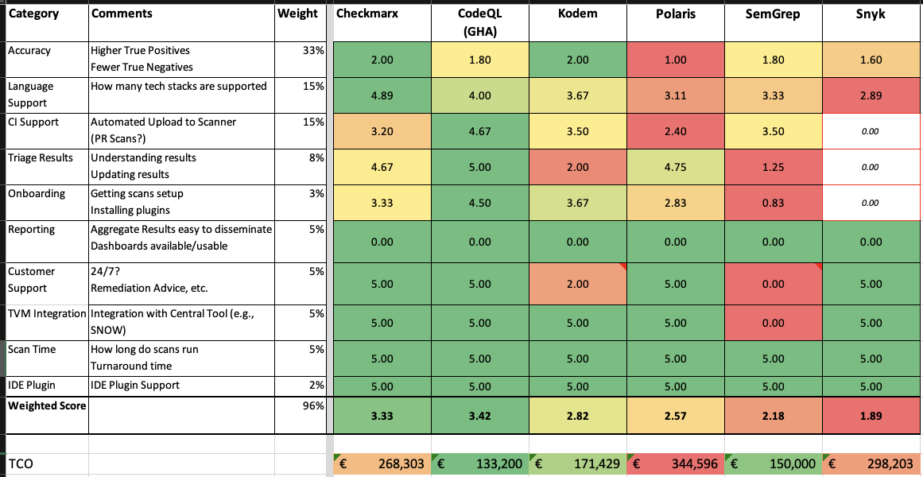
How = SAST Vendor Selection

Slide 7
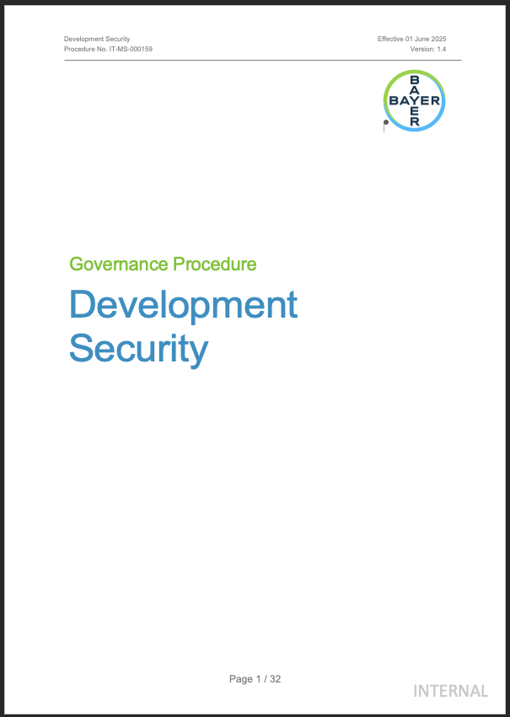
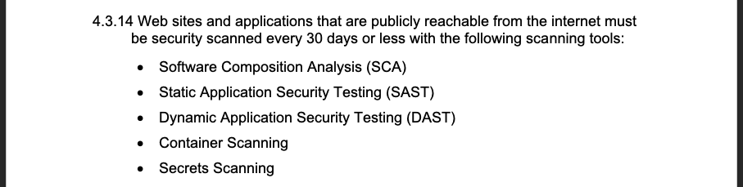
How = Policy Updates & Additions
Updated Development Security Procedure

Slide 8
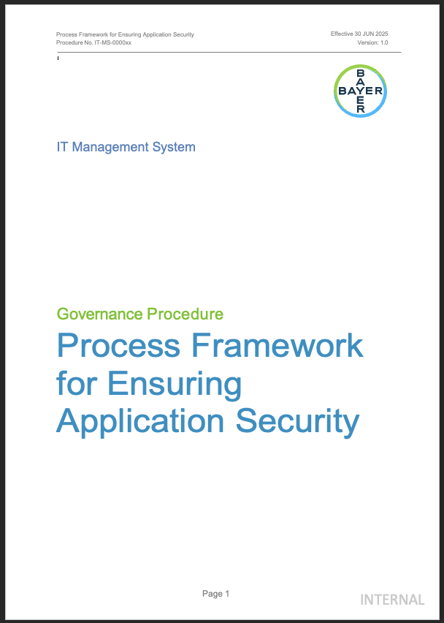
How = Policy Updates & Additions
New Application Security Framework Procedure

Slide 9
How = Awareness Campaigns
Stakeholder Toolkit (June 2025)
Email blast to all GitHub users
Posts on Teams channels
CloudTech Usergroup
Security Champions
Announcement at monthly meetings
CloudTech Usergroup
Security Champions
CSF Office Hours

Slide 10
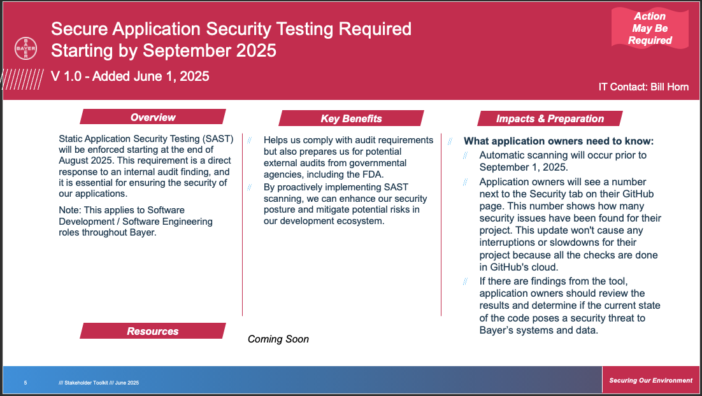
How = Awareness Campaigns

Slide 11
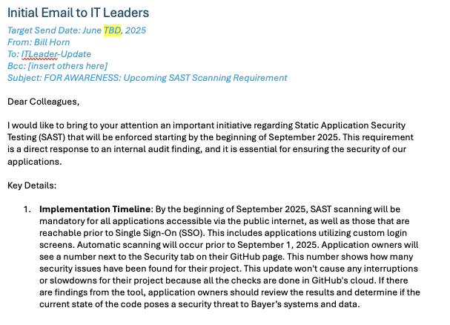
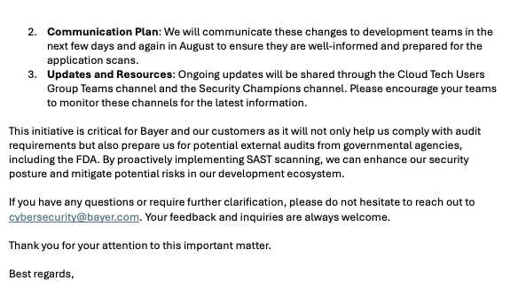
How = Awareness Campaigns

Slide 12
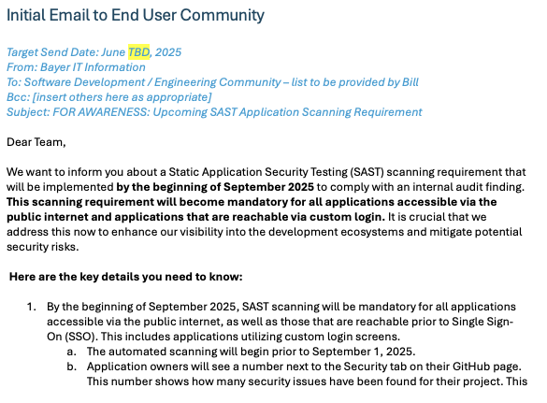
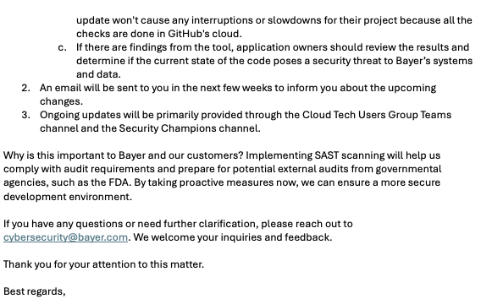
How = Awareness Campaigns

Slide 13
Who = Application Stakeholders (All Divisions)
Product Owners
System Owners
DevOps Engineers
CSF Governance & Compliance
CSF DevSecOps Squad

Slide 14
When = Q3 2025
Procedures published between now Aug. 31, 2025
Awareness campaigns between now and Dec. 31, 2025
Internal Audit due date for publishing Procedures = Aug. 31, 2025

Slide 15
Q & A
?

Slide 16

Gradient
Subheadline

Slide 17
Contact
Subheadline
NAME
Position
Phone:
Fax:
e-mail:
+XX – XXXXXXX
+XX - XXXXXXX
Your.name@bayer.com

Slide 18
Information classification labeling
Please use the CLASSIFICATION RIBBON in your PowerPoint at Bayer.
You can find further information about Bayer's classification labeling on Bayer Identity Net. Please copy the URL into your browser.
https://idnet.bayer.com/en/security-labeling.aspx

