Slide 1
AirTicket Bookng system
Boxiang Guo
Xinyu Li
Rong Wang

Slide 2
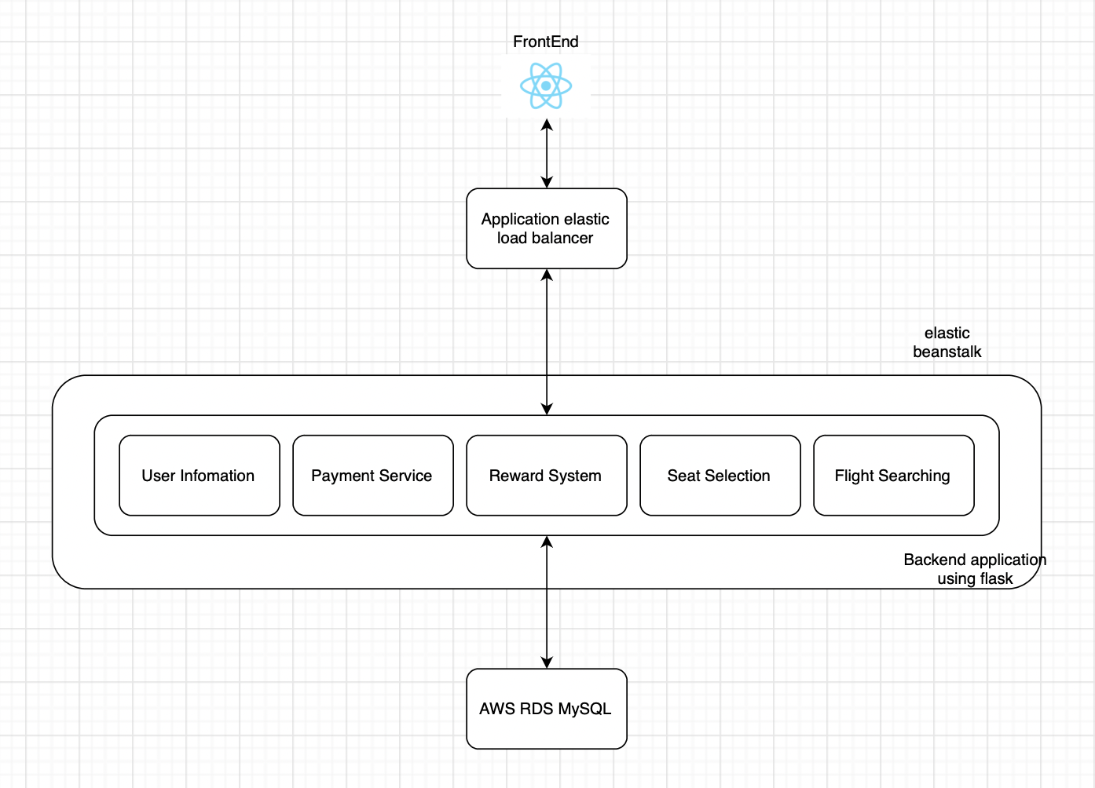
Architecture

Slide 3
APIs
Login: /login, POST
Register: /register, POST
Get Info: /getInfo/<userID>, GET
Get Rewards: /getRewards/<userID>, GET
Change Info: /<userID>/edit, POST
Search Flight: /search-results, POST
Search Seat: /searchseat/<flightNumber>, GET
Purchase Ticket: /purchase, POST
Find Order: /findorder/<reservationNumber>, GET
Find Orders: /findorders/<userID>, GET
Edit Reservation: /order/update, POST
Cancel Reservation: /order/cancel, POST

Slide 4
Demo

