Slide 1
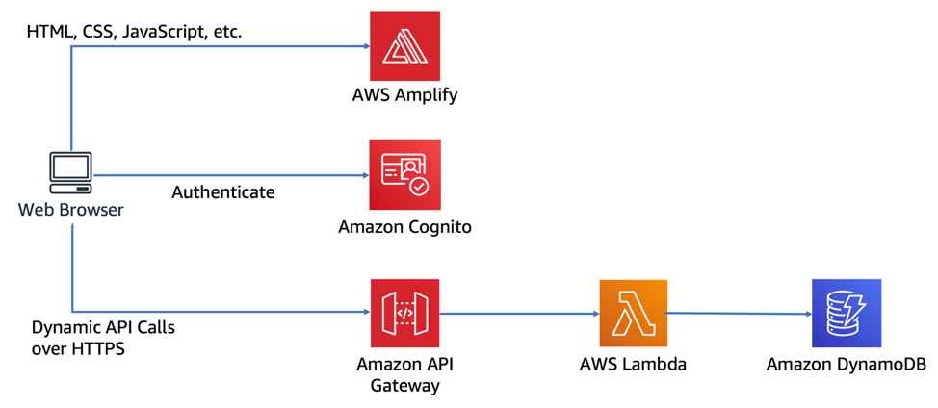
UI will be used by Customers and Hotel employees
X1
Enrolling as a new customer
X1
Search for Hotels
Manage your Hotel rewards account
Change/Cancel reservations
Room Options
Room rates
X2
APIs can be demonstrated using a basic Web/mobile UI

