Slide 1
MARIST COLLEGE
A replica of college registration process

Slide 2
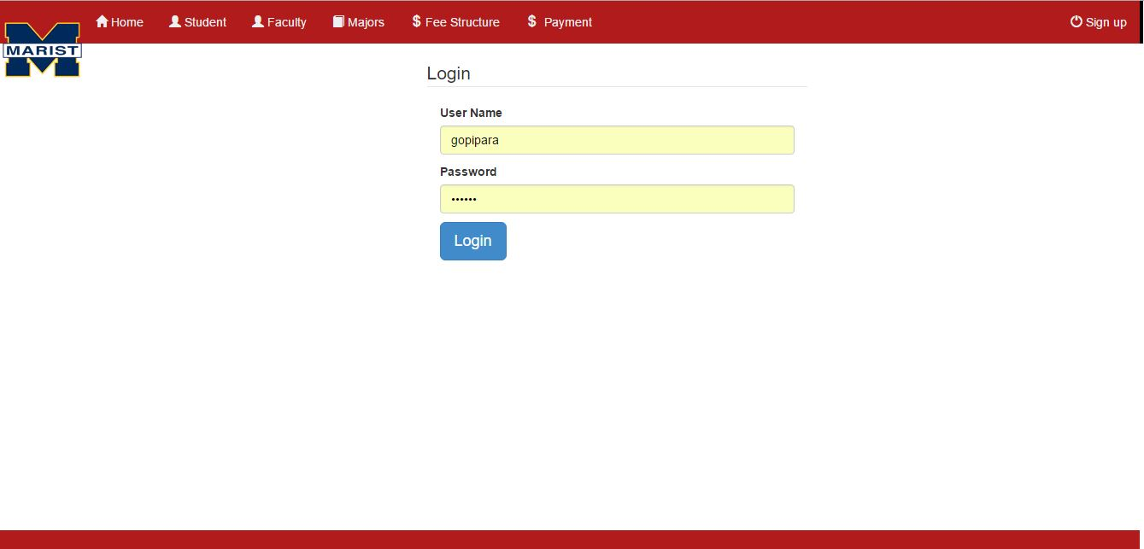
Login registration
Receptionist must login with their details
username and password must be given

Slide 3
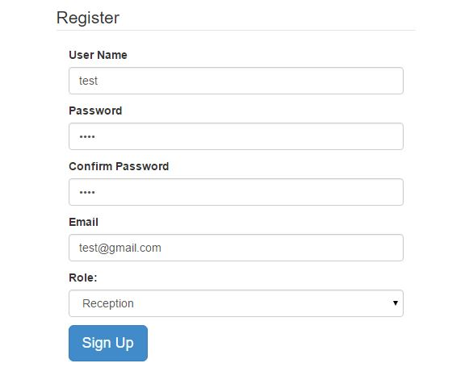
signup
Sign up will be at right corner of the page where receptionist will register with details.
The picture on right represents the sign up process.

Slide 4
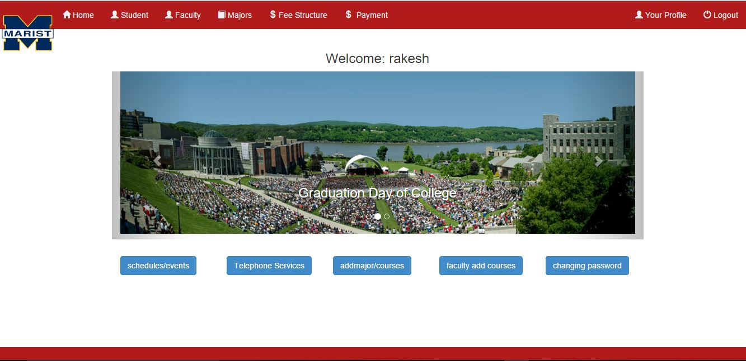
HOME

Slide 5
Home options
Student
faculty
majors
fee structure
payment
your profile
schedules/events
telephone services

Slide 6
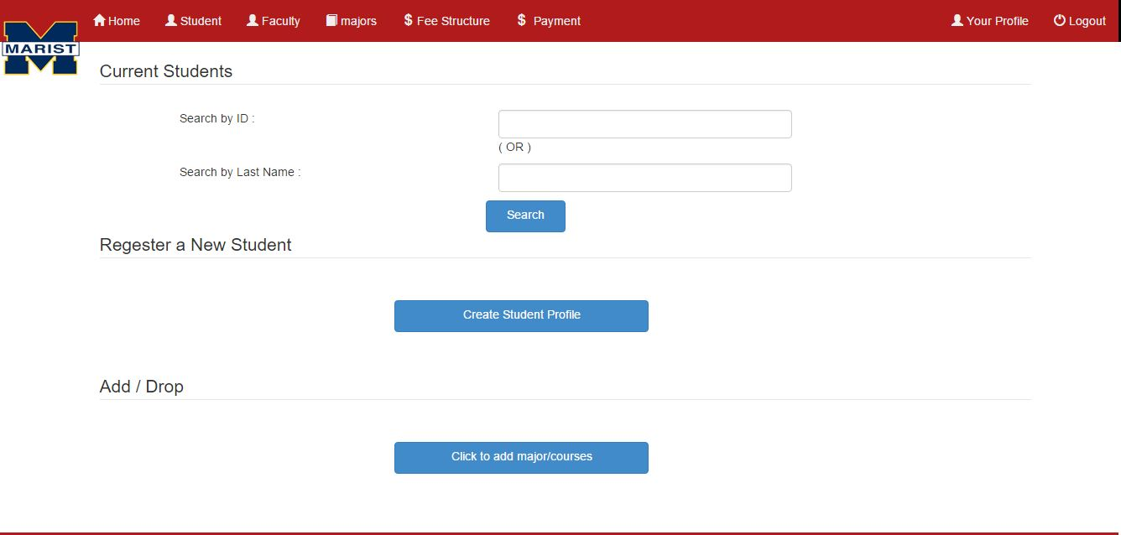
Student

Slide 7
Student options
current students
registering new students
add/drop

Slide 8
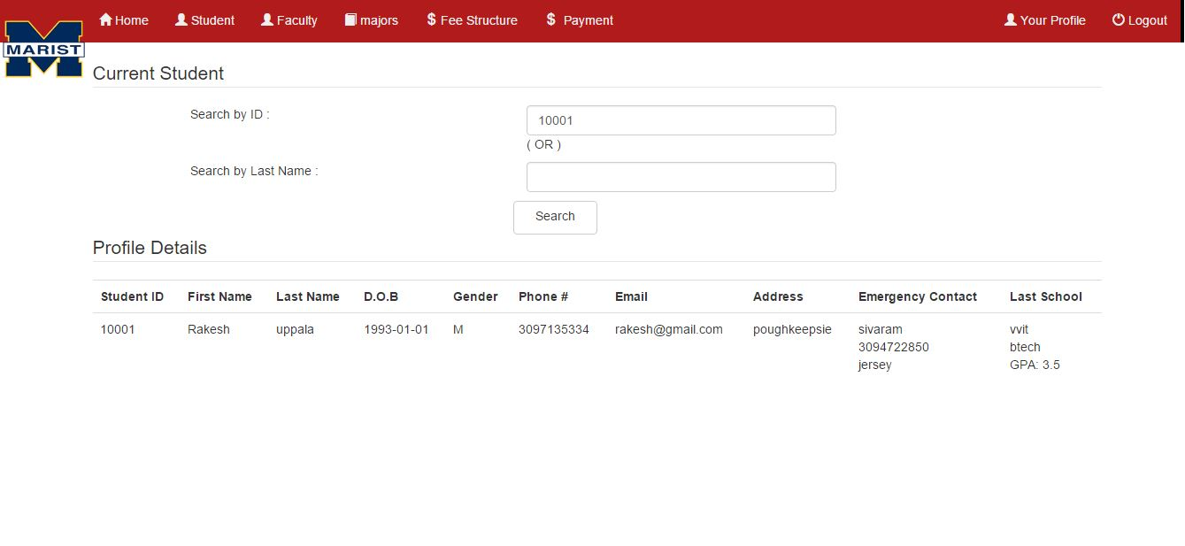
current students
Search student by their id or last name as shown below

Slide 9
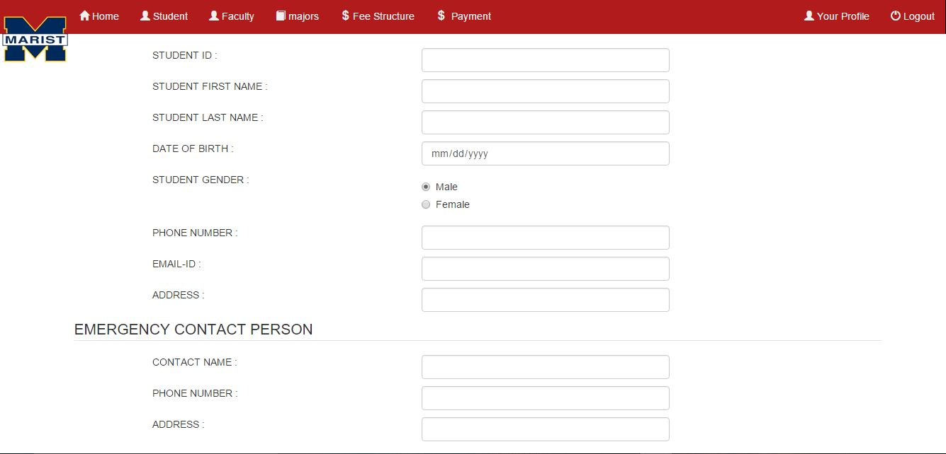
Registering new students

Slide 10
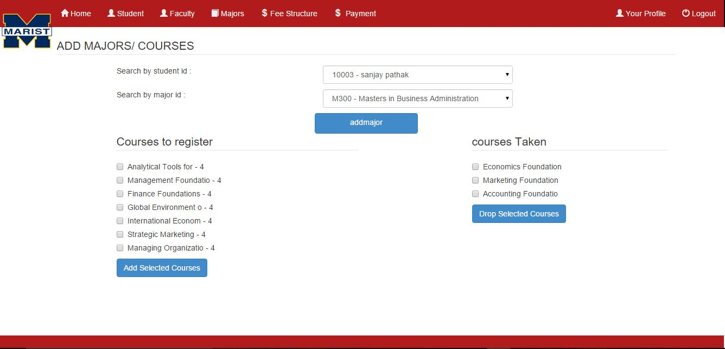
ADD/DROP

Slide 11
Faculty
current faculty
register a new faculty
add/drop
Same as Student search for faculty by id or last name, if the faculty is new we can create a new profile and then add major and courses

Slide 12
Majors
There are different majors available for the students to select
every student will be assigned to one and only one major
courses will be assigned accordingly with his majors elected
only three courses can register per semester
faculty will be assigned to majors respectively and courses are assigned accordingly to their respective majors

Slide 13
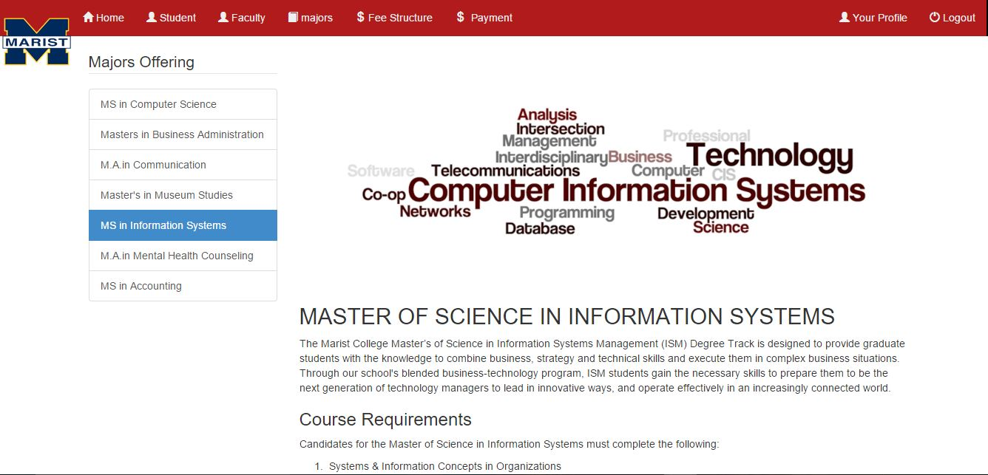

Slide 14
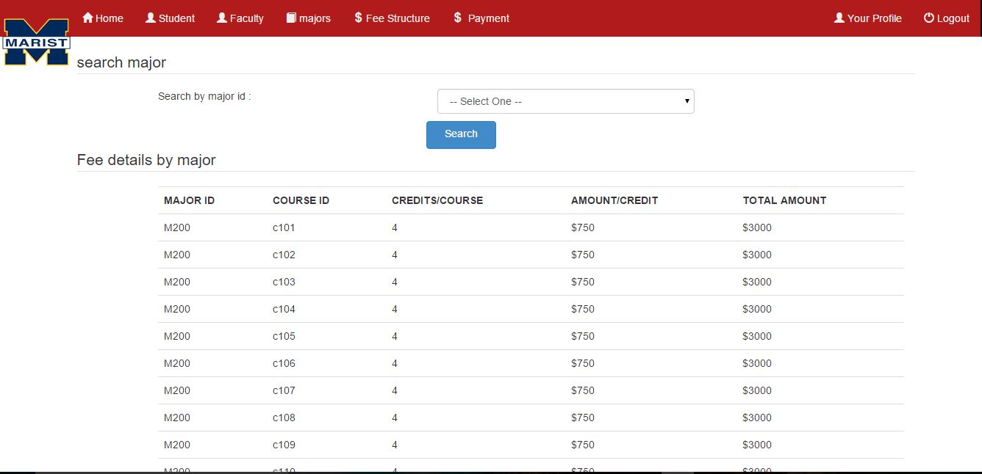
Fee structure

Slide 15
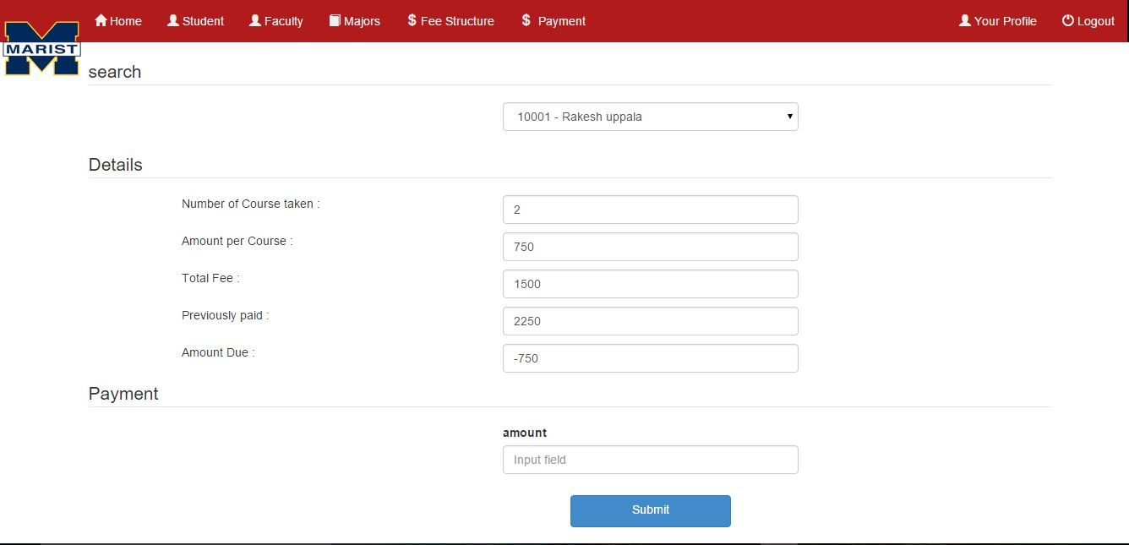
Payment method

Slide 16
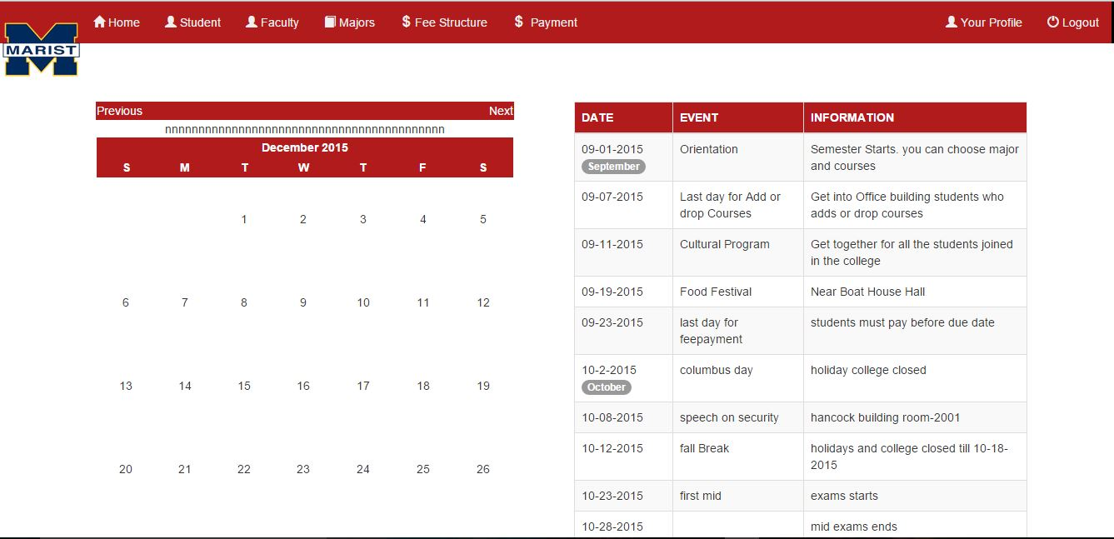
Schedules and events

Slide 17
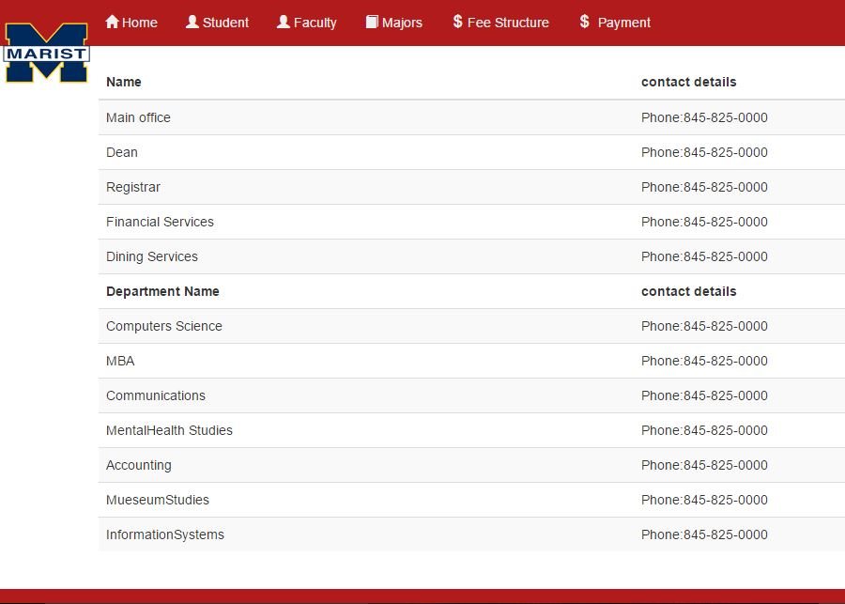
Telephone Services

Slide 18
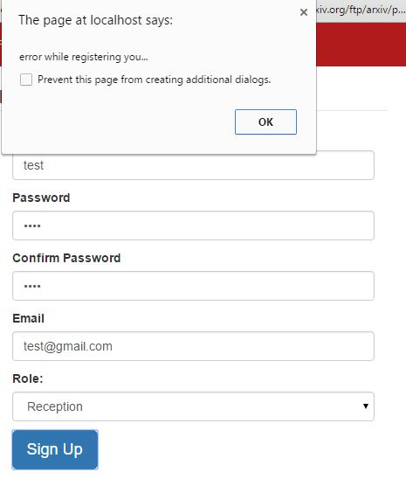
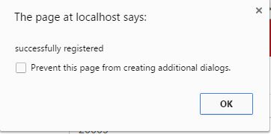
Errors/Successful

Slide 19
Errors/Successful messages
These messages will pop up when there is an error or success
while registering student
while registering faculty
while payment process
while sign up

Slide 20
About
Project Details

Slide 21
FRONT END
HTML
CSS
BOOTSTRAP

Slide 22
LANGUAGES USED
PHP
JAVA SCRIPT

Slide 23
BACK END
MySQL
Flat form:
Wamp server
Sublime text editor (application software )

Slide 24
Team
Venkata Uppala (Code developer and HTML designer)
Gopi para (Database Designer)
Edde Lopez(Code developer and Analyst)

