Slide 1

Player Performance Prediction
Using Ridge and Lasso Regression
A walk through the machine learning life cycle on IPL batting data
M Jashwanth Reddy · G Akshay
Guide: Rani M · Team 1 · Section 5
Notes:
Introduce the project: predicting a batter's runs in an IPL innings with Ridge and Lasso regression. The talk follows the machine learning life cycle from problem definition to monitoring, using this project as the running example.

Slide 2

The machine learning life cycle
1
Slide 3
2
Slide 4
3
Slide 5
4
Slides 6–8
Define
Collect
Explore
Prepare
Predict a batter's runs in one innings
243,817 IPL deliveries from 2008 to 2023
Skewed scores, stable seasons
Aggregate, clean, engineer features, split by time
5
Slides 9–10
6
Slides 11–13
7
Slide 14
8
Slide 14
Model
Evaluate
Deploy
Monitor
Ridge, Lasso and a mean baseline
MAE, MSE, RMSE and R² on 2022–23 matches
Flask API and a web interface
Track error, retrain each season
It is a loop: monitoring tells us when to collect new data and retrain.
Notes:
The life cycle has eight stages. Each one maps to a slide in this deck. The cycle is a loop: monitoring tells us when to collect new data and retrain.

Slide 3



Define the problem
STAGE 1 OF 8 · DEFINE
How many runs will this batter score in this innings?
Target
innings_runs: runs off the bat in one innings, extras excluded
Selectors, analysts and fantasy players all make this call. A model can ground it in the batter's own earlier innings.
Task
Supervised regression with one row per batter per innings
17.46
runs: the error (MAE) of always guessing the training mean. A useful model must come in under it.
Success
Beat the mean baseline on MAE, MSE, RMSE and R² on unseen matches
Notes:
Frame the problem before touching data. The target is runs off the bat in one innings. The model must beat a trivial baseline: always predicting the average, which is off by about 17.5 runs on the test set.

Slide 4

Collect the data
STAGE 2 OF 8 · COLLECT
243,817
1,024
16
637
deliveries
matches
seasons, 2008 to 2023
batters
What each delivery records
Why ball-by-ball?
Match, season and date
Venue and innings number
Batting and bowling team
Striker, non-striker and bowler
Runs off the bat and extras
Wicket type and dismissed player
Deliveries roll up into any unit we need. Here that is one batter in one innings, rebuilt from history without looking ahead.
Notes:
The source is ball-by-ball IPL data: 243,817 deliveries across 1,024 matches and 16 seasons. Ball-by-ball records can be rolled up to any unit, which is why we chose them.

Slide 5
Explore the scores
STAGE 3 OF 8 · EXPLORE
12 vs 19.8
median vs mean runs: a long right tail, skew 1.58
8.8%
of innings finish on zero
10.7%
of innings reach 50 or more
r = 0.32
1st-innings average 20.3 vs 19.3 in the 2nd. Yearly averages stay close to 20 runs.
career average vs innings score
Notes:
EDA findings from all 15,466 player-innings: scores are right-skewed (median 12, mean 19.8, skew 1.58). 8.8 percent are zero and 10.7 percent reach 50. First and second innings are similar. Career average has the strongest simple link to the score at r = 0.32 in the modelled rows.

Slide 6




Prepare: aggregate and clean
STAGE 4 OF 8 · PREPARE
243,817
15,466
13,769
ball-by-ball deliveries
player-innings, 637 batters
modelling rows
Raw source
Aggregate: sum runs per batter per innings
Filter: at least 3 earlier innings
Extras excluded
Balls faced
Zeros kept
Outliers kept
The target sums runs off the bat only. Wides and byes are not the batter's runs.
A wide is not a ball faced, so strike rate stays fair.
8.8% of innings end on zero. They are real outcomes, not missing data.
Scores up to 175 are genuine innings, so none were removed.
Notes:
Preparation turns deliveries into player-innings. The target sums runs off the bat only. Zeros are kept because they are genuine outcomes. No outliers are removed because a score of 175 really happened. Rows need at least three earlier innings so history features are stable.

Slide 7





Engineer leakage-free features
STAGE 4 OF 8 · PREPARE
Career form
8
Recent form
7
101
average, strike rate, runs, balls, fours, sixes, dismissal rate, best score
last-5 and last-3 average runs, balls and strike rate; last-5 spread
model inputs: 17 numeric plus 84 one-hot columns
No leakage
Experience and rest
2
Match context
84
Every history feature is shifted back one innings before any running total or rolling window, so an innings never feeds its own features.
innings played so far, days since the last match
innings, venue, batting team and bowling team, one-hot encoded
Notes:
Features come in four groups: career form, recent form, experience and rest, and match context. That is 17 numeric features plus 84 one-hot columns, 101 inputs in total. The key rule is that every history feature is shifted by one innings first, so the innings being predicted never feeds its own features.

Slide 8


Split the data by time
STAGE 4 OF 8 · PREPARE
Train: 11,652 rows
Test
2,117
Apr 2008
1 Jan 2022: split date
May 2023
Why not a random split?
What the split guarantees
Preprocessing in a pipeline
Shuffling lets future innings train the model, which inflates scores that would not hold in real use.
Every test innings is predicted using only earlier matches, with features built point in time.
Scaler and one-hot encoder are fitted on training rows only. Unseen venues are ignored.
Notes:
A random split would let future innings train the model and give optimistic scores. We split by date: everything before 1 January 2022 trains, 2022 to 2023 tests. The scaler and encoder sit inside the pipeline and are fitted on training data only.

Slide 9
Select the models
STAGE 5 OF 8 · MODEL
Baseline
Ridge (L2)
Lasso (L1)
Predict the mean
Shrink everything
Shrink and select
ŷ = mean of training scores
min Σ(y − ŷ)² + α Σ w²
min Σ(y − ŷ)² + α Σ |w|
The bar every model has to clear.
Correlated features share the weight. All 101 inputs stay in.
Weak coefficients drop to exactly zero: built-in feature selection.
Why regularised linear models?
101 inputs, many correlated
Coefficients you can read
Fast to retrain each season
Notes:
Three contenders. The baseline predicts the mean. Ridge adds an L2 penalty that shrinks all coefficients. Lasso adds an L1 penalty that sets weak coefficients exactly to zero. We use regularised linear models because there are 101 inputs and many are correlated, and they are interpretable and fast to retrain.

Slide 10
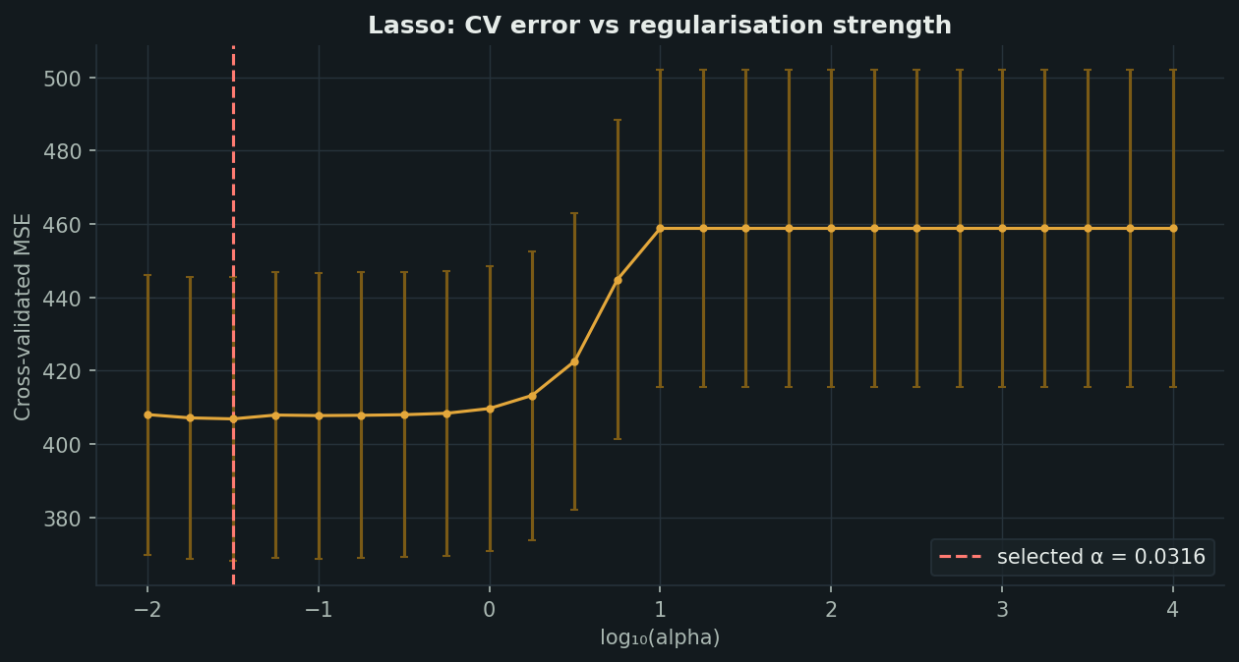
Train and tune
STAGE 5 OF 8 · MODEL
Scale
Standardise the 17 numeric features
1
Encode
One-hot encode innings, venue and both teams
2
Search
Cross-validate 25 values of α from 0.01 to 10,000 (log scale)
3
Lasso cross-validated error against α. The dashed line is the selected value.
Refit
Refit on all training rows with the best α
56.2
0.0316
4
Ridge α
Lasso α, keeps 34 of 101 inputs
Notes:
Training runs inside one pipeline: scale numeric features, one-hot encode categories, then fit Ridge or Lasso with a cross-validated search over 25 alpha values from 0.01 to 10,000. The chosen alpha is 56.2 for Ridge and 0.0316 for Lasso, and Lasso keeps 34 of the 101 inputs.

Slide 11
Evaluate on unseen matches
STAGE 6 OF 8 · EVALUATE
Model | MAE | MSE | RMSE | R²
Ridge (L2) | 16.018 | 452.5 | 21.27 | 0.1186
Lasso (L1) | 16.011 | 452.3 | 21.27 | 0.1191
Baseline | 17.455 | 513.9 | 22.67 | −0.001
−8.3%
0.119
2,117
MAE vs the mean baseline
R² for Lasso
unseen test innings
Notes:
On 2,117 unseen innings from 2022 and 2023, both regularised models beat the baseline on every metric. Lasso edges Ridge: MAE 16.011 against 16.018. The MAE drop against the baseline is 8.3 percent. R-squared is 0.119, which is modest, and we say so plainly.

Slide 12
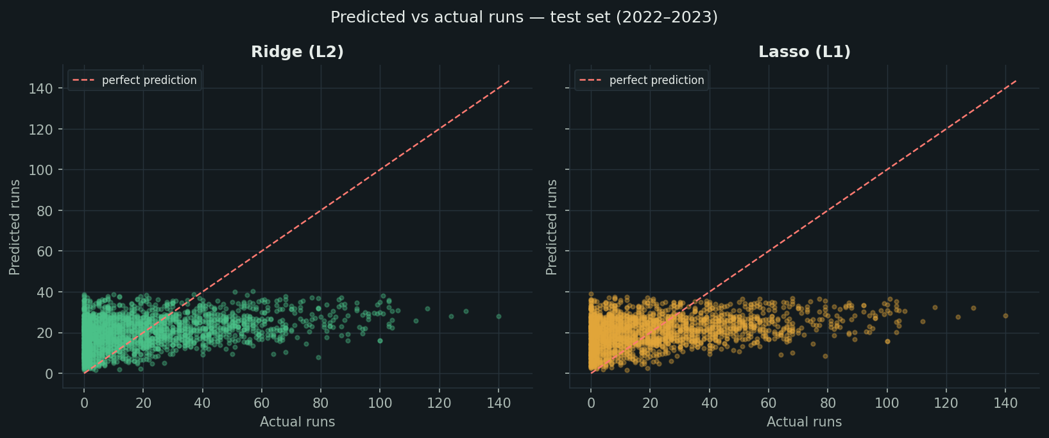
Check the diagnostics
STAGE 6 OF 8 · EVALUATE
Narrow band
Predictions sit between about 2 and 40 runs. The models play it safe.
Big scores missed
Every innings above 60 is under-predicted. They are rare.
No strong bias
Residuals average under 1 run, with wider spread at high scores.
Test set, 2022–2023. Points on the dashed line would be perfect predictions.
Ridge and Lasso make almost the same predictions: the limit is the information in the inputs, not the penalty.
Notes:
The scatter shows predictions staying in a band of roughly 2 to 40 runs while actual scores run to 140. The models pull toward the middle and under-predict big innings. That is expected: a single innings is noisy, and history features cannot see the pitch or the bowler on the day.

Slide 13
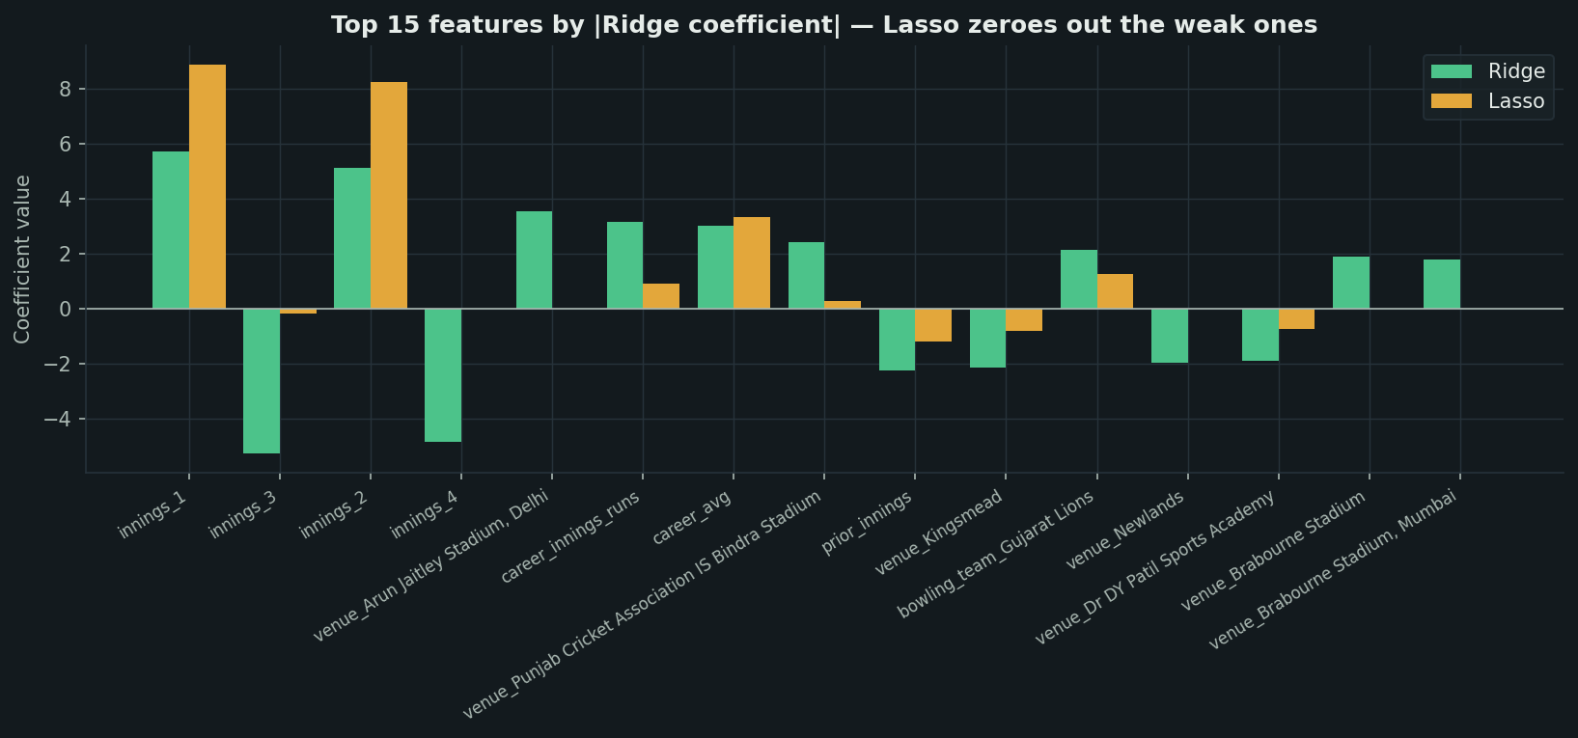
Interpret what was learned
STAGE 6 OF 8 · EVALUATE
34 of 101
inputs kept by Lasso. The rest are exactly zero.
Largest weights
Innings number, career average and career runs, plus a few venues.
Same story
Top 15 features by Ridge coefficient size. Lasso sets the weaker ones to exactly zero.
Where both keep a feature, the sign agrees.
Notes:
Lasso keeps 34 of 101 inputs and sets the rest to exactly zero, yet matches Ridge on accuracy. The largest weights belong to the innings number, career average and career runs, plus a few venues. Where both models keep a feature, the sign agrees.

Slide 14
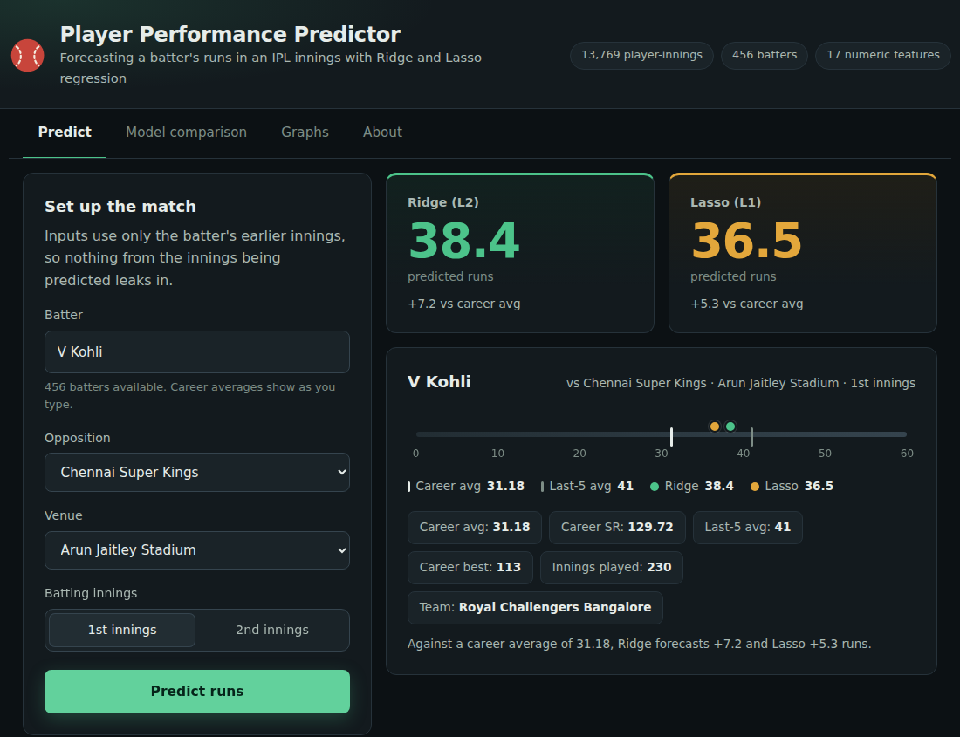


Deploy and monitor
STAGES 7–8 OF 8 · DEPLOY & MONITOR
train.py
Fits the models and saves them to disk
Flask API
/api/meta, /api/players and /api/predict
Web app
Autocomplete, forecasts and charts
Monitor and retrain
Compare MAE with the mean baseline every season
Retrain as new matches arrive, keeping the date split
Flag drift above the 16-run test error
The web interface: pick a batter, opposition, venue and innings.
Notes:
Deployment is a small Flask service. train.py writes the fitted models and metrics to disk, the API serves metadata, players and predictions, and the web app calls it. Monitoring means checking error against the baseline every season and retraining as new matches arrive.

Slide 15
Conclusions and next steps
8.3%
0.119
34 / 101
lower MAE than the mean baseline
R² on 2022–23 matches: a modest, honest gain
inputs kept by Lasso with Ridge-level accuracy
Limitations
Next steps
One innings is noisy, so R² stays near 0.12
Big scores are under-predicted
No bowler-level, pitch or toss features yet
Add bowler, pitch and toss features
Compare with gradient-boosted trees
Predict a range, not one number
Automate seasonal retraining and drift checks
Notes:
Takeaways: regularised linear models beat the baseline by 8.3 percent on MAE, but R-squared is only about 0.12, so single innings stay hard to call. Lasso matches Ridge with a third of the inputs. Next steps add richer context features, try boosted trees, and automate retraining.

