Slide 1
Data Structures and Algorithms -3
(25CS2103E)
High-Performance Text Search
Using the KMP Algorithm
Team Members
M Jashwanth Reddy 2520030236
G Akshay 2520030363
M Ritvik Chowdhary 2500030236
Notes:
Project: High-Performance Text Search Using KMP. Content based on the supplied problem statement and the main.java/index.html implementation. Core complexity excludes file transfer, stored results and UI rendering.

Slide 2
Contents
Abstract
Introduction
Literature Survey
Problem Statement and Objectives
Flow Chart
Results
Hardware and Software Requirements
Conclusion
Future Scope
Notes:
Project: High-Performance Text Search Using KMP. Content based on the supplied problem statement and the main.java/index.html implementation. Core complexity excludes file transfer, stored results and UI rendering.

Slide 3
Abstract
The application finds every occurrence of an exact pattern in manual text or multiple uploaded files.
KMP preprocesses the pattern into an LPS table and reuses matched prefixes after a mismatch.
The matching core takes O(N + M) time and O(M) auxiliary space, excluding stored results.
A Java backend returns match positions to a browser dashboard. Sources with no matches can be edited and downloaded.
N = total text length across files. M = pattern length.
Notes:
Project: High-Performance Text Search Using KMP. Content based on the supplied problem statement and the main.java/index.html implementation. Core complexity excludes file transfer, stored results and UI rendering.

Slide 4
Introduction
Exact pattern matching supports document search, log analysis and inspection of text datasets.
A naive search may compare the same characters repeatedly, giving O(NM) worst-case time.
KMP keeps the text index moving forward and uses a prefix table to adjust the pattern index.
Example: ABA occurs in ABABA at indices 0 and 2 when overlapping matches are enabled.
LPS for ABA: [0, 0, 1]. Indices start at 0.
Notes:
Project: High-Performance Text Search Using KMP. Content based on the supplied problem statement and the main.java/index.html implementation. Core complexity excludes file transfer, stored results and UI rendering.

Slide 5
Literature Survey
Naive search checks the pattern at each possible position. It is simple but can repeat O(NM) comparisons.
Knuth, Morris and Pratt (1977) introduced a linear-time string matching method that reuses previous comparisons.
Boyer–Moore uses mismatch-based shifts. Rabin–Karp uses rolling hashes and verifies candidate matches.
KMP suits this project because its prefix table explains the search process and guarantees linear core matching time.
References: Knuth et al., SIAM J. Comput. 6(2), 1977. Sedgewick & Wayne, Algorithms, §5.3.
Notes:
Sources: https://epubs.siam.org/doi/abs/10.1137/0206024
https://algs4.cs.princeton.edu/53substring/
The project uses the LPS formulation of KMP. Princeton also presents a DFA formulation.

Slide 6
Problem Statement and Objectives
Problem statement
Implement a high-performance text searching application using KMP. Construct a prefix table and locate all occurrences in large text files while avoiding unnecessary character comparisons.
Objectives
1. Achieve O(N + M) time for the matching core.
2. Search multiple text files independently.
3. Visualize matches with index, line and column.
4. Demonstrate exact matching and prefix-table reuse.
Notes:
Project: High-Performance Text Search Using KMP. Content based on the supplied problem statement and the main.java/index.html implementation. Core complexity excludes file transfer, stored results and UI rendering.

Slide 7
Work Flow
Input files, pattern and options
Validate input and construct LPS
Run KMP for each source
Collect matches and display positions
No matches: edit, download or search again
Notes:
Project: High-Performance Text Search Using KMP. Content based on the supplied problem statement and the main.java/index.html implementation. Core complexity excludes file transfer, stored results and UI rendering.

Slide 8
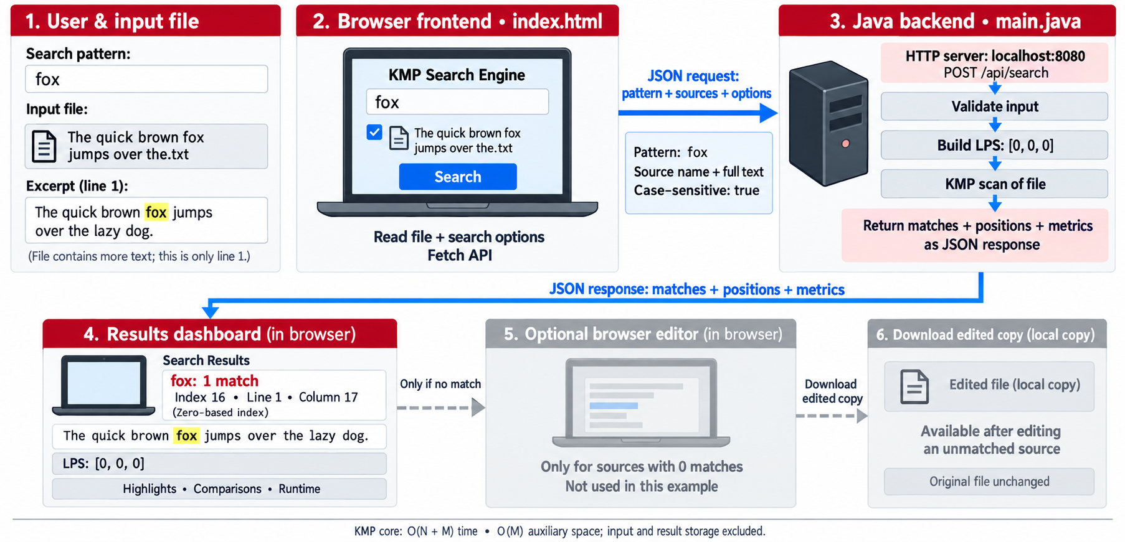
Flow Chart
Notes:
Project: High-Performance Text Search Using KMP. Content based on the supplied problem statement and the main.java/index.html implementation. Core complexity excludes file transfer, stored results and UI rendering.

Slide 9
Results
Illustrative expected outputs
Text: ABABA Pattern: ABA
Overlaps enabled: indices 0, 2 LPS: [0, 0, 1]
Overlaps disabled: index 0
Text: HELLO Pattern: XYZ
No matches. Edit the source and download an edited copy.
The dashboard also shows character comparisons, match count and execution time for each analysis.
These examples explain behavior. They are not large-file performance benchmarks.
Notes:
Project: High-Performance Text Search Using KMP. Content based on the supplied problem statement and the main.java/index.html implementation. Core complexity excludes file transfer, stored results and UI rendering.

Slide 10
Hardware and Software requirements
Hardware: a computer that can run a JDK and a modern browser. Memory needs grow with uploaded text and result count.
Development: IntelliJ IDEA and Java 17 or newer. The backend uses the JDK’s built-in HTTP server.
Frontend: HTML, CSS and JavaScript. JSON requests connect the dashboard to POST /api/search.
Execution: Run main.java and open localhost:8080. Supported uploads include TXT, MD, CSV and LOG files.
Notes:
Project: High-Performance Text Search Using KMP. Content based on the supplied problem statement and the main.java/index.html implementation. Core complexity excludes file transfer, stored results and UI rendering.

Slide 11
Conclusion
KMP demonstrates exact matching by reusing prefix information instead of restarting after every mismatch.The application combines multiple-file search with an LPS display and detailed matching positions.Editing and downloading a source after a failed search makes the project useful beyond a search demonstration.The O(N + M) guarantee covers the KMP core. File loading, position reporting and rendering add application overhead.
Notes:
Project: High-Performance Text Search Using KMP. Content based on the supplied problem statement and the main.java/index.html implementation. Core complexity excludes file transfer, stored results and UI rendering.

Slide 12
Future Scope
Stream large files in chunks while preserving KMP state across chunk boundaries.Compute line and column positions in one pass and paginate large result lists.Improve Unicode case handling and keep normalized matches aligned with original text.Benchmark against naive search using varied file sizes and repeated patterns. Add cancellation and progress updates.
Notes:
Project: High-Performance Text Search Using KMP. Content based on the supplied problem statement and the main.java/index.html implementation. Core complexity excludes file transfer, stored results and UI rendering.

Slide 13
Sample Code
$('editText').oninput = () => {
const entry = editEntries[Number($('editSource').value)];
if (entry) {
entry.draft = $('editText').value;
}
$('editStatus').textContent =
'Draft updated. Download or apply your changes.';
};
Notes:
Project: High-Performance Text Search Using KMP. Content based on the supplied problem statement and the main.java/index.html implementation. Core complexity excludes file transfer, stored results and UI rendering.

Slide 14
Sample Code
private static int[] buildLps(String pattern) {
int[] lps = new int[pattern.length()];
for (int i = 1, length = 0; i < pattern.length();) {
if (pattern.charAt(i) == pattern.charAt(length)) {
lps[i++] = ++length;
} else if (length > 0) {
length = lps[length - 1];
} else {
i++;
}
}
return lps;
}
Notes:
Project: High-Performance Text Search Using KMP. Content based on the supplied problem statement and the main.java/index.html implementation. Core complexity excludes file transfer, stored results and UI rendering.

Slide 15
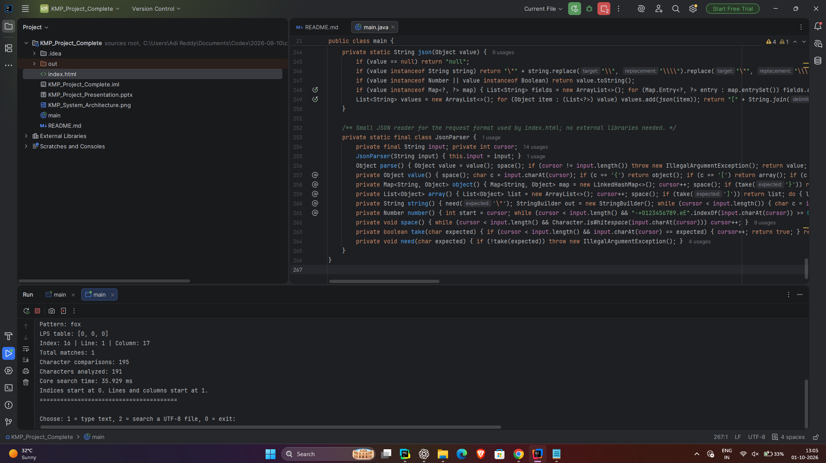
Terminal Output
Notes:
Project: High-Performance Text Search Using KMP. Content based on the supplied problem statement and the main.java/index.html implementation. Core complexity excludes file transfer, stored results and UI rendering.

Slide 16
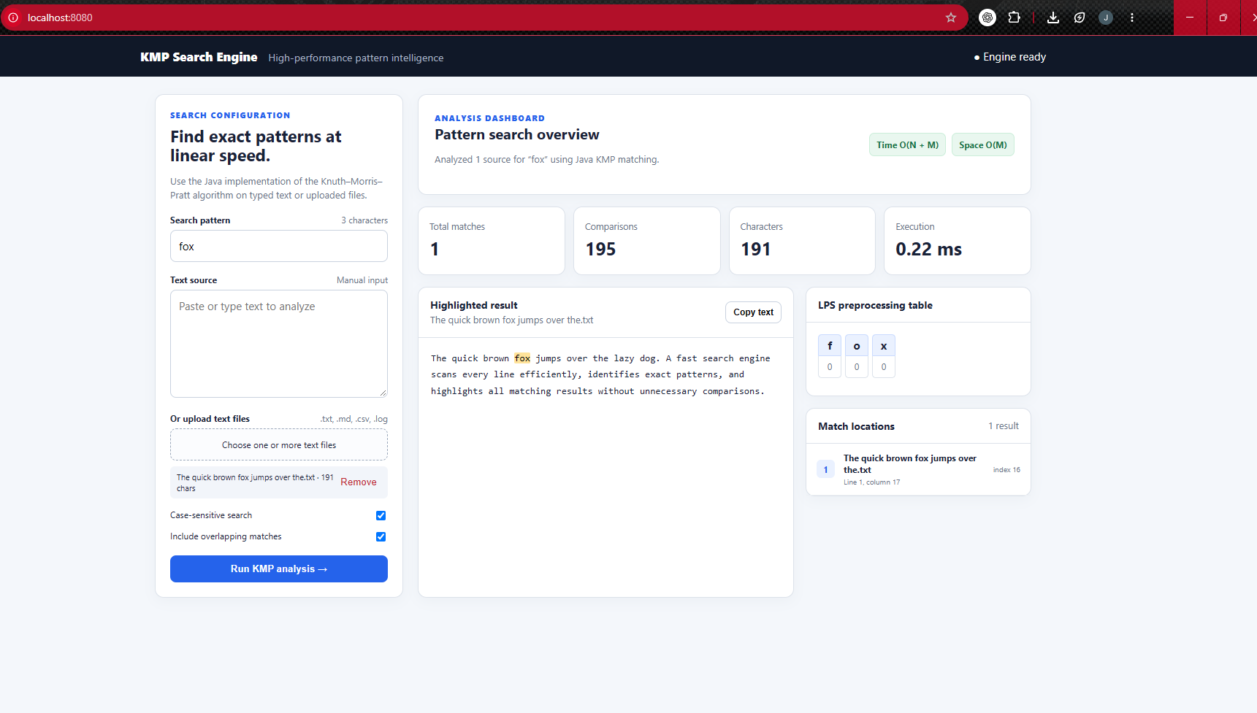
Sample Output
Notes:
Project: High-Performance Text Search Using KMP. Content based on the supplied problem statement and the main.java/index.html implementation. Core complexity excludes file transfer, stored results and UI rendering.

Slide 17
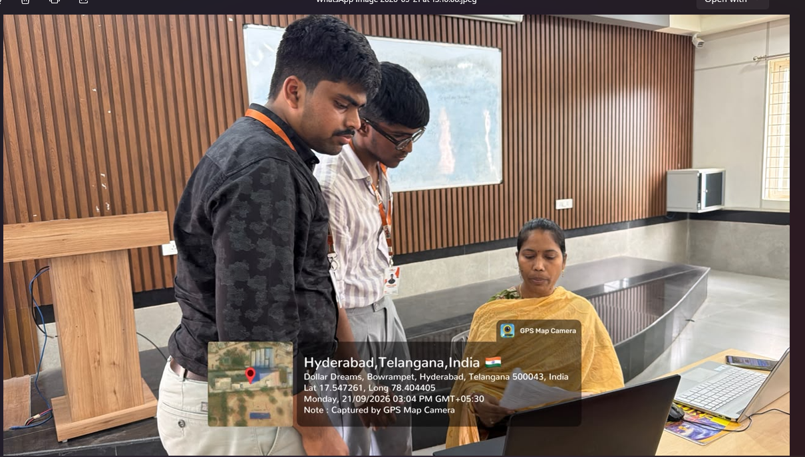
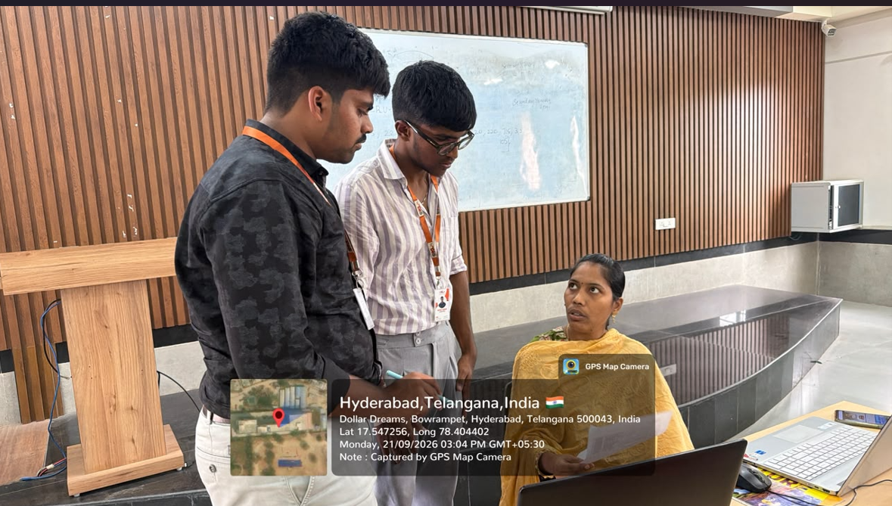
Geo-Tag
Notes:
Project: High-Performance Text Search Using KMP. Content based on the supplied problem statement and the main.java/index.html implementation. Core complexity excludes file transfer, stored results and UI rendering.

Slide 18
Thank you
Questions and discussion
Notes:
Project: High-Performance Text Search Using KMP. Content based on the supplied problem statement and the main.java/index.html implementation. Core complexity excludes file transfer, stored results and UI rendering.

