Slide 1

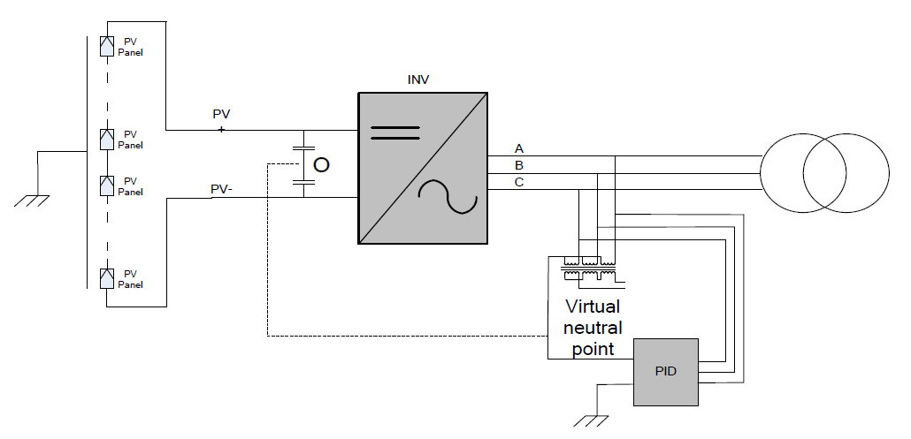
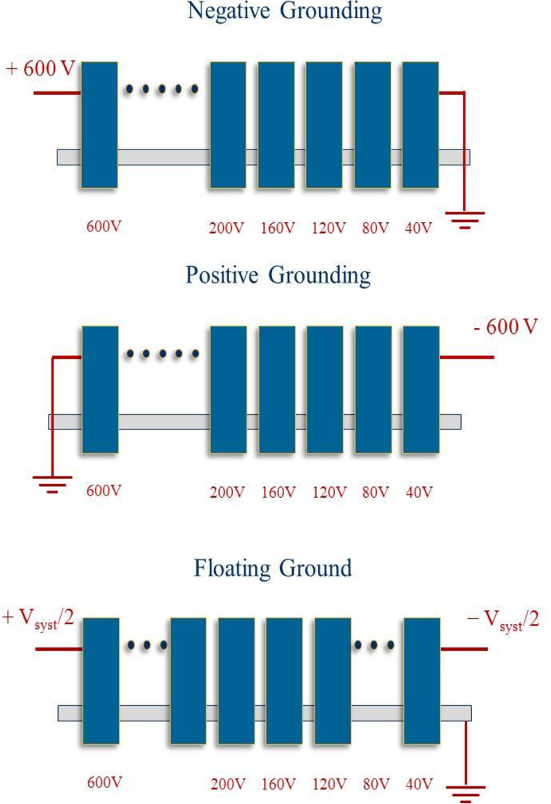

COMPARISON OF DIFFERENT ANTI-PID TECHNIQUES FOR GRID-TIED ISOLATED SOLAR INVERTERS
Prashanth Sangani, Rishabh Makholia, Vijayaraju Pagolu, Nagaraja Kumari M, Bhavani Prasad D.V, Dharmappa Barki, Greenko Group Hyderabad
ABSTRACT - Potential Induced Degradation (PID) is caused by the high potential difference with respect to earth. PID effect can be eliminated by raising the potential of negative side of DC link to positive with respect to ground. This work compares different anti PID techniques being used in strings and central inverters.
METHODOLOGY - The PID effect is stronger in panels that are closer to the negative side of the string because the negative potential with respect to earth is the highest at that side. In India the system voltages changed from 1000V to 1500V hence PID effect is more pronounced in floating system.
PID effect can be eliminated by raising the potential of negative side of DC link to positive with respect to ground provided the grid- connected inverters are isolated from the grid by transformer.
In String inverters, it is achieved by lifting the negative of DC link from DC side, lifting the DC link negative from the AC side by forming virtual neutral point, anti-PID recovery at night. In central inverter, the negative of the DC link is
grounded with a resistor to eliminate PID effect.
Simulated Circuit
Conclusions :
All techniques are superior in terms of PIS recovery, However while comparing all techniques Lifting DC link Negative terminal voltage with respective to ground voltage has an added advantage with respective to cost, paralleling of inverters, easy to implementation & Maintenance, safety of human beings.
String inverter
References
Huawei Smart PV Solution Anti-PID Module
SMA central inverter

