Slide 1
Additional Line 18 Point Verdana

Slide 2
PivotalR
An R Interface to the Pivotal Platform
Hai Qian @ Predictive Analytics Team
Woo Jae Jung @ Data Science Team

Slide 3
Introduction
In a traditional analytics workflow using R, data are loaded from a source, modeled, and scores are pushed back to the data source
Such an approach works well when:
The amount of data can be loaded into memory
The transfer of large amounts of data is inexpensive and/or fast
Here we explore the situation involving large data sets where these assumptions are violated

Slide 4
Objective
MADlib is an open-source library for highly scalable in-DB analytics, providing parallelized SQL implementations of statistical & machine learning models that run directly inside the database
In addition to statistical model estimation, traditional SQL queries including JOINS also benefit from the performance & scalability of a distributed & parallel computing platform
PivotalR aims to harness the the familiarity of R’s interface and the performance & scalability benefits of in-DB analytics

Slide 5
Wait, don’t we already have this (PL/R)?
PL/R is wonderful:
Mostly focuses on explicitly parallel jobs
Scales to each mapper
Primarily a SQL & R interface for the end user
Would also be nice to have an interface & tool that:
Is implicitly parallelized
Scales to the database
Primarily an R interface for end users who are less familiar with SQL

Slide 6
Enter PivotalR
Challenge
Want to harness the familiarity of R’s interface and the performance & scalability benefits of in-DB analytics
Simple solution:
Translate R code into SQL

Slide 7


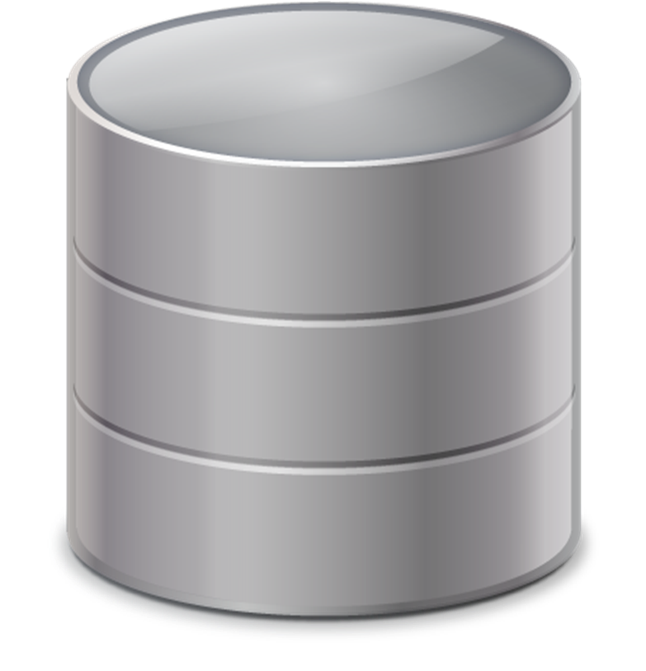


Design
RPostgreSQL
PivotalR
SQL to execute
R → SQL
Computation results
Database w/ MADlib
No data here
Data lives here

Slide 8
PivotalR as an R Interface to Traditional DB Operations
Manipulate database tables directly from R without needing to be familiar with SQL
Perform the equivalent of select statements (including joins) in a syntax that is similar to R's data.frame operations

Slide 9
PivotalR as an R Interface to MADlib
Call MADlib’s in-DB machine learning functions directly from R
Syntax is analogous to native R functions – for example, madlib.lm() mimics the syntax of the native lm() function
Data doesn’t need to leave the database
All heavy lifting, including model estimation & computation, are done in the database

Slide 10
Current Functionality
And more ...
+ - * / %% %/% ^
$ [ [[ $<- [<- [[<-
== != > < >= <=
MADlib Wrapper
Linear regression
Logistic regression
Table summary
& | !
merge
is.na
Categorical Variable Support
as.factor()
by
sort
preview
db.data.frame
content
as.db.data.frame
c mean sum sd var min max length colMeans colSums
db.connect db.disconnect db.list db.objects db.existsObject delete
dim names

Slide 11
Class hierarchy
MADlib
Wrapper
Functions
Points to objects in database
x = db.data.frame("table")
db.obj
db.data.frame
db.Rquery
Resides in R only
x[,1:2],
merge(x, y,by="column"), etc.
as.db.data.frame(...)
db.table
db.view
Most operations

Slide 12
People
Predictive Analytics Team:
Caleb Welton,
Anant Chintamaneni,
Sujit Philip,
Grace Gee,
Shengwen Yang,
Rahul Iyer,
Hai Qian
Data Science Team:
Woo Jae Jung

Slide 13
Resources
PivotalR Download: GitHub or CRAN
Practitioner’s Guide to Pivotal & R Interoperability: GitHub
Questions/Feedback: user@madlib.net

Slide 14
DEMO

