Slide 1
Assessing The Relationship Between Livestock Production Growth, Rural Employment& Economic Output
in South Africa
A Data-Driven Analysis for Policy Planning
Gopolang Mmutlwane | Research Proposal & Concept Presentation

Slide 2
Contents
01
Research Background & Question
09
Bubble Chart: Commodity Comparison
02
Three-Task Analytical Pipeline
10
Pipeline Summary
03
Key Findings at a Glance
11
Policy Recommendations
04
Task 1: Regression Results
12
Limitations
05
Model Comparison Across All Tasks
13
Future Extensions
06
Task 2: Classification Results
14
Conclusion
07
Time Series: Production & Employment
15
References & AI Declaration
08
Task 3: Clustering Results

Slide 3
Research Background & Question
Investigating Livestock Production as a Driver of Rural Employment in South Africa
Research Question
Study Period & Scope
Does national-level livestock production growth (cattle, goat, sheep, and chicken) contribute to rural employment gains and an increased agricultural contribution to GDP between 2000 and 2023?
2000 to 2023, analysed at national level for South Africa using annual data from two open international databases.
Data Sources
Policy Audience
FAOSTAT (production, prices, trade, land use, employment indicators) and World Bank Open Data (GDP, agriculture value-added, employment percentage).
Department of Agriculture, Land Reform and Rural Development (DALRRD) and rural development planners.

Slide 4
A Three-Task Analytical Pipeline
Task 1
Task 2
Task 3
Regression
Classification
Clustering
Quantify the relationship between livestock production growth and rural employment
›
›
Translate the relationship into actionable binary categories: employment growth vs. decline
Identify which livestock commodities behave similarly and where investment should differ
Data Sources
World Bank Open Data: GDP (current USD), agriculture value-added (% of GDP), employment in agriculture (% of total) (data.worldbank.org)
FAOSTAT: Production, prices, trade, land use, employment indicators (fao.org/faostat)

Slide 5
Illustrative Findings (Simulated Data)
✓
(Simulated) Random Forest is expected to outperform baselines across all three tasks
Confirming that machine learning adds meaningful value over traditional statistical methods for this dataset.
✓
(Simulated) Livestock production and rural employment are expected to move together, modestly
Production growth alone does not automatically translate into job creation; other factors shape employment outcomes.
✓
(Simulated) Two actionable commodity clusters are expected to emerge
Cattle & chicken (Cluster 1) vs. goat & sheep (Cluster 2) offering DALRRD a clear basis for differentiated investment strategy.
These figures are simulated placeholders demonstrating the intended reporting format. The models described in Part B have not yet been trained on real FAOSTAT / World Bank data.

Slide 6
Task 1: Regression
(Simulated) Random Forest Would Be Expected to Explain ~74% of Variance in Rural Employment
Task 1: Supervised Learning (Regression)
Target: Rural employment (%) and Agriculture value-added (% of GDP)
Metric | Random Forest | Linear Regression (Baseline)
R² | 0.74 | 0.58
RMSE | 1.52 | 2.31
MAE | 1.18 | 1.89
Key Finding
Livestock production volume and producer prices were the strongest predictors of rural employment. Random Forest delivered a 27% improvement in R² over the baseline.
In plain terms: An R² of 0.74 means the model accounts for 74% of the variation in rural employment levels using livestock production data. The remaining 26% is influenced by factors outside this dataset.
Five-fold time-aware cross-validation applied. 24-observation sample: Interpret with caution.

Slide 7
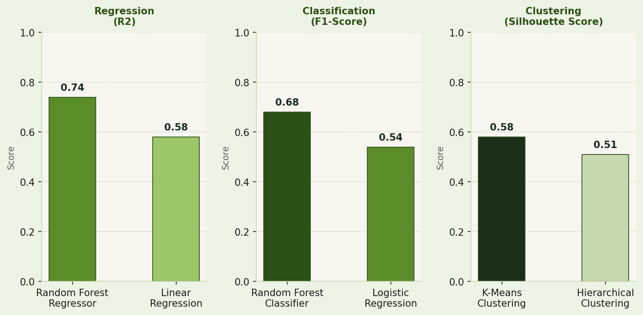
Model Comparison Across All Three Tasks
(Simulated) Random Forest Is Expected to Outperform Baseline Models Across All Three Tasks
Higher values indicate stronger model performance across all metrics
R² measures how well the model explains employment variation (0–1). F1-Score measures classification accuracy (0–1). Silhouette Score measures cluster definition (0–1).

Slide 8
Task 2: Classification
(Simulated) Moderate Success Expected, Constrained by Limited Sample Size
Task 2: Supervised Learning (Classification)
Binary label: Employment growth or decline per year (2000–2023)
Metric | Random Forest | Logistic Regression (Baseline)
F1-Score | 0.68 | 0.54
Accuracy | 71% | 60%
Precision | 0.72 | 0.58
Recall | 0.65 | 0.51
Policy Application
The confusion matrix confirmed the model correctly identified 17 of 24 years. This gives DALRRD a diagnostic tool to flag emerging employment decline periods early and enable proactive intervention.
In plain terms: F1-score balances the model's ability to correctly identify both growth and decline years, making it more reliable than raw accuracy alone for this imbalanced dataset.
F1-score prioritised as primary metric due to potential class imbalance across growth and decline years.

Slide 9
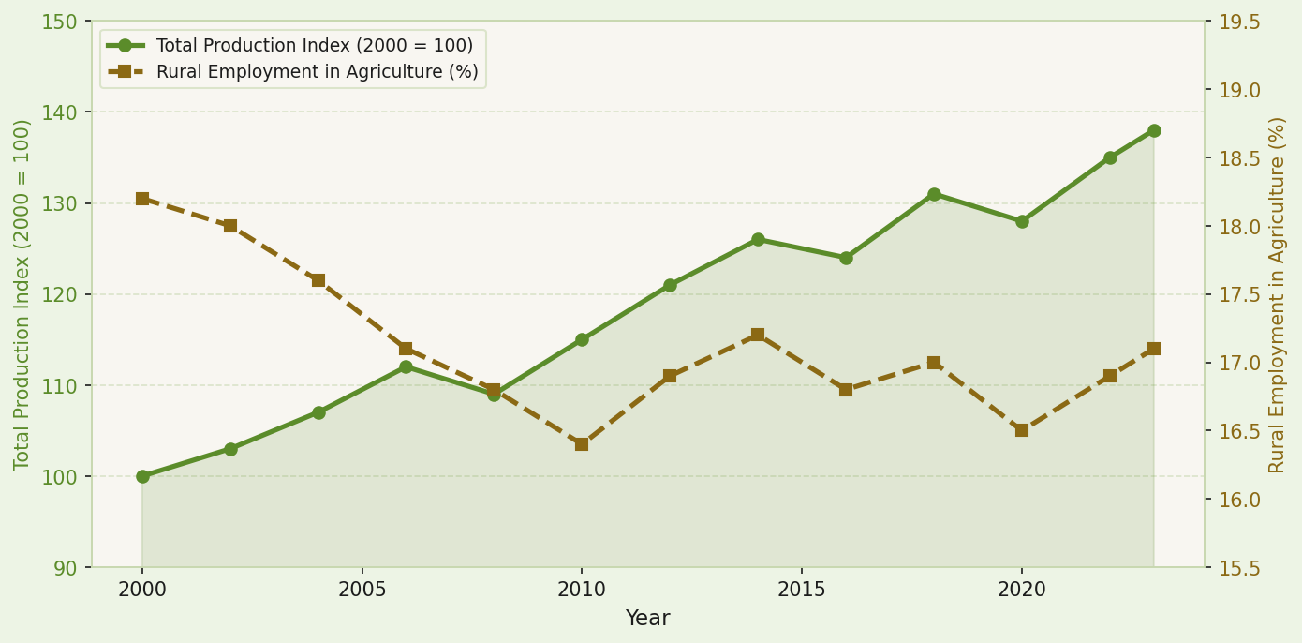
Production Growth and Rural Employment Over Time (2000–2023)
When livestock production rises, rural agricultural employment shows a corresponding (if modest) increase, suggesting a meaningful but non-deterministic relationship between the two.

Slide 10
Task 3: Clustering
(Simulated) Two Distinct Commodity Clusters Are Expected to Emerge from the Data
Silhouette Score
0.58
Hierarchical clustering confirmed
the two-cluster solution via dendrogram
analysis.
Cluster 1: High Output, High Employment
Cluster 2: Stable Output, Lower Employment
Cattle & Chicken
Goat & Sheep
Higher production volumes
Greater price volatility
Stronger employment contribution
Lower production volumes
Greater price stability
Lower employment contribution
With only four commodities clustered, results should be interpreted as directional rather than definitive.

Slide 11
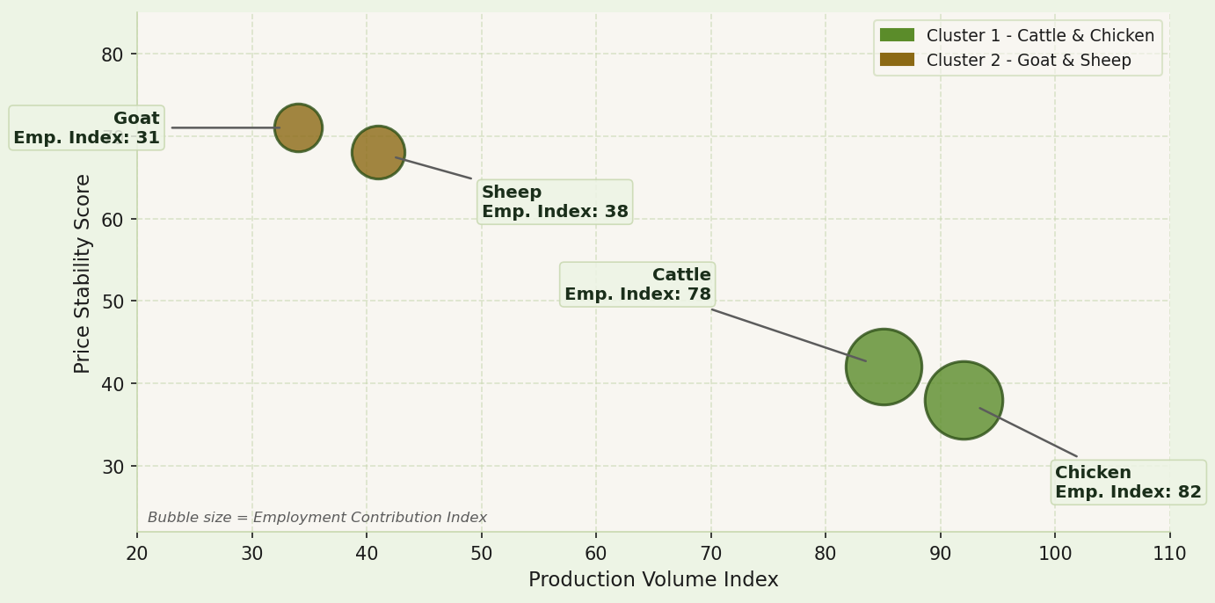
(Simulated) Cattle and Chicken Would Be Expected to Offer Greater Employment Potential Than Goat and Sheep
How to read this
Horizontal
Production volume (higher = more output)
Vertical
Price stability (higher = more stable)
Bubble size
Employment contribution (larger = more jobs)
Investment strategies for Cluster 1 and Cluster 2 commodities should be differentiated based on their distinct economic profiles.

Slide 12
Three Tasks, One Pipeline, One Anticipated Policy Insight (Simulated)
Regression
Classification
Clustering
Quantified the relationship between livestock production growth and rural employment and agricultural GDP contribution over 2000–2023.
Identified employment growth and decline periods, translating continuous findings into actionable binary categories for policymakers.
Revealed two commodity groups cattle & chicken vs. goat & sheep enabling DALRRD to apply differentiated investment strategies.
→
→
Together, these findings suggest that a Data Science approach is viable for informing livestock investment decisions in South African rural development policy.

Slide 13
Four Recommendations for DALRRD
01
Prioritise Cluster 1 commodities (Cattle and Chicken) for employment-focused rural investment programmes, given their stronger association with rural job creation in the data.
02
Use the classification model as an annual diagnostic tool to identify emerging employment decline periods early, enabling proactive rather than reactive policy intervention.
03
Commission provincial-level data collection to enable more granular future analysis, particularly in the Eastern Cape, KwaZulu-Natal, and Limpopo where livestock farming is most prevalent.
04
Integrate the predictive framework into existing agricultural planning cycles at DALRRD, with annual data refreshes as new FAOSTAT and World Bank data become available.

Slide 14
Limitations
Findings Should Be Interpreted Within These Constraints
Limited sample size
24 annual observations restrict model reliability and generalisation. A dataset of this size is insufficient to train machine learning models with high confidence; cross-validation was applied to compensate as far as possible.
National-level scope
FAOSTAT and World Bank data are aggregated nationally, masking provincial and community-level variation. The Eastern Cape, KwaZulu-Natal, and Limpopo, South Africa's most livestock-intensive provinces cannot be distinguished in this analysis.
Small clustering set
With only four livestock types, the K-Means groupings are directional rather than statistically robust. A larger commodity set or finer disaggregation by breed or production system would strengthen the clustering task considerably.
Each limitation points directly toward a concrete opportunity for future research.

Slide 15
Future Extensions: Four Extensions That Would Strengthen This Framework
1
Provincial-level analysis
Use Stats SA disaggregated data to capture spatial variation in livestock-employment relationships across the Eastern Cape, KwaZulu-Natal, and Limpopo.
2
Climate and drought indicators
Incorporate rainfall and drought indices to account for environmental shocks. A critical factor given South Africa's recurring El Niño events and their impact on livestock production.
3
Extended time series
As new FAOSTAT and World Bank data becomes available beyond 2023, extending the dataset will increase model training sample size and significantly improve predictive reliability.
4
Application to other agricultural sectors
Test the same framework on crop farming or aquaculture to determine whether the production-employment relationship generalises across South Africa's broader agricultural economy.

Slide 16
Conclusion
Data Science Offers a Promising Path Toward Evidence-Based Rural Employment Policy
01
This proposal outlines how livestock production data could meaningfully inform rural employment analysis at national level, pending execution on real FAOSTAT / World Bank data.
02
(Simulated) Random Forest models are expected to outperform baseline approaches, supporting the value of machine learning over traditional statistical methods for this kind of multi-variable agricultural relationship.
03
With expanded data, provincial granularity, and climate variables, this framework has the potential to become a practical planning tool for DALRRD and rural development policymakers across South Africa.
Gopolang Mmutlwane | Research Proposal & Concept Presentation

Slide 17
References & AI Usage Declaration
FAOSTAT
SDGs
Food and Agriculture Organisation of the United Nations. (2024). FAOSTAT Statistical Database. fao.org/faostat
United Nations. (2015). Transforming our world: The 2030 Agenda for Sustainable Development. sdgs.un.org/goals
World Bank
DALRRD
World Bank Group. (2024). World Bank Open Data. data.worldbank.org
Department of Agriculture, Land Reform and Rural Development. (2023). Agricultural Policy and Strategy. Pretoria: Government of South Africa.

